Slide 1


NOSM U PROMOTIONS
Moving on Up!
Notes:
Katie

Slide 2

  AN INTRODUCTION TO THE NOSM U JOINT AND STIPENDIARY FACULTY PROMOTIONS PROCESS
Dr. Katie Richardson MD CCFP FCFP Associate Professor
Ms. Anita Arella MA, Director Faculty Affairs
Notes:
Katie

Slide 3
Identify the key requirements and criteria for promotion at NOSM University, including metrics for clinical competence, teaching contributions, administration and scholarly activities.
  Develop a portfolio that highlights clinical competency teaching, administration and scholarly contributions, structured to meet academic promotion standards
  AN INTRODUCTION TO THE NOSM U JOINT AND STIPENDIARY FACULTY PROMOTIONS PROCESS
Facilitate participants’ reflection on their personal readiness to seek promotion by evaluating their strengths and areas for improvement in relation to promotion criteria
Notes:
Katie

Slide 4
CONFLICT DISCLOSURE INFORMATION:
Presenter: Dr. K Richardson
Title of Presentation: Moving on up: An introduction the NOSM U promotions process
I have no financial or personal relationships to disclose
Notes:
Katie

Slide 5
CONFLICT DISCLOSURE INFORMATION:
Presenter: Ms. Anita Arella
Title of Presentation: Moving on up: An introduction the NOSM U promotions process
I have no financial or personal relationships to disclose
Notes:
Anita

Slide 6
  WHY WOULD I WANT TO SEEK PROMOTION?
  Recognition for hard work
  Strengthens position for research proposals
Increases credibility for your advocacy and scholarly work
  Financial Incentives
  Natural progression in your academic career
NOAMA’s Faculty Rank Enhancement Fund and increased remuneration of administrative roles
Notes:
Anita

Slide 7
  JSFPC COMMITTEE COMPOSITION
As per section 6.3 of the Promotions Policy
  Four members of PCTA
  Three non physician faculty
  Two NOSM U representatives
  Non-voting members
Four physicians from Clinical Sciences Division appointed by PCTA
One non-physician facutly member from each of the Medical Division, Human Sciences Division and Clinical Division
Two senior academic administrators as chosen by the Dean or Vice Dean of Academics
Director Faculty Affairs
Administration FA
Associate Dean FA
Conflict of Interest identified prior to reviewing applications
Notes:
Katie

Slide 8
As
  WHAT ARE THE REQUIREMENTS AND CRITERIA FOR PROMOTION?
At leased five (5) years at current rank
  Clinical Competency (for CSD applicants)
  Teaching Activity
Supported by referees
Including academic and/or clinical including bedside teaching
  Scholarly Activity
  Administration
Boyers Definition of Scholarship
Administrative activities at NOSM U or to outside professional bodies
Notes:
Katie

Slide 9
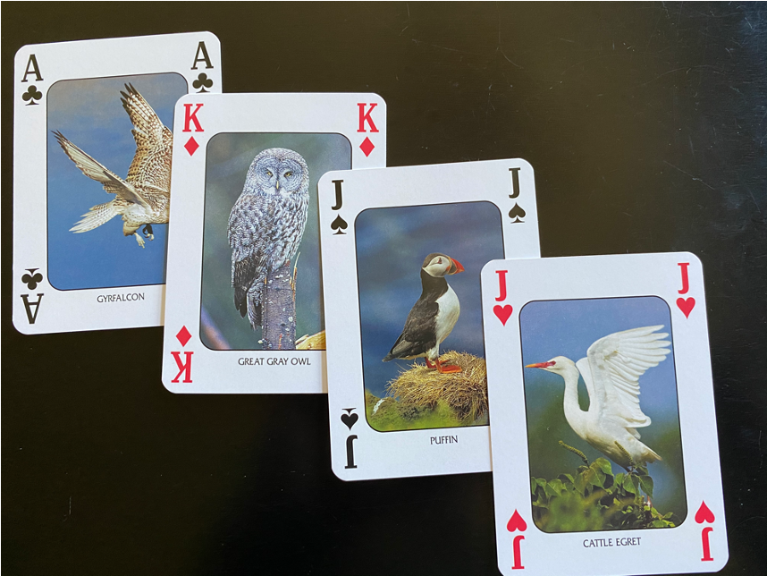
AM I READY?
What are my strengths?
Do I have a single strong suit or decent hand in all the areas?
Notes:
Anita
Teacher? Administrator? Scholar? Clinician?
associate professor
-You do not need to be strong in all four, but at leased strength in 1 or 2 is required.
-you could also be sufficient in all four
lets look at each item more in depth

Slide 10

TIMING
For promotion to Associate Professor the candidate has 5 years of experience at the Assistant Professor rank
Exceptional performance as an Assistant Professor can reduce the requirement to 4 year
Promotion to full Professor requires at leased 5 years as Associate Professor, but must also demonstrate long standing commitment to NOSM U
Notes:
Katie
For early promotion must be very exceptional
-we often see cases at four years and we feel they are appropriate to promote if it had been five years, but does't meet the 'exceptional' category
-candidate then has to repeat process after the 5 year mark

Slide 11
  CLINICAL COMPETENCY
High degree of competence expected of all Clinical Faculty
  Maintenance of clinical competence as professionally mandated will be expected
  The documented development of special interests and expertise
  The development of new techniques and approaches
  Reputation of competence
Notes:
Katie
professionally mandated
-will need to be a member of good standing with the CPSO,
special interest/expertise
-can look towards ongoing professional development (list of ongoing trainings from cfpc/or royal college)
new techniques/approaches especially important if they have an impact on the practice of other clinicians
reputation of competence
-verified by references

Slide 12
  CLINICAL COMPETENCY
High degree of competence expected of all Clinical Faculty
  Maintenance of clinical competence as professionally mandated will be expected
  The documented development of special interests and expertise
  The development of new techniques and approaches
  Reputation of competence
For Professor:
Recognition by their peers as outstanding
Made documented significant contributions
Developed Expertise
Notes:
Katie
professionally mandated
-will need to be a member of good standing with the CPSO,
special interest/expertise
-can look towards ongoing professional development (list of ongoing trainings from cfpc/or royal college)
new techniques/approaches especially important if they have an impact on the practice of other clinicians
reputation of competence
-verified by references

Slide 13
  TEACHING ACTIVITY
Evaluated by teaching dossier, learner evaluations, letters from NOSM U and/or peers, award and participation in faculty development
  Volume of Teaching
  Bedside Teaching
  Teaching Awards
  Mentoring
Including all phases of UME, Post-graduate and CEPD and other learners
Clinical rotations including bedside teaching and rounds presentations
Including awards and nominations also any letters of recgonition from NOSM U
CAMINO project, summer studentship, advisor roles
Notes:
Katie
teaching: this includes all classroom sessions such as scs, cbl, tos etc, any resident round presentations, presentations at cepd events etc
-keep track and tabulating amount of learners (or estimating as best you can)
-often receive letters from nosm u based on summary of evaluations (ie/ congrats on 4.5/5 teaching evals)
-participation in mentor projects such as camino or summer studentship - evidence of teaching and faculty development

Slide 14
ADMINISTRATION
Contribution to administrative activities at NOSM U or to outside professional bodies
  Leadership Positions
  Participation in Accredition
  Service within hospital
Formal administrative posts such as program director or course chair
Both within NOSM U accreditations cycles and contributing to external accreditations
Departmental leadership, REB involvement, committee work
  Committees
  Organization of Course
NOSM U Committees, hospital committees or other organizational committees
Within all phase of UME , PGME, CEPD and external medical education
Notes:
Anita
official leadership positions within nosm, or with external bodies such as hospital or oma
-committee work - leadership roles such as chair are weighed more heavily
courses - can also sometimes be considered as scholarly work
hospital
-many examples (REB, MAC, order sets, rounds, medical education committees, pharmaceutical committees etc)

Slide 15
ADMINISTRATION
Contribution to administrative activities at NOSM or to outside professional bodies
  Leadership Positions
  Participation in Accredition
  Service within hospital
Formal administrative posts such as program director or course chair
Both within NOSM U accreditations cycles and contributing to external accreditations
Departmental leadership, REB involvement, committee work,
  Committees
  Organization of Course
NOSM U Committees, hospital committees or other organizational committees -
Within all phase of UME , PGME, CEPD and external medical education
For Professor:
Roles in national and international organizations
Notes:
Katie
for professor:
expectation would be that leadership would develop into provincial, national and perhaps international level organization

Slide 16
SCHOLARLY ACTIVITY
Peer Reviewed Publications
Books and Chapter
Grants
Boyer’s Definition of Scholarship
Editorial Services
Creative Works
Creation of Educational Material
Keynote Addresses
Curriculum Development
Educational Material Development
Course Creation
Quality Improvement Projects
Including Guideline Development
Notes:
Katie
Boyers definitions (appendix b of policy)
grants - also important to note completion and knowledge translation
editorial service - many faculty peer review for a variety of publications
creative works
-many options here (ex podcasts)
educational material creation
-sky is the limit here
-QI
-locally, hospital based
-many have included guideline development

Slide 17
SCHOLARLY ACTIVITY
Peer Reviewed Publications
For Professor:
Dissemination of results
Individual is an established authority in his/her field
Books and Chapter
Grants
Editorial Services
Creative Works
Creation of Educational Material
Keynote Addresses
Curriculum Development
Educational Material Development
Course Creation
Quality Improvement Projects
Including Guideline Development
Notes:
Katie
For Professor, since the promotion to the rank of Associate Professor the candidate has disseminated the results of scholarly activity of sufficient quality and significance for the
discipline in question to establish the individual as an authority in his/her field, and to
warrant promotion.

Slide 18
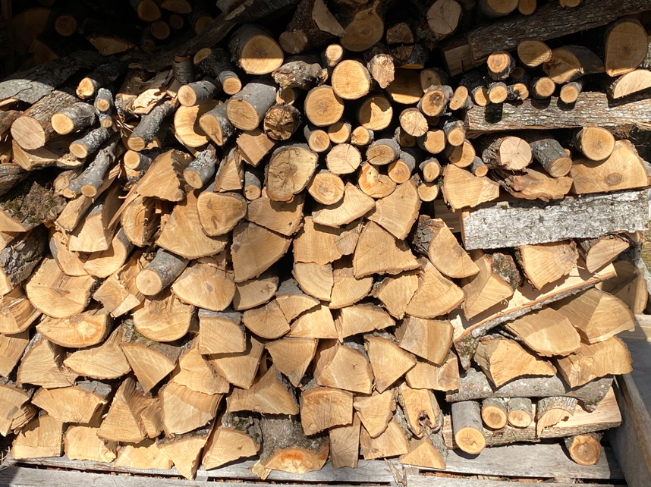
PROCESS
Refer to How To Apply For Promotion Guide: https://www.nosm.ca/wp-content/uploads/2023/04/Promotion-How-To-Guide-2024.pdf
Notes:
Anita
process - link to quick guide
process itself is a lot of work and requires organization

Slide 19
TIMELINE OF PROCESS
Recommendations shared with applicants
Request a meeting with your Section Chair or Division Head
Division Head and/or Section Chair will provide a recommendation to JSFPC
By April 30th
By June 1st
By December 31st
Application and Supporting Material Submitted Online
JSFCP reviews files and makes recommendation to the President
Promotion takes effect
July 1st
By September 30th
By April 30th
Notes:
Anita
Highlight importance of meeting with the Chair/Dhead

Slide 20
  ALL APPLICATIONS MUST INCLUDE:
  UPDATED CV
  PERSONAL STATEMENT
REFERENCE
  LETTERS
  FACULTY EVALUATIONS
  COMPLETED CONTRIBUTION DOSSIER
The focus of CV should be last five years or since last promotion
Narrative letter to committee to highlight your accomplishments
Supply three NOSM U references
As a composite should speak to all four areas
Include all learner evaluation, letters regarding evaluations, teaching performance or awards
Tool to keep track of academic contributions
Encourage to complete to best of your ability
01
02
03
04
05
Notes:
Anita
CV
-template is provided on website, to help jog your memory of all things to include
-can use that template or if you already have an up to date CV you are welcome to use that
-ensure clear dates (ie/ when were you last promoted)
statement:
Address the opportunity to tell a story of your passions and accomplishments. 1-2 pages
Time to show off and highlight your strengths
If there are deficient areas, highlight these in your cover letter and provide a valid explanation
** highlight the 'gems' in your career
References
associate professor - 3 references needed
-each may not be able to speak to all your areas, which is fine as long as someone can address each area
-rank and title/how they know you (professional references are helpful)
-supply them with the information to be able to submit the application (**this is usually hardest step for us)
evaluations
"evidence of teaching effectiveness"
can email Debbie Reed (dreed@nosm.ca) to get copy of all evals, esp those since last promotion - important to corroborate teaching (ie/ states 100s of days of resident teaching and no evals - very difficult for committee) ** address in letter
-these are all only seen by committee - confidential; not shared
-letters from NOSM U ('congratulations on your 4.5/5 evals) include
-letters from previous learners (some will include letters for other purposes ie/awards)
-any teaching awards

Slide 21
  ALL APPLICATIONS MUST INCLUDE:
  Iterative Template Provided
  You are welcome to use your own
  Please ensure clear dates including last promotion dates
  UPDATED CV
The focus of CV should be last five years or since last promotion
01
Notes:
Anita
CV
-template is provided on website, to help jog your memory of all things to include
-can use that template or if you already have an up to date CV you are welcome to use that
-ensure clear dates (ie/ when were you last promoted)

Slide 22
  ALL APPLICATIONS MUST INCLUDE:
  Your opportunity to tell your story
  Highlight the ‘gems’ in your career
  If there are areas of deficiency in your application this is your opportunity to explain
  PERSONAL STATEMENT
Narrative letter to committee to highlight your accomplishments
02
Notes:
Katie
statement:
Address the opportunity to tell a story of your passions and accomplishments. 1-2 pages
Time to show off and highlight your strengths
If there are deficient areas, highlight these in your cover letter and provide a valid explanation for example if you have taught 100 days but only have one eval and it's because you work in the ER and individual assessments aren't done for ER shifts
** highlight the 'gems' in your career
References
associate professor - 3 references needed
-each may not be able to speak to all you areas, which is fine as long as someone can address each area
-rank and title/how they know you (professional references are helpful)
-supply them with the information to be able to submit the application (**this is usually hardest step for us)
evaluations
"evidence of teaching effectiveness"
can email Debbie Reed (dreed@nosm.ca) to get copy of all evals, esp those since last promotion - important to corroborate teaching (ie/ states 100s of days of resident teaching and no evals - very difficult for committee) ** address in letter
-these are all only seen by committee - confidential; not shared
-letters from NOSM U ('congratulations on your 4.5/5 evals) include
-letters from previous learners (some will include letters for other purposes ie/awards)
-any teaching awards

Slide 23
  ALL APPLICATIONS MUST INCLUDE:
Associate Professor
  Each reference may not be able to speak to all four domains
  As a composite your references should address all four domain
  Include rank and title and their association to the applicant
  Professional references are usually the most helpful
  PERSONAL STATEMENT
REFERENCE
  LETTERS
Narrative letter to committee to highlight your accomplishments
Supply three NOSM U references
As a composite should speak to all four areas
02
03
Notes:
Katie
References
associate professor - 3 references needed
-each may not be able to speak to all you areas, which is fine as long as someone can address each area
-rank and title/how they know you (professional references are helpful)
-supply them with the information to be able to submit the application (**this is usually hardest step for us)

Slide 24
  ALL APPLICATIONS MUST INCLUDE:
Professor
  Must be qualified to assess research and creative works
  Able to establish if the applicant is an authority in their field
  Arms-length from applicant
  Not NOSM U Faculty
  PERSONAL STATEMENT
REFERENCE
  LETTERS
Narrative letter to committee to highlight your accomplishments
Suggest four external references
Division Head will suggest two references
02
03
Notes:
Katie
professor – 4 external reviewers plus 2 more chosen by the division head
(qualified to assess research and creative works, arms length, not nosm u faculty)
*often getting references letters is most difficult part

Slide 25
  ALL APPLICATIONS MUST INCLUDE:
  Evidence of teaching effectiveness
  Confidential
  Helpful to collaborate teaching record
  Include NOSM U Letters of Recognition
  Letters from previous learners
  Evidence of teaching awards or nominations
  FACULTY EVALUATIONS
Include all learner evaluation, letters regarding evaluations, teaching performance or awards
04
Notes:
Anita
evaluations
"evidence of teaching effectiveness"
can email Debbie Reed (dreed@nosm.ca) to get copy of all evals, esp those since last promotion -
these are all only seen by committee - confidential; not shared
important to corroborate teaching (ie/ states 100s of days of resident teaching and no evals - very difficult for committee) ** address in letter
-
-letters of recognition from NOSM U ('congratulations on your 4.5/5 evals) include
-letters from previous learners
(especially if there are lacking evaluations - ie/ emerg preceptor but no direct evaluations of bedside teaching)
(some will include letters for other purposes ie/awards)
-any teaching awards

Slide 26
  ALL APPLICATIONS MUST INCLUDE:
  Please use Contribution Dossier Tool
  Can ask administration for support
  Columns and rows can be expanded
  Fill to the best of your ability
  Continuing education records from Royal College or CFPC to be used
  COMPLETED CONTRIBUTION DOSSIER
  FACULTY EVALUATIONS
Include all learner evaluation, letters regarding evaluations, teaching performance or awards
Tool to keep track of academic contributions
Encourage to complete to best of your ability
04
05
Notes:
Anita
-review nosm university contribution dossier (now a word document)
record of clinical teaching (pls fill record)
-could expand a column/row if needed (write in the box beneath) – but we ask that you please include
-best if you kept track all along, but if you didn’t admin staff can be helpful (ie/PaNDA Coordinator)
We kindly ask that you complete the dossier to the best of your ability, recognizing that some information may be approximate. Please provide as accurate and thorough a representation of your academic contributions as possible
-do your best (sometimes it is impossible to know 100% for sure, but pls try and get the data – do not leave blank)
Continuing education (printout from the royal college or cfpc mainpro is fine, instead of listing every cme you have attended

Slide 27

PERSONAL REFLECTION
TIME
Process takes time
MEET WITH SECTION CHAIR OR DIVISION HEAD
Do they feel you are ready?
COMPLETE FULL APPLICATION
Document all activities, follow process, use templates
SUBMIT WITH CONFIDENCE
Ensure you are submitting a strong and organized application
Notes:
Anita
This process takes time, ensure you have time to develop your application
-meet with your section chair or division head early to ensure you are ready from their point of view, if not, reflect on what is needed and complete that prior to applying
-ensure documentation of all activities
-follow the guidelines, review the process
incomplete applications will be returned for future submission
-use the templates
-please check spelling/grammar before submission
-avoid handwritten submissions
-meet deadlines

Slide 28
THANK YOU AND GOOD LUCK
Questions?
Notes:
Anita

