Slide 1
Student Accounts & Financial Aid Information Session
Nick Foxon | Terry Oja

Slide 2
Presentation Agenda
Student Accounts Office
Tuition and Ancillary Fees
Financial Aid Office
Expenses and Funding
Refunds
Tax forms
Line of Credit vs OSAP
Provincial/Federal Funding
NOSM U Bursaries and Awards
Health Plan Insurance (Opting Out)
Calculating your Payment
Accessing Self-Service
How to Pay
Payment Options
Strategy for borrowing
National Student Loan Centre (NSLSC)
Budgeting

Slide 3
The Student Accounts Office
Nick Foxon (He/Him)
Financial and Student Accounts Coordinator
Financial Services
Contact information:
Email: accounts@nosm.ca
Phone: (807) 766 - 7433 | Thunder Bay
Thunder Bay Office BSC HS 2016

Slide 4
Tuition & Ancillary Fees
Tuition and Ancillary Fees, also known as registration fees are charged to your student account annually
Tuition Fees cover the cost of learning and curriculum
Ancillary Fees are collected to provide necessary services and support to all NOSM University learners throughout the year

Slide 5
Year 1 Tuition & Ancillary Fees
Year 1 UME (MD program) Registration Fees
Tuition Fees
$23,247.00
NOSM U Ancillary Fees
$100.00 Health & Wellness Fee
Year 1 Total Fees
$428.39 Student Health Plan
Student Council Ancillary Fees
$29.89 Administration Fees
$50.00 Campus Safety Fee
$100.00 Canadian Federation of Medical Students (CFMS)
$110.11 Executive Portfolio Fees
$24,065.39

Slide 6
NOSM University Self Service Account
Review your Fees
Print your Account Statement
Calculate your Instalment
Retrieve refund codes
Retrieve your Tax forms
Access PayMyTuition

Slide 7
Accessing and Navigating your Self-Service Account
Step 1
NOSM University Website
Step 2
Click myNOSM U (Top Right)
Step 3
Under Learners tab
https://www.nosm.ca
Click Self-Service
Tip: Bookmark the Self-Service tab to your desktop

Slide 8
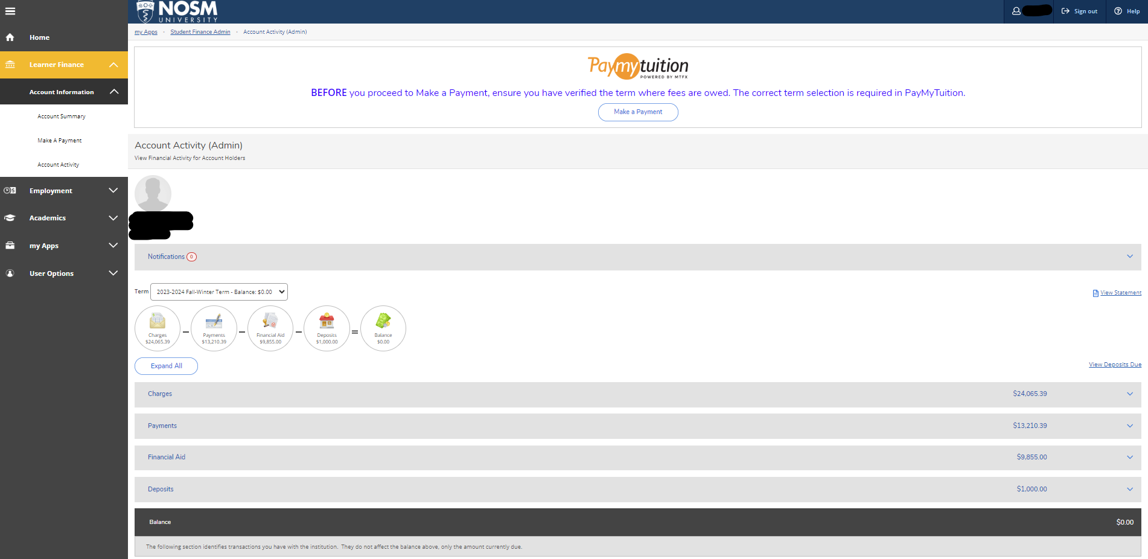
Making a payment
View and print your Account Statement
Calculating your Instalments
Account balance

Slide 9
Payment Options
Registration fees are payable in 2 options:
Option 1: In Full
Single payment of $24,065.39 by August 15
Option 2: Instalments
First Instalment: Payment of $11,032.69 by August 15
Second Instalment: Payment of $11,032.70 by December 15

Slide 10
Calculating your Instalments
Second Installment: 50% of your total fees or your remaining account balance
Confirmed OSAP: The amount of OSAP to be disbursed in January
Other types of Funding: Sponsorships, Scholarships, Awards can all be deducted from your payment
$12,023.24
$9,855.00
$2,168.24
Second Instalment
Winter Term Confirmed OSAP Funding / Financial Aid
Amount to pay

Slide 11
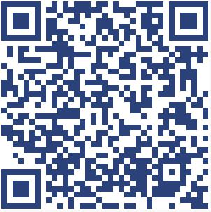
How To Pay
Payments for tuition and other fees can be made directly through PayMyTuition via the Self-Service link or directly through the PayMyTuition website
MyNOSM U > Self-Service > Log in > Account Information > Make a Payment

Slide 12
Refunds
Once Tuition and Ancillary fees are paid in full...
All Awards, Bursaries and Financial Aid resulting in a credit will be refunded to your bank account!

Slide 13
Refunds
How do I accept the funds?
PayMyTuition will email you!
Retrieve refund code from Self Service notifications tab
Accept funds as regular e-transfer
Email from PayMyTuition

Slide 14
Refund Code in Notification Tab

Slide 15
Tax forms
NOSM University learners will likely receive both a T2202 and T4A tax forms by the end of February each year if the following criteria apply.
T2202
Claimable PAID Tuition and Fees
T4A
Income from Awards, Scholarships, or Bursaries

Slide 16
Tax Forms
When and How do I receive my tax forms?
T2202’s and T4A’s are released by the end of February annually
Log into Self-Service > Learner Tax Information Card > Select year
T2202’s and T4A’s are issued online through Self-Service as long as your online consent is granted. To grant consent please log in prior to Jan 1, 2024

Slide 17
Opting-out of the Health Plan
How Do I Opt-Out?
Visit www.WeSpeakStudent.com
Select Northern Ontario School of Medicine University
Submit the Opt-Out form
Receive your reimbursement directly from the Insurance provider
Notes:
Take a photo of this slide

Slide 18
Health Insurance Plan Opt-out Process
Opt-out information…
All opt out reimbursements come from the WeSpeakStudent Insurance provider, please visit their website to review requirements.
Opt-Out Period is from September 1 – 30!

Slide 19
The Financial Aid Office
Terry Oja
Financial Aid Officer
Learner Support Services
Contact information:
Email: financialaid@nosm.ca
Thunder Bay Office MSW MS 2001 B
Sudbury Office HSERC 124

Slide 20
Expenses and Funding
Total costs of Medical School averages $60,000 - $70,000 per year
Tuition and Fees $24,065.39
Living Expenses $40,000 - $50,000

Slide 21
Expenses and Funding
Line of Credit
Prime 7.2% minus .25%
OSAP
Part Loan and Grant interest free
Bursaries
Provided by Donors to support MD students
Parental Contribution and RESP
Student Savings and Employment
Total interest 6.95%
2nd Undergraduate Degree with potential lack of family financial support
Savings and additional funds may be used
Managing your Funding…

Slide 22
Line of Credit vs OSAP
Line of Credit
Offered specifically for Medical Students while in school
Up to $350,000 available with interest of 6.95%
OSAP
0% Loan and Grant funding
Not required to pay it back until after you graduate. 0% on student loans

Slide 23
Strategy of borrowing
Pay Full Tuition 100% from LOC on Aug 15
Approx $25,000 with interest starting immediately on full amount
Pay the Tuition installment from LOC on Aug 15
Approx $11,000 with interest starting immediately on half the amount
Smaller interest payment
OSAP plus LOC to pay installment on Aug 15
OSAP will cover a portion and can be deferred. 0% loan
LOC can be used to pay the difference. Borrow a fraction of the installment with interest.

Slide 24
Provincial/Federal Funding
Explore Provincial and Federal Financial Assistance programs on the NOSM University website…
Visit the Financial Aid Webpage under the Current Learners tab

Slide 25
Budgeting
Importance and consideration…
NOSM University graduates accumulate an average of $190,000.00 of debt
Knowledge of Income, Expenses, and Resources
Control of Spending over the year
Organization: Calculate your budget
Email the Financial Aid Office to book a 1 on 1 budgeting session.
financialaid@nosm.ca

Slide 26
National Student Loans Service Centre
OSAP negotiates the loan, but it is held with the NSLSC
You will be able to login to NSLSC to see your balance owing and to make payments
How to Log into NSLSC… Sign-in partner
Canada Student Loan Interest Update
The Government of Canada has permanently eliminated the accumulation of interest on Canada Student Loans effective April 1st, 2023.

Slide 27
NOSM University Bursaries and Awards
Approximately $1,460,000.00 awarded in 2021 with over 500 endowed and annual awards!
What Do I need to know?
Bursary application form will be emailed out this Fall to your @nosm.ca email address
Bursaries are awarded before the 2nd tuition payment
NOSM U bursaries and Awards do not impact provincial funding

Slide 28
Bursary Flow Unmet Need
Notes:
Don’t be afraid to ask questions and say I will look into it
Shop around
Ask the same questions to each institution and don’t be afraid to ask them a second time if there is more information you are looking for

Slide 29
Questions?

