Slide 1
Homeopathy, marijuana and coffee enemas...How to counsel patients with safety in mind
Nov. 15th, 2019
Dr. Lacey D. Pitre FRCP(C)
Medical Oncologist - Health Sciences North, Sudbury ON
Assistant Professor - Northern Ontario School of Medicine
Clinician Lead – Northeast Cancer Centre Clinical Trials
Regional Systemic Clinical and Quality Lead - CCO

Slide 2
Disclosures
Relationships with commercial interests:
Speakers Bureau/Honoraria:
Merck Oncology – speakers honoraria May and December 2017
ED Serono – speakers honoraria February 2018
Astra Zeneca – Journal Club November 2018
Consulting Fees:
Astella’s Oncology – Advisory board participation February 2016
Novartis Ribbon Program – Train the Trainer – Sept/Oct. 2018
Principal Investigator – Clinical trials:
Boehringer Ingelheim Canada Ltd.
Bristol Myers Squibb
Amgen Canada Inc.
Galera Therapeutics Inc.
F. Hoffman-La Roche Ltd.
Astra Zeneca

Slide 3
Disclosures
This program has not received financial support
No off-label use of medications will be discussed

Slide 4
Disclosures
I am NO expert on this subject
I am however open-minded and have a very specific approach to patients who are interested in ‘complementary’ or alternative treatments

Slide 5
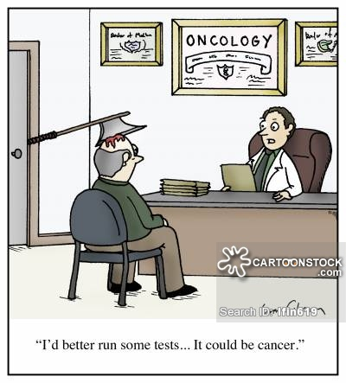

Slide 6
Objectives
At the end of this session attendees will be able to:
Identify the risks and benefits of cannabis for cancer patients
Explain the potential benefits and harms of complementary and alternative treatments

Slide 7
Some definitions
Complementary therapies are used together with conventional cancer treatments
Alternative therapies are used instead of conventional cancer treatments
CAM is Complementary and Alternative Medicine (used throughout)
Homeopathic therapies
a solution that is more dilute is described as having a higher ‘potency’
end product is often ++ diluted - indistinguishable from the base (water or ETOH)

Slide 8
CAMs General Categories:
Diets: Gerson, ketogenic, Peskin, Budwig, alkaline, and paleo etc.
Biologics: teas (green, medicinal, chaga mushroom, Essiac), natural health products [ginger, curcumin (turmeric), flaxseed oil, cat’s claw], medicinal cannabis etc.
Energy therapies: Rife device, Beck device, oxygen or ozone treatment etc.
Alternative medical systems: Traditional Chinese Medicine, acupuncture, homeopathy, massage, Reiki
Spiritual therapy and mind–body systems: faith healing or prayer, divination, meditation, hypnosis, psychic therapy, mental imagery, yoga etc.

Slide 9
The Case – Initial Consult
Sept. 2014
Patient AM
Formerly healthy premenopausal 50F
Locally-advanced breast cancer (L breast) seen for consideration of NEOadjuvant systemic therapy

Slide 10
The Case – Biopsy
Pathology: Invasive carcinoma with lobular features; ER+ PR-
On exam:
L breast – palpable mass measuring 8cm
Two large palpable nodes in L axilla

Slide 11
The Case – Medications
B12
Desiccated liver
Co-Enzyme Q10 (15 tablets/day)
Vitamin D (Over 5000IU/daily)
On closer questioning –
Husband is chiropractor/naturopathic physician
Plans for strict adherence to ‘Gerson therapy’
Coffee enemas up to QID

Slide 12
The Case – Recommendations
Locally-advanced breast cancer
Area of enhancement on MRI nearly 9cm with 8cm palpable mass and large lymph nodes
Strong recommendation for:
Completion of STAGING
Neoadjuvant chemotherapy – DD-ACT
Followed by SURGERY
Radiation Oncology referral
Endocrine therapy

Slide 13
The Case – Recommendations
Patient decision:
Declined neoadjuvant chemotherapy
Declined further Medical Oncology follow-up
Declined any discussion re: endocrine treatment
Declined Radiation Oncology referral
Agreed to Surgery

Slide 14
Pathology
12.5cm invasive ductal carcinoma
Grade III, +LVI
Less than 1mm to posterior margin
15/15 nodes +, extranodal extension
T3N3 disease
FISH analysis: +ve for Her2
OVERALL: Triple positive Stage IIIC invasive ductal carcinoma

Slide 15
Follow-up
Declined therapies:
NEO/ADJUVANT CHEMOTHERAPY
Her2+ - Adjuvant trastuzumab
Radiation Oncology referral
Antiestrogen treatments
****Multiple visits, liaison with HCP etc.

Slide 16
Follow-up
Accepted therapies:
Tamoxifen
GERSON therapy
Naturopathic supplements (desiccated liver etc.)
Homeopathic treatments
High-dose VITAMINS (C, D etc.)

Slide 17
What did I really want this PATIENT TO KNOW?
What is her risk of DEATH with TAMOXIFEN alone?
GERSON THERAPY – what is it really?
What do we know about ‘natural supplements’?
What are the overall benefits/drawbacks to complementary/alternative therapies?

Slide 18
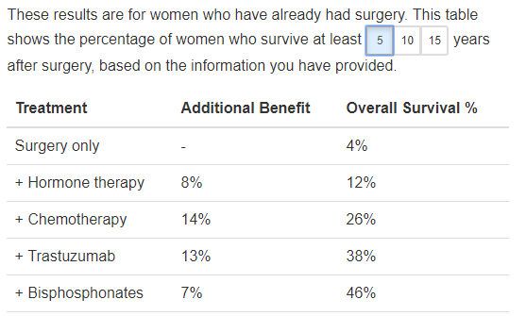
❶

Slide 19
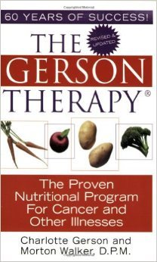
Gerson Therapy
❷

Slide 20
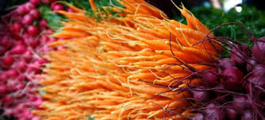
GERSON – The basics
❷
“Activates the body’s extraordinary ability to heal itself”
Diet: 13 glasses of raw carrot-apple and green-leaf juices/day
Three full plant-based meals, includes ‘Hippocrates soup’…

Slide 21
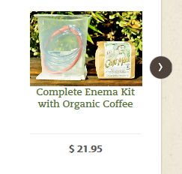
GERSON – The basics
❷
“Coffee enemas accomplish this essential task, assisting the liver in eliminating toxic residues from the body for good”
Cancer patients on the Gerson Therapy may take up to 5 coffee enemas per day
Supplements: Lugol’s, B12, thyroid etc.

Slide 22
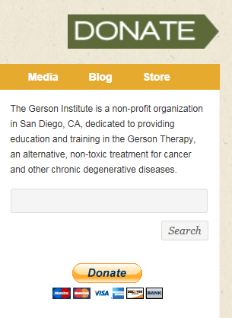
❷

Slide 23
❷

Slide 24
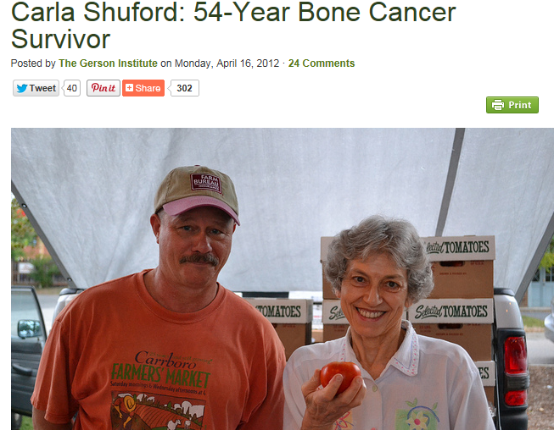
GERSON Therapy - Evidence
❷
Notes:
Gerson therapy ‘survivors’
- Sarcoma – radical surgery with amputation…GERSON diet following ---- Gerson therapy saved my life

Slide 25
GERSON Therapy - Evidence
❷
1983 – Retrospective study (38 patients): Patient interviews. No evidence to support usefulness of GERSON therapy
1995,- Gerson Research Organization Retrospective study: Melanoma patients. Concluded that in Stage III or IV melanoma – increased OS. No clinical trial information to support this study…patient phone calls
A case review of 6 patients with metastatic cancer who used the Gerson therapy reported that the regimen helped patients in some ways, both physically and psychologically

Slide 26
GERSON Therapy – S/E
❷
Three deaths that may be related to coffee enemas have been published
?Related to electrolyte disturbances?

Slide 27
❸

Slide 28
Lack of regulation
❸
Lax government regulations for ‘natural’ health products
Non-prescription drugs (Tylenol etc.) and natural health products – all ‘approved’ by health Canada…implies endorsement of safety/efficacy
Non-prescription drugs require scientific evidence – carefully reviewed by Health Canada
Natural products have a separate regulatory system – such minimal requirements – effectively a rubber stamp
If a problem arises with a natural health product – HC has little authority to compel changes in manufacturing, labelling or sale
Notes:
Editorial
Natural health products should be sold separately from drugs
Matthew Stanbrook
CMAJ June 26, 2017 189 (25) E848; DOI: https://doi.org/10.1503/cmaj.170661
The new framework would also require all health claims on the product to be supported by scientific proof, yet would still permit other “claims” to be made without proof — a loophole ripe for exploitation. Regardless of how product labels are regulated, as long as stores continue to stock natural health products and nonprescription drugs together in aisles labelled according to clinical indications such as “cough and cold remedies,” consumers will continue to assume mistakenly that these products all work equally well.
Distinct from the main framework, Health Canada is also “exploring” whether to require a printed disclaimer on all products with claims that are not reviewed by Health Canada, and whether they need additional powers to order the removal of unsafe products from the market, force changes in product labels or levy heavy fines against companies that break the law. Such measures are definitely needed, and Health Canada’s perceived hesitancy here is not reassuring, nor is its potential to bow under lobbying pressure. A recent, more limited effort to change labels on natural health products for cough and cold that are targeted at children was watered down after consultations between Health Canada and the homeopathy industry, and remains unenforced.³
Health Canada should adopt the proposed changes, but it must go further if it sincerely expects to achieve its stated objective to protect consumers and ensure that they can make informed choices. If consumers are unable to separate products with no scientific proof behind them from products supported by evidence, then we need to separate them in stores. Natural health products should be pulled from the shelves where they are mixed with nonprescription drug products and confined to their own separate section, away from any signage implying a therapeutic use.
The double standard perpetuated by both regulators and retailers that enables the deception of unsuspecting Canadians must end. Alternative medicines with claims based on alternative facts do not deserve an alternative, easy regulatory road to market — at the very least, they need to be moved to an alternative shelf.

Slide 29
❹
Notes:
Results The entire cohort comprised 1 901 815 patients with cancer (258 patients in the CM group and 1 901 557 patients in the control group). In the main analyses following matching, 258 patients (199 women and 59 men; mean age, 56 years [interquartile range, 48-64 years]) were in the CM group, and 1032 patients (798 women and 234 men; mean age, 56 years [interquartile range, 48-64 years]) were in the control group. Patients who chose CM did not have a longer delay to initiation of CCT but had higher refusal rates of surgery (7.0% [18 of 258] vs 0.1% [1 of 1031]; P < .001), chemotherapy (34.1% [88 of 258] vs 3.2% [33 of 1032]; P < .001), radiotherapy (53.0% [106 of 200] vs 2.3% [16 of 711]; P < .001), and hormone therapy (33.7% [87 of 258] vs 2.8% [29 of 1032]; P < .001). Use of CM was associated with poorer 5-year overall survival compared with no CM (82.2% [95% CI, 76.0%-87.0%] vs 86.6% [95% CI, 84.0%-88.9%]; P = .001) and was independently associated with greater risk of death (hazard ratio, 2.08; 95% CI, 1.50-2.90) in a multivariate model that did not include treatment delay or refusal. However, there was no significant association between CM and survival once treatment delay or refusal was included in the model (hazard ratio, 1.39; 95% CI, 0.83-2.33).

Slide 30
I explained all of this in DETAIL… Did it help?
No.
She discontinued TAMOXIFEN week 3. Declined f/up with me because I was too ‘close-minded’ about her treatment decisions.
Case conclusion: 16 months later – seizure, death from brain metastases.

Slide 31
What do I do differently?

Slide 32
10 step PROCESS ☺
ASK (CAM use) – ASK (beliefs) - ASK (diet changes)
Try not to be argumentative, judgmental or condescending
Talk to the NATUROPATH if you can!
Let the safe stuff slide (e.g. homeopathy)
Look it up, follow-up and know some trivia (e.g. Essiac tea!)
Recognize the value of certain CAMs (CBD)
Support and encourage true lifestyle changes (yoga, exercise, massage, physio etc.)
Recognize when we have ‘natural’ treatments too!
Compile some ‘easy-access’ printable resources
Make a stand…about the things that MATTER and are ACTUALLY dangerous!
Notes:
Try NOT to be argumentative, judgmental, or condescending

Slide 33
ASK – ASK - ASK
❶
Some studies suggest that about 60% of patients who use cams do not disclose that use to their primary care providers!

Slide 34
❶

Slide 35
ASK – ASK - ASK
❶
60% of OUR patients reported using at least 1 cam after their cancer diagnosis
High use products in our patients included:
Green tea
Curcumin (turmeric)
Homeopathy
Chagas tea, Essiac tea etc.

Slide 36
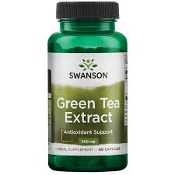
Important to our PATIENTS
❶
Green tea
?synergistically enhances the anticancer properties of chemotherapeutic drugs or to protect against chemotherapy-induced toxicity?
green tea polyphenols might interfere with drug-metabolizing enzymes and drug transporters

Slide 37
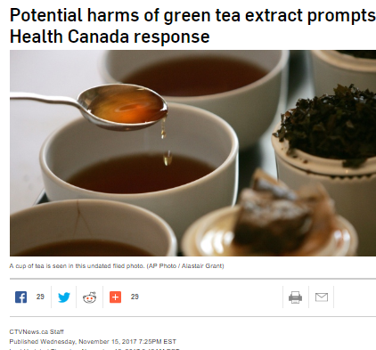
❶
Green tea
Patients using GREEN TEA with systemic therapy know that there are risks
Increased LFT monitoring

Slide 38
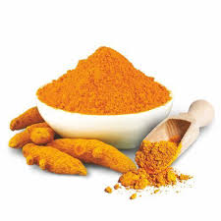
Important to our PATIENTS
❶
Curcurmin/TURMERIC
Anti-inflammatory properties
Very few side effects
In vitro interest -

Slide 39
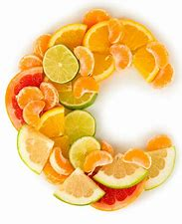
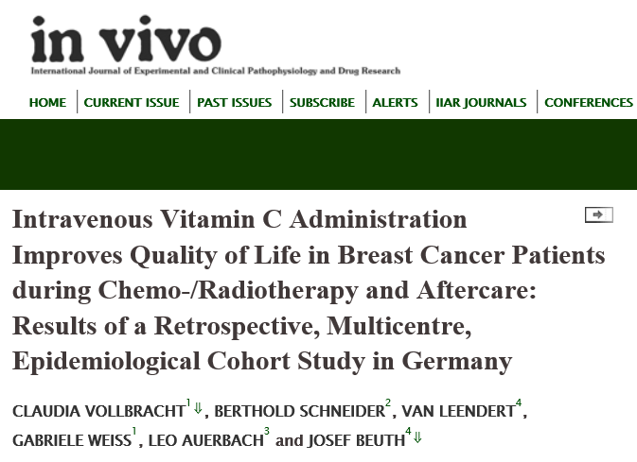
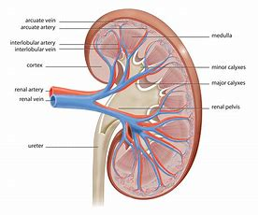
Important to our PATIENTS
❶
Vitamin C infusions

Slide 40
Important to our PATIENTS
❶
Vitamin C infusions

Slide 41
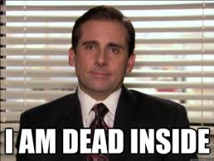
Don’t get upset – no matter what the patient says Try not to be argumentative, judgmental or condescending
❷

Slide 42
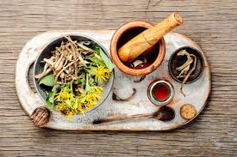
Talk to the NATUROPATH if you can!
❸

Slide 43
Let the safe stuff slide (homeopathy)
❹

Slide 44
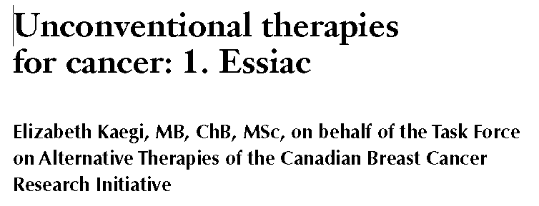
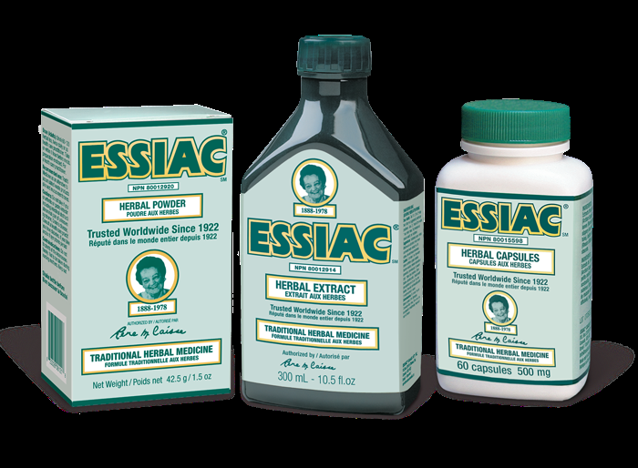
Look it up, follow-up and know some trivia (e.g. Essiac tea!)
❺

Slide 45
History of ESSIAC
❺
Herbal mixture (4 herbs):
Burdock root
Indian rhubarb
Sheep sorrel
Inner bark of slippery elm
Popularized by RN Rene Caisse (Bracebridge, ON) CAISSE - - ESSIAC
Immune-system booster, appetite improver, pain reducer

Slide 46
EVIDENCE
❺
No published reports in humans
Mice injected with ESSIAC – increased tumour necrosis/cell degradation
Unpublished Canadian study (1970s) – no clinical benefit in OS/tumour regression
?Subjective improvements in symptom-control and well-being (David Walde, SSM)
?Issues with potency

Slide 47
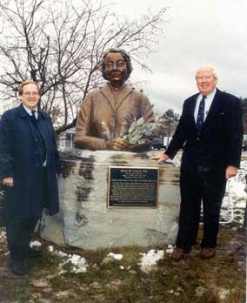
Side-Effects
❺
MILD
Allergic dermatitis
Laxative effect

Slide 48
Recognize the value of certain CAMs (CBD)
❻
In-vitro or Phase I/II/III studies in CANNABIS for reduction in CANCER burden are still immature
There is some evidence that THC can be helpful for:
Nausea/vomiting
Loss of appetite (?possible)
Chronic pain (?possible)
Side Effects
(++): balance changes, dry mouth, cardiac concerns (tachycardia, HTN), having a really good time…
Cannabis clinic …1-2g/day

Slide 49
CBD for other indications?
❻

Slide 50
Patient randomized to 2.5mg THC + 1mg cannabidiol vs. 2.5mg THC vs. placebo
Intent-to-treat analysis showed no significant differences between the three arms for appetite, QOL, or cannabinoid-related toxicity
An independent data review board recommended termination of recruitment because of insufficient differences between study arms
No differences were found for the CannTox scales for dizziness, feeling good, feeling high, hallucinations, heart beating, panic attacks, feeling active, or walking insecurely

Slide 51
Support and encourage true lifestyle changes
❼
Yoga
Massage
Physiotherapy
Exercise

Slide 52
We do natural things too!
❽
Taxol – bark of the PACIFIC YEW tree

Slide 53
BEST RESSOURCES
❾
https://www.cancerresearchuk.org/about-cancer/cancer-in-general/treatment/complementary-alternative-therapies/
https://www.cancer.gov/about-cancer/treatment/cam/patient
https://www.cancer.ca/en/cancer-information/diagnosis-and-treatment/complementary-therapies/
https://www.mskcc.org/cancer-care/integrative-medicine

Slide 54
Despite all of this…
❿
Sometimes you have to DRAW THE LINE…
Large variations in diet leading to weight loss (e.g. Gerson)
Very expensive and ineffective treatments (e.g. Alkalinizing)
Potentially deadly (laetrile/Vit. B17 - - - cyanide)

Slide 56
Make a stand…no matter the cost

Slide 57
In SUMMARY:
ASK (CAM use) – ASK (beliefs) - ASK (diet changes)
Try not to be argumentative, judgmental or condescending
Talk to the NATUROPATH if you can!
Let the safe stuff slide (e.g. homeopathy)
Look it up, follow-up and know some trivia (e.g. Essiac tea!)
Recognize the value of certain CAMs (CBD)
Support and encourage true lifestyle changes (yoga, exercise, massage, physio etc.)
Recognize when we have ‘natural’ treatments too!
Compile some ‘easy-access’ printable resources
Make a stand…about the things that MATTER and are ACTUALLY dangerous!
Notes:
Try NOT to be argumentative, judgmental, or condescending

Slide 58
Continuum of potential harm
Low RISK
Yoga, meditation, balanced diet, exercise
Intermediate RISK
Herbal treatments (Essiac tea, chagas, black cohosh etc.)
Supplements (vitamins/minerals)
High RISK
Multiple IV infusions
Rectal suppositories/enemas etc.
Acupuncture, massage therapy
Large variations in diet
Homeopathic treatments
?HIGHEST RISK: Patient declines all proven therapy

Slide 59
❹
Notes:
Results The entire cohort comprised 1 901 815 patients with cancer (258 patients in the CM group and 1 901 557 patients in the control group). In the main analyses following matching, 258 patients (199 women and 59 men; mean age, 56 years [interquartile range, 48-64 years]) were in the CM group, and 1032 patients (798 women and 234 men; mean age, 56 years [interquartile range, 48-64 years]) were in the control group. Patients who chose CM did not have a longer delay to initiation of CCT but had higher refusal rates of surgery (7.0% [18 of 258] vs 0.1% [1 of 1031]; P < .001), chemotherapy (34.1% [88 of 258] vs 3.2% [33 of 1032]; P < .001), radiotherapy (53.0% [106 of 200] vs 2.3% [16 of 711]; P < .001), and hormone therapy (33.7% [87 of 258] vs 2.8% [29 of 1032]; P < .001). Use of CM was associated with poorer 5-year overall survival compared with no CM (82.2% [95% CI, 76.0%-87.0%] vs 86.6% [95% CI, 84.0%-88.9%]; P = .001) and was independently associated with greater risk of death (hazard ratio, 2.08; 95% CI, 1.50-2.90) in a multivariate model that did not include treatment delay or refusal. However, there was no significant association between CM and survival once treatment delay or refusal was included in the model (hazard ratio, 1.39; 95% CI, 0.83-2.33).

Slide 60
Increase in mortality related to CAM use wasn’t necessarily due side effects/death related to the complementary medicines per se
However use of CAM was highly associated with higher rates of refusal of surgery, chemotherapy (34 vs. 3%) and radiotherapy (53% vs. 2%)
There was no significant association between CAM and survival once treatment delay or refusal was included in the model (hazard ratio, 1.39; 95% CI, 0.83-2.33).

Slide 61
Prove me wrong…
Hypothesis:
It is better to accept the CAM treatments patients are using despite UNKNOWN drug interactions and side effects than to alienate patients who are using CAM
Evidence suggests that if patients decline ‘traditional’ treatments – this is where mortality starts to increase

Slide 62
Questions
lpitre@hsnsudbury.ca

Slide 63
Too much of a good thing…
Vitamin E – large doses may increase prostate cancer risk
Vitamin D – large doses may increase risk of kidney stones, affect risk of heart disease
Etc.

Slide 64
❺ Unintended Consequences
PINK notes

Slide 65
❻ How to talk to well-meaning loved-ones
Thank you
I will bring this and discuss with my XXX practitioner
When I’m on active treatment – the goal will be to create unnatural environment in my body – so the cancer can’t survive
After treatment is complete – the focus will change to ‘wellness’

Slide 66
HIGH-DOSE VITAMIN C can CURE CANCER

Slide 67
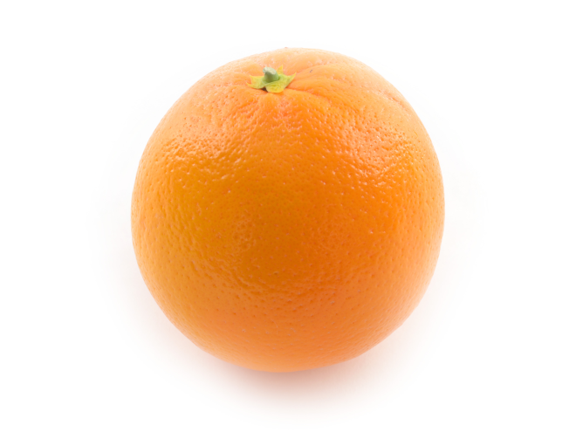
VITAMIN C Infusion
Linus Pauling
Founder of quantum chemistry – Nobel prize
Peace activist – Nobel Peace prize
1974 published study
High dose vitamin C (10g/day)
100 patient series (very little chemo exposure)
Stage IV patients
Mean OS 210 vs 50 days (historical controls)

Slide 68
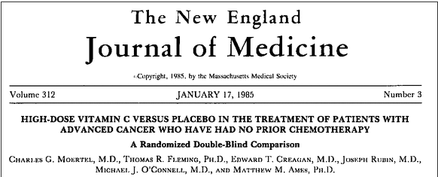

Slide 69
Vitamin C Infusion
Double-blind study – 100 patients with advanced CRC
Randomly assigned to Vitamin C 10g/day) vs placebo
None had received prior treatment with cytotoxic drugs
No difference in OS, disease progression
No objective improvement in measurable disease

Slide 70
Vitamin C Infusion
The World Health Organization recommends taking 45 milligrams of vitamin C a day
Cost ~$30 - $150/infusion

Slide 71
Cancer-causing lifestyle factors
Obesity
Alcohol
Tobacco
Sun
Radon gas exposure
Infectious agents (e.g. HPV)
Environmantal polutants

