Slide 1


Cancer and Mino Bimaadiziwin
Dr. Cindy Peltier
Nipissing University
November 15, 2019

Slide 2
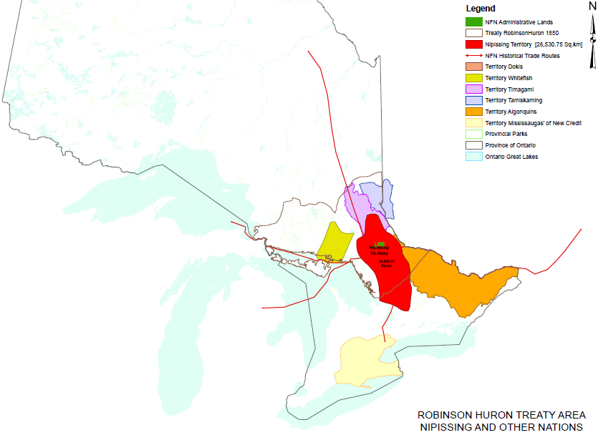
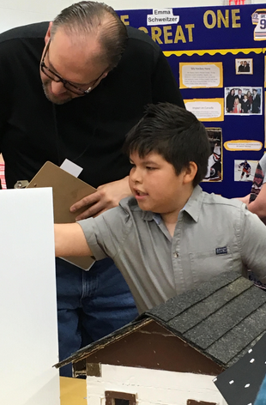
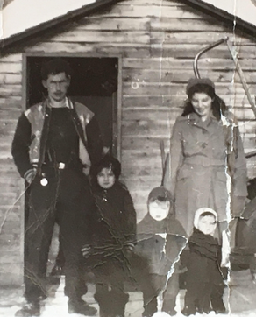
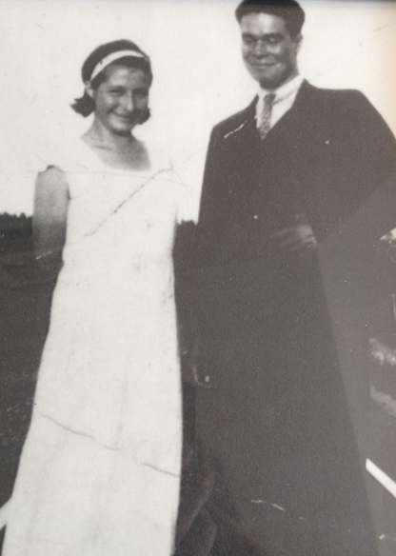
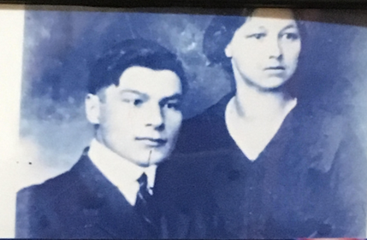
Acknowledging the Land, the People, the Future

Slide 3
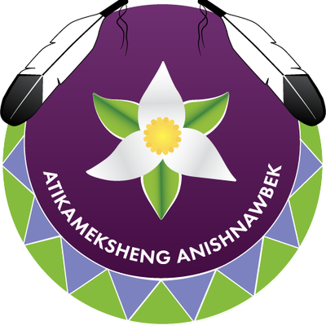

Land Acknowledgement
We are in the territory of the Robinson-Huron Treaty of 1850 and the land on which we gather is the traditional territory of the Atikameksheng Anishnaabek and Métis.

Slide 4
Disclosure of Affiliations, Financial Support, and Mitigating Bias
Affiliations:
McMaster University (Indigenous Health Research Development Program Graduate Scholarship, CIHR – Institute of Aboriginal People’s Health)
Nipissing University - Nipissing University Start-Up Research Grant
Financial Support:
This session/program has received financial support from:
McMaster University Indigenous Health Research Development Program Graduate Scholarship, CIHR – Institute of Aboriginal People’s Health in the form of a student scholarship.
Nipissing University - Nipissing University Start-Up Research Grant
Mitigating Potential Bias:
I have no conflict of interest to declare.

Slide 5
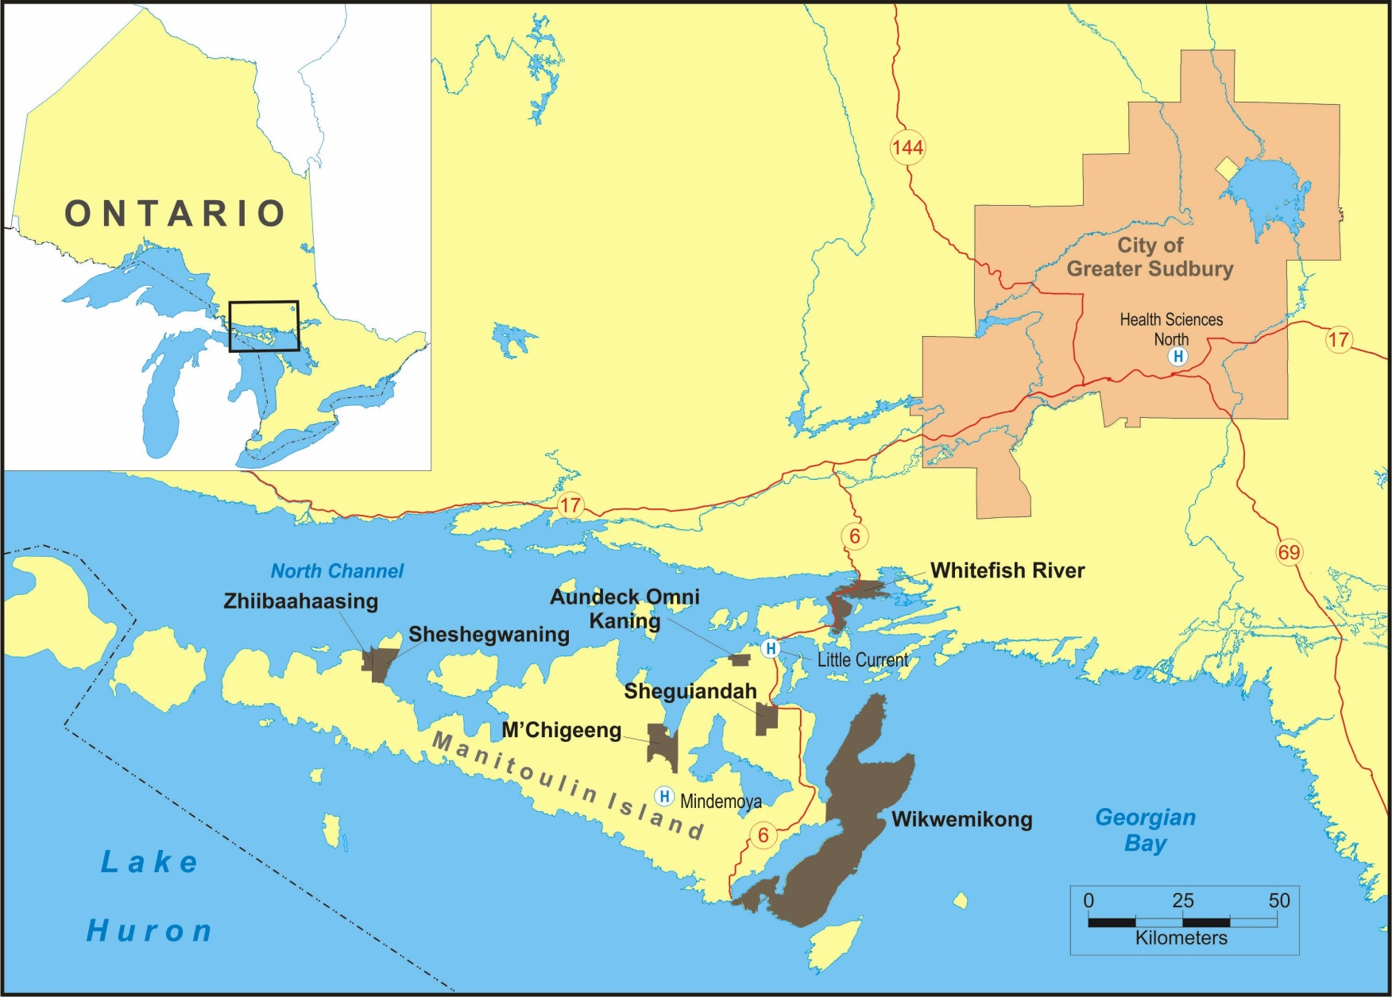
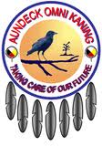





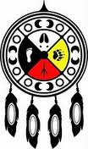
Acknowledging Communities

Slide 6
Learning Outcomes
At the end of this session attendees will be able to:
Interpret and incorporate an Anishinaabe worldview and understandings of wellness as they apply to cancer care
Describe how Anishinaabe healing methods differ from conventional medicine for the purposes of delivering culturally safe care
Apply the concepts of patient choice and agency as they relate to Mino Bimaadiziwin (the way of a good life) and cancer care

Slide 7
Wellness, Resilience and Indigenous Knowledge
“In spite of the considerable health issues and challenges, Indigenous peoples continue to demonstrate resilience and strive for wellness based in Indigenous ways of knowing and being” (NCCAH, 2013)

Slide 8
(Fayed et al., 2018)

Slide 9
In their words:
Trauma, stress and cancer
Stress builds up in your system and it’s got to go somewhere. They say it’s like that fire that burns and burns. Stress is a killer and if it has no place to go, it could manifest in cancer. (APDC05)
I think it would be a critical thing to try and reduce some of the mental health stresses that have accumulated within the communities. These stressful, negative energies are underlying increased cancer rates in First Nations – that's more in the preventative aspect (WHP06)
In our culture, everything we do deals with trauma in people. The traumas of their experience are honoured and recognized and then if the person wants it relieved, we help to release the trauma. (IHP09)

Slide 10
What is Indigenous Wellness?
A wholistic conceptualization that recognizes the physical, mental, emotional and spiritual dimensions of health.
Extends beyond the individual to include our inter-relationships with others – families, communities, Nations, the world around us – as well as our ancestors and future generations.
Maintaining balance in all aspects of life’s pathway is integral to wellness.
Is not just the absence of disease; indeed, wellness can be achieved in the context of a variety of pathologies.
Is a journey in itself, both individually and collectively.
(King et al., 2018)

Slide 11
Mino Bimaadiziwin “The Way of a Good Life”
The way of a good life
Balance between mental, physical, emotional and spiritual health
Choice
A path of living well
Respecting and taking care of one another

Slide 12
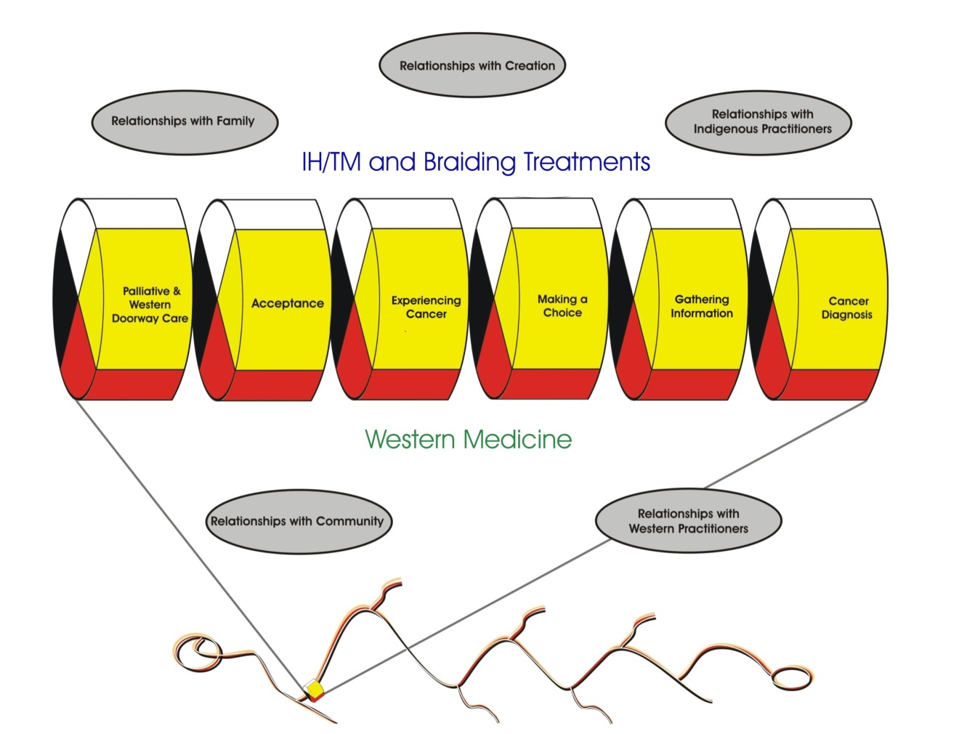

Slide 13
Achieving Mino Bimaadiziwin
Cancer can be “a teacher,” but this requires acceptance, agency and choice to achieve Mino Bimaadiziwin
Involves individual choice and personal responsibility in health care decision-making
Involves the concept of relationality and responsibility to all of Creation

Slide 14
In their words:
“Kiingwa [It’s up to you]”
[Cancer] either forces a person to look at their life and make those changes to correct things in their life … Or, the person just doesn’t make those changes and heads down a road of uncertainty and maybe in the end that they will accept that this road has an end to their time here. It’s really up to them. There’s two roads presented to them and they have to choose. There’s only one choice if you want that Mino Bimaadiziwin and that’s to look at it and address it and make those changes … (IHP06A)

Slide 15
United Nations Declaration on the Rights of Indigenous Peoples
Article 24
Indigenous peoples have the right to their traditional medicines and to maintain their health practices, including the conservation of their vital medicinal plants, animals and minerals. Indigenous individuals also have the right to access, without any discrimination, to all social and health services.
Indigenous individuals have an equal right to the enjoyment of the highest attainable standard of physical and mental health. States shall take the necessary steps with a view to achieving progressively the full realization of this right.

Slide 16
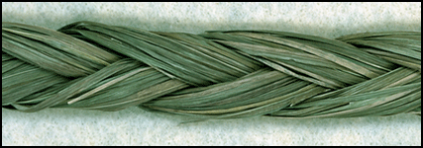
Western Medicine
IH/TM
How can we eradicate the disease?
A physical intervention making some gains toward holistic
Meets the “gold standard” of clinical trials
Due to the loss of IH/TM and “new diseases,” like cancer, it is required
Participants highly valued the Western treatments for cancer, especially if they were successful
What can the disease teach the patient?
It is preventative measure
Enables one to realize Mino Bimaadiziwin while supporting physical, mental, emotional and spiritual wellness
Acknowledges the spiritual component
Anishinaabe teachings are part of healing and changing mindsets

Slide 17
In their words:
Agency,
Respect and Empowerment
I shared with my doctor that I followed through with my people. I can still remember the look on his face, there was that sense of respect. He never asked what it was that I was taking. He was very respectful in that way. Having that affirmation from the Western medical side was like having a sense of mutual respect. The first time he said it to me was like permission, like permission to go and seek out my people. I think because the doctor gave permission, I made my choice freely without resistance. I think that made a big impact (APDC11)

Slide 18
A sneak peek …
The Collective Story of the Mnidoo Mnising Anishinaabe Kweok
https://vimeo.com/369947181

Slide 19
Concluding thoughts …
Ongoing cultural safety training should:
Involve a focus on the cultural significance of braiding and development of structural competence;
Include partnerships between Western and Indigenous health care providers to foster a mutual understanding of Mino Bimaadiziwin;
Encourage health professionals to empower Indigenous peoples to choose healing models that are specific to achieving their Mino Bimaadiziwin.

Slide 20
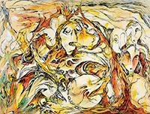
Miigwech
Daphne Odjig, “Medicine Man and The Shaking Tent” (1974)

