Slide 1
YOGA – Interactive Session

Slide 2
Learning Objectives
At the end of this presentation, participants will be able to:
Identify the signs of compassion fatigue in the health care setting
2. Implement yoga based breathing techniques and meditation
3. Practice 3 yoga poses for stress relief and balancing mind body and spirit
Notes:
The effect you have on others is the most valuable thing you have in this life.
Fulfillment is not attained through money, or a promotion, or power.
It’s attained by giving your gifts and contributing them to the world. So find your gifts and listen to the voice inside that calls you to action.
The one that drives you. Inspires you. The one that ignites a fire in your soul and tells you what your purpose is on this planet and in this life...
That’s what’s going to get you out of bed in the morning with a genuine smile on your face. The kind of smile that no one can take away. The kind of joy and motivation that is derived internally and is independent of external motivators.
Our work, in health care, specifically in oncology, is not for the weak. How many people ask you “how do you do what you do every day?” Or say “wow, that must be so hard”? You chose this path because you know that you have what it takes to care for people who are facing ultimate fear and desperation.
You were born to be a care giver!

Slide 3
Warning signs of compassion fatigue
Abusing drugs, alcohol or food
Anger
Blaming
Chronic lateness
Depression
Diminished sense of personal accomplishment
Exhaustion (physical or emotional)
Frequent headaches
Gastrointestinal complaints
High self-expectations
Hopelessness
Hypertension
Inability to maintain balance of empathy and objectivity
Increased irritability
Less ability to feel joy
Low self-esteem
Sleep disturbances
Workaholism
When practicing medicine feels more like labor than a labor of love, take steps to heal the healer. John-Henry Pfifferling, PhD, and Kay Gilley, MS
Fam Pract Manag. 2000 Apr;7(4):39-44.
Notes:
But it is taxing. This kind of work requires discipline in self care and a deep connection to your purpose. You have to be able to connect to your purpose, to your why, in moments where challenging circumstances test your dedication and your internal strength.
When a patient gets upset with you for not doing enough, when you’ve done your very best. Maybe they lash out with unkind words and it leaves you feeling under appreciated. Maybe they break down in tears and you feel guilty for not being able to do more.
When a colleague is unhelpful, disrespectful or discredits your work. You feel distant from the team, unsupported, attacked.
When management delivers the bad news that were in deficit and we must now work harder than ever before and with less resources. You feel hopelessness- you feel like giving up. How can you give the quality of care you were trained to deliver with such limited resources.
When this happens, you have to come back to your purpose, and in yoga, we call this our intention.

Slide 4
Implement yoga based breathing techniques
Notes:
I’d like to invite you to take a moment here and close your eyes.
What mark do you want to leave on the world? What makes you proud of who you are and what you do? If money did not exist, what would you do with your time and efforts on this earth. Hold on to this ... this is your intention.
With your eyes closed- keep this intention in your heart. Challenge yourself to stay inside your own circle. Stay inside your mind space. Do not allow yourself be distracted by anything outside of your circle. If a distracting thought or emotion comes to you, name the emotion and allow it to pass. This moment is about you- and your intention. Hold onto it.
Begin to turn your attention to your breath. Notice how the breath flows through the body in an organic, cyclical pattern, like waves crashing and receding on a shore. Become aware of any subtleties of your breath – is the breath continuous or interrupted? is it heavy or light? See if you can smooth out the breath so that there is no beginning and no end to your inhale and exhale. Continue to do this for 10 cycles and notice how your body is feeling as you do this.
As you begin to experience a sensation of calm washing over the body, begin to constrict the back of the throat slightly as you inhale and exhale through the nose

Slide 5
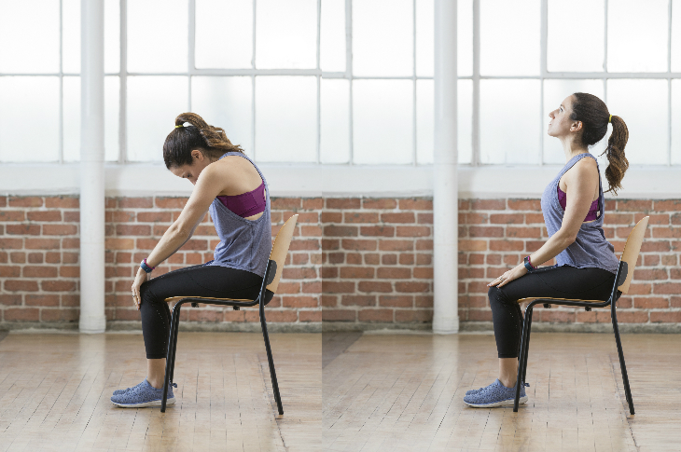
Restorative Seated Cat-Cow Pose “Upavistha Bitilasana Marjaryasana”
Notes:
Cat-Cow can relieve lower back pain, sciatica and ease menstrual symptoms by gently massaging the reproductive organs. The movement of the body with the breath helps to alleviate symptoms of depression and anxiety. This pose brings awareness to our spine, posture and balance. It changes our focus and brings our conscious mind into the physical body.
INHALE COW: lead your heart across the room, draw your shoulders back, point the tail bone up, tilt the pelvis backward, look up. EXHALE CAT: tuck your chin, rock your pelvis forward, tuck your tail between your legs, roll the shoulder blades down, feel a lengthening of the spine from the base of skull, through the mid thoracic spine and gently pulling down to the lumbar spine.
This pose stretches the muscles in the hips, back and abdomen. The movement of the abdominal area with breathing helps in stimulating abdominal organs including the gastrointestinal tract. It aids breathing by stretching the chest and the lungs, making breathing smoother, bringing the conscious mind into the expansion and contraction of the chest.

Slide 6
Mountain Pose “Tadasana”
Notes:
Stand with the bases of your big toes touching, heels slightly apart.
Lift and spread your toes and the balls of your feet, then lay them softly down on the floor. Rock back and forth and side to side, rooting into the 4 corners of the feet. Gradually reduce this swaying to a standstill, with your weight balanced evenly on the feet.
Firm your thigh muscles and lift the knee caps, without hardening your lower belly. Lift the inner ankles to strengthen the inner arches, then grow the body tall all the way up along your inner thighs to your groins, and from there through the core of your torso, neck and head seeing if you can gain ½ or ¼ inch height.
Turn the upper thighs slightly inward. Lengthen your tailbone toward the floor and lift the pubis toward the navel. Press your shoulder blades into your back, pulling the shoulders away from the ears.
Without pushing your lower front ribs forward, lift the top of your sternum straight toward the ceiling. Widen your collarbones. Hang your arms beside the torso, rotating the palms to face forward. Balance the crown of your head directly over the center of your pelvis, with the underside of your chin parallel to the floor, throat soft, and the tongue wide and flat on the floor of your mouth. Soften your eyes.
Alteration 1: close the eyes to challenge your balance

Slide 7
Tree Pose “Vrksasana”
Notes:
Tree pose improves balance, gently stretches your inner right thigh and front of thigh while strengthening your outer thigh, buttocks and ankle. It also stretches around your shoulders and lattisimus dorsi, strengthens your core – all while calming and relaxing the mind, boosting energy and fighting fatigue.
From Tadasana, bend the right knee and place the right foot high on the left inner thigh, taking the hands to the hips, allow the right knee to be as far forward in space as will keep the frontal hipbones square so there is no rotation in the pelvis.
Make sure the standing foot continues to point straight forward and press the right foot and the left inner thigh against each other
Alteration 1: Take the right sole and place it below the knee, pressing up against the calf.
Alteration 2: Take the right heel up to the calf, keeping the toes on the ground for balance.
Alteration 3: To add challenge to this pose, lift the sole of the right foot and bring the outer edge of the foot to rest on the top of the left thigh.
Notice that the right hip is hiked up higher than the left, shortening the right waist; descend the right sitting bone towards the left heel.
Observe how the body compensates: the left thigh bows forward, and the left outer hip protrudes. Correct this, pressing the left thigh bone back and firm, the left outer hip pulls into the midline.
Keeping the pelvis squared to the wall you are facing, carefully draw the right knee backwards to deepen the external rotation in the hip.
Only draw the knee back to the extent you can keep the hips square!
Raise the arms without flaring the front ribs
If able to keep the arms straight, reach up, touch palms and take the gaze to the thumbs.
Alteration 1: bring the hands to heart center.
Alteration 2: bring the hands to the hips
Alteration 3: keep hands on a chair in front of you.
Hold for 5 to 10 breaths
To exit, use an exhale to release back to Tadasana

Slide 8
Questions/Comments?

Slide 9
Session Evaluation and Outcome Assessment These short forms serve important functions!
For speakers: Your responses help them understand their strengths and weaknesses, participant learning needs, and teaching outcomes
For the CEPD office:
To plan future programs
For quality assurance and improvement
To demonstrate compliance with national accreditation requirements
For YOU: Reflecting on what you’ve learned and how you plan to apply it can help you enact change as you return to your professional duties
Please take 3-5 minutes to fill the evaluation form out. Thank you!

