Slide 1
Rural Hospice Co-Location An Integrated Approach to Hospice Palliative Care Services within Rural North East Ontario
The challenge of place of care:
Hospice suites in acute care rural hospitals
October 25, 2019
Sault Ste. Marie
Moderators:
Frances Kilbertus, Maryse Bouvette, Betty Smallwood
Kirkland and District Hospital
Timiskaming Hospice Palliative Care

Slide 2
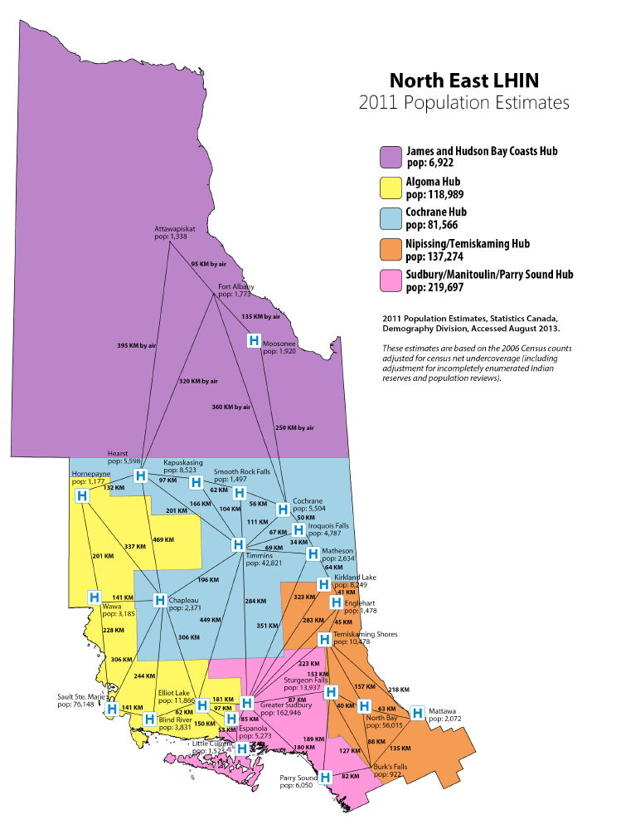
Timiskaming District
14,000 sq km landmass
34,000 population
(1 hospice bed/ 100,000=1.99 beds)
3 central areas - Kirkland Lake, Englehart, Temiskaming Shores
Many outlying towns & villages
Significant health challenges and poor socioeconomic and lifestyle factors
“These characteristics are typical of each of the rural districts/hubs in NE Ontario”

Slide 3
Issues and their Impact on Patients
Individuals travel long distances to be diagnosed, and later to receive treatment throughout their illness trajectory
Decentralization of hospitals in the 90’s, though best practice for the patient and our health care system, has created additional challenges to deliver and obtain care in community
Individuals with cancer or chronic life-limiting illness, who are being cared for at home, find themselves having to be treated in Emergency Department and/or admitted to Hospital for pain and symptom management, or when family no longer able to cope
Gaps in HPC Service Delivery:
In care setting – here are no dedicated palliative care beds in any of the three hospitals in the District; and no hospice care beds in the District.
Lack of Coordination of care and services for individuals throughout their illness trajectory.

Slide 4
Quality Intervention and Implementation
Opportunity and Vision –
Community Partners idea to incorporate Hospice Care within existing infrastructures, across the District
Right timing / Right leadership
Repurposing of unused space (an obstetrics ward) within the Kirkland and District Hospital (KDH)
Fall of 2013 – a dedicated 1-bed community hospice suite was opened as a pilot project in the KDH
Oct 2013 - A proposal to develop this model as an Integrated Rural Hospice Co-location Model was endorsed by the Kirkland and District Hospital, and the Timiskaming District Hospice Palliative Care local planning table

Slide 5
Outcomes/Impact of 1-Bed Rural Hospice Suite Co-Location Model:
For the Patient and Families Truly at centre of care and in better control over their lives Focus on all domains of issues – physical, spiritual, psychosocial Reduction in caregiver burnout | For Service Providers Improved hospice palliative care awareness and use of common resources (PPS and CCO Symptom Guidelines) Improved skills, confidence and practice amongst all settings
For Local Integration Opportunity for direct admission from home Development of capacity to serve patient in location of choice Co-location model builds on space, heating, maintenance, IT and other supports provided by the hospital Rural hospice is not sustainable as a stand alone model | For the Health Care System Building capacity to deliver hospice care, while improving the quality of palliative and EOL care Early identification and capacity amongst providers is key Successfully evaluated against Hospice Palliative Care Ontario’s Community Residential Hospice Standards of care.
Notes:
Benefit to hospital and builds capacity for Hospice and Palliative Care within the rural community

Slide 6
Rural Hospice Suite Co-located at Kirkland and District Hospital
The Hospice Suite provides a home-like environment
End-of-Life care services are offered by an inter-professional team with palliative care expertise 24 hours a day, 7 days a week.
Significant connections have been established with all providers
This Community Model of Hospice Palliative Care promotes the understanding that care and support begins at the time of diagnosis, not solely when patients are admitted to the Hospice Suite.

Slide 7
Sustainability and Sharing of the Initiative
Demonstrated that, in a rural area, 1-bed hospice suite and program can be co-located within an existing infrastructure to:
provide quantifiable improvements to the patient experience at end-of-life;
enhance the continuum of care;
support the family through the dying and bereavement process; and,
provide value for money.
To improve access to service in rural communities and build capacity for hospice palliative care in line with provincial direction, the NE LHIN endorsed the co-location model developed as a pilot project in Kirkland Lake and in 206-2017 (17 hospitals within the NE received start up financing)
17 hospitals in NE now receive annualized funding as a Hospice bed - $105,000 per bed which is directed toward nursing and PSW supports.
Two of the early pilot sites are awaiting funding

Slide 8
Survey – Discussions What has the effect of a One Bed Hospice in an Acute Care Setting been?
----------------------------------------
In relation to the care delivery & the management
of clients/families within the Rural Hospice
Palliative Care Co-Location Suite within your
Community hospital:
What are the strengths?
What have you found to be a challenging?
What improvements can be made?

Slide 9
SUMMARY Post –Survey & Conference:
What improvements can be made?
THEMES IDENTIFIED:
FUNDING & SUSTAINABILIY
EDUCATION & SUPPORT
EARLY IDENTICATION STRATEGIES (EARLY IDNETIFICATION OF PERSONS WHO WOULD BENEFIT FROM A PALLIATIVE APPROACH TO CARE)
DEVELOP COMMUNITY INTEGRATED TEAM APPROACH

