Slide 1



Ontario’s Lung Cancer Screening Pilot for People at High Risk
Presenter: dr. Gail Darling
Presentation for the Northeast Oncology Conference
Sudbury, Ontario
November 15, 2019

Slide 2
Disclosure of Affiliations, Financial Support, and Mitigating Bias
Speaker Name: Dr. Gail Darling
Affiliations:
I have no relationships with for-profit or not-for-profit organizations.
Financial Support:
This session/program has not received financial or in-kind support.

Slide 3
CONFIDENTIAL
Do not publish or disseminate the contents of this presentation including First Nations, Inuit, Métis data (if applicable) without the consent of Cancer Care Ontario.
This presentation contains de-identified and/or aggregate information (the “Information”). Recipients of this presentation acknowledge and agree that they will not use the Information, either alone or with other information to: identify an individual; attempt to decrypt information that is encrypted; attempt to identify an individual based on unencrypted information; or attempt to identify an individual based on prior knowledge.

Slide 4
Agenda
Overview of Lung Cancer Screening Evidence & Burden of Disease
Objectives and Site Locations of the Lung Cancer Screening Pilot for People at High Risk (the pilot)
Screening Pathway Overview and Tools
Early Results
Next Steps
Q&A

Slide 5
Learning Objectives
Examine evidence for lung cancer screening and components of organized lung cancer screening
Describe recruitment strategies and importance of navigation
Recognize opportunities for smoking cessation interventions within the screening process

Slide 6
Overview of Lung Cancer Screening
Evidence & Burden of Disease

Slide 7
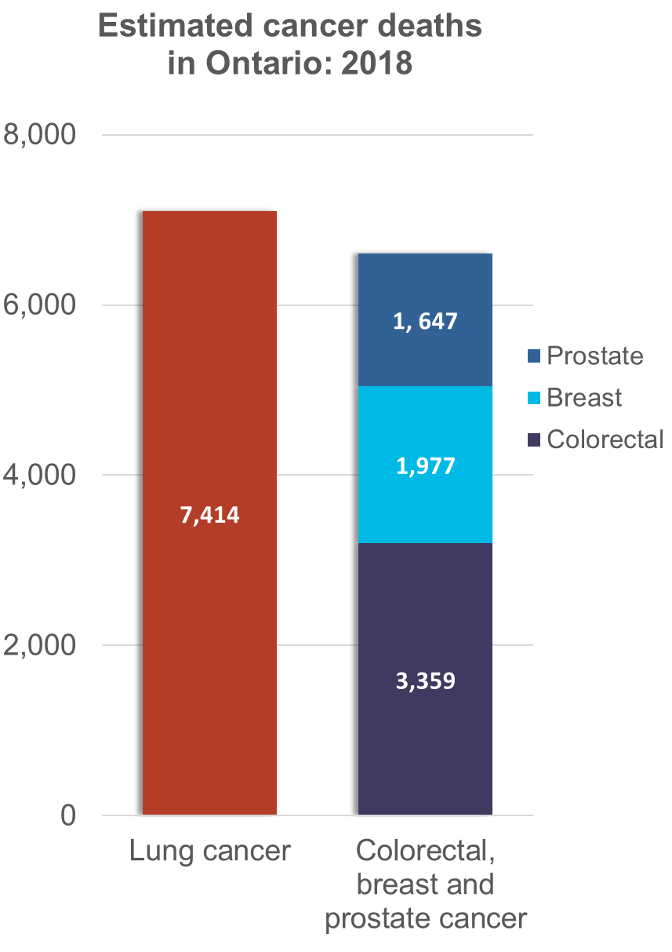
The Importance of Lung Cancer Screening
Leading cause of cancer death for women and men in Ontario1
Lung cancer is usually diagnosed at an advanced stage, when treatment has less of a chance of working
Screening can find lung cancer earlier, when treatment has a better chance of working
1. Cancer Care Ontario. Ontario Cancer Statistics 2018 [Internet]. Toronto (ON): Cancer Care Ontario; 2018 [cited 2018 Nov 2]. Available from: https://www.cancercareontario.ca/sites/ccocancercare/files/assets/OCS2018_1.pdf
Notes:
In 2018, lung cancer was expected to be the third most commonly diagnosed cancer in Ontario, following female breast and colorectal cancer.
In 2013, lung cancer was the second most commonly diagnosed cancer in Ontario; there were 10,269 cases of female breast cancer, 9,757 cases of lung cancer, 8,759 of colorectal cancer and 7,647 cases of prostate cancer.
Lung cancer accounts for approximately 13% of cancer diagnoses, but approximately 24% of cancer deaths. It is the number one cause of cancer death in Ontario. In 2018, 7,414 people were expected to die from lung cancer – more than colorectal, breast and prostate cancer combined. ¹
The age-standardized five-year relative survival ratio for people diagnosed with lung cancer in Ontario from 2009 to 2013 was 21.7%, showing some improvement over the past decade, but being much less than female breast (87.9%), colorectal (67.9%) and prostate (94.1%) cancer.
People are usually diagnosed with lung cancer when the disease is at an advanced stage when treatment has less of a change of working. Screening with low-dose computed tomography (LDCT) can detect lung cancers earlier, when treatment has a better chance of working.
Cost Effectiveness of Screening:
Lung cancer screening with computed tomography can be cost-effective in a population-based setting if stringent smoking history eligibility criteria are applied.
Annual screening scenarios are more cost-effective than biennial screening scenarios.
Speaking Note Sources:
Cancer Care Ontario. Ontario Cancer Statistics 2018 [Internet]. Toronto (ON): Cancer Care Ontario; 2018 [cited 2018 Nov 2]. Available from: https://www.cancercareontario.ca/sites/ccocancercare/files/assets/OCS2018_1.pdf
Cancer Quality Council of Ontario. Cancer in Ontario [Internet]. Toronto (ON): Cancer Care Ontario; 2018 [cited 2018 Nov 2]. Available from: https://www.csqi.on.ca/highlights/cancer-in-ontario
ten Haaf K, Tammemagi MC, Bondy SJ, van der Aalst CM, Gu S, McGregor SE, et al. (2017) Performance and Cost-Effectiveness of Computed Tomography Lung Cancer Screening Scenarios in a Population-Based Setting: A Microsimulation Modeling Analysis in Ontario, Canada. PLoS Med 14(2): e1002225. doi:10.1371/journal. pmed.1002225
Slide Content Source:
1. Cancer Care Ontario. Ontario Cancer Statistics 2018 [Internet]. Toronto (ON): Cancer Care Ontario; 2018 [cited 2018 Nov 2]. Available from: https://www.cancercareontario.ca/sites/ccocancercare/files/assets/OCS2018_1.pdf

Slide 8
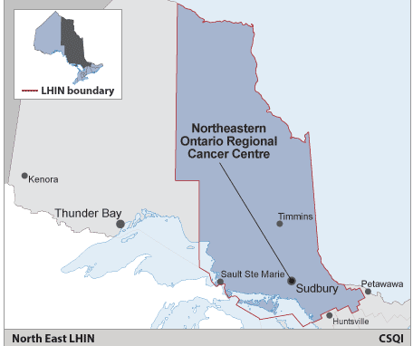
Lung Cancer Indicators: North East Local Health Integration Network (LHIN)
Indicator (total population)² | North East LHIN | Ontario
Age-standardized incidence of lung cancer (per 100,000 people) (2018 estimate) | 95.6 | 69.7
Age-standardized 5-year relative survival of lung cancer (2009–2013) | 18.8% | 20.8%
% of adults (age 20+) who are daily or occasional smokers (2015) | 26.4% | 18.5%
2. Csqi.on.ca. [Internet]. Local Health Integration Network. Toronto: Cancer Care Ontario; [cited 2018 Nov 6]. Available from: https://www.csqi.on.ca/indicators/by-lhin
Notes:
Slide Content Source
2. Csqi.on.ca. [Internet]. Local Health Integration Network. Toronto: Cancer Care Ontario; [cited 2018 Nov 6]. Available from: https://www.csqi.on.ca/indicators/by-lhin

Slide 9
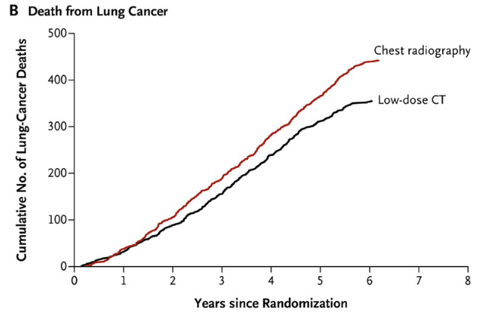
National Lung Screening Trial (NLST)
Evidence from the NLST³
Randomized controlled trial with over 50,000 participants ages 55–74 at randomization
Compared screening with a low-dose computed tomography (LDCT) scan to screening with a chest X-ray
Screening people at high risk for lung cancer with LDCT resulted in a 20% relative reduction in lung cancer mortality over 6 years
³
3. Aberle D, Adams A, Berg C, Black W, Clapp J, Fagerstrom RM, et al. Reduced lung-cancer mortality with low-dose computed tomographic screening. N Engl J Med. United States; 2011 Aug 4;365(5):395–409
Notes:
Speaking Notes:
Cancer Care Ontario accepts the evidence generated by the National Lung Screening Trial (NLST)
The NLST was a randomized controlled trial with over 50,000 participants
People were eligible to participate in the NLST if they were ages 55 to 74, had smoked for at least 30 pack-years, and were either current smokers or former smokers who had quit within the past 15 years.
It compared people at high risk for lung cancer who got screened with an LDCT scan to people who got screened with a chest X-ray
Screening with LDCT resulted in a 20% relative reduction in lung cancer mortality over 6 years
Speaking Notes Source:
Cancer.gov [internet]. National Cancer Institute at the National Institutes of Health; 2014 September
Slide Content Source:
3. Aberle D, Adams A, Berg C, Black W, Clapp J, Fagerstrom RM, et al. Reduced lung-cancer mortality with low-dose computed tomographic screening. N Engl J Med. United States; 2011 Aug 4;365(5):395–409

Slide 10
Dutch-Belgian Randomized Lung Cancer Screening Trial (NELSON study)
Evidence from the NELSON Study⁴
Randomized controlled trial with over 15,000 participants
Compared people at high risk for lung cancer who got screened with computed tomography (CT) at four different time points to people who did not get screened
For men, screening with CT resulted in a 26% reduction in lung cancer mortality after 10 years of follow-up
For women, there was a significant and larger reduction in lung cancer mortality compared to men
4. International Association for the Study of Lung Cancer (IASLC). NELSON study shows CT screening for nodule volume management reduces lung cancer mortality by 26 percent in men [Internet]. 2018 [cited 2019 Jun]. Available from: https://wclc2018.iaslc.org/media/2018 WCLC Press Program Press Release De Koning 9.25 FINAL .pdf
Notes:
Speaking Notes:
NELSON study was a randomized controlled trial with over 15, 000 participants
The study compared people at high risk for lung cancer who got screened with computed tomography at four different time points to people who did not get screened
Participants that were randomized to the screening group in the NELSON study had computed tomography scans at baseline, 1, 3, and 5.5 years after randomization. A minimum follow-up period of 10 years was used for the majority of participants.
Like the National Lung Screening Trial, the findings from the NELSON trial show that lung cancer screening results in reduced risk of dying from lung cancer.
For men, screening with CT resulted in a 26% reduction in lung cancer mortality after 10 years of follow-up
For women, there was a significant and larger reduction in lung cancer mortality compared to men
Speaking Notes and Slide Content Sources:
4. International Association for the Study of Lung Cancer (IASLC). NELSON study shows CT screening for nodule volume management reduces lung cancer mortality by 26 percent in men [Internet]. 2018 [cited 2019 Jun]. Available from: https://wclc2018.iaslc.org/media/2018 WCLC Press Program Press Release De Koning 9.25 FINAL .pdf

Slide 11
Objective and
Site Locations of the Pilot

Slide 12
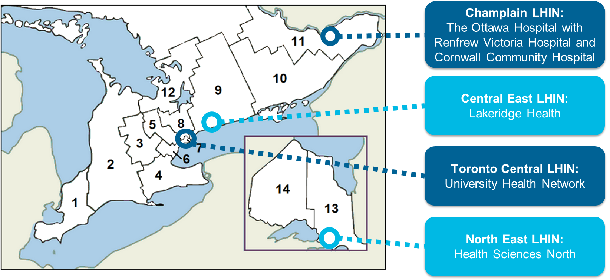
Pilot Objective and Site Locations
Pilot organized lung cancer screening for people at high risk, using LDCT, to inform design and implementation of a provincial program
Notes:
Project Goal and Objectives
Pilot organized, lung cancer screening for people at high risk, using LDCT, to inform the design and implementation of a provincial program.
Pilot sites initiated screening in June 2017.
An interim evaluation will be conducted after completion of 1 year of the pilot, using the first year of data. A final evaluation will be conducted at the end of the pilot and the results will be finalized in Fall 2021. Evaluation findings will inform recommendations for the optimal design and implementation of a provincial lung cancer screening program for people at high risk in Ontario.
How Pilot Sites were Chosen:
Cancer Care Ontario selected 4 hospital-based pilot sites to assess feasibility of implementing organized lung cancer screening for individuals at high risk for lung cancer due to cigarette smoking history. Findings and learnings from the pilot will inform how to best implement a provincial program.
Pilot sites were selected from hospitals that submitted proposals of interest to CCO. All proposals were reviewed and ranked by a Selection Committee that included CCO leadership and leading clinicians from other jurisdictions. Selection was based on quality of proposals and also considered other factors to ensure diversity based on geography, hospital setting and service delivery model (i.e., single site or multiple, affiliated sites with shared radiology infrastructure and resources).
The pilot sites include:
The Ottawa Hospital (Ottawa), together with Renfrew Victoria Hospital and Cornwall Community Hospital, as part of the hub and spoke model
Lakeridge Health (Oshawa)
Health Sciences North (Sudbury)
University Health Network (Toronto)
Note: CCH was added in October 2018 while UHN was added in Feb 2019
Cancer Care Ontario has led and managed all planning, and preparation for the pilot, as well as pilot launch and ongoing pilot evaluation and monitoring.

Slide 13
Screening Pathway Overview and Tools

Slide 14




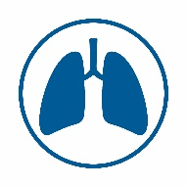
Key Aspects of Pilot Design
Provider and public recruitment strategies | Eligibility based on a risk prediction model⁵ | Navigation | Radiology quality assurance (QA) | Lung-RADSTM | Seamless transition to diagnostic assessment
RECRUITMENT
RISK
ASSESSMENT
SMOKING
CESSATION
RADIOLOGY
DIAGNOSIS
5. Tammemägi MC, Katki HA, Hocking WG, Church TR, Caporaso N, Kvale PA, et al. Selection criteria for lung-cancer screening. New England Journal of Medicine. 2013 Feb 21;368(8):728-36.
Notes:
This is a high-level overview of the screening pathway that people will follow from the point of referral to potential diagnosis, staging and treatment for lung cancer.
Participants are recruited through primary care providers and public-facing messaging.
Tammemägi risk prediction model - A modified version of the lung cancer risk prediction model developed by Tammemägi et al. (PLCOm2012) that estimates someone’s risk of developing lung cancer in the next six years. This version of the model (also known as PLCOm2012noRace) does not include the race/ethnicity variable that is a component of the original PLCOm2012 model; removing this variable was found to have no meaningful impact on the model’s predictive performance.
Tammemägi risk score - the output of a risk calculator that is based on the Tammemägi risk prediction model. The risk score reflects someone’s risk (as a percentage) of developing lung cancer in the next six years.
An individual is eligible for screening if they have a 2% or greater risk of developing lung cancer in the next 6 years.
Smoking cessation services are embedded in the screening pathway
Lung-RADSTM scoring system is used for nodule management
Radiology quality assurance program and training for radiologists e.g., Continuing Professional Development Workshop or equivalent
Seamless transition for lung diagnostic assessment for investigation of suspicious findings
Navigation support throughout the screening pathway

Slide 15
Recruitment
RECRUITMENT
RISK
ASSESSMENT
SMOKING
CESSATION
RADIOLOGY
DIAGNOSIS

Slide 16
Recruitment Objectives
Objectives
  Recruit potentially eligible individuals through provider and community-based (e.g., culturally relevant print materials, local media) recruitment strategies
  Support equitable access to screening through recruitment activities targeted to the hard to reach eligible population (e.g., lower socioeconomic status; First Nations, Inuit, Métis and urban Indigenous)
Notes:
Considerations for recruitment:
Potential stigma and negative attitudes related to smoking cigarettes
First Nations, Inuit, Métis and urban Indigenous communities as well as people with lower socio-economic and education status, may have higher smoking rates^{1,2}
Potentially eligible people are not easily identified; smoking related data is not readily available
Some people may not have a primary care provider
Implications to recruitment strategy:
Primary care providers play a crucial role in identifying people who may benefit from screening
Cannot rely on correspondence programs or solely on primary care providers to recruit people; must include a community-based strategy
Smokers are typically at a lower SES and education levels
Individuals may have lower socio-economic and education status, and some may not have a primary care provider
Interviews with current smokers identified themes that may contribute to reduced participation including fatalism, fear of diagnosis/treatment, pessimism about survival and stigma that lung cancer was a self-inflicted disease
Speaking Note Sources:
Cancer Care Ontario. Aboriginal Cancer Strategy III 2015-2019 [Internet]. Toronto (ON): Cancer Care Ontario; 2015. Retrieved from: https://www.cancercareontario.ca/sites/ccocancercare/files/assets/CCOAboriginalStrategy3.pdf
Cancer Care Ontario. Cancer Risk Factors in Ontario: Tobacco. Toronto, Canada, 2014. Retrieved from http://www.cancercare.on.ca/tobaccoreport

Slide 17
Development of Recruitment Strategies
The following recruitment strategies were informed by a rapid literature review⁶
Active Recruitment | Multi-Component Strategies | Personalized Strategies
Developed an overarching provincial recruitment strategy with tailored regional/local outreach | Included both primary care provider and public/community-led strategies Used segmented target populations based on market research to recommend recruitment modalities | Created Continuing Professional Development (CPD) course delivered in person to primary care physicians Facilitated multiple meetings with primary care practices and First Nations, Inuit and Métis providers groups
6. Peirson L, et al. 2016, March 30. Recruiting hard-to-reach groups for high risk lung cancer screening: A rapid review. Unpublished internal document, Cancer Care Ontario
Notes:
Purpose of Literature Review: identify and synthesize available and relevant evidence about strategies to reach, inform and motivate hard-to-reach individuals/groups to attend cancer screening (Lung, Breast, Cervical, and Colorectal).
Studies Included: A total of 34 primary studies were included, which were conducted in USA (32), Australia (1) and England (1). In terms of study details, 24 (71%) studies were RCTs, eight (24%) used quasi-experimental designs (six used non-randomized groups; two used pre-post designs) and two (6%) studies used observational designs.
Findings:
Support Active Recruitment:
There was no single formula for an effective recruitment strategy; it is unclear which specific intervention elements or combinations had the most impact on screening uptake.
In most cases, using some type of intervention to recruit people for screening resulted in significantly more people getting screened than following usual practice or not using a recruitment strategy.
As a result, we developed an overarching provincial strategy used by all sites with tailored regional/local outreach
2. Use Multi-Component Strategies:
Almost all of the recruitment interventions relied on multi-component strategies. Many strategies used professional or lay navigators, individual education, cultural tailoring, printed materials, telephone communication, and addressed structural barriers.
As a result, we Included both primary care provider and public/community led strategies
Segmented target populations using market research to recommend recruitment modalities
3. Include Personalized Strategies
When compared with each other, active and personalized strategies were usually more likely to lead to screening uptake than less intensive or impersonal approaches.
As a result, we created CPDs that were delivered in person to providers by regional primary care and aboriginal cancer care leaders
Facilitated multiple meetings with PCP practices and FNIM providers groups to build trust and engage providers
The site specific strategies are outlined below:
The Ottawa Hospital – Tertiary and academic hospital, major urban centre, with a satellite community hospital
Using media led to high recruitment, but lower eligibility rates
Provider-led recruitment was more successful at reaching target populations and eligible participants
Health Sciences North – Academic hospital, city and rural region
Primary care providers identified and referred most potential participants
Word of mouth was the most commonly reported recruitment method among self-presenters
Lakeridge Health – Community hospital, city and rural region
Provider-led strategies were somewhat less successful
Community-led strategies (e.g., road shows, newspaper) led to increased recruitment rates
*These are based on the results of the interim evaluation
Cornwall and UHN are not accounted for
Example of supporting targeted recruitment:
The Lung Cancer Screening for People at High Risk Continuing Professional Development Course for primary care physicians includes information (e.g., statistics, case study) about First Nations, Inuit and Métis people to support recruitment from these target populations.
Slide Content Source:
6. Peirson L, et al. 2016, March 30. Recruiting hard-to-reach groups for high risk lung cancer screening: A rapid review. Unpublished internal document, Cancer Care Ontario

Slide 18

Recruitment Resources
Recruitment materials include:
Recruitment Tool for Primary Care Providers (one page pilot design summary)
CPD course for primary care physicians
Brochures (available in English, French, Ojibway, Mohawk and Inuktitut)
Frequently Asked Questions for Healthcare Providers (available on public webpage)
Notes:
Public advisors informed development of materials
Translators from First Nations, Inuit and Métis communities developed culturally and linguistically appropriate materials
Brochures: Available in English, French, Ojibway, Mohawk and Inuktitut

Slide 19




Target Population for Recruitment
Smoking History
Exclusion Criteria:
Have been diagnosed with lung cancer;
Are under surveillance for lung nodules;
Have experienced hemoptysis of unknown cause or unexplained weight loss of more than five kilograms in the past year; or
Are currently undergoing diagnostic assessment, treatment or surveillance for life-threatening conditions (such as a cancer with a poor prognosis) as assessed by the referring physician
Smoked cigarettes daily for at least 20 years (not necessarily 20 years in a row)
Referral Criteria
Age
Between ages 55 and 74 years
0-54
55-74
75+
Notes:
People should be referred to the Lung Cancer Screening Pilot for People at High Risk if they meet the REFERRAL CRITERIA:
Are current or former smokers ages 55 to 74, and
Have smoked daily for a total of at least 20 years within their lifetime (not necessarily 20 years in a row). Note that this is not 20 pack-years (pack-years incorporates duration AND intensity)
While more restrictive referral criteria would increase the proportion of referred people who are eligible, the criterion of 20 years of daily smoking has been selected to help ensure that people who meet the eligibility criteria are not excluded before undergoing risk assessment (i.e., to maintain the sensitivity of the risk prediction model). It is possible, but very unlikely, that someone who smoked fewer than 20 years would be eligible for screening.
People should not be referred to the Lung Cancer Screening Pilot for People at High Risk if they:
• Have been diagnosed with lung cancer;
• Are under surveillance for lung nodules;
• Have experienced hemoptysis of unknown cause or unexplained weight loss of more than five kilograms in the past year; or
• Are currently undergoing diagnostic assessment, treatment or surveillance for life-threatening conditions (such as a cancer with a poor prognosis) as assessed by the referring physician.
Determining eligibility for the Lung Cancer Screening Pilot for People at High Risk (the pilot) is a two-step process. Only people who meet the criteria in steps 1 and 2 will be eligible to get screened for lung cancer through the pilot.
In step 1, physicians refer current and former smokers ages 55 to 74 who have smoked cigarettes daily for at least 20 years (not necessarily 20 years in a row, which means there could be times when they did not smoke) to a pilot site. People can also self-present (contact the pilot site on their own) to a pilot site to have their age and smoking history criteria assessed.
In step 2, a pilot site screening navigator conducts a risk assessment with anyone who meets the smoking history and age criteria in step 1. The results of the risk assessment in step 2 determine whether someone is eligible to get screened for lung cancer through the pilot.
When physicians refer their patients to a pilot site for a risk assessment in step 1, they must complete the pilot referral form to authorize the use of low-dose computed tomography in case their patient is found to be eligible for the pilot in step 2. People who self-present to a pilot site and are found to be eligible in step 2 will still need a referral from a physician to participate in lung cancer screening in the pilot. The referral form can be found on the pilot site website.

Slide 20
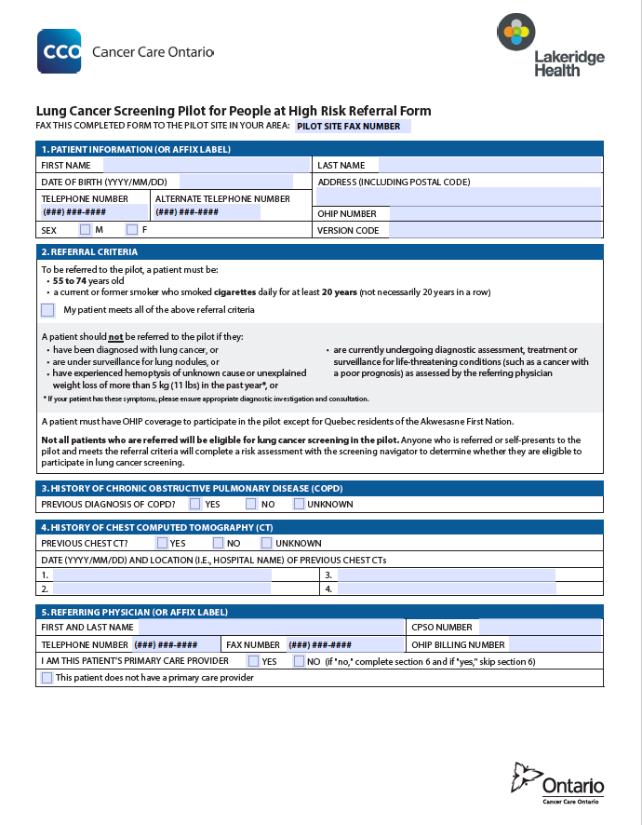
Referral Form
A physician authorizes:
Use of LDCT for baseline screening, ongoing routine annual screening and/or follow-up of lung nodules according to pilot policies
Booking of LDCT scans
Referral for diagnostic assessment, as recommended by the reporting radiologist
³
SAMPLE
Notes:
A physician authorizes the following activities through the HR LCSP Referral Form before screening begins:
Use of low-dose computed tomography (LDCT) for baseline screening, ongoing routine annual screening and/or follow-up of lung nodules, as recommended by the pilot
Referral for diagnostic assessment, as recommended by the reporting radiologist
Booking of LDCT scans

Slide 21
Risk Assessment
RECRUITMENT
RISK
ASSESSMENT
SMOKING
CESSATION
RADIOLOGY
DIAGNOSIS

Slide 22
Eligibility for Screening
Risk assessment is conducted over the phone by a screening navigator to determine eligibility
Tammemägi lung cancer risk prediction model⁵, which is different from the eligibility criteria used in the NLST
  People with ≥ 2% risk of developing lung cancer over the next 6 years are eligible for screening
For eligible people, an informed participation conversation with a screening navigator is completed over the phone
5. Tammemägi MC, Katki HA, Hocking WG, Church TR, Caporaso N, Kvale PA, et al. Selection criteria for lung-cancer screening. New England Journal of Medicine. 2013 Feb 21;368(8):728-36.
Notes:
Questions Asked During the Telephone Risk Assessment:
What is your date of birth?
Do you still smoke?
If NO:
Have you smoked a cigarette in the past 30 days?
How far did you go in school?
What is your weight now? (your best guess)
How tall are you now? (your best guess)
Have you ever been told by a doctor that you have emphysema, chronic bronchitis or COPD (chronic obstructive pulmonary disease)?
Have you ever been told by a doctor that you have cancer?
Has your mother, father, brother, sister or child ever had lung cancer?
When you smoked, how many cigarettes did you usually smoke per day? (your best guess)
At what age did you start to smoke? (your best guess)
How many years ago did you quit smoking cigarettes? (For former smokers only)
Did you ever stop smoking (before you quit)?
If YES:
How many times did you stop? (your best guess)
About how long did you stop each time? Please start with the longest time you stopped.
Lung cancer risk increases with:
Increasing age
Current smoker status (vs. former smoker status)
Increasing smoking intensity (average number of cigarettes smoked per day over all the years the person smoked)
Increasing smoking duration
History of COPD (vs. no history of COPD)
Personal history of cancer (vs. no personal history of cancer)
Family history of lung cancer (vs. no family history of lung cancer)
Lung cancer risk decreases with:
Increasing level of education
Increasing quit time (for former smokers)
Increasing body mass index
By having the screening navigator conduct the risk assessment, rather than the primary care physician, the questions can be asked in a more standard way, brief smoking cessation advice can be embedded in the conversation with current smokers, and the navigator can be trained to address complex questions. The two referral criteria (age and smoking history) are relatively easy for a primary care physician to assess, compared to the risk assessment questions, and should facilitate referring people to the pilot.
The Tammemägi lung cancer risk prediction model is more efficient in selecting people who may benefit from screening.
Slide Content Source:
5. Tammemägi MC, Katki HA, Hocking WG, Church TR, Caporaso N, Kvale PA, et al. Selection criteria for lung-cancer screening. New England Journal of Medicine. 2013 Feb 21;368(8):728-36.

Slide 23
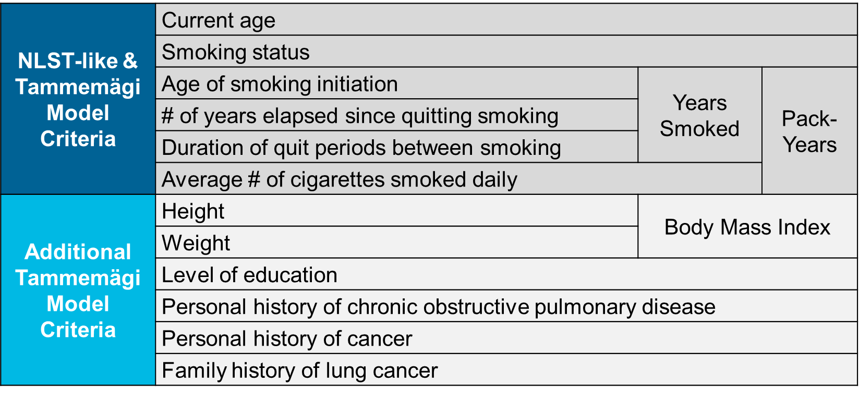
Data Required to Determine Eligibility
Notes:
When you look at the information that is needed to assess eligibility using the NLST-like criteria one needs to know the age, smoking status, age of smoking initiation, # of years since quitting, duration of in between periods and # of cigarettes smoked per day. The number of cigarettes smoked per day is the hardest to estimate, especially for people who have smoked for many years.
The additional elements required to be collected for the Tammemägi model such as height, weight, level of education, personal history of chronic obstructive pulmonary disease or cancer and family history of lung cancer are easy to collect.

Slide 24
Risk Assessment and Referral are Key Steps Toward Screening Participation
Physician Referral
Physician completes referral form based on referral criteria and sends to pilot site. Screening clerk confirms the referred person meets the age criterion.
Screening navigator conducts risk assessment to determine eligibility for screening.
Participant is screened with LDCT.
Pilot site books 15 minute phone appointment.
Person is eligible and chooses to participate.
Self-Presenting
Pilot site books 15 minute phone appointment.
Person is eligible and chooses to participate.
Person self-presents to the pilot site (without referral). Screening clerk confirms they meet the age and smoking history criteria.
Screening navigator conducts risk assessment to determine eligibility for screening.
Pilot site will contact the person’s primary care provider for a mandatory referral form* before they get screened with LDCT.
*The pilot site will attach eligible people without a primary care provider to a primary care physician.
Notes:
Slide Objective: to show the differences between the two ways that people can enter the Lung Cancer Screening Pilot for People at High Risk
Note for presenter: for potential participants who are physician referred, only the age criteria is confirmed by the screening clerk because age is easy to assess and the person may no longer meet the criteria if it has been some time since they were referred (e.g. 74 turned 75); smoking history would have already been assessed by the physician.
If a potential participant self presents and is found eligible to participate, the pilot site will work with them to get a referral form from their primary care provider. If the self-presenting potential participant does not have a primary care provider, the pilot site will attach them with a primary care physician.
Screening can only occur with a referral form from a physician.

Slide 25
Smoking Cessation
RECRUITMENT
RISK
ASSESSMENT
SMOKING
CESSATION
RADIOLOGY
DIAGNOSIS

Slide 26
Smoking Cessation Support
Smoking cessation services are offered to all current smokers who interact with the pilot:
Eligible individuals who accepted screening are automatically scheduled for smoking cessation counselling (minimum 10 minutes) with a trained counsellor at the pilot site, using an opt-out model
Eligible people who decline screening are offered a choice of hospital-based counselling or referral to Telehealth Ontario (free counselling service)
Eligible people who decline smoking cessation services can continue to participate in screening
Ineligible people are offered a referral to Telehealth Ontario
Notes:
*People will not be asked directly about forms of tobacco other than cigarettes in the pilot
Quitting smoking is the best way that someone can reduce their risk of lung cancer. Based on findings from the Pan-Canadian Early Detection of Lung Cancer Study, it was estimated that about 60% of the people eligible to participate in the pilot would be current daily smokers.
Any interaction with the pilot presents a “teachable moment” for smoking cessation, and is an opportunity that should be taken advantage of. While screening with low-dose computed tomography (LDCT) has demonstrated a significant reduction in lung cancer mortality, the delivery of smoking cessation interventions along with this screening has the potential to reduce mortality even further, from all tobacco-related causes.
An opt-out approach is included in the screening pathway. This approach involves providing all current smokers seeking lung cancer screening with access to a smoking cessation service, regardless of their motivation to quit.
Current smokers who choose to participate in screening will automatically be booked for an appointment (minimum 10 minutes) with a hospital-based smoking cessation counsellor for the same visit as their baseline LDCT scan.
Provides behavioural counselling
Recommends or prescribes pharmacotherapy, if appropriate
Arranges for proactive follow-up supportive contact
The smoking cessation counsellor will recommend a first-line smoking cessation pharmacotherapy (nicotine replacement therapy, varenicline or bupropion), and either provide a prescription or a recommendation on how to get a prescription (e.g., through someone’s primary care provider or pharmacist).
People eligible for screening may decline the smoking cessation services offered, which does not affect their ability to participate in the pilot.
People eligible for screening who choose not to participate in screening are offered the choice of an appointment with a hospital-based smoking cessation counsellor or a fax referral to Telehealth Ontario 1-866-797-0000
Following an opt-out approach, people may decline the smoking cessation service offered. Someone’s refusal to participate in smoking cessation will not affect their participation in other aspects of the pilot.
People can also contact the following services directly for support:
Telehealth Ontario: 1-866-797-0000
Smokers’ Helpline: SmokersHelpline.ca
Speaking Note Source:
Tammemägi MC, Schmidt H, Martel S, McWilliams A, Goffin JR, Johnston MR, et al. Participant selection for lung cancer screening by risk modelling (the Pan-Canadian Early Detection of Lung Cancer [PanCan] study): a single-arm, prospective study. Lancet. 2017 Nov;18:1523–1531.

Slide 27
Radiology
RECRUITMENT
RISK
ASSESSMENT
SMOKING
CESSATION
RADIOLOGY
DIAGNOSIS

Slide 28
LDCT Scan Process
Informed Participation Conversation (In-person)
LDCT Scan
Results Communication
LDCT uses much less radiation than a diagnostic CT and does not require contrast
Results and next steps are communicated to the participant over the phone by the screening navigator within two weeks of scan date
Lung-RADS™ scoring system is used for nodule management
At the first screening visit, a participant information sheet is used to facilitate a conversation about:
Each LDCT scan is reported using a highly structured, standardized reporting template
The person’s lung cancer risk
The LDCT scan
Possible results and next steps
Benefits and risks of screening
Smoking cessation
Next steps are based on the participant’s Lung-RADSTM score
Notes:
The Participant Experience (PE) surveys evaluate participant experience during risk triage, risk assessment, and screening using items relevant to the dimensions of Patient Experience outlined below:
Patients' Preferences
Emotional Support
Information & Education
Continuity and Transition
Coordination of Care
Access to Care
*Dimensions that are not relevant are: physical comfort; and family and friends
Paper based surveys have been translated into French, Ojibway, Mohawk and Inuktitut
The Risk Triage and Assessment Experience Survey (5 item) is administered to participants over the phone following the Risk Assessment call or after booking an LDCT appointment for eligible individuals who are unattached
The Baseline Participant Experience Survey (11 item) is a paper-based survey administered to individuals following their baseline LDCT scan
The Follow-up Participant Experience Survey (8 item) is a paper-based survey administered to individuals following their 3, 6 or 12 month follow-up LDCT scan

Slide 29
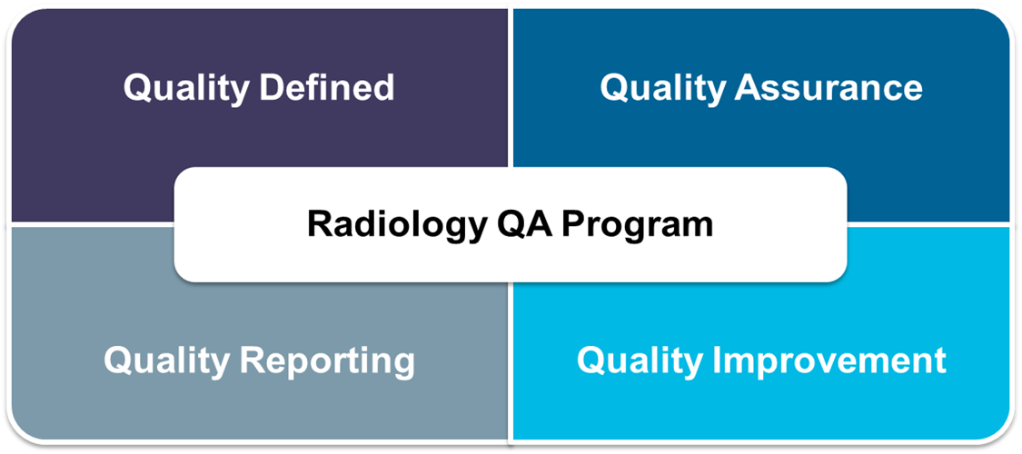
Radiology QA Program
Objective: Promote safe and appropriate use of LDCT by ensuring that LDCT scans are conducted, interpreted and reported in a high quality manner across pilot sites
Notes:
The Radiology QA Program for HR LCSP will support the definition, implementation and adoption of requirements to ensure LDCT is performed and interpreted according to quality standards across pilot sites by establishing quality standards, processes, and clear accountability required to ensure that quality is achieved.
Two basic categories: Equipment and personnel
An expert panel was convened by Cancer Care Ontario to develop the Radiology QA Program for the HR LCSP through a Call for Participation in 2016. The panel selected represented a cross-section of experts in diagnostic imaging and included radiologists, MRTs, diagnostic imaging administrators, and medical physicists with demonstrated commitment to quality assurance, patient-focused care, and public accountability. The panel was co-chaired by two radiologists. Cancer Care Ontario staff provided secretariat support.
The Radiology QA Expert Panel was mandated to develop an evidence-based radiology quality assurance program for LDCT lung cancer screening. Panel activities included review of evidence and relevant jurisdictional, professional association or government agency guidance to inform requirement recommendations for LDCT lung cancer screening.
Standards were abstracted from all included publications for each category of personnel, equipment and facility.
The findings of the literature search were presented to the Radiology QA Expert Panel monthly. Among the sources which contributed to the evidence base include:
The American College of Radiology
The College of Physicians and Surgeons of Ontario
The Canadian Association of Radiologists
Health Quality Ontario
The expert panel reviewed the evidence, discussed, and established a set of radiology quality requirements for LDCT lung cancer screening as well as processes to ensure quality is achieved.
Components of the Radiology QA Program for HR LCSP
Quality defined
Defining quality involves establishing the requirements to provide a foundation for quality assurance processes. Requirements are minimum acceptable levels of quality based on best available evidence.
Quality assurance
Quality assurance processes establish clear accountability to ensure that quality is achieved. These processes provide a consistent way to assess quality and monitor adherence to requirements across facilities.
Quality reporting
A key component of the Radiology QA Program for HR LCSP is to provide pilot sites with ongoing progress reports to support quality and quality improvement opportunities at the pilot site level.
Quality improvement
The Radiology QA Program for HR LCSP will support and foster a culture of continuous quality improvement for pilot sites that do not meet radiology quality assurance requirements. To support the implementation of requirements across the pilot sites, a program governance model and a issues management process has been developed
Radiology QA Requirements:
Evidence Review
Rapid review
Jurisdictional scan of existing quality standards for personnel, equipment, and facilities for LDCT lung cancer screening
Ongoing review by the Radiology QA team occurs
Expert Panel Review & Consensus
Multidisciplinary Expert Panel provides guidance and endorsement
Radiology QA Requirements
23 mandatory requirements and 2 recommendations
Outlined in Radiology Quality Assurance Manual
Assessment Tools
Tools to monitor adherence to requirements:
Initial assessment
Annual assessment
Indicator reporting
Completeness Audit
Radiology Quality Assurance Summary:
Radiology QA Program - Establishes standards, processes, and accountability for high quality LDCT lung cancer screening
Radiologist CPD Workshops - Provides radiologists the tools and education to read and report LDCT lung cancer screening scans – standardizing image interpretation and reporting
LDCT Lung Cancer Screening Technical Protocol - Has been adapted from American Association of Physicists in Medicine – ensures dose is minimized while maintain image quality. All sites will follow the same protocol
LDCT Lung Cancer Screening Reporting Template - Is mandatory to use when reporting for the pilot program; supports complete and consistent reporting for all scans and is implemented in all pilot site Voice Recognition systems
Standardized Follow-up of Nodules - Lung-RADS™ standardizes the follow-up of nodules
Continual Quality Assurance - Peer review, double reads, complex case webinars
A lot of work has been put in ensuring the radiology components are of high quality and standardized.

Slide 30
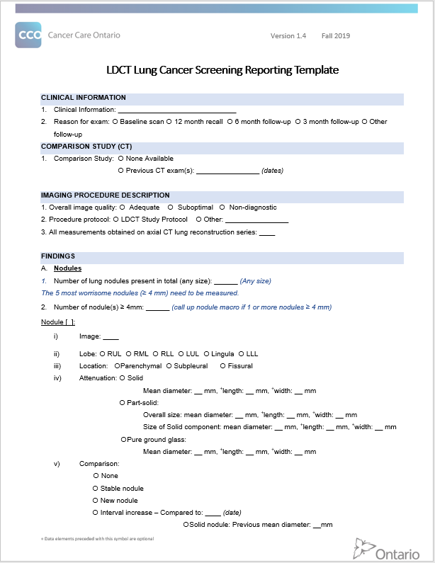
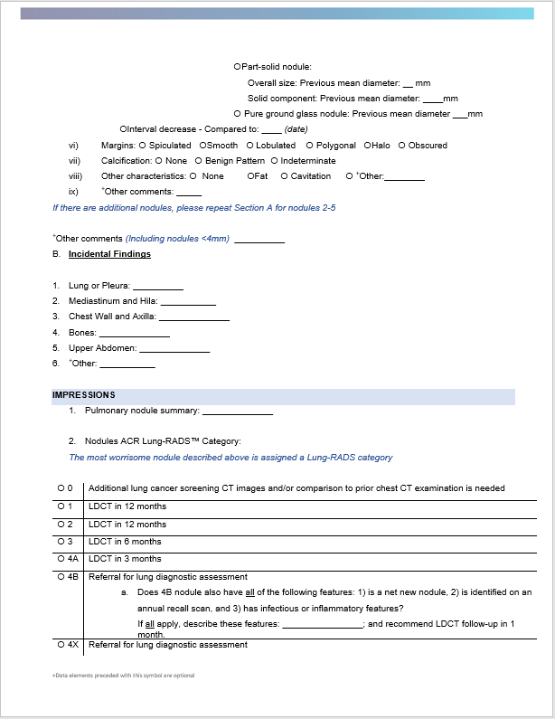
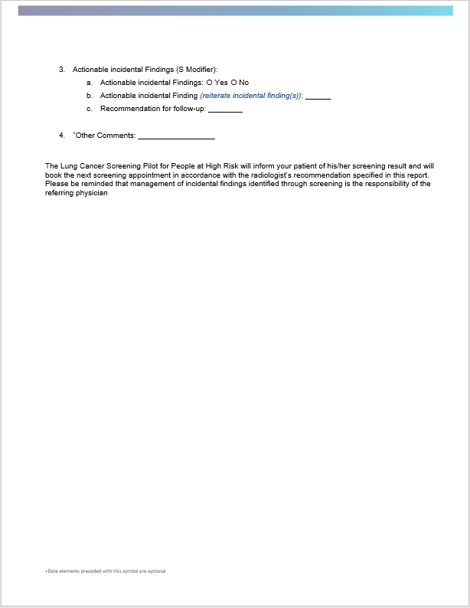
LDCT Lung Screening Reporting Template
Notes:
Highly-structured reporting template ensures consistent and complete reporting of all screening scans, supporting standardized approach for participant management and reporting of all findings, including incidental findings.
Template was developed by a CCO-supported multidisciplinary working group, including radiologists, treating physicians (e.g., surgeons, radiation oncologists), pathology, primary care, epidemiology. Was informed by available evidence and existing high-quality templates.
Content of template supports use of the Lung-RADs categorization system for nodules, as described in subsequent slides. (ie – by using the template, radiologists are reporting on all components that ultimately contribute to the score, which is also reported in the Impressions section of the report)

Slide 31

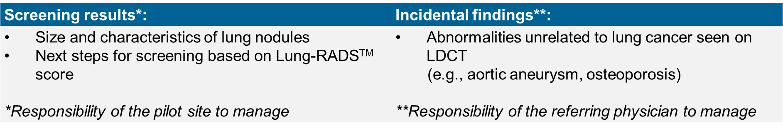
LDCT Results: Lung-RADSTM (Version 1.1)
American College of Radiology’s Lung-RADS™ is a quality assurance tool designed to:
  Standardize screening CT reporting and management recommendations
  Reduce confusion in screening CT interpretations
  Facilitate outcome monitoring
Standardized lung cancer screening radiology report includes:
Notes:
Using the reporting template allows radiologists to easily utilize a standardized scoring criteria adapted from the American College of Radiology called Lung-RADS™.
Radiologists will describe lung nodules using Lung-RADS™ and provide relevant complete clinical information in the standard reporting template, ensuring that clinicians have the appropriate information for follow up investigations as needed.

Slide 32
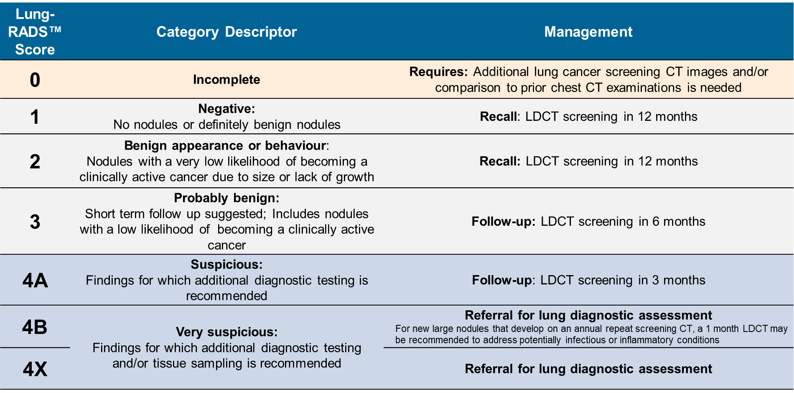
LDCT Results: Lung-RADSTM (continued)
Notes:
Probability of Lung Nodule Malignancy for Each Lung-RADS™ Score:
1: <1%
2: <1%
3: 1-2%
4A: 5-15%
4B: >15%
4X: >15%
If incidental findings are reported on the radiology report (marked with “S” modifier), an additional reminder communication will be sent to the referring physician.

Slide 33
Diagnosis
RECRUITMENT
RISK
ASSESSMENT
SMOKING
CESSATION
RADIOLOGY
DIAGNOSIS

Slide 34
Diagnosis
Participants with a Lung-RADSTM score of 4B or 4X are referred for diagnostic assessment, per the reporting radiologist’s recommendation
The physician who conducts the lung diagnostic assessment may send the participant back to screening if the participant is clearly negative for lung cancer or if their lung nodules are indeterminate

Slide 35
Navigation
RECRUITMENT
RISK
ASSESSMENT
SMOKING
CESSATION
RADIOLOGY
DIAGNOSIS

Slide 36

Screening Navigators in the Pilot
Screening navigators play a pivotal role by facilitating the screening pathway process from initial referral to required follow-up, including:
  Risk assessments for screening eligibility
  Informed decision-making about participating in screening
  Smoking cessation support to current smokers
  Communication of screening results and next steps
  Facilitated recall and follow-up
  Seamless transition to diagnostic assessment
The screening navigator can have a significant impact on participant experience, especially through:
  Informed participation
  Results communication
Notes:
Navigators facilitate entire screening pathway process from initial referral, scanning, recall and all required follow-up to ensure support for all participants to maximize participant retention and avoid people falling through the cracks as they navigate through a complex health care system.
Risk assessments to determine eligibility for screening
Informed decision-making about participating in lung cancer screening
Smoking cessation support to all current smokers
Communication with referring providers and primary care physicians (if different) of screening results and next steps
Facilitated participant recall and follow-up that is similar to the Ontario Breast Screening Program
Seamless transition to diagnostic assessment for surveillance of scans with suspicious findings
The screening navigator can have a significant impact on participant experience, especially through their role in
Informed participation
Results communication
Informed Participation
Screening navigators provide a supportive environment for decision making and discussion of complex information with the participant
Facilitating informed participation in lung cancer screening includes:
Providing easy to understand information about LDCT lung cancer screening to help participants decide whether or not to get screened
Keeping participants informed and ensure they understand what is happening throughout the screening process
Informed participation discussions occur at a minimum of 2 points in the screening pathway
Risk Assessment
LDCT scan
Tools available: Navigator Scripts, Participant Information Sheet
The following three are guiding principles of informed decision making:
A potential participant:
should be presented with balanced and accurate information about the benefits, harms, limitations and alternatives to any procedures/screening tests
should actively participate in decision-making processes throughout the care pathway.
understands his or her personal values and preferences, and makes decisions consistent with these values and preferences.
Informed Participation: ensures participants are provided easy to understand information about LDCT to help them choose whether or not to get screened and understand what is happening through screening and follow-up
Takes into consideration that someone’s decision to participate in the ongoing screening process is based on adequate knowledge, a positive attitude towards the option chosen and actual participation
HR LCSP Informed Participation Policy: Informed participation in lung cancer screening must be facilitated, which includes providing information on a potential participant’s risk of developing lung cancer, the benefits, harms and limitations of lung cancer screening, and possible scan outcomes and next steps.
The informed participation conversation will occur at a minimum of two points in the screening pathway:
After completing the risk assessment on the phone,
At the first hospital visit, before the scan,
After considering the information, potential participants may choose not to participate in screening or they may wish to take more time to make a decision. If someone does not wish to continue at this point, there must be no attempts to influence their decision, either intentionally or unintentionally (e.g., through body language). The purpose of informed participation is to inform potential participants and not to persuade them.
Screening navigators may use some discretion in assessing how much information to give to a potential participant
General overview of benefits and harms of screening to help decide whether to book a screening appointment
Potential participant is notified that more information will be provided before the LDCT scan
Potential participant is informed of their eligibility, which is based on their risk score
Tools available: Scripts
Screening navigators may spend more time than anticipated to respond to questions
More comprehensive 1:1 discussion
Potential participant is offered the option of finding out their risk score
The risk score is explained (absolute vs. relative score)
Potential participant verbally confirms if they wish to continue with LDCT appointment
Tools available: Scripts and Participant Information Sheet
Results Communication
Screening navigators communicate lung cancer screening results to participants, referring physicians and primary care providers
Results Communication: Ensures participants have full knowledge of their results and a clear plan for their next appointment based on their specific screening results
Communicating lung cancer screening results:
Inform participants of LDCT scan results and next steps within 2 weeks of the LDCT scan
Notify referring physician and primary care provider (if different) of:
LDCT results via a standardized radiology report, including any actionable incidental findings
Unsuccessful efforts to communicate results with the participant
Tools available: Navigator Scripts, Participant Information Sheet
Lung cancer screening results will be communicated to screening participants by the screening navigator.
Only low-dose computed tomography (LDCT) findings pertaining to lung cancer screening results may be communicated by the pilot site’s screening navigator (i.e., the Lung-RADSTM scores).
The pilot site should not communicate anything about incidental findings to participants. Communicating results related to incidental findings is the responsibility of the referring physician, as outlined in the incidental findings policy.
When communicating results, the screening navigator will use the Participant Information Sheet to explain what the participant’s Lung-RADSTM score means and to inform them of the next step. The exact language from the “Results” section of the Participant Information Sheet (shown on the previous page) must be used. The screening navigator will have scripts to ensure appropriate messaging and to identify when to refer questions to a physician.
If a participant requests more information about their screening result, the screening navigator will tell them how to access the radiology report through existing hospital processes. The screening navigator will tell the participant up front that they will not be able to discuss the information in the radiology report. The navigator will advise the participant to speak with their physician if they have any questions about the report.
Screening results should be communicated to the participant within two weeks of their LDCT scan visit.
The navigator will let the participant know that they will receive their result within two weeks. The navigator may use discretion in determining whether an in-person visit is more appropriate for communicating the result.
The first attempt to communicate the result must occur within two weeks of the screening appointment.
If the result is provided over the phone, participants will be asked to refer to their Participant Information Sheet during the communication of their result.
The pilot site must notify a participant’s referring physician and primary care provider (if different) when efforts to contact them to communicate their screening result have been unsuccessful. The site must work with the referring physician and primary care provider to ensure that the result is communicated and next steps are arranged. The referring physician and primary care provider should be engaged as soon as the hospital’s processes for attempting to contact a participant have been completed and contact was unsuccessful.
The next screening LDCT appointment will be booked when the result is communicated.
This does not apply to participants referred for diagnostic assessment.
LDCT results will be communicated to the referring physician and primary care provider (if different) via the standardized radiology report.
Additional notes:
Nurse practitioners are not permitted to refer for CT; referring provider is a physician
Only one primary care provider is notified of results if they aren't the referring physician; could be a nurse practitioner or a physician
The pilot site must notify a participant’s referring physician and primary care provider (if different) when efforts to contact them to communicate their screening result have been unsuccessful.

Slide 37
Early Results

Slide 38
Interim Evaluation (June 1, 2017 – May 31, 2018)
RECRUITMENT
RISK
ASSESSMENT
SMOKING
CESSATION
RADIOLOGY
DIAGNOSIS
4,205 total referred
82% (n=3,496) physician referred
3,234 risk assessments completed
66.5% (n=2,151) eligible for screening
1,443 current smokers
92% (n=1,326) accepted smoking cessation services
1,624 baseline LDCT scans completed
Promising results of the pilot show cancer detection at earlier stages
CONFIDENTIAL – NOT FOR DISTRIBUTION
Notes:
The distribution of proportions of lung cancer stages in the pilot shows statistically significant differences when compared to historical proportions in Ontario (p<0.05), even after adjusting for over-diagnosis.

Slide 39





Early Results for Health Sciences North Pilot Site
(April 1, 2017 – March 31, 2019)
Recruitment
1575 people were
recruited to the Health Sciences North site
The majority of people recruited were physician referred
Of the people whose risk was assessed, most were eligible for LDCT
Risk Assessment
1469 risk assessments were completed
Results (Apr-Jun 2018) (continued)
994 participants had an initial LDCT scan
Median wait time in March 2019 from risk assessment to LDCT scan was 7 days
LDCT
CONFIDENTIAL – NOT FOR DISTRIBUTION
Data Range: APRIL 1, 2017 to MARCH 31, 2019
This content is based on the best available data as of: 2019-07-25
Notes:
Median wait time from pilot entry (physician-referred or self-presented) to risk assessment completion (to confirm eligibility to participate in the pilot) in March 2019: 1 day.
Median wait time from the screening navigator completing the risk assessment to LDCT completed in March 2019: 7 days.

Slide 40
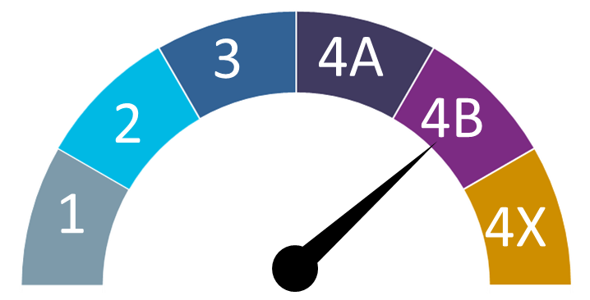

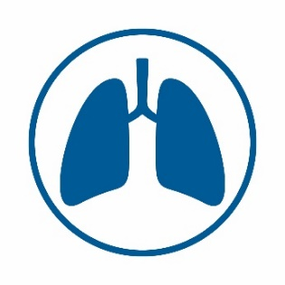
Early Results for Health Sciences North Pilot Site (continued)
(April 1, 2017 – March 31, 2019)
Less than 5% of screened participants had a Lung-RADS™ 4B or 4X result and were referred for diagnostic assessment for consultation with a thoracic surgeon
Lung-RADSTM
!
Incidental Findings
In March 2019, about 1 in 10 LDCT scans detected actionable incidental findings
CONFIDENTIAL – NOT FOR DISTRIBUTION
Data Range: APRIL 1, 2017 to MARCH 31, 2019
This content is based on the best available data as of: 2019-07-25

Slide 41
Next Steps

Slide 42
Next Steps
2017–2021
Interim evaluation
August 2019
Final evaluation
Spring 2021
2015–2017
2021/22–onwards
PLAN AND
LAUNCH PILOT
SUPPORT SCREENING, MONITOR AND EVALUATE
PLAN FOR PROVINCIAL PROGRAM AND EXPANSION
Notes:
The Lung Cancer Screening Pilot for People at High Risk (HR LCSP) is organized into three phases:
(April 2015 – March 2017): Planning for and selecting pilots and preparing for screening
(current phase) (April 2017 – March 2020): Supporting initiation of screening, monitoring and evaluation of pilots and development of recommendations for a provincial program
Pilot sites initiated screening in June 2017.
An interim evaluation was conducted after completion of 1 year of the pilot, using the first year of data.
A final evaluation will be conducted at the end of the pilot and the results will be finalized in Spring 2021. Evaluation findings will inform recommendations for the optimal design and implementation of a provincial lung cancer screening program for people at high risk in Ontario.
Learnings from the pilot will identify opportunities for improvement and will inform implementation of organized, programmatic lung cancer screening
Once the pilot ends, we anticipate continuing screening services at the existing pilot sites while planning for a provincial program
Critical success factor: Continued Ministry support to expand screening services and develop a provincial program

Slide 43
Q&A

