Slide 1
Stereotactic Radiation for Liver
Experience at H.S.N.
David Want MD,FRCP(C)

Slide 2
Overview
Multidisciplinary (Hepatobiliary) Tumor Board
Treatment selection
Outcomes

Slide 3
Liver
Metastases
Hepatocellular carcinoma
Intrahepatic cholangiocarcinoma

Slide 4
Multidisciplinary Approach
Hepatobiliary Surgeon
Interventional Radiologist
Radiation Oncologist
Medical Oncology
Radiology
Pathology

Slide 5
Alternatives
Transarterial Chemoembolization (TACE)
Radiofrequency Ablation (RFA)
S.A.B.R.

Slide 6
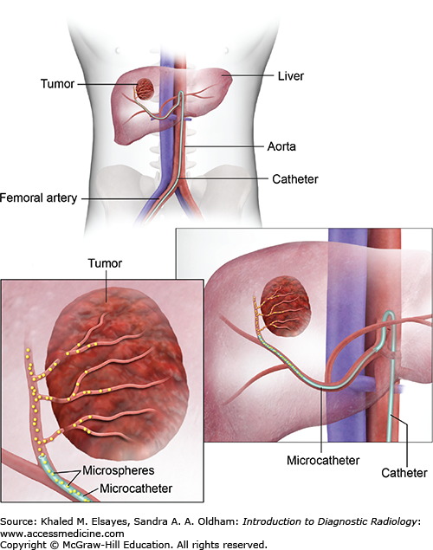
TACE

Slide 7
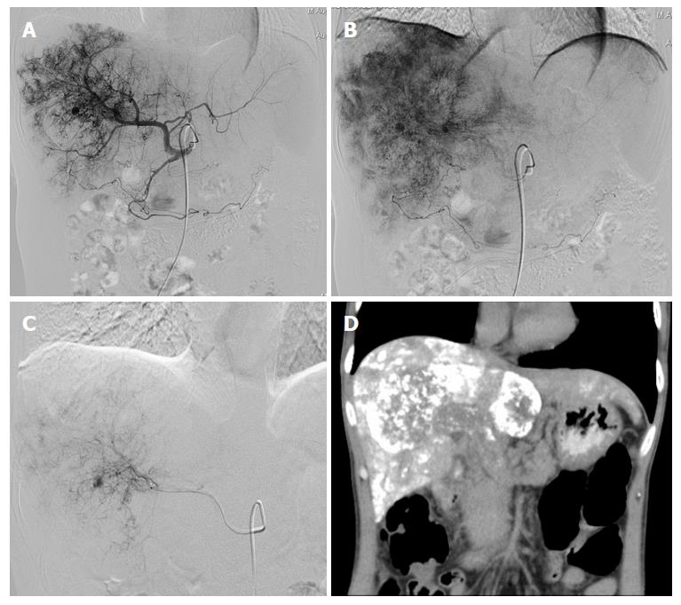
TACE

Slide 8
TACE
Lesion proximity to vessels
Able to treat larger lesions in some cases
Adriamycin

Slide 9
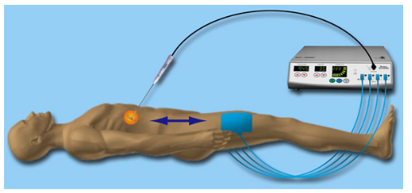
RFA

Slide 10
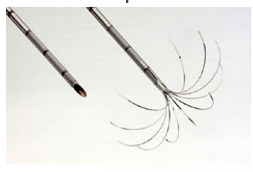
RFA

Slide 11
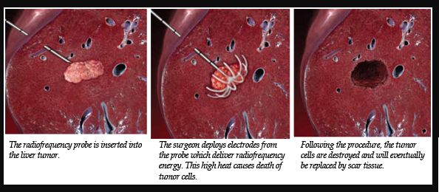
RFA

Slide 12
RFA
Lesion location and diaphragmatic motion factors.
Cirrhosis

Slide 13
Radiation
Non invasive
Immobilization and reproducibility issues
Dose (volume, normal tissues)

Slide 14
Reproducibility
Gastric preparation
Abdominal compression
Margins
Liver deformity (as well as motion)

Slide 15
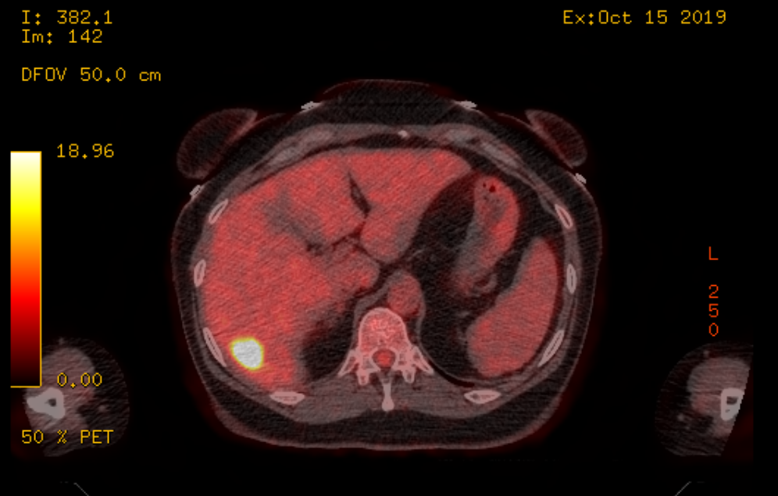
IGRT

Slide 16
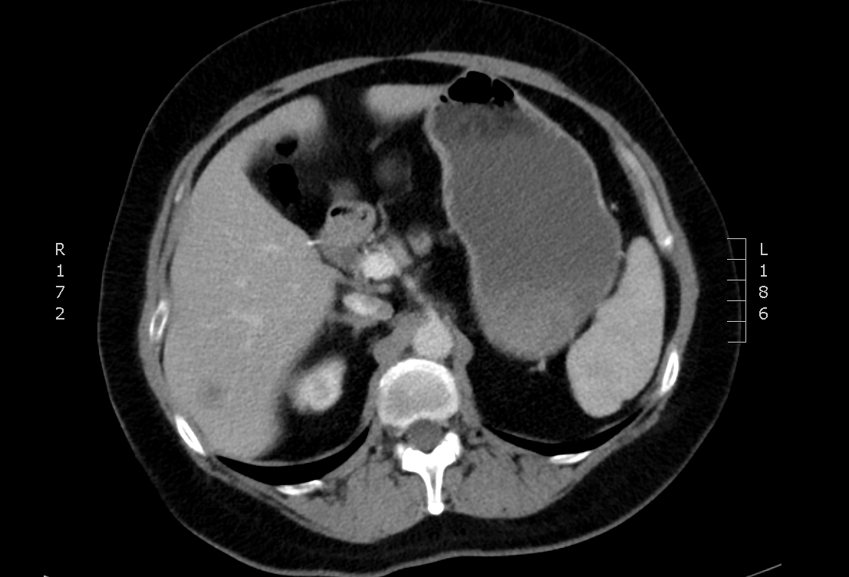
IGRT

Slide 17
Dose Considerations
Size, number of lesions
Location (normal organs)
Previous treatment
Volume (normal liver)
Child Pugh score

Slide 18
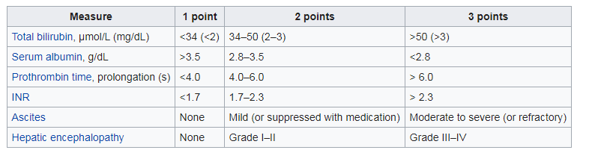
Child Pugh Score

Slide 19
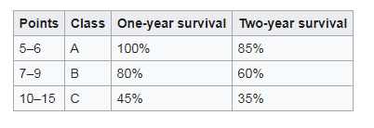
Child Pugh Score

Slide 20
First Case – Post TACE

Slide 22
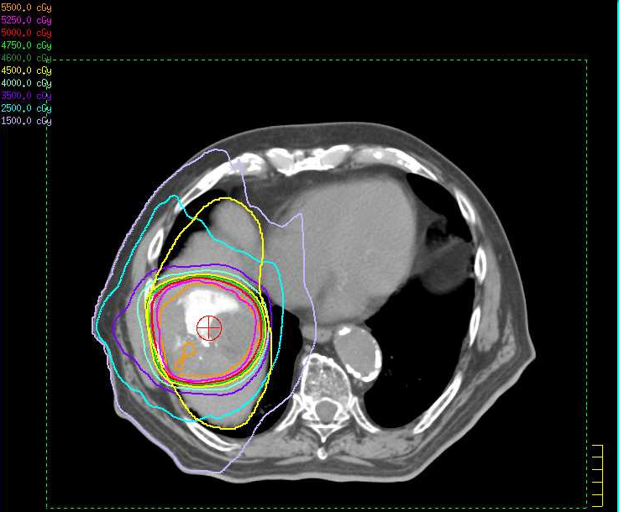

Slide 23
Outcomes
Local control
Survival

Slide 24
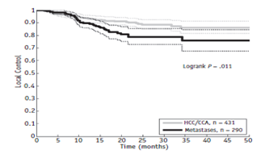

Slide 25
