Slide 1



X
Does Statistical Significance
Really Prove that
Power was Adequate?
Bruce Weaver
Northern Ontario School of Medicine
Northern Health Research Conference
June 4-6, 2015
Notes:
NOTE: Analyses for this talk were done with syntax file consequences of categorization v2.SPS.

Slide 2
OR…
Should I be concerned if I think
that the “intellectually challenged”
reviewer might have been right?

Slide 3
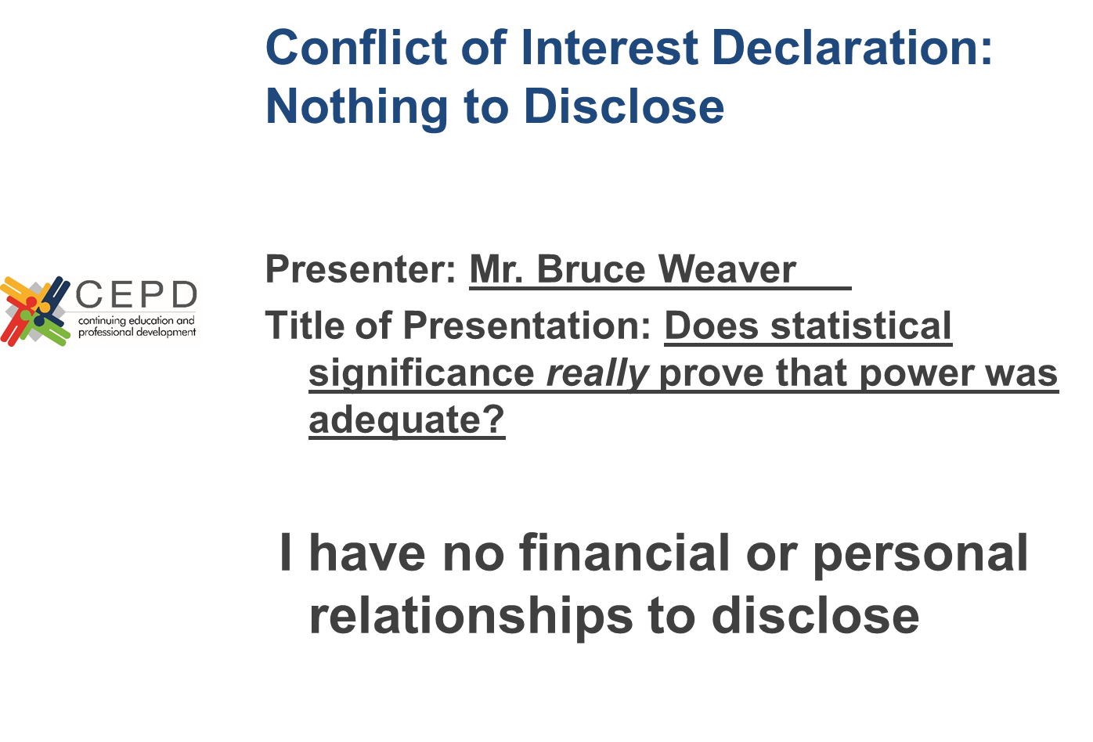

Slide 4

Speaker Acceptance & Disclosure
I have no affiliations, sponsorships, honoraria, monetary support or conflict of interest from any commercial sources.
However…it is only fair to caution you that this talk has not undergone ethical review of any sort.
Therefore, you listen at your own peril.

Slide 5
The Objective
To challenge the common misconception that if one obtains a statistically significant result, one must have had sufficient power.

Slide 6
What motivated this presentation?

Slide 7
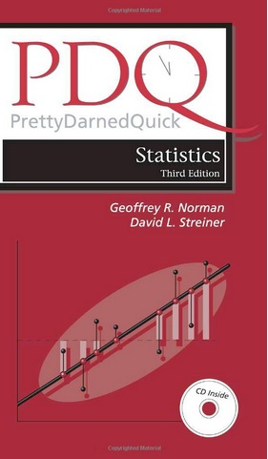
“Conversely, on one occasion, when we had reported a significant difference at the < 0.001 level with a sample size of approximately 15 per group, one intellectually challenged reviewer took us to task for conducting studies with such small samples, saying we didn’t have enough power.”
“Clearly, we did have enough power to detect a difference because we did detect it.”
(PDQ Statistics, 3rd Ed., p. 24)
Norman & Streiner (2003)

Slide 8
Q.
Does getting a statistically significant result prove that you had sufficient power?
A.
Norman & Streiner (2003) say YES.
The “intellectually challenged” reviewer (ICR) says NO.
I agree with the ICR!
I’ll now try to demonstrate WHY via simulation.

Slide 9
An Example Using the Risk Difference
Suppose the risk of some bad outcome is 10% in untreated (or treated as usual) patients
A new treatment is supposed to lower the risk
Suppose a 5% risk reduction would be clinically important (i.e., from 10% to 5% in the treated group)
I estimate the sample size needed to achieve power = 80% (with α = .05), and then conduct a clinical trial

Slide 10
Sample Size Estimate (from PASS)
Two Independent Proportions (Null Case) Power Analysis
Numeric Results of Tests Based on the Difference: P1 - P2
H₀: P1-P2=0. H₁: P1-P2=D1<>0.
Test Statistic: Z test with pooled variance
Power N1 N2 P1 P2 Alpha
0.8005 435 435 0.10 0.05 0.05
0.5015 214 214 0.10 0.05 0.05
0.2012 69 69 0.10 0.05 0.05
Equivalent to a Pearson Chi-Square test on the 2×2 table for this scenario

Slide 11
The Simulation
I generated 1000 pairs of random samples from two independent populations with these risks:
  Population 1: Risk = 10%
  Population 2: Risk = 5%
I set n₁ = n₂ = 435, the value needed to achieve 80% power
The Chi-square Test of Association was performed for each of the 1000 2×2 tables
If Power = 80%, then we should find that about 800 (80%) of the Chi-square tests are statistically significant (p ≤ .05)

Slide 12
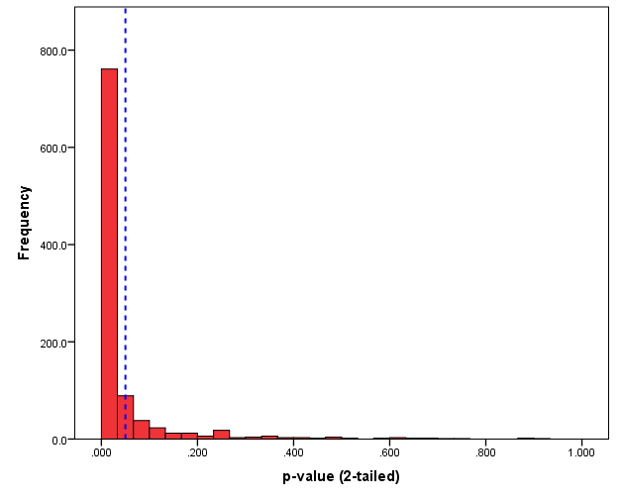
Distribution of the 1000 p-values
(given n₁ = n₂ = 435 and population risks of 10% & 5%)
Dashed line at p = .05
To the left, correctly reject H₀
To the right, Type II error
H₁ is true
We aimed for 80% power, but actually achieved 82%.
Some fairly high p-values here!
Notes:
As expected, Fisher’s Exact Test (aka., the Fisher-Irwin test) and Pearson’s Chi-square with Yates’ correction are both conservative.

Slide 13
Validation of the Simulation
Just to convince you (and myself) that the simulation is working, I repeated it twice more changing only the sample sizes:
  With n₁ = n₂ = 214, aiming for 50% power
  With n₁ = n₂ = 69, aiming for 20% power
If the simulation works, I should see approximately 50% and 20% of the Pearson Chi-square tests achieve statistical significance in these two new simulations

Slide 14
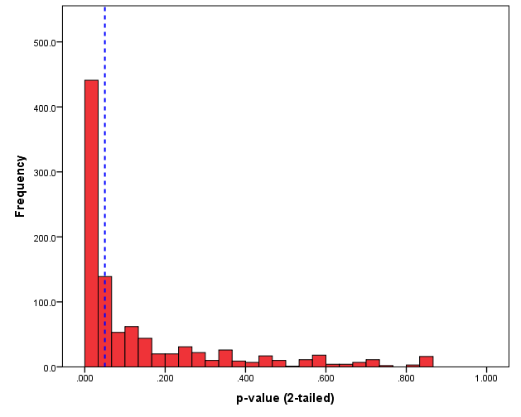
Distribution of the 1000 p-values
(given n₁ = n₂ = 214 and population risks of 10% & 5%)
Dashed line at p = .05
To the left, correctly reject H₀
To the right, Type II error
H₁ is true
We aimed for 50% power, and achieved 51%.

Slide 15
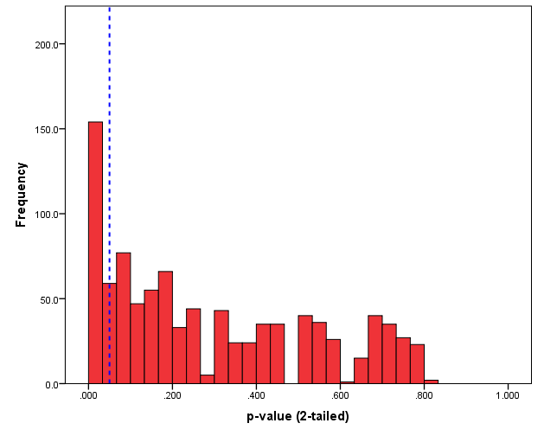

Distribution of the 1000 p-values
(given n₁ = n₂ = 69 and population risks of 10% & 5%)
Dashed line at p = .05
To the left, correctly reject H₀
To the right, Type II error
H₁ is true
We aimed for 20% power, and achieved 20%.

Slide 16
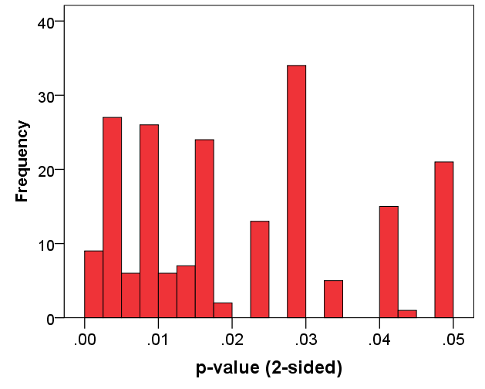

Distribution of p-values < .05
(given n₁ = n₂ = 69 and population risks of 10% & 5%)
Power = .20
H₁ is true
Fascinating.
Some of the p-values are very low, even with Power = .20!

Slide 17

Back to Norman & Streiner (2003)
“Clearly, we did have enough power to detect a difference because we did detect it.”
In the last simulation, we detected statistically significant risk differences in 20% of the tests.
Does this mean we had sufficient power for those 20% of the tests, but not for the other 80%?
NO—it certainly does not!
We always had n = 69 per group, so Power was .20 for every test.

Slide 18
A priori power vs. post hoc power (1)
IM(NS)HO, Norman & Streiner have confused a priori power and post hoc power (aka., retrospective power, observed power)
For example:
  “Power is an important concept when you’ve done an experiment and have failed to show a difference.” (PDQ Statistics, 3rd Ed., p. 24, emphasis added)
This statement reveals a post hoc frame of mind when it comes to power

Slide 19
A priori power vs. post hoc power (2)
Post hoc power, as it is usually computed, is little more than a transformation of the p-value:
  If p ≤ .05, post hoc power is sufficient
  If p > .05, post hoc power is not sufficient
Many authors have discussed the serious problems inherent in post hoc or retrospective power analysis
To find a couple of my favourites, do Google searches on:
  Russell Lenth 2badhabits
  Len Thomas Retrospective Power
Both are relatively short and very readable!

Slide 20

Another Fly in the Ointment
Notes:
Image source: http://kingsenglish.info/wp-content/uploads/2011/05/fly-in-the-ointment-226x300.jpg

Slide 21
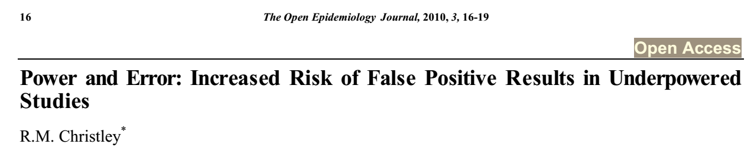

“It is well recognised that low statistical power increases the probability of type II error, that is it reduces the probability of detecting a difference between groups, where a difference exists.”
“Paradoxically, low statistical power also increases the likelihood that a statistically significant finding is actually falsely positive (for a given p-value).”
If this was a 20-minute talk, I would show some more simulation results that support that second point. But it’s a 10-minute talk, so you’ll just have to trust me.
Notes:
Image source: https://lewwaters.files.wordpress.com/2013/03/car-sales-1.jpg

Slide 22

SUMMARY
A p-value ≤ .05 does not prove that power was adequate.
  We saw many p-values ≤ .05 with Power = .20.
  Many of those p-values were very low (< .01, or < .001).
As power decreases, the proportion of significant results that are falsely positive increases.
Norman & Streiner’s emphasis on having “a significant difference at the < 0.001 level” is irrelevant.
The “intellectually challenged” reviewer was probably right!
I asked you to trust me on this point.

Slide 23


FINALLY…
Once upon a time, Geoff Norman gave me a job when I needed one, and he has always treated me very well
I correspond with David Streiner frequently, and he has been a great help to me on many occasions
None of the material presented here should be interpreted as a personal attack on either of these fine gentlemen!
I hope that I’ve said enough here to satisfy their lawyers.
Geoff Norman
☺
David Streiner

Slide 24



Okay…it’s over!
Time to wake up!
Any Questions?

Slide 25
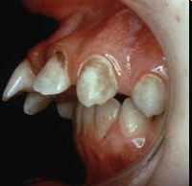

Questions?
I love that picture!
Severe Malocclusion

Slide 26

Contact Information
Bruce Weaver
Assistant Professor (and Statistical Curmudgeon)
NOSM, West Campus, MS-2006
E-mail: bweaver@lakeheadu.ca
Tel: 807-346-7704

Slide 27

The Cutting Room Floor

Slide 28
“It is well recognised that low statistical power increases the probability of type II error, that is it reduces the probability of detecting a difference between groups, where a difference exists.”
“Paradoxically, low statistical power also increases the likelihood that a statistically significant finding is actually falsely positive (for a given p-value).”
Notes:
Image source: https://lewwaters.files.wordpress.com/2013/03/car-sales-1.jpg

Slide 29
Distribution of the 1000 p-values
(given n₁ = n₂ = 435 and population risks of 10% & 5%)
H₁ is true
POWER = .820
820 p-values ≤ .05
180 p-values > .05

Slide 30
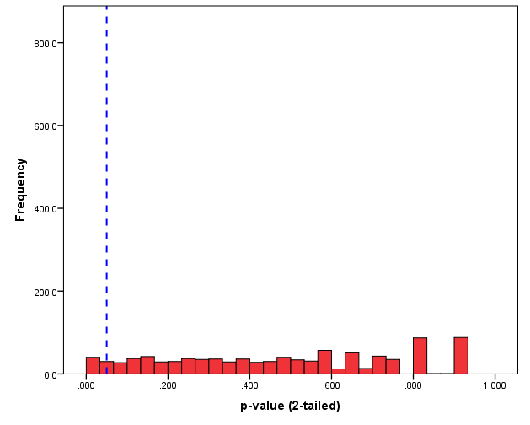
Distribution of the 1000 p-values
(given n₁ = n₂ = 435 and population risks of 10% & 10%)
H₀ is true
Alpha = .056
56 p-values ≤ .05
944 p-values > .05

Slide 31
(a)
(b)
(c)
(d)
Alpha = 56 ÷ 1000 = .056
Beta = 180 ÷ 1000 = .180
Power = 820 ÷ 1000 = .820
% of rejections that are FALSE = 56 ÷ 876 = 6.4%

Slide 32
Distribution of the 1000 p-values
(given n₁ = n₂ = 214 and population risks of 10% & 5%)
H₁ is true
POWER = .507
507 p-values ≤ .05
493 p-values > .05

Slide 33
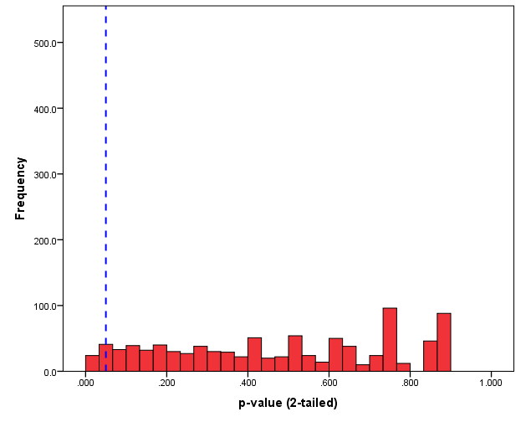
Distribution of the 1000 p-values
(given n₁ = n₂ = 214 and population risks of 10% & 10%)
H₀ is true
Alpha = .049
49 p-values ≤ .05
951 p-values > .05

Slide 34
(a)
(b)
(c)
(d)
Alpha = 49 ÷ 1000 = .049
Beta = 493 ÷ 1000 = .493
Power = 507 ÷ 1000 = .507
% of rejections that are FALSE = 49 ÷ 556 = 8.8%

Slide 35
Distribution of the 1000 p-values
(given n₁ = n₂ = 69 and population risks of 10% & 5%)
POWER = .196
H₁ is true
196 p-values ≤ .05
804 p-values > .05

Slide 36
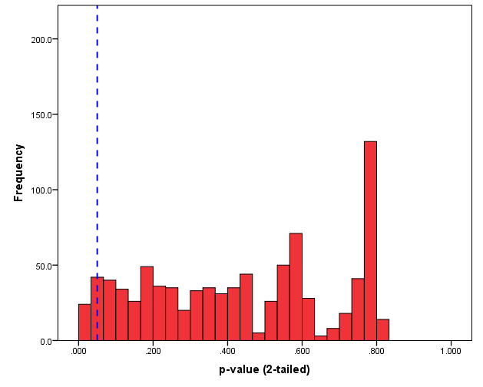
Distribution of the 1000 p-values
(given n₁ = n₂ = 69 and population risks of 10% & 10%)
Alpha = .046
H₀ is true
954 p-values > .05
46 p-values ≤ .05

Slide 37
(a)
(b)
(c)
(d)
Alpha = 46 ÷ 1000 = .046
Beta = 804 ÷ 1000 = .804
Power = 196 ÷ 1000 = .196
% of rejections that are FALSE = 46 ÷ 242 = 19.0%

Slide 38
As Christley (2010) noted, the lower the power, the higher the percentage of significant test results that are false positives.

Slide 39
Why do we set α = .05?
Because of an arbitrary choice by Sir Ronald Fisher!
... it is convenient to draw the line at about the level at which we can say: "Either there is something in the treatment, or a coincidence has occurred such as does not occur more than once in twenty trials."...
If one in twenty does not seem high enough odds, we may, if we prefer it, draw the line at one in fifty (the 2 per cent point), or one in a hundred (the 1 per cent point). Personally, the writer prefers to set a low standard of significance at the 5 per cent point, and ignore entirely all results which fail to reach this level. A scientific fact should be regarded as experimentally established only if a properly designed experiment rarely fails to give this level of significance.
Source: Fisher (1926, p. 504)
Notes:
Fisher RA (1926). The Arrangement of Field Experiments. Journal of the Ministry of Agriculture of Great Britain, 33, 503-513.
http://www.jerrydallal.com/lhsp/p05.htm
Notice that Fisher implied that replication was necessary—”A scientific fact should be regarded as experimentally established only if a properly designed experiment rarely fails to give this level of significance” (emphasis added).

Slide 40
What does α = .05 mean?
When α is set to .05, this means that for every 20 cases where H₀ is true, it will be rejected only once (on average)
It does not mean that “one out of every 20 studies that reports a significant difference is wrong” (PDQ Statistics, 3rd Ed., p. 22)
  The statement from PDQ Statistics describes a probability that is conditional on having rejected H₀
  But α is a probability that is conditional on H₀ being true
  Given the usual 2×2 table that is used to represent the 4 possibilities when testing hypotheses (Reject H₀ vs Fail to Reject H₀ in the rows; H₀ True vs H₀ False in the columns), Norman & Streiner are talking about a row percentage where it should be a column percentage

Slide 41
(a)
(b)
(c)
(d)
Alpha = column % for cell a = 56 ÷ 1000 = 5.6%
% of statistically significant results that are FALSE = row % for cell a = 56 ÷ 876 = 6.4%
When explaining what α means, Norman & Streiner are describing the row % for cell a rather than the column %
They are describing the False Discovery Rate (FDR), not α
Notes:
The mistake Norman & Streiner are making here is equivalent to computing 1−PV+ (or 1−PPV) for a diagnostic test 2×2 table, and calling it 1−Specificity.
Definition of False Discovery Rate (from http://www.stat.berkeley.edu/~stark/SticiGui/Text/gloss.htm):
“In testing a collection of hypotheses, the false discovery rate is the fraction of rejected null hypotheses that are rejected erroneously (the number of Type I errors divided by the number of rejected null hypotheses), with the convention that if no hypothesis is rejected, the false discovery rate is zero.”

Slide 42
(a)
(b)
(c)
(d)
Alpha = column % for cell a = 46 ÷ 1000 = 4.6%
% of statistically significant results that are FALSE = row % for cell a = FDR = 46 ÷ 242 = 19.0%
As we saw earlier, the percentage of significant results that are false positives (the FDR) increases as power decreases

