Slide 1



X
Silly or Pointless Things People Do
When Analyzing Data:
Bruce Weaver
Northern Ontario School of Medicine
Northern Health Research Conference
October 13-14, 2017

Slide 2

X
Silly or Pointless Things People Do
When Analyzing Data: 3. Transforming
Variables to Make Them More “Normal”
Prior to Linear Regression Analysis
Bruce Weaver
Northern Ontario School of Medicine
Northern Health Research Conference
October 13-14, 2017

Slide 3
Faculty/Presenter Disclosure
Slide
Bruce Weaver
Relationships with commercial interests: NONE
Potential for conflict(s) of interest: NONE

Slide 4
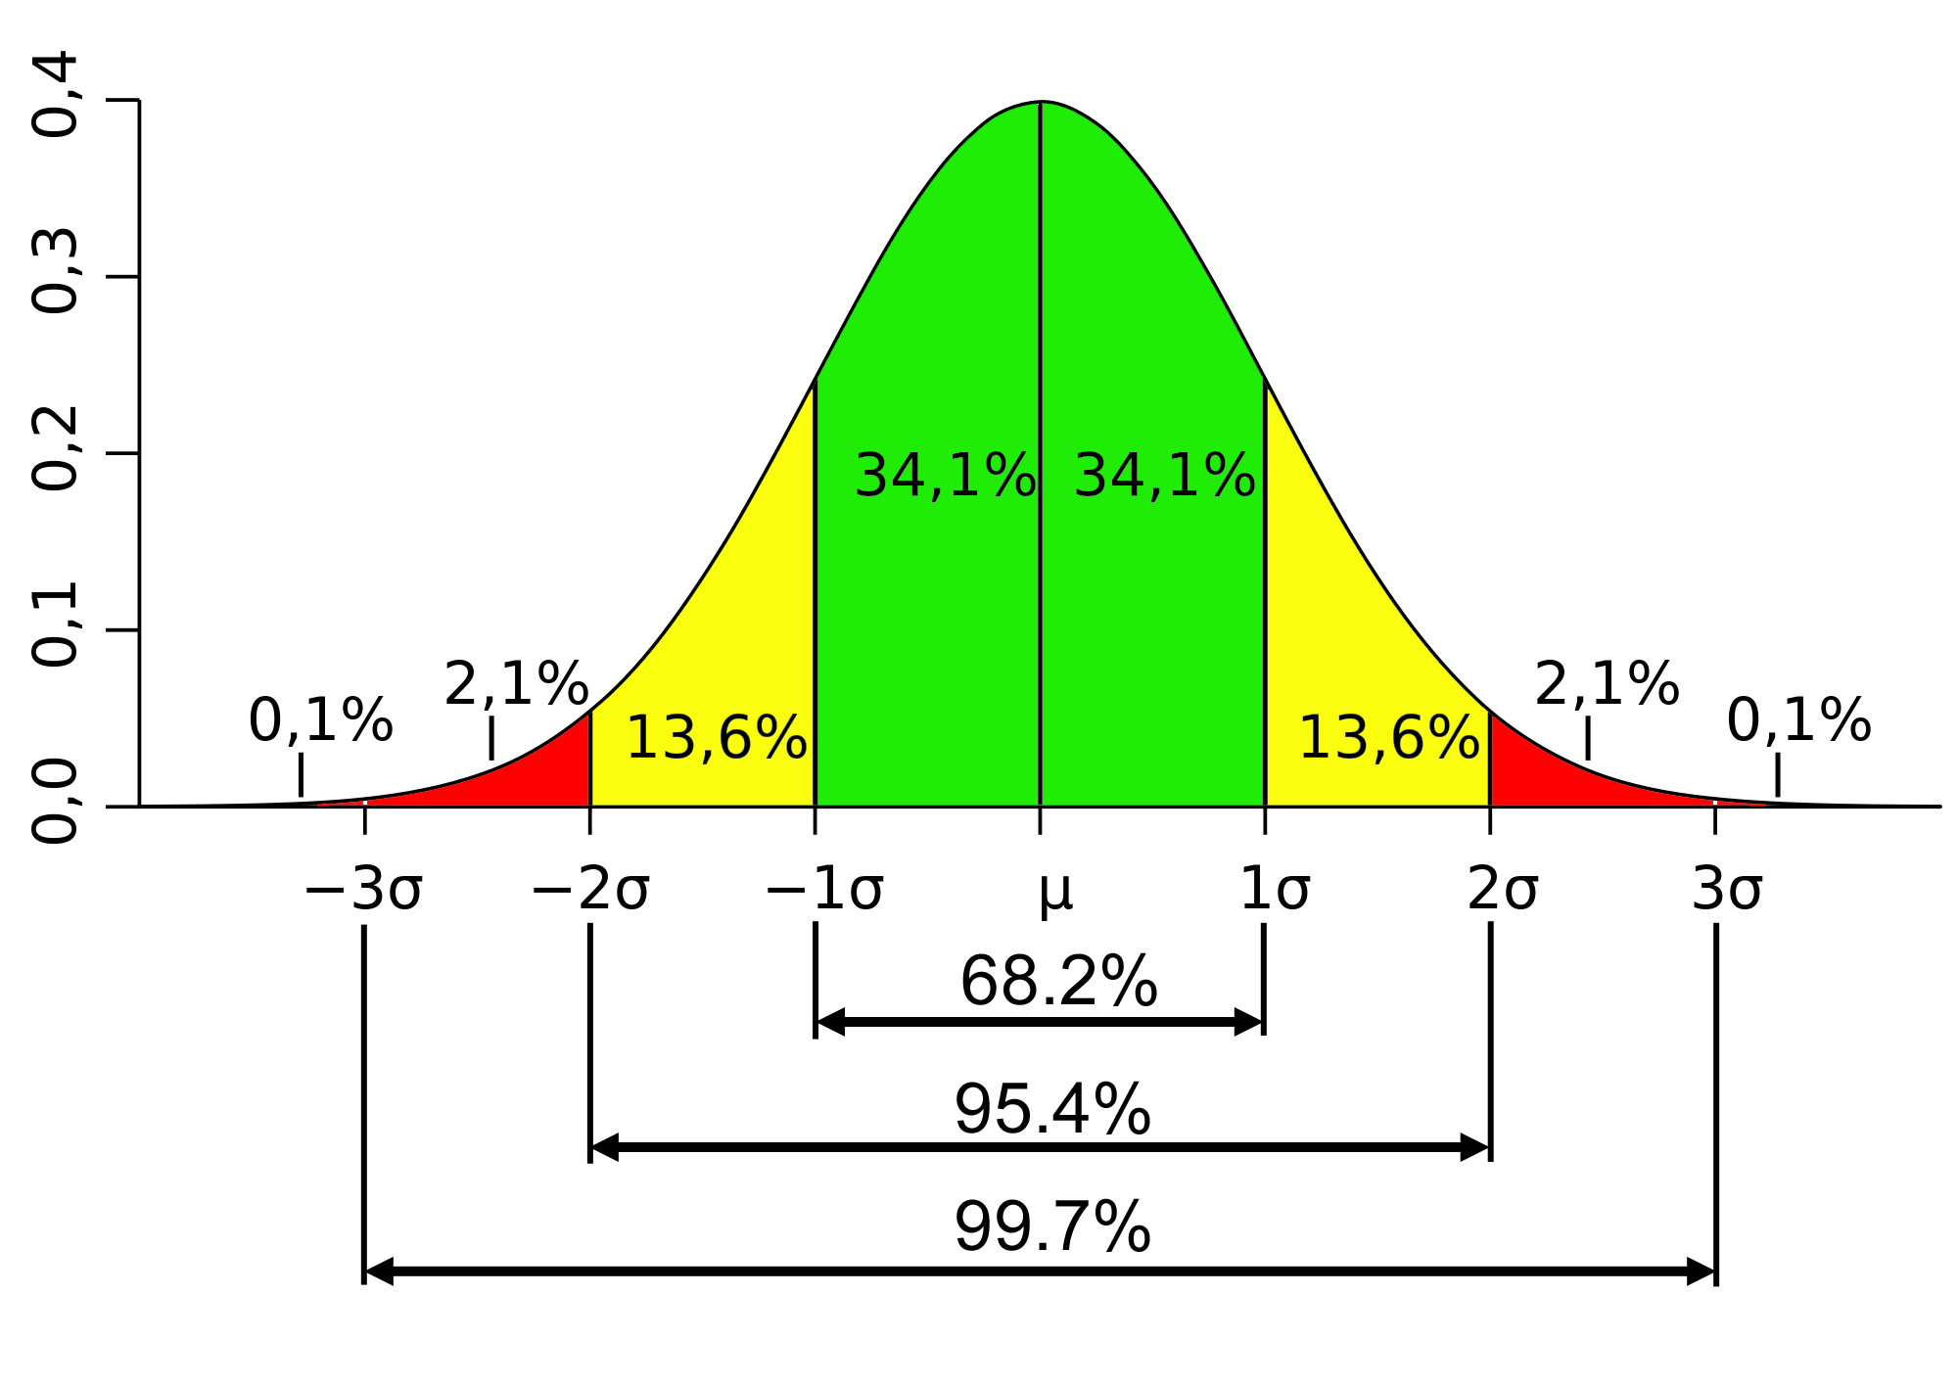

Many people believe that the variables used in linear regression models must be normally distributed.
Why do they believe this?

Slide 5

Perhaps they learned it in a stats class

Slide 6
Another possibility…

Slide 7

Free advice I found on the internet
This lends a certain air of respectability & credibility
Source: http://dss.princeton.edu/online_help/analysis/regression_intro.htm

Slide 8

Unless, of course you’re from

Slide 9


Slide 10

Thank you to Hillary Maxwell for creating this image.

Slide 11

Free advice I found on the internet
This lends a certain air of respectability & credibility
Source: http://dss.princeton.edu/online_help/analysis/regression_intro.htm

Slide 12

Princeton folks make typos too?

Slide 13
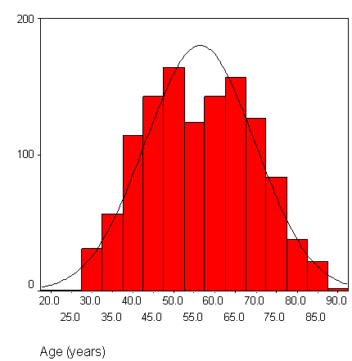
What the author says re normality (1)
You also want to check that your data is normally distributed.
To do this, you can construct histograms and "look" at the data to see its distribution.
This histogram shows that age is normally distributed:

Slide 14
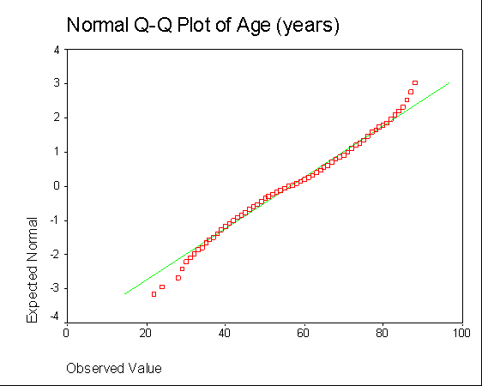
What the author says re normality (2)
You can also construct a normal probability plot.
This plot also shows that age is normally distributed:
In a perfectly normal distribution, the red data points would all fall exactly on the green line.
The clear implication is that the variables must be normally distributed.

Slide 16
What the author says re transformations
Since the goal of transformations is to normalize your data, you want to re- check for normality after you have performed your transformations.
Deciding which transformation is best is often an exercise in trial-and-error where you use several transformations and see which one has the best results.
"Best results" means the transformation whose distribution is most normal.

Slide 17

Credit where credit is due
The author acknowledges that transformations can be done for other reasons, and that interpretation may be very difficult when transformed variables are analyzed
  “You could also use transformations to correct for heteroscedasiticy, nonlinearity, and outliers.”
  “Some people do not like to do transformations because it becomes harder to interpret the analysis.
  Thus, if your variables are measured in "meaningful" units, such as days, you might not want to use transformations.”
✓

Slide 18
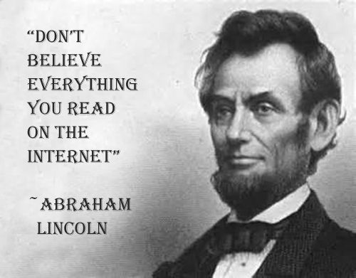
Anybody can publish their statistics notes on the internet.

Slide 19
Advice I found in a reputable peer-reviewed journal

Slide 20
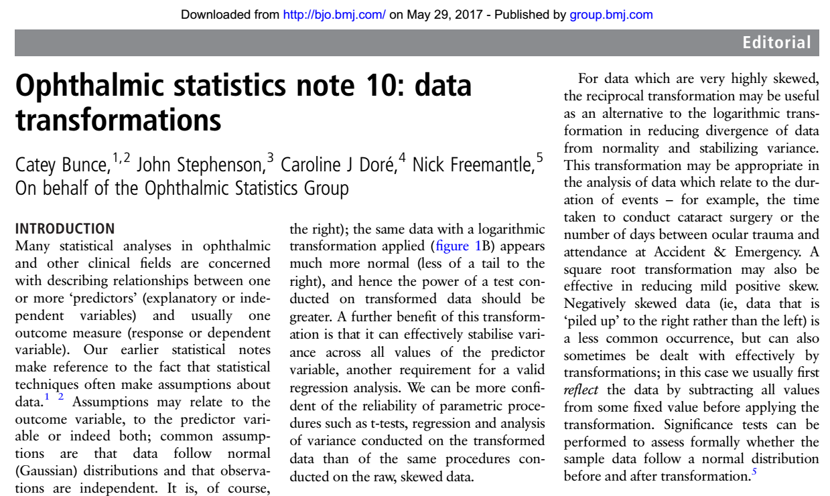

British Journal of Ophthalmology Dec 2016, 100 (12) 1591-1593; DOI: 10.1136/bjophthalmol-2016-308824
Air of respectability & credibility
Ophthalmic Statistics Group (OSG)

Slide 21
About the Journal
Aims and scope
The British Journal of Ophthalmology is an international peer-reviewed journal for ophthalmologists and visual science specialists describing clinical investigations, clinical observations, and clinically relevant laboratory investigations related to ophthalmology.
Ownership
British Journal of Ophthalmology is owned by BMJ.

Slide 22

BMJ, BM-Shmay!

Slide 23
What the authors say (1)
Many statistical analyses … are concerned with describing relationships between one or more ‘predictors’ (explanatory or independent variables) and usually one outcome measure (response or dependent variable).
Our earlier statistical notes make reference to the fact that statistical techniques often make assumptions about data.^{1 ,2}

Slide 24
What the authors say (2)
Assumptions may relate to the outcome variable, to the predictor variable or indeed both; common assumptions are that data follow normal (Gaussian) distributions and that observations are independent.
One approach when assumptions are not adhered to is to use alternative tests which place fewer restrictions on the data – non-parametric or so-called distribution free methods.²

Slide 25
What the authors say (3)
A more powerful alternative, however, is to transform your data.
While your ‘raw’ (untransformed) data may not satisfy the assumptions needed for a particular test, it is possible that a mathematical function or transformation of the data will.
Analyses may then be conducted on the transformed data rather than the raw data.

Slide 26
Credit where credit is due
The OSG acknowledges that interpretation of results is more difficult after transforming the variables:
  Care must be taken when interpreting analysis of transformed data; results from analyses will be for transformed data, not the raw data.
✓

Slide 27

Summary to this point
The key message on the Princeton Library website and in the BJO article seems to be that variables used in OLS regression models must be normally distributed.
Is that really true?

Slide 28
Distributional Assumptions
for OLS Linear Regression
Explanatory Variables
Outcome Variable
None!
None!
There is no requirement of normality for any of the variables used in OLS linear regression.

Slide 29
All right then, what are the key assumptions for OLS linear regression?

Slide 30
The Key Assumptions of
OLS Linear Regression
The errors are independently and identically distributed as normal with a mean of zero and variance = σ²
In conventional statistical short-hand:
ε~ i.i.d. N(0, σ²)

Slide 31
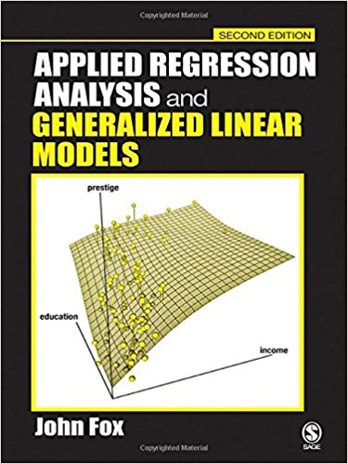
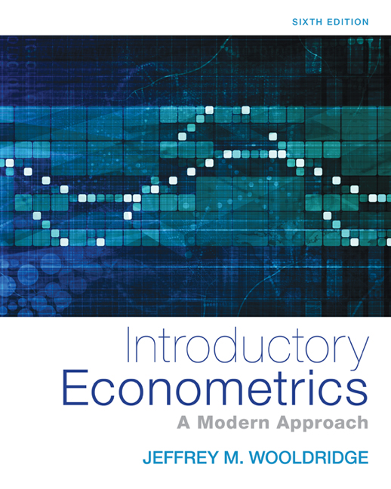
Some Relevant References

Slide 32
The Key Assumptions of
OLS Linear Regression
The errors are independently and identically distributed as normal with a mean of zero and variance = σ²
In conventional statistical short-hand:
ε~ i.i.d. N(0, σ²)

Slide 33
But even here, normality is at best an approximation.

Slide 34
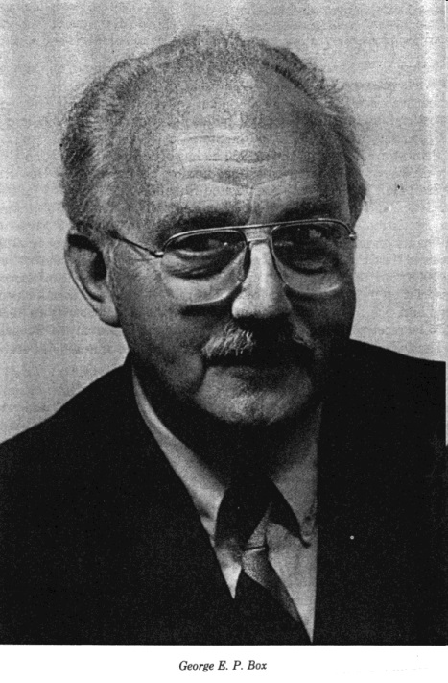
George Box on normality
George Box was a famous statistician (and the son-in-law of Sir Ronald Fisher)
Here is what he said about normality (and linearity):
  “…the statistician knows…that in nature there never was a normal distribution, there never was a straight line, yet with normal and linear assumptions, known to be false, he can often derive results which match, to a useful approximation, those found in the real world.” (JASA, 1976, Vol. 71, 791-799; emphasis added)

Slide 35
Normality of Errors Least Important
The least important part of ε ~ i.i.d. N(0, σ²) is the N (for normally distributed)
  And normality is at best an approximation
The i.i.d. part (independently and identically distributed) is far more important

Slide 36
Robustness to non-normality of errors
Regression is quite robust to non-normality of the errors (especially as n increases)
Robust: “resistant to errors in the results, produced by deviations from assumptions”
(http://en.wikipedia.org/wiki/Robust_statistics#Definition)

Slide 37
Approximate vs. Exact Tests
The F-test and t-tests for OLS regression would be exact tests if the errors were exactly normally distributed (and independently & identically distributed)
In the real world, where nothing is exactly normal, they are approximate tests

Slide 38
Should we be concerned that the F- and t-tests are only approximate?
Short Answer: No!

Slide 39

Essentially, all models are wrong, but some are useful.
In other words, the fact that a statistical test is approximate rather than exact is not the end of the world!

Slide 40

Approximate statistical tests will doom us!

Slide 41
So how should we proceed when estimating a linear regression model?

Slide 42
Before fitting your OLS model…
Inspect & clean the data
  Basic descriptive stats & plots for each variable (e.g., histograms)
  Look for impossible or unusual values
  Use scatter-plots to look for unusual combinations of values (e.g., 2 year child weighing 90 kg)
Frequently due to data entry errors

Slide 43
After you estimate your model…
Observable estimates of the unobservable errors
Plot the residuals
  Residual plots to assess the independently & identically distributed assumptions
  Histograms and Q-Q plots to visually assess the (less important) assumption of normally distributed errors
Examine measures of influence

Slide 44
Measures of Influence
An observation is influential if deleting it causes a substantial change in the results
Some common measures of influence:
  Cook’s distance
  DFBETA
  DFITS
  Studentized residuals
All have rules of thumb about values that should arouse suspicion
All use a leave-one-out approach

Slide 45


If neither the residuals nor the measures of influence reveal anything alarming…
Then don’t be alarmed!

Slide 46
If the residual plots or measures of influence do arouse suspicion, consider using some form of robust regression, or a Generalized Linear Model that specifies a more appropriate error distribution.
For example, binary logistic regression is a Generalized Linear Model with a binomial error distribution (and a logit link function).

Slide 47



Okay…it’s over!
Time to wake up!
Any Questions?

Slide 48

Contact Information
Bruce Weaver
Assistant Professor (and Statistical Curmudgeon)
NOSM, West Campus, MS-2006
E-mail: bweaver@lakeheadu.ca
Tel: 807-346-7704

Slide 49

The Cutting Room Floor

Slide 50
Common Regression Models as Generalized Linear Models
Outcome variable | Error distribution | Link function | Model name
Continuous | Normal | Identity | Linear regression
Dichotomous | Binomial | Logit: | Binary logistic regression
 |  | Probit | Probit regression
Proportional | Binomial | Logit | Binomial logistic regression
Counts | Poisson | Log | Poisson regression
 | Negative binomial | Log | Negative biomial regression
Survival | Gamma | Log | Survival analysis
 | Weibull
Ordinal | Multinomial | Cumulative logit | Ordinal logistic regression
Nominal (k > 2) |  | Generalized logit | Multinomial logistic regression

Slide 51
Speaker Acceptance & Disclosure
I have no affiliations, sponsorships, honoraria, monetary support or conflict of interest from any commercial source.
However…it is only fair to caution you that this talk has not undergone ethical review of any sort.
Therefore, you listen at your own peril.

Slide 52
ε~ i.i.d. N(0, σ²)
Independently and identically distributed
Normal with μ = 0 and variance = σ²
Errors
Deviations of observed Y-values from the true (population) regression expression

Slide 53
Error vs. Residual: A Simple Example
Population = all Canadian adult males, Y = height
  Let μ represent the mean height of all Canadian men (i.e., the unknown population mean)
  Let Y (Y-bar) represent the mean height of a random sample of Canadian men
= ERROR
= RESIDUAL

Slide 54
Error vs Residual in Regression
In the context of simple linear regression:
Deviation of observed Y-value from the regression line computed using the entire population
ERROR =
The true regression expression
Deviation of observed Y-value from the regression line computed using a random sample from the population
RESIDUAL =

Slide 55
ε~ i.i.d. N(0, σ²)
Independently and identically distributed
Normal with μ = 0 and variance = σ²
Errors
Deviations of observed Y-values from the true (population) regression expression
The true (population) regression expression is typically not known
Therefore, the errors are unobservable
We use residuals in their place when evaluating the model
← This is the problem!

Slide 56

The Analysis Factor is on a mission to make quality applied statistical support accessible and affordable.
Karen Grace-Martin
URL: http://www.theanalysisfactor.com/

Slide 57
Source: http://www.theanalysisfactor.com/the-distribution-of-independent-variables-in-regression-models/

Slide 58
Small correction: It’s about the errors, not the residuals. (More on the distinction between them shortly.)
Source: http://www.theanalysisfactor.com/assumptions-about-residuals/

Slide 59

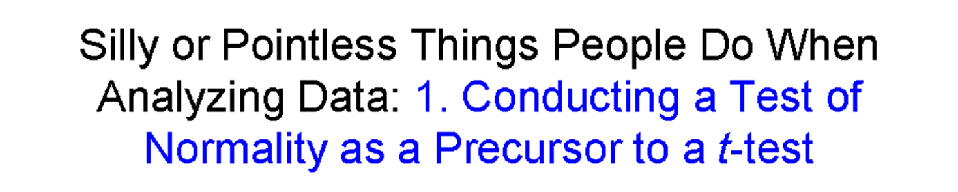

One more thing the OSG said
Significance tests can be performed to assess formally whether the sample data follow a normal distribution before and after transformation.⁵
The OSG obviously missed installment 1 in my Silly or Pointless Things series…

Slide 60

Princeton
Shminceton

