Slide 1
The Treatment of Symptomatic Uterine Fibroids
in Rural and Remote Communities:
A Cost-Effectiveness Analysis from the Perspective of Women
Roxanne Turuba, BHSc
Research Assistant, TBRHRI

Slide 2
Faculty/Presenter Disclosure Slide
[Roxanne Turuba]
Relationships with commercial interests: NONE
Potential for conflict(s) of interest: NONE

Slide 3
Overview
Background
Objectives
Cost-effectiveness Analyses
Model Overview
Base-case Analysis
Results
Conclusions/Next Steps

Slide 4
Uterine Fibroids
Benign smooth muscle tumours
Affects 40% of women
70% of women by the age of 50
Symptoms:
Menorrhagia
Anemia
Abdominal pain/pressure
Increased urinary urgency/frequency
Bowel dysfunction
Infertility

Slide 5
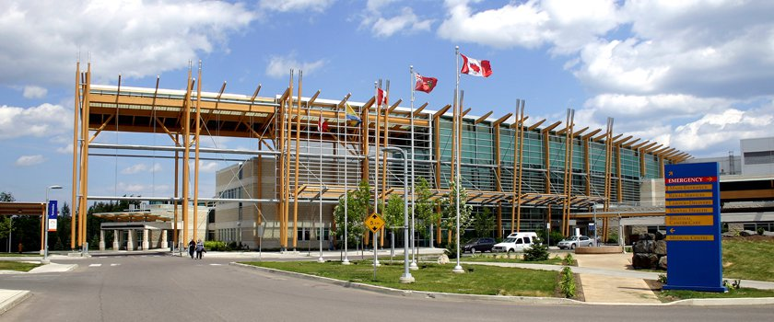
Treatment of Uterine Fibroids at TBRHSC
Surgical
Hysterectomy
Myomectomy (preserves fertility)
Minimally invasive
Endometrial ablation (EA)
Medical therapy
Short-term use only

Slide 6
MR-HIFU
Magnetic resonance-guided high intensity focused ultrasound
Non-invasive (without incision)
Low complication rates
Recovery of a few days
Decreases loss productivity
Preserves fertility

Slide 7
Background
Thunder Bay is the only referral center in the region for gynaecology
Social and economic burden associated with referral to Thunder Bay
Travel
Overnight appointments in Thunder Bay
Time off work (loss productivity)
Time away from dependents
Image from Come Explore Canada (2006)

Slide 8
Objectives
To compare the cost-effectiveness of MR-HIFU to standard treatments for uterine fibroids offered at the TBRHSC
To understand the costs associated with uterine fibroid treatment from the perspective of women receiving care in rural and remote communities

Slide 9
What is a cost-effectiveness analysis?
Costs
Costs associated with treatment from the perspective of the women receiving treatment
Travel
Accommodations
Meals
Loss productivity
Support/childcare services
Effectiveness
Health benefits gained from treatment
Measured by quality-adjusted life-years (QALYs)
1 QALY = 1 year of perfect health
Measured through patient questionnaires

Slide 10
Model Overview
State transition (Markov) model
Patients transition from health states over time
Based on transition probabilities
Health state
6-month interval defined by
the presence or absence of symptoms and
treatment received
Associated with a cost and utility
Health utilities: used to measured QALYs
Predicts total costs and quality-adjusted life years associated with each treatment

Slide 11
Model Overview

Slide 12
Base-case Analysis
Over 5-years
Assumed patients would be accompanied by a working spouse/primary support person
Categorized communities by the distance patients need to travel:
0-2 hours away
2-4 hours away
Greater than 4 hours away
Fly-in community

Slide 13
Results
Endometrial ablation (EA) was the dominating strategy in all scenarios
EA can only treat small submucosal fibroids: low eligibility
Excluding EA from the analysis:
MR-HIFU was the most cost-effective strategy regardless of living location
MR-HIFU became increasingly dominant as a person lived closer to the city
Hysterectomy was only cost-effective for fly-in communities

Slide 14
Baseline – 5 years | Total costs | Total QALYs | ICER ($/QALY)
No road access
Hysterectomy | $17,737.45 | 7.2869 | -
Myomectomy | $19,167.06 | 7.4040 | $65,643.93
MR-HIFU | $18,486.09 | 7.3936 | 7,019.53*
Greater than 4 hours away
Hysterectomy | $10,056.90 | 7.2869 | Dominated
Myomectomy | $10,969.18 | 7.4040 | $154,134.87
MR-HIFU | $9,370.22 | 7.3936 | *
2-4 hours away
Hysterectomy | $8,105.09 | 7.2869 | Dominated
Myomectomy | $8,849.97 | 7.4040 | $217,372.22
MR-HIFU | $6,595.00 | 7.3936 | *
0-2 hours away
Hysterectomy | $7,980.07 | 7.2869 | Dominated
Myomectomy | $8,712.86 | 7.4040 | $219,410.15
MR-HIFU | $6,436.75 | 7.3936 | *
ICER: Incremental cost-effectiveness ratio
*Most cost-effective strategy/dominating strategy

Slide 15
Conclusions/Next Steps
Conclusions
First economic analysis from the perspective of the patient
EA is the most cost-effective strategy, if eligible
MR-HIFU: cost-effective for women receiving treatment in NWO, along with myomectomy.
Hysterectomy: cost-effective strategy for fly-in communities
Next Steps:
Help patients make well-informed decisions
MR-HIFU is cost-effective from the perspective of the Ontario healthcare system
Currently conducting a clinical trial at the TBRHSC to offer women a non-invasive, fertility preserving option

Slide 16
Acknowledgments
Jumah, N. (MD, DPhil, FRCSC, Obstetrics and Gynecology, TBRHSC)
Bishop L. (BHSc, MPH, Thunder Bay Regional Health Research Institute)
Krahn, M. (MD, MSc, FRCPC, THETA, University of Toronto)
TreeAge Software staff, particularly Andrew Munzer
Northern Ontario Heritage Fund Corporation
Physicians’ Services Incorporated (PSI) Foundation

Slide 17
Questions?

