Slide 1
Northern Health Research Conference
June 4-6, 2015
Timmins ON
Does a Northern Education Produce
Northern Physicians?
Exploring Practise Locations of Recently Graduated Family Physicians in Ontario
Patrick Timony, MA ¹
Elizabeth Wenghofer, PhD ^{1,2}
John Hogenbirk¹
¹Centre for Rural and Northern Health Research (CRaNHR), Sudbury ON
²School of Rural and Northern Health, Laurentian University, Sudbury ON

Slide 2
Conflict of Interest Declaration:
Nothing to Disclose
Presenter: Patrick Timony
Title of Presentation: Does a Northern Education Produce Northern Physicians? Exploring Practise Locations of Recently Graduated Family Physicians in Ontario
I have no financial or personal relationships to disclose

Slide 3
Introduction
Physician shortages and maldistribution in Northern Ontario
Recruitment and retention literature:
  Location of education
  Rural exposure
One of NOSM’s key goals was to encourage newly trained physicians to practice in rural and northern regions
NOSM Tracking Study – now entering 11th year
First 4 cohorts of NOSM’s family medicine students are now in full practice

Slide 4

Research Question
Are NOSM undergraduates (UGs) and NOSM post-graduates (PGs) more likely to locate their practices in rural and/or northern Ontario than physicians who received training from other Canadian institutions?

Slide 5
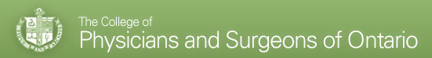
Methods
Ethical Approval = Laurentian University REB
2013 physician registry and Annual Membership renewal survey
  Age, gender, French
  UG and PG locations
  Primary practice location (postal code)
  Year of UG graduation (post 2009)
  All certified family physicians (FPs) in Ontario…
CPSO
Data

Slide 6

Methods
MEDICAL SCHOOL
UG and/or PG training at NOSM vs. elsewhere in Canada
Categorized sample into 4 medical school groups:
  NOSM/NOSM
  NOSM/Other
  Other/NOSM
  Other/Other

Slide 7
Methods
PRACTICE LOCATION
Primary practice address (postal code)
Link with Statistics Canada data
North = Practices located within NE LHIN or NW LHIN boundaries
Rural = Practices located outside census metropolitan areas (CMAs) and census agglomerations (CAs)
Categorized sample into 4 practice location groups:
  Rural North
  Rural South
  Urban North
  Urban South
Notes:
Practices located in census metropolitan areas (CMAs) and census agglomerations (CAs) were considered urban. CMAs and CAs have populations of at least 100,000 and 10,000, respectively. All areas outside of CMAs and CAs were classified as rural.

Slide 8

Analysis
Main outcome = Primary practice location
X
Medical School Category
Statistics:
  Descriptive for age at graduation, gender, French practice language by practice location
  Differences Medical School Categories
Notes:
ANOVA with least significant difference (LSD) post-hoc analyses were used to determine if the medical school categories differed by age of graduation.
Fisher’s Exact Tests were used to determine if medical school categories differed by gender, French language status and practice location.

Slide 9
Results: Study Population Characteristics
Medical School Category | % of Total Sample (n) | Mean Age (s.d.) † | % Female | % French*
NOSM/NOSM | 6.7 (36) | 35.8 (6.7) | 55.6 | 19.4
NOSM/Other | 2.6 (14) | 36.6 (7.6) | 64.3 | 35.7
Other/NOSM | 3.2 (17) | 32.2 (4.0) | 64.7 | 29.4
Other/Other | 87.5 (468) | 31.5 (3.0) | 60.0 | 14.5
Total | 100 (535) | 31.9 (3.8) | 60.0 | 15.9
Older
12.5% (67)
†ANOVA p<0.001
*Fisher’s Exact Test p=0.048
Notes:
The total sample consisted of 535 FPs. This included 67 (12.1%) who had any level of exposure to NOSM, either at both UG and PG (NOSM/NOSM), at UG only (NOSM/OTHER), or at PG only (OTHER/NOSM). A total of 468 (87.5%) had no exposure to NOSM at either the UG or PG levels (OTHER/OTHER)
The mean age at graduation of the total sample was 31.9 (s.d. 3.79) years. ANOVA of age at graduation between the medical school categories was significant (p<0.001). Post-hoc analysis revealed that age differed significantly between medical school categories according to UG location. The two categories with NOSM UG were significantly older than two OTHER UG categories (p≤0.008).
The total sample consisted of 60.0% (321) female FPs and there were no significant differences found in the gender distribution between medical school categories.
FPs who indicated that they were able to practice in French comprised 15.9% (85) of the total sample. The proportions of French FPs were significantly different between the medical school categories with NOSM/OTHER having the highest proportion of French FPs at 35.7% (5) and the OTHER/OTHER category with lowest at 14.5% (68) (Fisher’s Exact Test = 7.366; p=0.48).

Slide 10
RESULTS:
Primary Practice Location
n=535 | % of Physician in each Location per Medical School Category (n)* |  |  |  | TOTAL % Location
 | NOSM/ NOSM (36) | NOSM/ OTHER (14) | OTHER/ NOSM (17) | OTHER/ OTHER (468)
Rural North (20) | 25.0 | 0.0 | 0.0 | 2.4 | 3.7
Rural South (45) | 8.3 | 28.6 | 5.9 | 7.9 | 8.4
Urban North (45) | 63.9 | 7.1 | 70.6 | 1.9 | 8.4
Urban South (425) | 2.8 | 64.3 | 23.5 | 87.8 | 79.4
TOTAL % Medical School | 100 | 100 | 100 | 100 | 100
* Fisher’s Exact Test= 206.225; p<0.001
Notes:
As anticipated, the total sample was overwhelmingly practising in urban (87.9%) and southern (87.9%) regions. The sample was distributed in increasing proportions from rural north to urban south from 3.7 % (20) to79.4% (425), respectively.
Fisher’s exact test revealed significant differences in FP practice locations by medical school category (p<0.001).
The OTHER/OTHER group was overwhelmingly located in the urban south (87.8%).
The NOSM/OTHER group also had a large proportion of physician in the urban south (64.3%) with another large group located in the rural south (28.6%).
The largest proportions of the NOSM/NOSM category (63.9%) and the OTHER/NOSM category (70.6%) were practicing in the urban north.
The NOSM/NOSM group had the largest proportion of physicians practising in the rural north from any medical school category (25%) and only 2.8% of these physicians were practicing in the urban south.

Slide 11
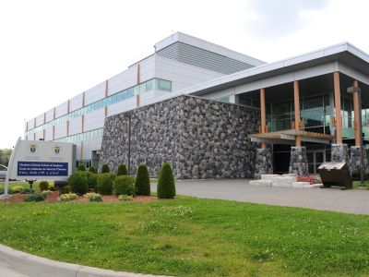
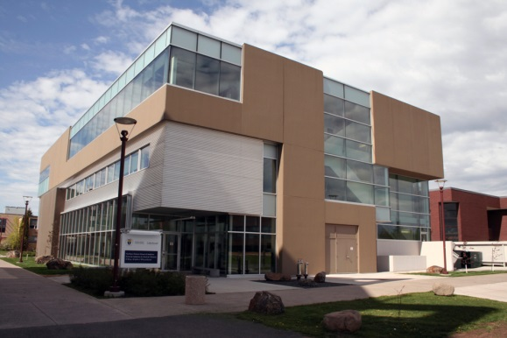
Conclusions
NOSM UG or NOSM PG = rural or northern Ontario
  Any NOSM exposure = in rural and north.
  NOSM UG = Rural
    distributed education/clerkships?
    selection process (i.e. rural backgrounds)?
  NOSM PG = North
    PG experience may be more influential than UG experience.
Notes:
LIMITATIONS AND FUTURE WORK
Tracking study will continue for some time and this will address some of the limitations associated with the presented results
Relatively small cells in the NOSM/OTHER (n=14) and OTHER/NOSM (n=17) categories, some of the differences seen between medical school categories may disappear/strengthen with more graduates (some differences could be a function of the first 3 cohorts, who we know are different – particularly the charter class (older, more life experience, prior medical careers, already established in the north) = not sure if this is worth discussing here)
Short time frame – only FPs so far – will need to continue research as the specialists come online
Short time frame also doesn’t tell us much about retention – will need to continue to monitor to see if they are staying
Should also look at other rural schools to see how they are doing in comparison to NOSM students – perhaps we can learn from each other’s success

Slide 12

Conclusions
Implications for student selection and curriculum design
  if we are selecting the right ones and they are staying
  NOSM must be doing something right
If it works with MDs, then why not with other providers?
  health provider training in northern and rural areas
Celebrate successes
  it seems to be working
  it seems that money was well invested

Slide 13


Slide 14
Questions and Comments are Welcome!

