Slide 1
Generating Research in the Small, Rural and Northern Hospital
Roger Walker BA, MPA, MHA, CHE
CEO and President (retired)
Timmins and District Hospital

Slide 2
Generating Research in the Small, Rural and Northern Hospital
Roger Walker BA, MPA, MHA, CHE
CEO and President (retired)
Timmins and District Hospital
Conflict of Interest Declaration:
I have no financial or personal relationships to disclose

Slide 3
Generating Research in the Small, Rural and Northern Hospital
Anecdotal – a personal journey
Evidence-based – some background data
Descriptive – very limited view of the waterfront
Prescriptive – a few thoughts and suggestions

Slide 4
Generating Research in the Small, Rural and Northern Hospitals
A Personal Journey
Multiple small to mid-size hospitals in Canada and USA
SRPC
UNBC
U of T/McMaster and NOMP
CRANHR
NOSM
Healthcare - Education - Research

Slide 5
Generating Research in the Small, Rural and Northern Hospitals
A Personal Journey
1973: MPA study of Salt Lake Clinic operations
emphasis on market analysis and research
1985-8: Red Deer Regional Hospital
PharmHand IV minibag robotic workstation
1994: Bariatric Surgery
1996-7: Stockholm-Seattle Medical Tourism
2002-4: demographics re: SLMHC capital project (Raymond Pong)
SLMHC Traditional Healing and Medicines Program
2004-9: Diversity, Equity and Cultural Competency
Compilation of ~20 peer-reviewed articles
2008-11: Canadian Consortium for Health Equity
Standards for Diversity, Equity and Competency

Slide 6
Generating Research in the Small, Rural and Northern Hospitals
Existing NOSM Mission:
Innovative Education and Research for a Healthier North
Innovative
High Quality
International
Recognition
Community
Engaged
Learning
Centered
Social
Accountability
Distributed
Learning
Distributed
Research
NOSM 2020 Vision:
REACHING BEYOND EXTRAORDINARY TOGETHER
Source: NOSM website, June 2015

Slide 7
Generating Research in the Small, Rural and Northern Hospitals
Alternative Funding Plans (AFPs) in Ontario support physicians who provide clinical instruction to medical students and residents.
At NOSM, the distributed medical education model has resulted in the establishment of Local Education Groups
commonly known as LEGs.
LEGs are self-organized groups of NOSM clinical faculty
established at the local level through an oversight, funding and review process administered by NOAMA.
Source: CRaNHR Evaluation Framework, Current Projects, May 2015

Slide 8
Generating Research in the Small, Rural and Northern Hospitals
LEGs
provide selected medical education services
support professional development
fund research and clinical innovation
NOAMA
administers the LEGs initiatives
administers funds provided by the MOHLTC under
an agreement between OMA, NOSM, PCTA, MOHLTC
Source: CRaNHR Evaluation Framework, Current Projects, May 2015

Slide 9
Generating Research in the Small, Rural and Northern Hospitals
The PCTA and NOSM signed an agreement in January 2010 to establish a governing body called the Northern Ontario Academic
Medicine Association (NOAMA). NOAMA is an unincorporated association established to manage, distribute, and administer
the Alternative Funding Program funding on behalf of the MOHLTC and the Members in accordance with the contractual terms
of the AFP Agreement. The Physician Clinical Teachers Association holds the majority of the voting membership of NOAMA.
Academic Funds | Recruitment Funds | Innovation Funds (Provincially Held) | Administrative Funds
Monies to provide support for academic activities of Participating Physicians | Monies provided to NOAMA for recruitment of new Participating Physicians | Monies to support Participating Physicians in development of new and innovative practices in health care delivery and leadership | Monies to support the Governance Organization's administrative activities to manage the Agreement $7,012,987
$5,920,932 | $436,822 | $436,822 | $218,411
Allocated to the Participating Physicians as an enhancement for clinical teaching required in NOSM undergraduate and postgraduate programs at amounts approved by the NOAMA Board. A portion has been designated for the development of the Local Education Groups (LEGS) as provided for in the AFP Agreement. Physician Clinical Teachers Association administration is supported from these monies. | Funding provided to NOAMA to distribute to the Local Education Groups to recruit new Participating Physicians as set out in the AFP Agreement. | The NOAMA Innovation Fund Sub-Committee, through a transparent process, ensures that proposals are reviewed, scored, and ranked. Recommended proposals are forwarded to the NOAMA Board for approval to submit to the Innovation Fund Provincial Oversight Committee (IFPOC). Final approval of the submitted proposals by IFPOC determines the funding that will be allocated to NOAMA. | The administration budget is approved and an annual audited financial statement is provided.
Source: NOAMA, Brief to Northern Teaching Hospital Council, June 2012

Slide 10
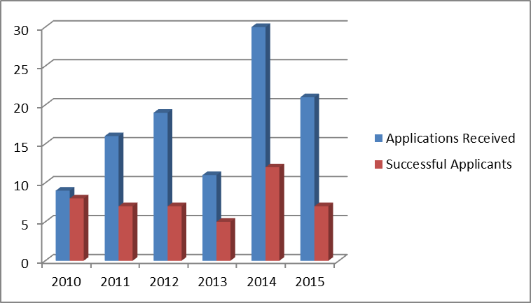
Generating Research in the Small, Rural and Northern Hospitals
NOAMA AFP Innovation Funds (primarily medical research focus)
106 applications
46 successful applications
$3.130M allocated
Source: NOAMA, April 2015

Slide 11
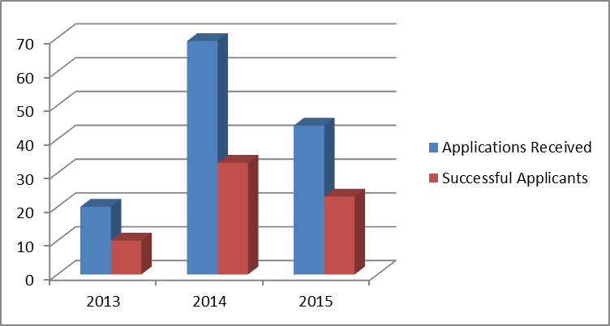
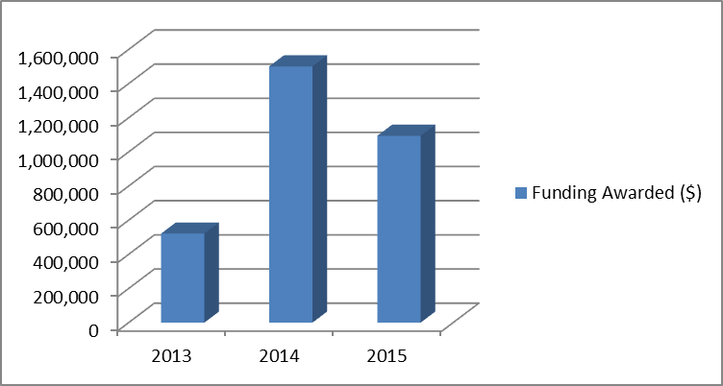
Generating Research in the Small, Rural and Northern Hospitals
NOAMA Clinical Innovation Opportunities Funds
133 applications
successful applications
$3.117M allocated
Source: NOAMA, April 2015

Slide 12
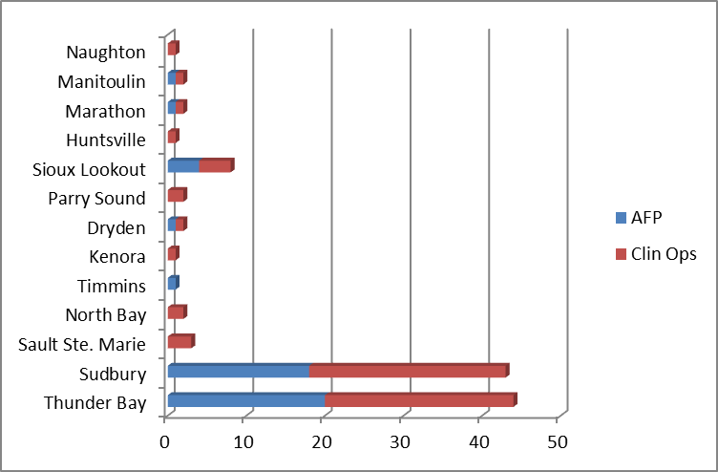
Generating Research in the Small, Rural and Northern Hospitals
Combined AFP and Clinical Opportunities project approvals 2011-15
239 applications
112 successful applications (47%)
$6.248M allocated
Source: NOAMA, April 2015
$7,012,987

Slide 13
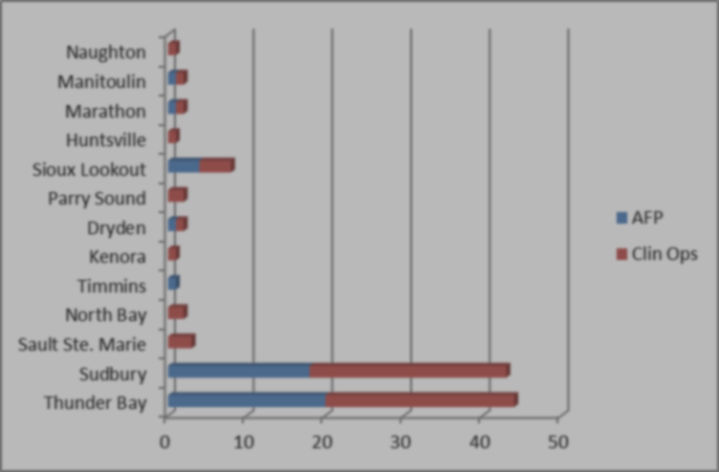
Generating Research in the Small, Rural and Northern Hospitals
Combined AFP and Clinical Opportunities project approvals 2011-15
239 applications
112 successful applications (47%)
$6.248M allocated
3 of 15 locations garnered 85% of the approvals
6 of the other small, rural and remote locations received equivalent approvals to larger centers
many locations did not submit applications
Source: NOAMA, April 2015
$7,012,987

Slide 14
Generating Research in the Small, Rural and Northern Hospitals
CRaNHR was engaged by NOAMA to evaluate LEG performance.
The November 2014 report provided valuable insights:
Highest scholarship, research and innovation priorities for all LEGs:
Develop/increase research & knowledge translation and exchange capacity
Increase amount of funded research being conducted by clinical faculty
High to medium SRI priorities in the near term for many LEGs:
Conduct community-engaged scholarship (CES) / community-based research
Increase volume of innovative activity
Increase KTE (documentation, dissemination, communication) for clinical innovations and QI activities
Lower priority or longer term SRI priority, at least in the short term:
Develop and participate in practice-based research networks
Increase the amount of regional (core-periphery) research collaboration
Source: see following slide
$7,012,987

Slide 15
Generating Research in the Small, Rural and Northern Hospitals
The CRaNHR review results suggested that
Many NOSM staff and partners are not aware of Local Education Groups and their mandate
Scholarship, research and innovation (SRI) priorities are the highest LEG priorities of all 5 domains defined in the evaluation
CRaNHR findings to date were based on survey/interview results
Source: DRAFT Monitoring and Evaluation Framework for the Local Education Groups (LEGs) Initiative
21 November 2014
Submitted to the Northern Ontario Academic Medicine Association (NOAMA)
Prepared by Jill E. Sherman, M.P.H. and Wayne Warry, Ph.D.
Centre for Rural and Northern Health Research , Laurentian University
November 2014
$7,012,987

Slide 16
Generating Research in the Small, Rural and Northern Hospitals
All LEGs are not at the same stage of development.
Some encourage clinicians to undertake research and development projects based on AHSC AFP or Clinical Opportunities funding.
At least one LEG directly funds community research initiatives from the LEG funding they receive.
Other LEGs are in earlier formative stages and consequently are focused on other LEG roles such as
Medical Education and Program Development
Professional Development
Recruitment, Retention and Community Engagement
LEG Administration and Development
Sources:
Dorothy Wright e-mail comments, June 4, 2015 and
DRAFT Monitoring and Evaluation Framework for the Local Education Groups (LEGs) Initiative
Submitted to the Northern Ontario Academic Medicine Association (NOAMA)
Prepared by Jill E. Sherman, M.P.H. and Wayne Warry, Ph.D.
Centre for Rural and Northern Health Research , Laurentian University
November 2014

Slide 17
Generating Research in the Small, Rural and Northern Hospitals
In addition to physician and allied profession driven initiatives, NOSM and our universities and colleges, northern Ontario hospitals are very active in research, development and innovation.
AMRIC (Advanced Medical Research Institute of Canada)
Health Sciences North (Sudbury)
Thunder Bay Regional Research Institute
Thunder Bay Regional Health Sciences Centre (Thunder Bay)
Sioux Lookout Meno Ya Win Health Centre (Sioux Lookout)
At least another 9 hospitals are supporting research and innovation on some level.
Source: NOAMA, April 2015

Slide 18
Generating Research in the Small, Rural and Northern Hospitals
Another very interesting SRI initiative:
NORTHERN ONTARIO ACADEMIC HEALTH SCIENCES NETWORK
a collaboration of Academic and Academic Health Science Centers
Source: North Bay Regional Health Centre, June 2015

Slide 19
Generating Research in the Small, Rural and Northern Hospitals
Collaboration + Research and Innovation + Education = Improved Health
Source: North Bay Regional Health Centre, June 2015

Slide 20
Generating Research in the Small, Rural and Northern Hospitals
NORTHERN ONTARIO ACADEMIC HEALTH SCIENCES NETWORK
“I think our model was trying to bring people who were geographically dispersed together …. We have lots of incredible academics in the North, but we are missing the collaboration and intimacy that sparks research and creativity in teams.”
Paul Heinrich
NBRHC .
Source: Paul Heinrich, June 2015

Slide 21
Generating Research in the Small, Rural and Northern Hospitals
The collaborative approach continues to hold great potential
“One initiative that the LEGs are looking for is the research support network….
I believe there is potential for NOSM to be the catalyst to bring the resources of TBRRI, AMRIC [and others] together with regional resources to develop this network. This would greatly assist the busy physicians in the communities….
There is significant potential and it is an evolution.”
Dorothy Wright
NOAMA .
Source: Dorothy Wright, June 2015

Slide 22
Generating Research in the Small, Rural and Northern Hospitals
What are some of the barriers for our hospitals
Budget pressures
Competing service, administrative and operational priorities
Failure to dedicate resources
Lack of interest
No identifiable champion
Lack of an ethics and/or research committee
No knowledge base of the research or development paradigm
The perception that it is only a “big player” game
Is our mission really healthcare, education and research?

Slide 23
Generating Research in the Small, Rural and Northern Hospitals
A SUGGESTED SRI SUCCESS FORMULA
Collaboration + Research and Innovation Focus + Education = Improved Health
Research and Innovation = ƒ(Need + Opportunity + Resources)
= ƒ(N_{i} + O + R_{c}) where _{i} = interest and
_{c} = competency

Slide 24
Generating Research in the Small, Rural and Northern Hospitals
Suggestions for a successful research and innovation grant application:
Consult www.noama.ca
Ask questions if you don’t understand: call NOAMA or consult the NOSM Research Support Group (see brochure on NOAMA website at “Clinical Opportunities Innovation Fund”
Follow guidelines suggested in the “Local Guidelines and Application Process” on the NOAMA website at both “AHSC AFP Innovation Fund” and “Clinical Opportunities Innovation Fund”
Forms for each type of fund are available on the NOAMA website. Know which fund to apply for. Ask if you need help deciding (see 2.)
Fill out the form completely. Pay attention to each section.
Answer each question and keep your answers focused. Use plain language.
Pursue your passions with vigor and intelligence, and clearly demonstrate your interest!
Source: NOAMA website: www.noama.ca, June 2015

