Slide 1
Rebuilding Health Services:
Dangerous Ideas from the Hinterland
NOSM Northern Health Research Conference June 4, 2015
Stefan Grzybowski, MD
Professor, Co-Director Centre for Rural Health Research | Department of Family Practice | UBC
Jude Kornelsen, PhD
Associate Professor, Co-Director Centre for Rural Health Research | Department of Family Practice UBC

Slide 2
Conflict of Interest
We have none to declare.

Slide 3
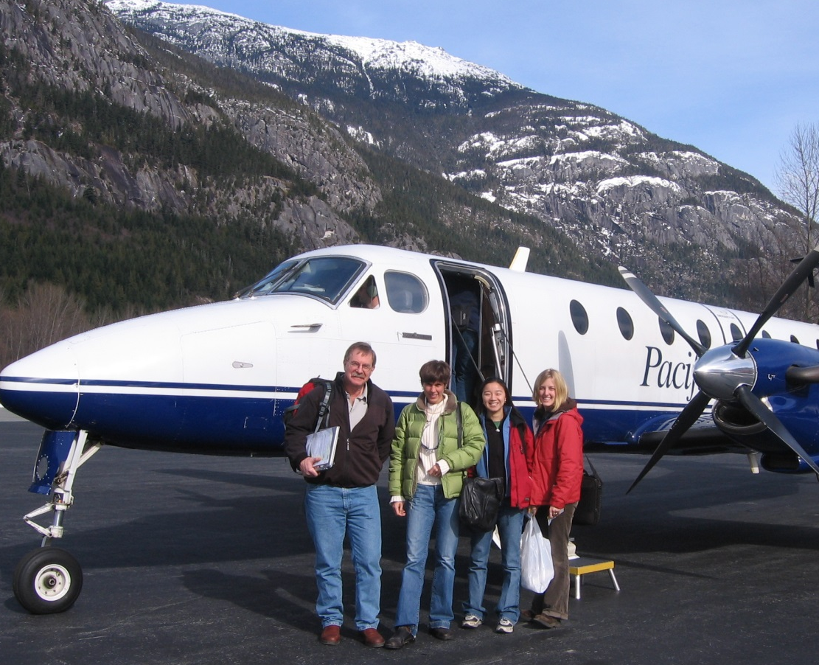
Centre for Rural Health Research
Stefan Grzybowski, MD, MClSc
Jude Kornelsen, PhD

Slide 4
Objectives & Approach
Provide context for our approach to rural health services research
Explore “dangerous ideas”
To consider 3 ideas that may be constructively disruptive

Slide 5
Research
Evidence
Policy

Slide 6
Research
Evidence
Policy

Slide 7
Research
Evidence
Policy
Research

Slide 8
Local Data
Population level (Quantitative)
Qualitative

Slide 9
Community Experience
Observations of impact
Evaluations of local initiatives
Documenting local priorities
Measuring local innovation
On-going challenge:
How to integrate local data into systems level planning

Slide 10
Research
Evidence
Policy
Concrete
Evidence
Epidemiological data
Administrative data
Qualitative data
Abstract
Social consequences
Cultural impact
Psychological results

Slide 11
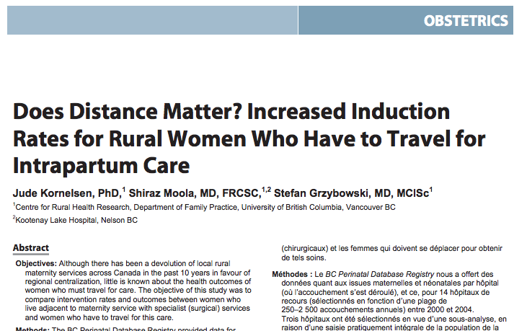
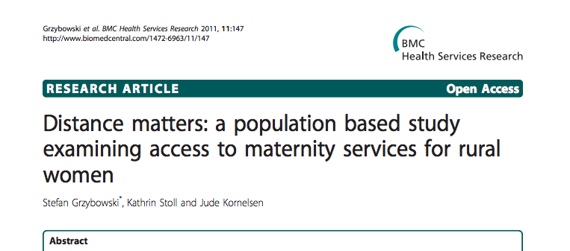
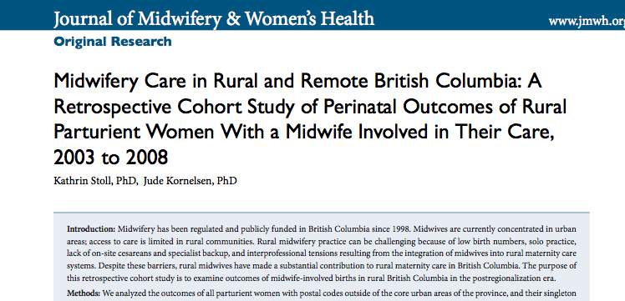
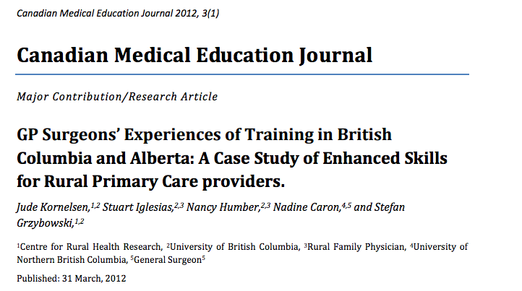
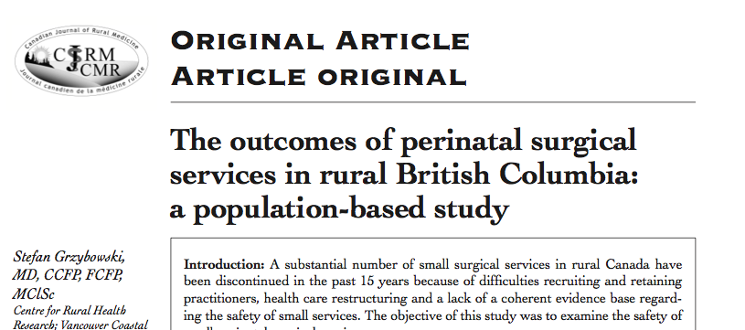
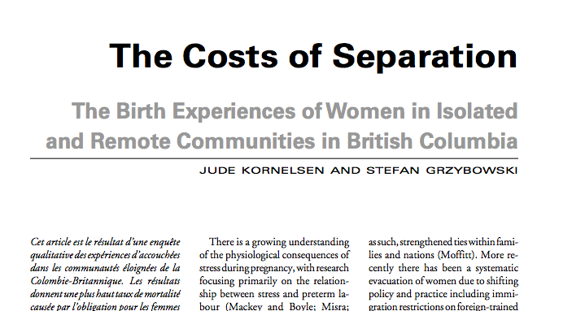
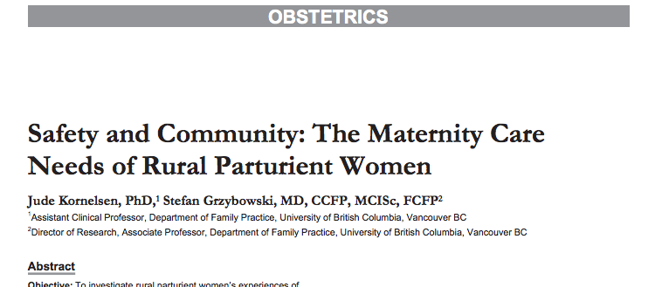
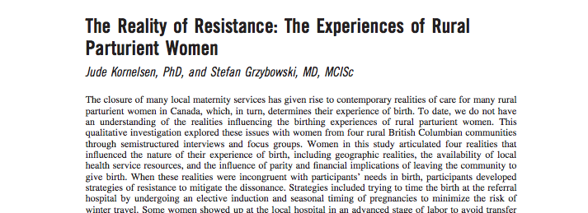
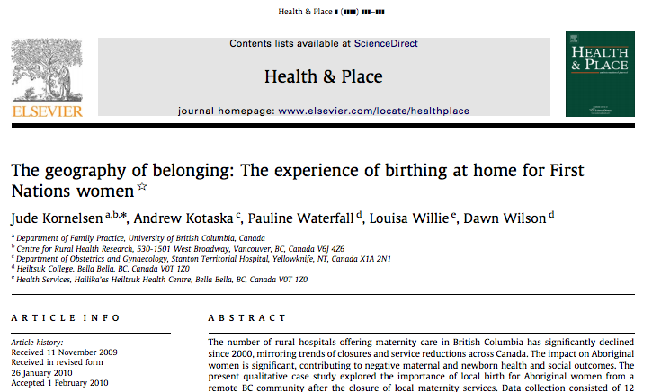
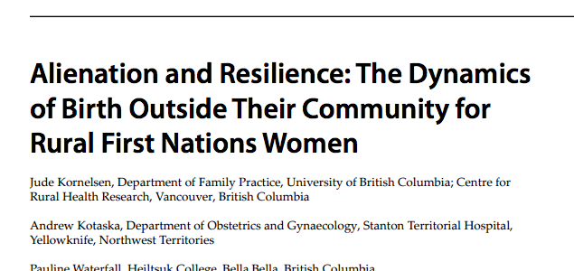
The Evidence
Meeting Population Need: Maternal-Newborn Outcomes
Provider Outcomes
Satisfaction

Slide 12
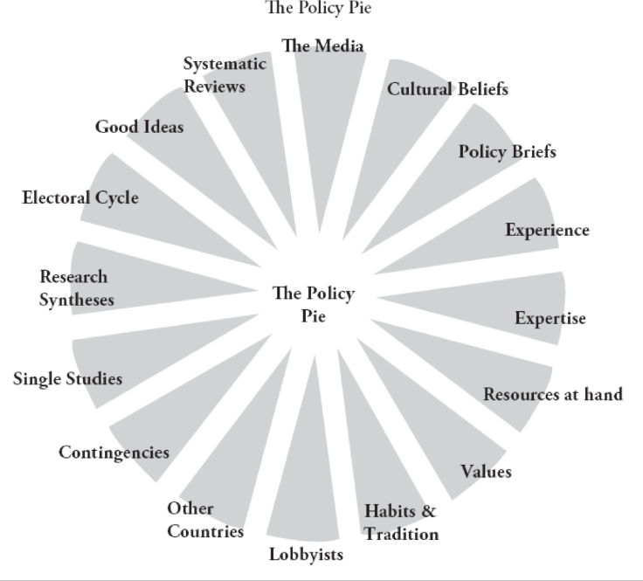
Gavin Bennett and Nasreen Jessani Eds. The Knowledge Translation Toolkit IDRC

Slide 13
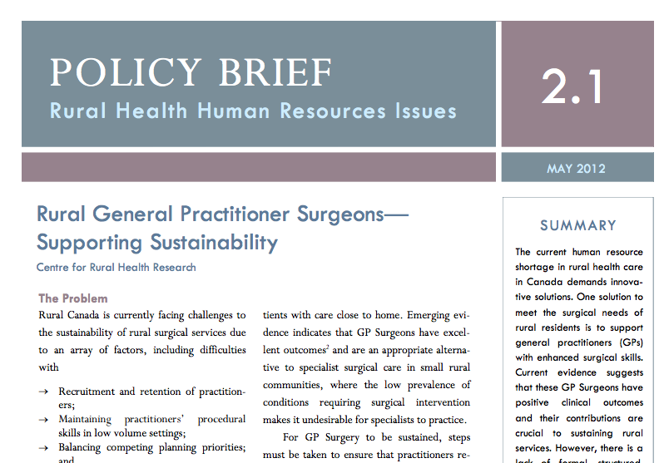
Policy

Slide 14
Resulting Evidence
Challenges the status quo
Constructive disruption
Potential to initiate paradigm shifts

Slide 15
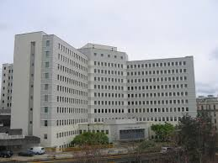
‘Dangerous ideas’
For whom are the ideas dangerous?

Slide 16
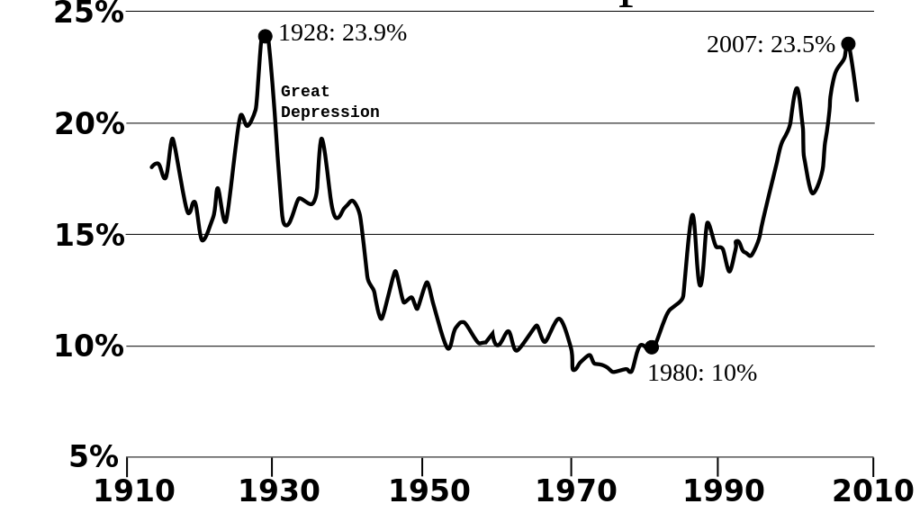
Annual U.S Income Share of the Top 1%

Slide 21
What about rural?
Rebuild the health care system starting with small rural communities based on the principles of generalism:
Comprehensive engagement with the patient from first contact
Provider flexibility and adaptability
Team Based Care

Slide 22
3 Dimensions of Change
Changing the way we use data
Rethinking ‘enhanced skills’
Integrating emergency transport into the hospital

Slide 23
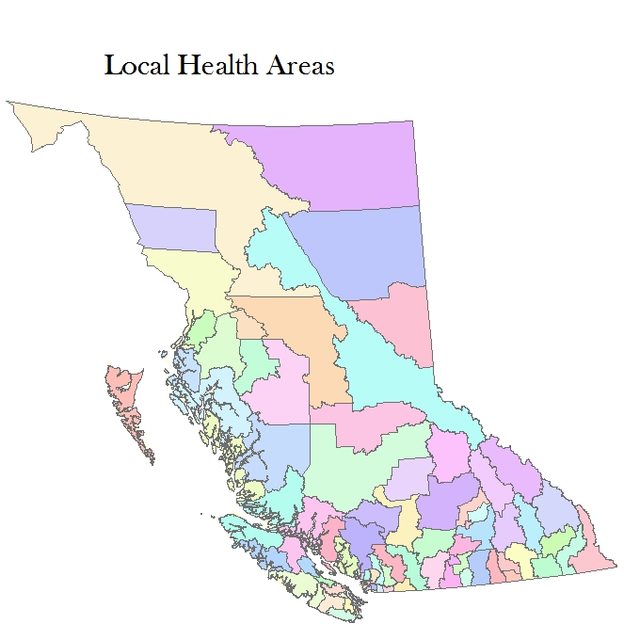
Population level local data: LHA’s as a unit of analysis
Notes:
Klemtu – home of the Kitasoo tribe of the Tsimshiams

Slide 24
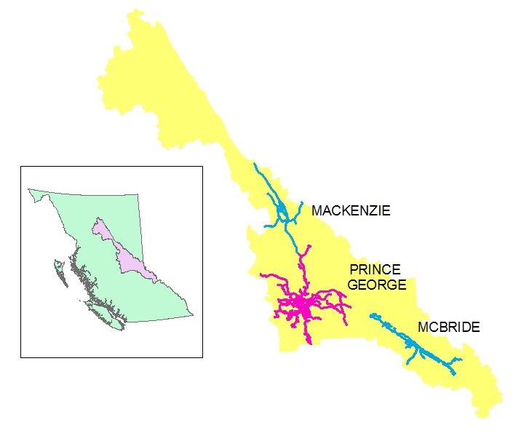
LHA 057 (Prince George)
Notes:
Klemtu – home of the Kitasoo tribe of the Tsimshiams

Slide 25
LHA’s overlayed by 1 hour catchments

Slide 26
Catchment Data - Assumptions
Population catchments can be created around a rural health care facility
Rural health care teams can be charged with the health services responsibility for the surrounding population

Slide 27
The utility of catchment data
Measuring population need to appropriately plan services;
Monitoring utilization patterns to assess service function;
Monitoring outcomes for the population served to assess quality of care;
Linking education with need, and outcomes

Slide 28
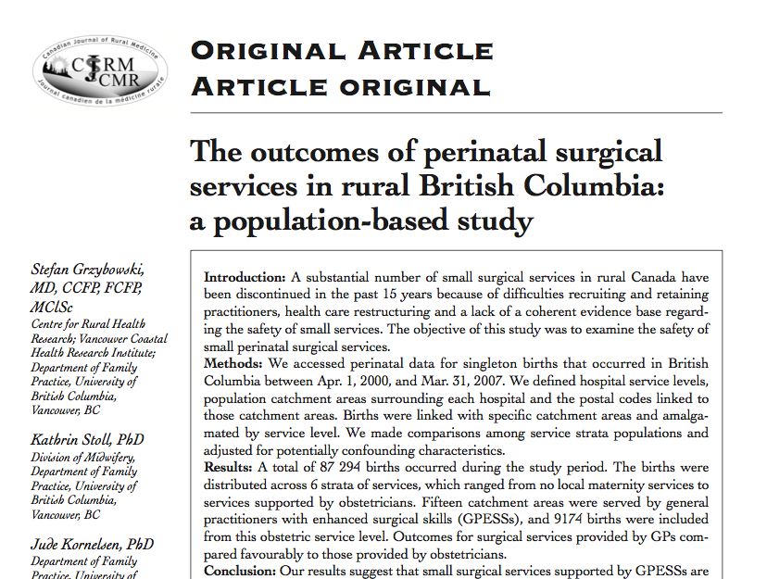
Population-based outcomes study
Grzybowski S, Stoll K, Kornelsen J. The Outcomes of Rural Perinatal Surgical Services in BC: A Population – Based Study. Canadian Journal of Rural Medicine, 2013; 18 (4): 123-129.

Slide 29
GP’s with Enhanced Surgical Skills
A set of defined competencies of rural family physicians, which generally include one or both of appendectomy and Caesarean section;
Generally found in communities of 5,000‐15,000 where ESS physicians provide most or all of the local surgical care; and,
in communities of 15,000‐25,000 where there is usually a significant local specialist presence that is supported by ESS physicians, especially for on-call relief (a “mixed” model).

Slide 32
Context:
Significant numbers of small surgical services in rural B.C. have been discontinued in the past 15 years;
Difficulties recruiting and retaining practitioners health care;
Lack of a coherent evidence base regarding the safety of small services.

Slide 33
Methods:
Compared perinatal outcomes by service level strata for singleton births that occurred in British Columbia between Apr. 1, 2000, and Mar. 31, 2007.

Slide 34
Findings:
A total of 87 294 births occurred during the study period;
The births were distributed across 6 strata of services, which ranged from no local maternity services to services supported by obstetricians;
Fifteen catchment areas were served by general practitioners with enhanced surgical skills (GPESSs), and 9174 births were included from this obstetric service level;
Population outcomes for surgical services provided by GPs were as good as those provided by obstetricians.

Slide 35
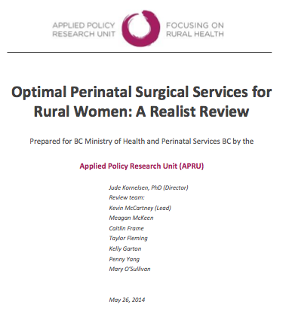
‘There is no existing clinical, case study or qualitative evidence that cesarean section is less safe when provided by GPESS than when provided by a specialist obstetrician.’
(Kornelsen 2014)

Slide 36
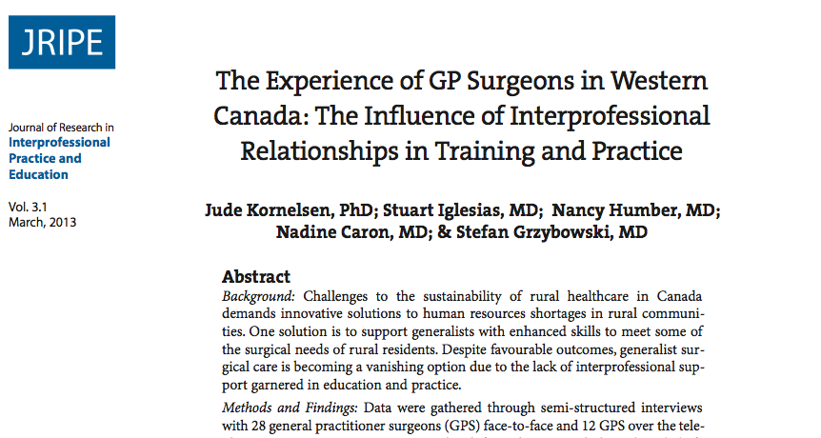
But…
No formal training opportunities / CME
No regulatory framework
Recent history of challenging inter-professional relationships

Slide 37
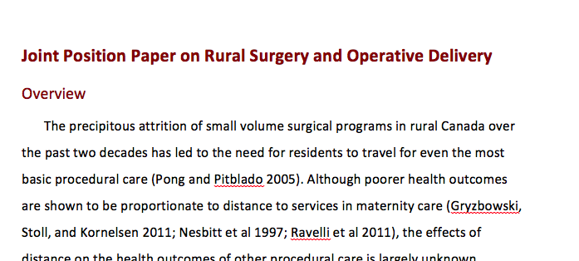
System shifts

Slide 38
Take Home Message:
‘Disruptive ideas’ require a solid evidence base;
Need to find the policy moment.

Slide 39
Emergency Transport
Historical organizational structure Police, Fire, Ambulance;
Paramilitary culture;
Works in urban centres;
Rurally - on call: paid when called out and transport occurs;
“You call – we haul”

Slide 40
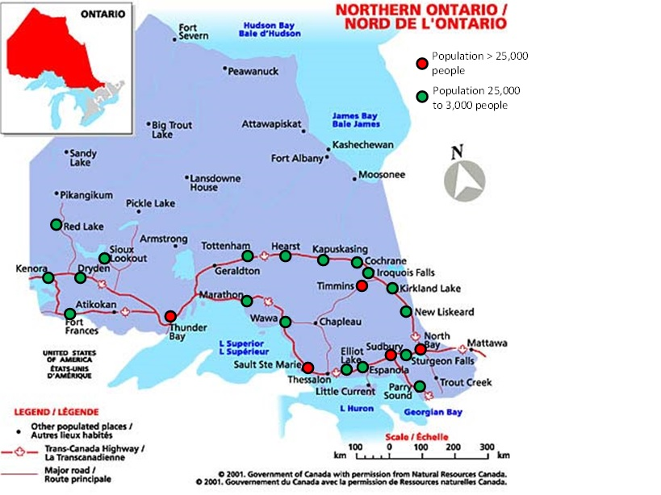

Slide 41
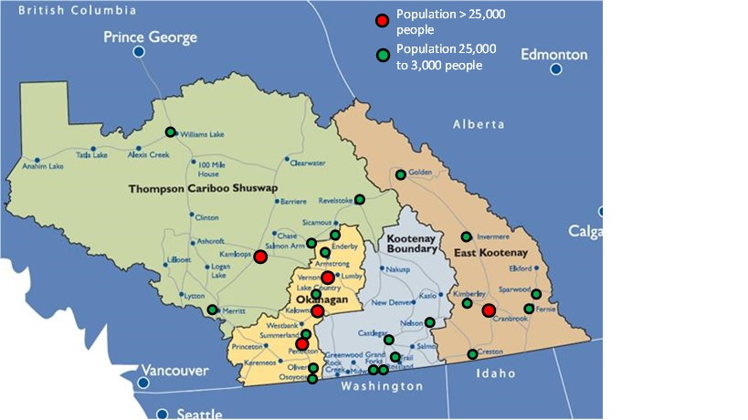

Slide 44
Overview of Emergency Transport Deployments in Interior Health Authority
2000 air transfers in IH per year
25,000 ground, inter-facility transfers (all acuity levels) in IH
Approximately 10% of overall volume are Yellow/Red Calls (High Acuity)
1200 HART transfers/year
30-35% of calls deploy the RT with the RN

Slide 45
Interviews
Base Hospitals: 30 interviews 4 sites
Satellite hospitals: 62 interviews 14 sites
Administrative site: 11 interviews 1 site
Other: 4 interviews N/A

Slide 46
Main Themes
Overall Satisfaction with the HART Program
Effects on Satellite Hospitals
Effects on Base Hospitals
Problems Identified with HART Program
Problems with the Rural Emergency Transport System;
Potential Solutions

Slide 47
Main Themes
Overall Satisfaction with the HART Program
Effects on Satellite Hospitals
Stabilizing the Workforce;
Change in Patterns of Responsibility;
Educational Outreach
Effects on Base Hospitals
Problems Identified with HART Program
Problems with the Rural Emergency Transport System;
Potential Solutions

Slide 48
Rural Health Services Systems Perspective
In an ideal world what could transport of high acuity rural patients look like?
What are the constraints on system evolution?

Slide 49
Systems Issues
There exists a somewhat artificial distinction between pre-hospital and inter-facility transport for rural patients which leads to a lack of service coordination and delays in transport.
Rural ambulance attendants are generally BLS certified, while urban-based attendants often have advanced certifications. Ironically, in an urban setting, the ambulance is generally close to advanced care support for patients; whereas in rural settings, there is often significant delay in being able to access advanced care.

Slide 50
Systems Issues
3. Inter-facility transport of high acuity patients from rural communities generally relies on medical and nursing staff from the small community to support the patient until the ambulance reaches the referral hospital. (Except for HART)
4. The BC Ambulance Services are not well integrated into local rural community hospital services. This can cause delays in inter-facility transport due to communication problems and competing priorities.

Slide 51
Potential System Recommendations
Establish a patient-centred emergency transport plan for high acuity rural patients which could be divided into 4 phases and planned for from the moment of the 911 call.
Pre-Hospital management;
Rural hospital care;
Transport to definitive care at a referral hospital;
Access to definitive care
Examples:
Chest pain – STEMI; or
MVI with serious injuries needing surgery.

Slide 52
Potential System Recommendations
2. Change the culture of the BC Ambulance service by moving away from the “Police, Fire, Ambulance” organizational approach to integrate ambulance services with hospitals.
Integrate paramedics into hospital and community health services;
Create flexible deployment of transport personnel in response to the acuity of the 911 call. Personnel might include a range of providers from BLS-trained paramedics to advanced skill transport nurses.

Slide 53
Potential System Recommendations
3. Comprehensive data management and transparency in order to improve the system.
Quality Improvement framework;
Timely Reporting;
Selected Case Review – Appropriateness of Transport

Slide 54
Implications
Recognize the ideas that are right in front of us;
Define the question(s) that will test the idea(s);
Do the research and the advocacy.

Slide 55
How?
Respect ideas; especially the “dangerous ones”;
Collaborate, collaborate, collaborate;
Recognize the expertise of rural (communities, health services, providers, perspective…)

