Slide 1
Glaucoma management in Canada – results from a nationwide survey.
Caputo MV¹, Arshinoff S^{2,3}, Scott G⁴, Mitchell B¹
¹Northern Ontario School of Medicine; ²University of Toronto; ³McMaster University; ⁴Laurentian University

Slide 3
Overview
Background: glaucoma is a leading cause of vision loss & disability in Canada.
Problem: sharp rise in vision loss expected through 2030.
Gap: little data available regarding glaucoma care practices in Canada.
Contribution: first study attempting to define current state of glaucoma care in Canada.
Notes:
Background:
The social and economic costs of vision loss represents an enormous burden in Canada –far ahead of most other diseases.
Problem:
vision loss is expected to rise sharply alongside aging population;
northern, rural and underserviced regions likely to face unique and important challenges.
Gap:
Unlike ARMD and DR, little scientific inquiry has focused on defining current glaucoma management in Canada.
Hook:
Canada urgently needs to develop a national vision plan to deal with the impending vision loss crisis. However, in order to guide policy-makers and other stakeholders, we must have a clear understanding of baseline care—including the strengths and weaknesses that will make possible the judicious allocation of limited healthcare resources. How can we strive to improve, or decide progress has been made if we lack baseline measures?
To address the paucity of data related to glaucoma management practices in Canada;

Slide 4
Context
https://www.aao.org/eye-health/diseases/glaucoma-vision-simulator

Slide 5
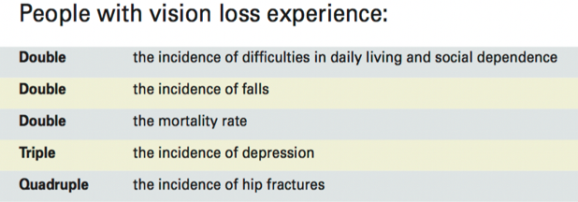
Context
Visual impairment exacts major social and economic costs¹
¹http://www.cnib.ca/en/about/media/vision-loss/Pages/default.aspx
Notes:
Visual impairment exacts major social and economic costs.
People with vision loss are at greater risk of social isolation and reduced community participation; and suffer double the incidence of falls, double the mortality rate, triple the incidence of major depressive disorder and quadruple the incidence of hip fractures.

Slide 6
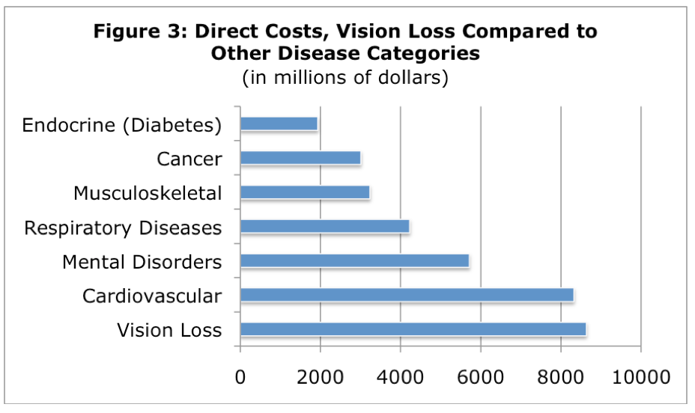
Context
Vision loss costs Canadians more health care dollars annually than any other disease category²
²The Cost of Vision Loss in Canada: A Report by Access Economics
Pty Limited for CNIB and COS, June 2009; available at www.cnib.ca.
Notes:
When compared to other diseases, vision loss – an all inclusive term that covers all people who are blind or partially sighted - represents an enormous burden in terms of financial expenditure, largely due to the high cost on lost productivity to the Canadian economy.
Vision loss costs Canadians more healthcare dollars each year than any other disease category, including 1) all cancer types; 2) Diabetes mellitus; 3) Cardiovascular disease. This cost is estimated to represent $15.8 billion per year, in which 55% is allocated to direct health care costs.

Slide 7
Context
The prevalence of vision loss in Canada is expected to increase nearly 30% in the next decade¹⁻³
Notes:
Approximately half a million Canadians are estimated to be living with significant vision loss that impacts their quality of life, and every year more than 50,000 Canadians will lose their sight.

Slide 8
Problem
Glaucoma: optic neuropathy +/- vision loss³
Second-leading cause of irreversible blindness in Canada¹⁻³
Associated with diagnostic delay¹⁻³
Timely treatment minimizes blindness³
Current standard of care relies on specialist involvement and availability of costly equipment³
Substantial variability in access to timely, quality health care in northern, rural, underserved regions
³http://cos-sco.ca/wp-content/uploads/2012/09/VisionLossinCanada_e.pdf
Notes:
Timely treatment minimizes blindness
Substantial variability in access to quality and timely health care in northern and rural regions
Screening for early disease is critically important.
Early and consistent detection relies largely on involvement of specialist physicians and availability of expensive diagnostic tools.
Furthermore, this sinister disease is associated with diagnostic delay. Since glaucoma progression can often be slowed when appropriately treated, screening for early disease is a critically important step required before initiation of disease-slowing therapy. There is a long-standing issue faced by Canadians regarding variable access to quality health care in the rural, remote and indigenous communities.

Slide 9
Study Objective
The aim of this study was to identify the current state of glaucoma management in Canada.
Notes:
With all of this information in mind, this study sought to identify the current state of glaucoma management across Canada.

Slide 10
Survey Design
Cross-sectional, self-report survey design
Survey endorsed by Canadian Ophthalmological Society
Questions included:
Does your department/practice have a designated person with over-riding
responsibility for glaucoma care?
Total number of patient visits to physicians and/or nurses during week 42?
Number of visits related to glaucoma during the same week?
Total number of patient visits (all-cause) to physicians or physicians and nurses?
# visits to nurse without a physician appointment?
# visual field tests (# eyes tested)?
# eyes subjected to fundus photography and/or computerized imaging?
Available diagnostic equipment (answers given by checking a table).
Creswell, J. W. (2013). Research design: Qualitative, quantitative, and mixed methods approaches. Sage publications.
Notes:
This research ethics board-approved study employed a cross-sectional, self-report design. We carefully modified a previously validated survey to include questions relevant to the provision of eye care in rural and underserved regions of Canada. A link to the survey was sent electronically by the Canadian Ophthalmological Society (COS) to all official members in Canada. Follow-up communication was also facilitated by the COS.
Answers were analysed based on type of health care providers and also with respect geographical region,
Previously validated survey³ modified to address questions relevant to northern and underserved populations
Responses were compared by province and Local Health Integration Network
This survey assessed glaucoma management practices including practice location, patient volume, assessment techniques, and TeleOphthalmology utilization. Geographic area was assessed by province and for those participants that were located in Ontario, Local Health Integration Network or ‘LHIN’.

Slide 11
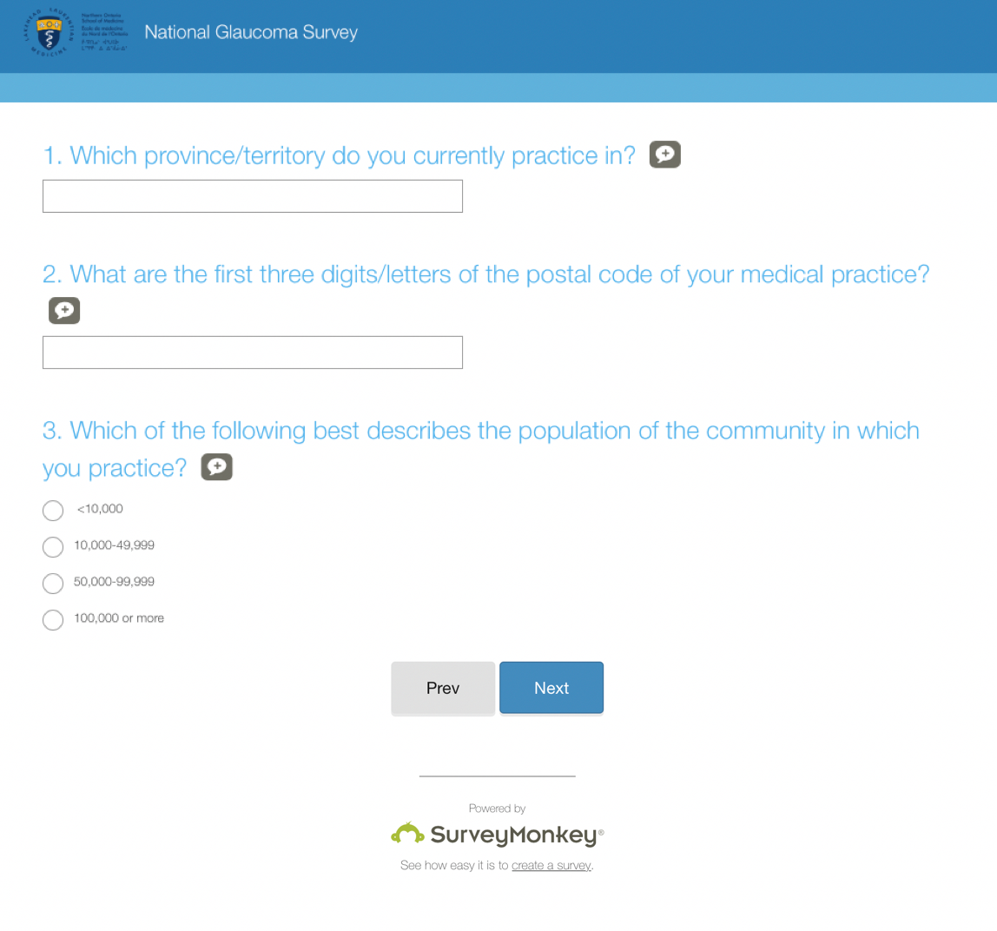
Electronic Survey

Slide 12
Data Collection
A modified Dillman approach was used:
Initial survey
2 weeks
2nd copy of survey
3 weeks
First reminder
3 weeks
Final reminder
Hoddinott, Susan N., and Martin J. Bass. "The Dillman total design survey method." Canadian family physician 32 (1986): 2366.
Notes:
The survey was distributed using a modified Dillman Method (Dillman, 1978). Surveys, accompanied by a brief cover letter that explained the purpose of the study and voluntary participation, were emailed to all surgeons listed on the official member list of the Canadian Ophthalmological Society in February 2017. Exactly two weeks later a reminder email, also accompanied by the survey, was re-distributed to all members. Email recipients were given the option of completing the survey online using an electronic Survey Monkey link, or completing the pdf copy of the survey and returning it to the email address provided. All survey materials were provided in both English and French. Completed surveys were received between February and June 2017.

Slide 13
Data Analysis
Descriptive statistics
Kruskal-Wallis Test
Notes:
All data were extracted and analyzed in an Excel database by a member of the research team. Responses were assessed individually and also grouped by province. Descriptive statistics were generated for each question. A Kruskal-Wallis test was used to compare patient volume estimates between groups (provinces). This non-parametric alternative was selected to account for the violation of normality encountered. This was examined using the Kolmogorov-Smirnov test. Violation of normality is quite common in samples of this size.

Slide 14
Results
Survey sent to 624 ophthalmologists practicing in Canada.
109 completed responses were received:
104 English (95.4%)
5 French (4.6%)
Response rate:
=109/624 =0.17468 = 17.5%

Slide 15
Participant Demographics
Survey Item | Participants (n,%)
Title Ophthalmologist Resident/trainee | 103 (94.5) 6 (5.5)
Province British Columbia Alberta Saskatchewan Manitoba Ontario Quebec Nova Scotia New Brunswick Prince Edward Island Newfoundland and Labrador | 22 (20.2) 9 (8.3) 2 (1.8) 3 (2.8) 45 (41.3) 16 (14.7) 7 (6.4) 4 (3.7) 1 (0.9) 0 (0)
Community Population <10,000 10,000 – 49,999 50,000 – 99,999 100,000+ | 1 (0.9) 12 (11.0) 7 (6.4) 89 (81.7)
Notes:
The breakdown of participant demographics is as follows. The majority were practicing ophthalmologists. Distributed across Canada. However, Of note, there were no respondents from Newfoundland and Labrador or any of the Territories. And finally the majority of participants practiced in communities with greater than 100,000 residents.

Slide 16
Results
Total number of patient visits per week | Mean = 296 (range = 20 – 3200)
Total number of glaucoma-related visits per week | Mean = 95 (range = 10 – 1100)
Total number of glaucoma-related visits to a non-physician per week* | Mean = 24 (range = 0 – 440)
British Columbia Alberta Saskatchewan Manitoba Ontario Quebec Nova Scotia New Brunswick Prince Edward Island | Md = 20/week Md = 2/week Md = 8/week Md = 1/week Md = 0/week Md = 0/week Md = 10/week Md = 12.5/week Md = 4/week
* p <0.05
Notes:
After inquiring about demographic features, we then assessed the patient volumes of the participants in the study. Participants were first asked to estimate the total number of patients they saw in a given week. For consistency, participants were asked to use week 4 of the current 52-week calendar year (January 23-29, 2017) as a reference. For this question, the mean number of visits per week was 296 with a wide range of 20 to 3200. We then asked participants to refine that estimate and instead identify only the number of glaucoma-related visits they had per week. For this the mean was 95 with a range of 10 – 1100. Now interestingly, despite these wide ranges, for these first two questions, when respondents were grouped and compared by province, there was not a statistically significant difference between provinces. The third question asked for the number of glaucoma-related visits to a non-physician, so perhaps an ophthalmic assistant or nurse took place in their practice and for this question the mean was 24 with a range of 0 – 440. Unlike the first two question, for this estimate there was a statistically significant difference between provinces identified with a p value of .016. As you can see on the slide, British Columbia had the greatest number of visits to a non-physician and Ontario and Quebec were tied for the least.

Slide 17
Results
Does your practice utilize TeleOphthalmology services?
‘Please choose one of the following as the statement that best describes the reason your practice does not use TeleOphthalmology services’:
TeleOphthalmology would not benefit my patients (12.7%)
I have been meaning to look further into using TeleOphthalmology services (17.6%)
TeleOphthalmology could lead to worse patient outcomes (0%)
TeleOphthalmology does not make financial sense to my practice (2.9%)
TeleOphthalmology? Never heard of it (2.9%)
TeleOphthalmology takes too long and limits the number of patients I can see (6.9%)
Equipment setup is complicated and time consuming (7.8%)
Yes (6.4%)
No (93.6%)
Notes:
The next section of the questionnaire asked participants to comment on their use of TeleOphthalmology services. First we asked participants whether or not their practice utilized TeleOphthalmology services. For this question the answer was a resounding No. 93.6% of respondents or 102 in total responded no to this question. For these individuals we wanted to find out why they weren’t using these services and invited them to select the best possible statement from a dropdown menu. You can see the various responses to the right. On an optimistic note, the most popular choice was ‘I have been meaning to look further into TeleOphthalmology services, with 17.6% of respondents selecting this option.

Slide 18
Results
Do you feel that you have access to the equipment you need to properly identify and manage patients with glaucoma?
Notes:
Finally we asked participants if they felt they had access to the equipment needed to properly identify and manage patients with glaucoma and for this question, the overwhelming majority, or 94.5% said yes.

Slide 19
Discussion
Patient volumes and Teleophthalmology usage varies greatly across the province.
Glaucoma management by interdisciplinary teams, including visits to non-physicians, would appear to be an underutilized area across the majority of provinces.
Despite a wide range of reported estimates of patient visits and glaucoma specific visits, there was not a statistically significant difference in the volume of patients seen per week based on province or LHIN in Ontario.
Teleophthalmology would appear to be highly underutilized.
The majority of physicians felt that they had access to the equipment needed to properly identify and manage patients with glaucoma.
Notes:
Overall, patient volumes and teleophthalmology usage varies greatly across the province. Glaucoma management by interdisciplinary teams, including visits to non-physicians, would appear to be an underutilized area across the majority of provinces. British Columbia was the exception to this case. And perhaps future research should compare the interdisciplinary management of glaucoma to patient outcomes. Despite a wide range of reported estimates of patient visits and glaucoma specific visits, there was not a statistically significant difference in the volume of patients seen per week based on province or LHIN in Ontario. Teleophthalmology would appear to be highly underutilized. The reason for which remains to be elucidated, however a significant number of respondents reported intending to look into such services. It would appear that the majority of physicians felt that they had access to the equipment needed to properly identify and manage patients with glaucoma.

Slide 20
Future Directions
Greater understanding of the distribution of eye care services provided in Canada would be valuable.
There may exist a wealth of information based on the non-respondents to this study.
Methods of delivering care cost- effectively to remote populations and new methods of delivering eye care more effectively in urban and rural Canada should be explored.
CNIB Eye Van
TeleOphthalmology (diabetic retinopathy, glaucoma, ARMD)
Notes:
In terms of future directions, it would be valuable to understand in greater detail the distribution of eye care services provided in Canada, especially in more rural and remote areas. There may exist a wealth of information based on the non-respondents to this study. That is, there were a significant number of ophthalmologists surveyed who did not complete the survey. Perhaps there is an intrinsic difference in those who chose not to participate. Secondly, there are vast geographic areas not covered in this study, indicating potential gaps in glaucoma management. In Ontario specifically, there were no respondents from the Northwest LHIN spanning Thunder Bay and surrounding area. Furthermore, the question remains whether patient outcomes (both morbidity and mortality as well as patient reported outcomes) vary based on location or population. And finally, methods of delivering care cost- effectively to remote populations and new methods of delivering eye care more effectively in urban and rural Canada should be explored.

Slide 21
Limitations
Significant risk of non-response bias due to limited response rate
Volunteer bias
Technical challenges
Notes:
There are important potential limitations to note in this study. First, this was a voluntary, self-report survey. With this, there may be an element of response bias, that is the tendency of a person to answer questions in what they perceive to be the most socially acceptable way. As I eluded to earlier, there may also be an element of volunteer bias, that is that people who volunteer to participate may have some different characteristics than those who do not volunteer. And finally because this was an electronic survey, we expect that technical difficulties are ubiquitous and that may have precluded individuals from participating or manifested bias in the answers and results.

Slide 22
Conclusions
This study serves as a baseline measure of glaucoma management in Canada.
Unequal distribution of practitioners and resources.
Unclear of the impact on patient care/outcomes.
Health service delivery models specific to rural ophthalmology care should be explored.
Notes:
The results of the study may serve as an important baseline measure of glaucoma management across the country. Based on the geographic distribution of respondents, it would appear that some areas of the country and in particular some areas of our province, are under resourced. The extent to which this resource allocation has on patient care and patient outcomes remains to be explored. Finally, To pursue equity in eye care and vision-related disability across the nation, health service delivery models specific to rural ophthalmology care must first be identified.

Slide 23
References
Chauhan, B. C., Mikelberg, F. S., Balaszi, A. G., LeBlanc, R. P., Lesk, M. R., & Trope, G. E. (2008). Canadian Glaucoma Study: 2. risk factors for the progression of open-angle glaucoma. Archives of ophthalmology, 126(8), 1030-1036.
Fung, S. S., Lemer, C., Russell, R. A., Malik, R., & Crabb, D. P. (2013). Are practical recommendations practiced? A national multi-centre cross-sectional study on frequency of visual field testing in glaucoma. British Journal of Ophthalmology, bjophthalmol-2012.
Iskedjian, M., Walker, J., Vicente, C., Trope, G. E., Buys, Y., Einarson, T. R., & Covert, D. (2003). Cost of glaucoma in Canada: analyses based on visual field and physician's assessment. Journal of glaucoma, 12(6), 456-462.
Leske, M. C., Heijl, A., Hyman, L., Bengtsson, B., & Early Manifest Glaucoma Trial Group. (1999). Early Manifest Glaucoma Trial: design and baseline data. Ophthalmology, 106(11), 2144-2153.
Linden, C., Bengtsson, B., Alm, A., Calissendorff, B., Eckerlund, I., & Heijl, A. (2013). Glaucoma management in Sweden—results from a nationwide survey. Acta Ophthalmology, 91(1), 20-24.
Verma, S., Arora, S., Kassam, F., Edwards, M. C., & Damji, K. F. (2014). Northern Alberta remote teleglaucoma program: clinical outcomes and patient disposition. Canadian Journal of Ophthalmology, 49(2), 135-140.

Slide 24
Acknowledgements
Dr. Brian Mitchell & Dr. Steve Arshinoff
Sault Ste. Marie Academic Medical Association
NOSM Dean’s Summer Student Research Award

Slide 25
Questions?

