Slide 1
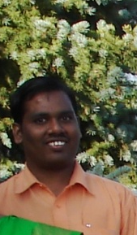
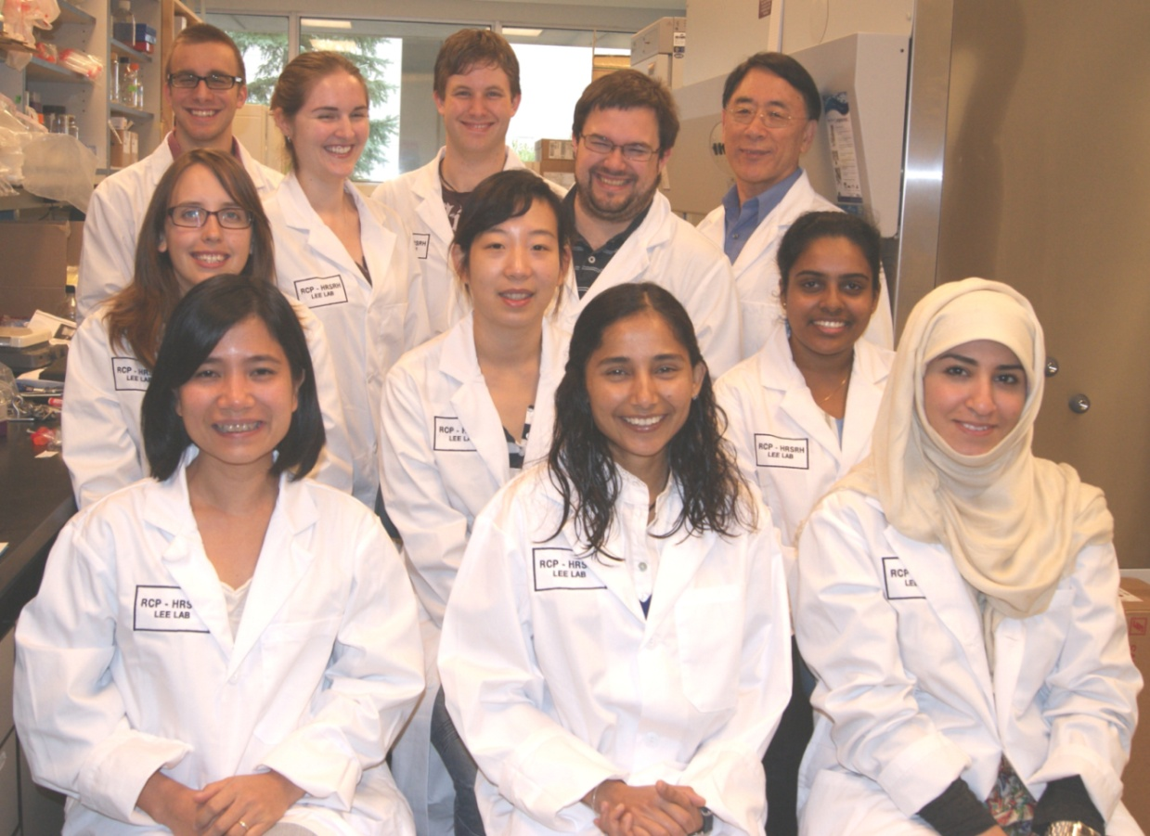




VR-23, a New Anticancer Drug Developed in Northern Ontario
Hai-Yen Vu, PhD and Hoyun Lee, PhD

Slide 2
Disclosure
VR23 has been filed for intellectual property protection to the U.S.A. (#61772032) and the International Patent Corporation Treaty (#PCT/CA2014/000121)
Hoyun Lee, the co-author of this presentation, is the Chief Scientific Officer and a major share holder of Ramsey Lake Pharmaceutical Corporation (RLPC), which has recently been created based on VR23 invention

Slide 3
Research Projects in the Lee Laboratory
How does a cell divide into two daughter cells? (Differences in cancer and normal cells?)
How signaling circuit is regulated in the cell? (Differences in cancer and normal cells?)
Drug discovery project I
  Synthetic compounds
  Natural products/compounds
Drug discovery project II
  Anti-bacterial
  Anti-fungal
  Anti-parasitic

Slide 4
Drug Discovery Project I
Focus:
Developing effective and safe anticancer drugs
(as single regimens or in combinations with other drugs)

Slide 5
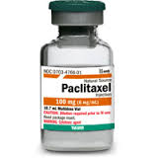
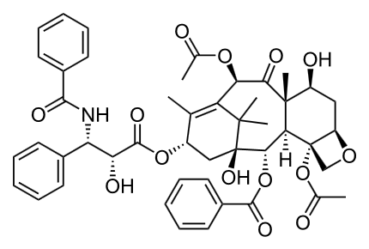

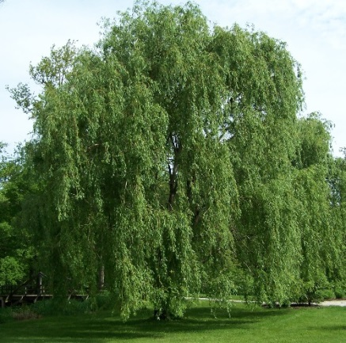
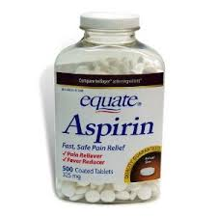
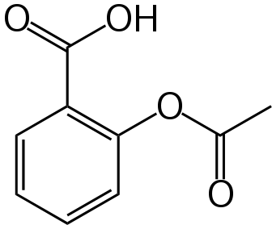
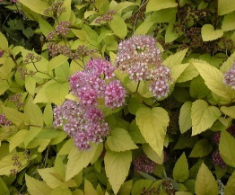
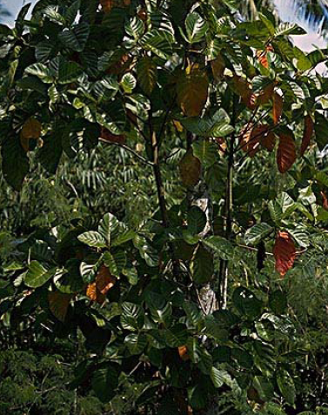
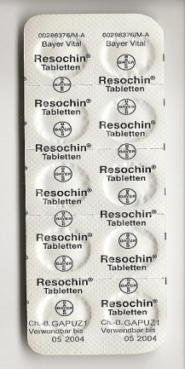
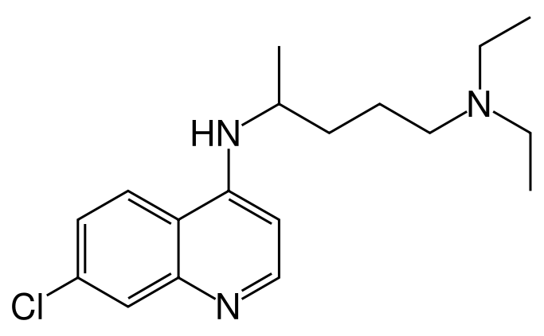
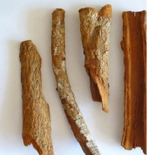
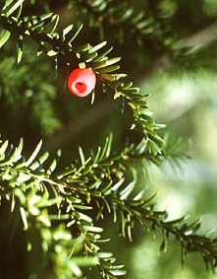
Yew tree
Willow & Spiraea
Cinchona (Quina)

Slide 6
Chemical libraries created by the Lee group
Quinoline-sulfonyl derivatives: 35 compounds, including VR-23
Chloroquine derivatives: 34 compounds
Quinacrine-thiazolidin-4-one derivatives: 42 compounds
Chalcone derivatives: 24 compounds
Isatin-benzothiazole derivatives: 30 compounds
4-Piperazinylquinoline derivatives: 25 compounds
4-aminoquinoline-thiourea/urea derivatives: 25 compounds
Inhibitors of signal transduction pathways (Dr. Piyush Trivedi): 75 compounds (CTR 17, 18, 19, 20)
Total: 290 novel compounds

Slide 7
31 compounds
applied for
IP protection

Slide 8
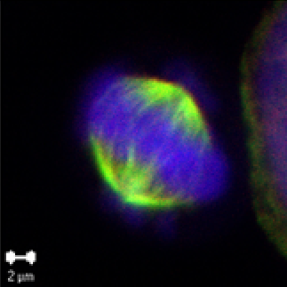
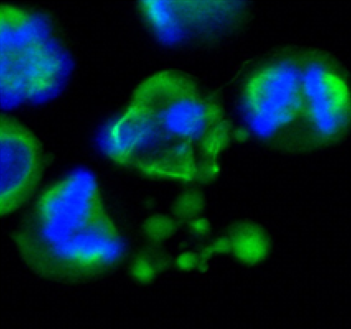
How does VR23 preferentially kill cancer cells?
VR23
VR23 treated normal cells
VR23 treated
cancer cells

Slide 9
Tumor Types | Killing Effects (Cancer vs normal cells in fold)
Breast Cancer | 2.6-17.6
Brain Cancer | 11.3-15.4
T Cell Leukemia | 11.3-15.4
Multiple Myeloma | 3.1-8.4

Slide 10
Bortezomib (BTZ), a proteasome inhibitor like VR23, is effective for the treatment of many different blood cancers including multiple myeloma. However, the development of BTZ-resistant tumor is a big problem.
VR23 may be able to overcome BTZ-resistance in cancer.

Slide 11
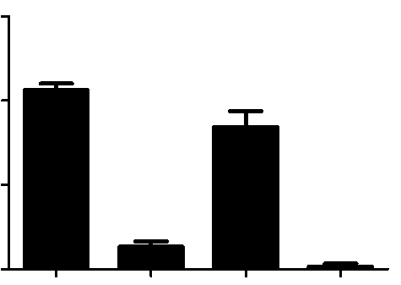
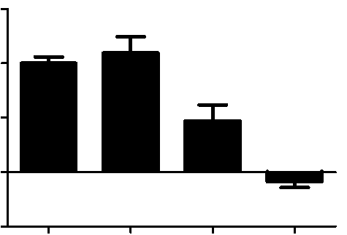
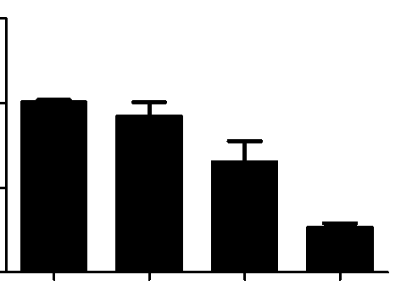
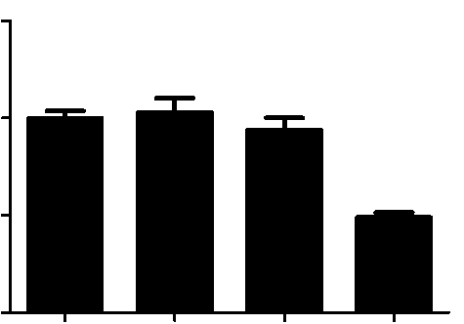
Combination of VR23 and Low Dose BTZ Dramatically Increases Cancer Cell Death and Overcomes BTZ Resistance in Multiple Myeloma Cells
Wild type
BTZ Resistant
B
150
100
50
0
E
150
8226-BR cells p < 0.0001
RPMI-8226 cells p=0.0004
100
Cell growth rates
50
100%
109.7%
Cell growth rates
100%
79.3%
47%
-8.6%
0
12.5%
1.6%
-50
Sham BTZ VR23 BTZ+VR23
Sham BTZ VR23 BTZ+VR23
C
F
150
100
50
0
150
100
50
0
KAS6/1 cells p= 0.0030
ANBL6-BR cells p<0.0001
Cell growth rates
Cell growth rates
100%
92%
100%
102.9%
94%
65%
48.9%
26.5%
Sham BTZ VR23 BTZ+VR23
Sham BTZ VR23 BTZ+VR23

Slide 12
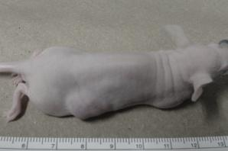
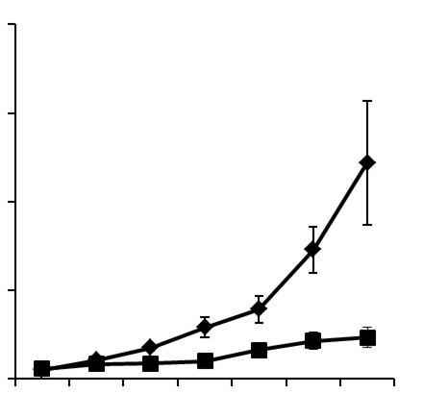


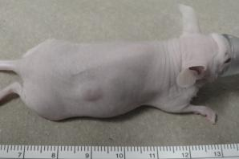
VR23 shows promising antitumor activity in animals
Untreated mouse
2000
Control
VR23-30mg/kg
1500
Tumor size (mm³)
1000
VR23 (20 mg/kg for 3 weeks)
500
0
D0 D6 D9 D13 D16 D19 D24
Post-treatment (days)

Slide 13
VR23 shows strong antitumor activity on metastatic breast cancer, and particularly effective when used in combination with paclitaxel (Taxol®)
 | Day 0 | Day 7 | Day 15 | Day 18 | Day 22
Vehicle | 50.25 ±4.84 | 94.50 ±32.52 | 132.39 ±32.56 | 246.72 ±10.55 | 305.01 ±37.95
VR23 | 46.51 ±2.82 | 52.74 ± 5.64 | 48.29 ±17.30 | 42.41 ±17.95 | 65.88 ±25.92
Tax | 43.04 ±4.05 | 47.63 ± 8.67 | 23.25 ±11.63 | 25.20 ±13.69 | 16.59 ±2.66
Tax + VR23 | 50.69 ±5.22 | 42.90 ± 9.91 | 20.16 ±1.00 | 20.13 ±7.80 | 10.51 ±3.56
* Data is from a study of MDA-MB231 breast tumor induced in ATH 490 mice

Slide 14
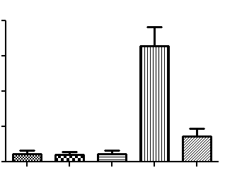
VR23 enhances the efficacy of Taxol® while dramatically reducing its side effects
1.6
1.2
0.8
0.4
0.0
Number of mitotic cells per mm²
Untreat
Vehicle
VR23
Tax
Tax, VR23
Liver toxicity
Notes:
CQ accumulates inside the digestive vacuole of the infected red blood cells. CQ acts by binding to heme molecules released from the hemoglobin that is digested by malalia parasites as they grow within their host red blood cells. This binding interferes with the process by which heme is normally incorporated into inert crystals and detoxified, thereby effectively poisoning the parasites. The plasmidium falciparum is the most pathogenic malarial parasites. The CQ resistantant parasites can reduce CQ accumulation in their acid digestive vacuoles where the drug causes damaging effects.

Slide 15
Next Steps
VR23 in brain cancer treatment
  Recently found that VR23 can kill brain cancer cells >40 times more effectively than Temozolomide®, a “standard” therapeutic agent to treat brain cancer
  When combined with radiation, VR23 can effectively kill temozolomide®-resistant brain cancer cells
Further looking into VR23’s efficacy on other cancer types
Developing effective combinational therapies utilizing biomarkers being studied in our lab

Slide 16





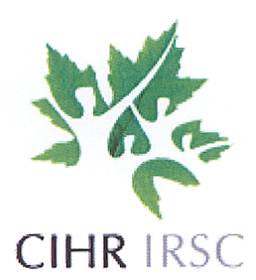
Acknowledgement
Researchers:
V. Raja Solomon
Sheetal Pundir
Funders:
NSERC
NOHFC

