Slide 1
Faculty/Presenter Disclosure Slide
Michael Conlon
Relationships with commercial interests: NONE
Potential for conflict(s) of interest: NONE

Slide 2
Trends in end-of-life care for northern and rural Ontario cancer patients
Mike Conlon

Slide 3
Barbara Ballantyne, Palliative Symptom Management Clinic
Joe Caswell, Epidemiology, HSN
Craig Earle, Institute for Clinical Evaluative Sciences
Mark Hartman, Northeast Cancer Centre, HSN
Andrew Knight, Palliative Symptom Management Clinic
Peggy Meigs, Epidemiology, HSN
Stacey Santi, Epidemiology, HSN

Slide 5
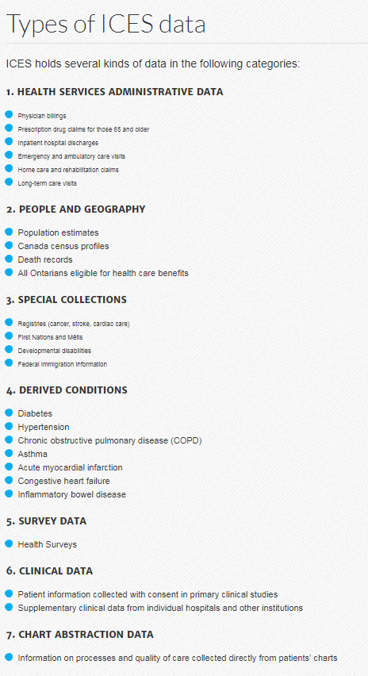

Slide 6
ICES CORE Data Repository: Coded and Linkable
Provider/
Facilities
Real-time
Health Service
Encounters
People & Geography
Special Collections*
Derived Chronic Conditions
Project Specific Research Data
Physicians
Hospitals
Complex care
Long-term care homes
Home care
Health Outcomes for Better Information Care (nursing home)
Implantable Cardiac Defibrillators
Physician claims
Hospital discharge abstracts
Emergency visits
Ontario Drug Benefit claims
Narcotics Monitoring System
Home care
Rehab
Long-term care
People in Ontario eligible for health care since 1985
Unique individual
ICES Key Number (IKN) used for linking across all data sets
Demographics
Deaths
Census
Disease registries (ex. cancer, stroke, cardiac, perinatal)
HIV clinics
Immigration
First Nation
Métis
Social Assistance
Disabilities
Early Development Instrument
Using routine ICES data
Diabetes
Respiratory problems (ex. Asthma, chronic obstructive pulmonary disease)
Cardiac problems (ex. heart attacks, hypertension)
Schizophrenia
Many others
* Special
governance
Linked
data set

Slide 7
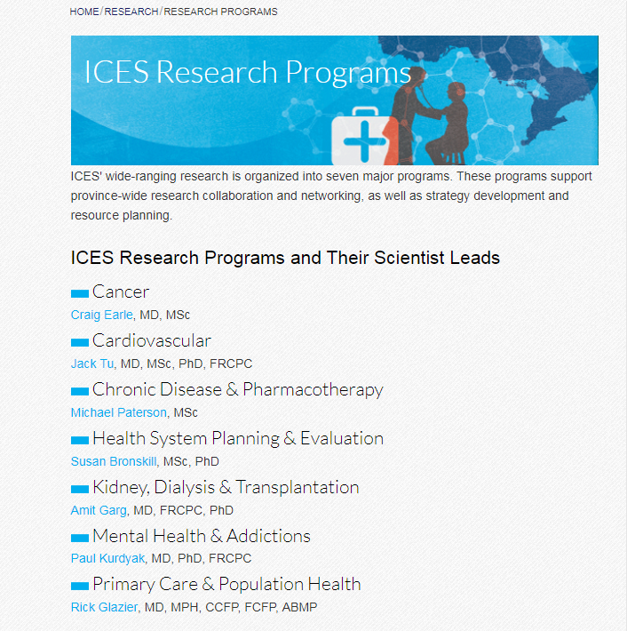

Slide 8
How to access data/analytics at ICES
Through a collaboration with an ICES scientist at any satellite site
Access to the entire data repository and analytic staff
ICES project – ICES PI responsible for the final product
Through ICES Data & Analytic Services
Access to most data repositories (individual-level records)
Analytic services
Considered third party project
REB governed
AHRQ

Slide 9
Available Services
Access to highly risk-reduced coded data
Available through secure “Virtual Desktop Infrastructure” called IDAVE
Client performs analyses using analytics software and produces reports
Re-identification risk assessment is conducted on all research results
Full analytic services
Data set creation and analysis according to client requirements
Report generation
Linkage of ICES data holdings with external project-specific data
Data sharing agreement required

Slide 10
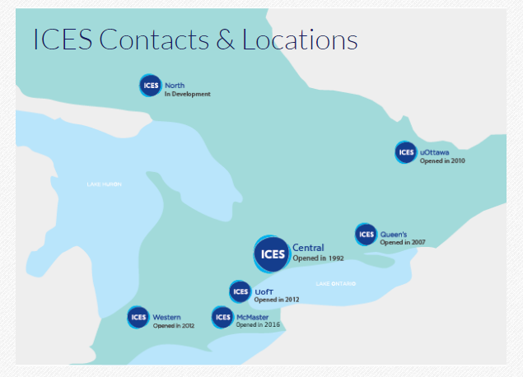

Slide 11
Trends in end-of-life care for northern and rural Ontario cancer patients

Slide 12
Guiding questions for our project
How many residents of Ontario, with a cancer diagnoses, died with cancer as the cause of death, within 2007-2012?
What proportion experienced at least one form of potentially aggressive end-of-life care?
What proportion experienced palliative care?
Was there an association between palliative care and the use of potentially aggressive end-of-life care?
What risk factors were associated with never having received palliative care?

Slide 13
ICES CORE Data Repository: Coded and Linkable
Provider/
Facilities
Real-time
Health Service
Encounters
People & Geography
Special Collections*
Derived Chronic Conditions
Project Specific Research Data
Physicians
Hospitals
Complex care
Long-term care homes
Home care
Health Outcomes for Better Information Care (nursing home)
Implantable Cardiac Defibrillators
Physician claims
Hospital discharge abstracts
Emergency visits
Ontario Drug Benefit claims
Narcotics Monitoring System
Home care
Rehab
Long-term care
People in Ontario eligible for health care since 1985
Unique individual
ICES Key Number (IKN) used for linking across all data sets
Demographics
Deaths
Census
Disease registries (ex. cancer, stroke, cardiac, perinatal)
HIV clinics
Immigration
First Nation
Métis
Social Assistance
Disabilities
Early Development Instrument
Using routine ICES data
Diabetes
Respiratory problems (ex. Asthma, chronic obstructive pulmonary disease)
Cardiac problems (ex. heart attacks, hypertension)
Schizophrenia
Many others
* Special
governance
Linked
data set

Slide 14
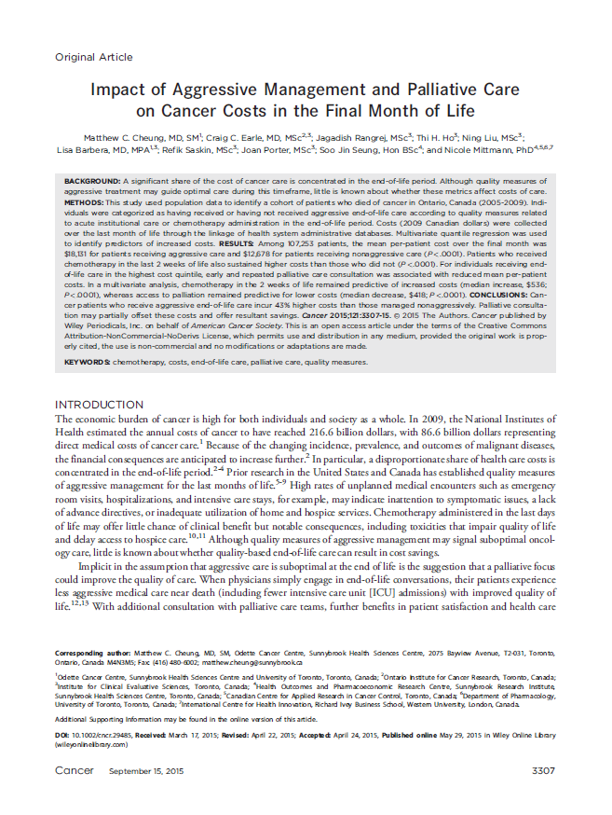
Palliative care defined by hospitalization, home care, physician billing codes specific for palliative consultation
At least 2 palliative codes identified at least 30 days apart and in the last 365 days before death

Slide 15
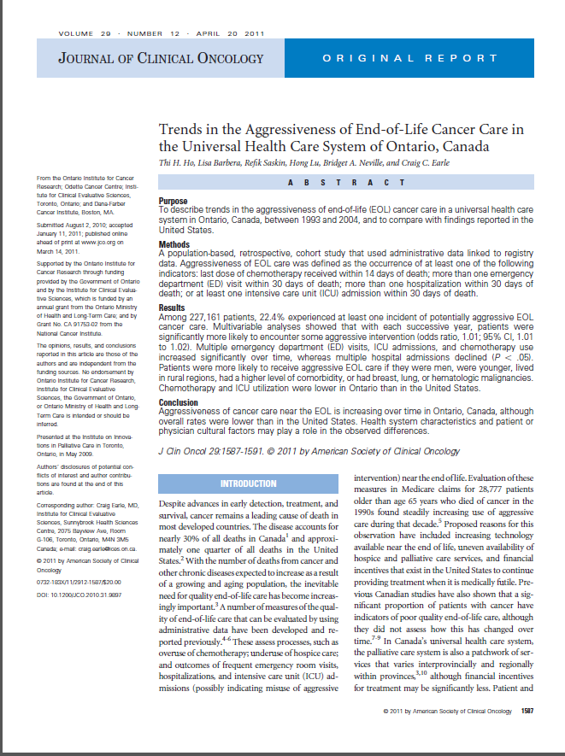
Last dose of chemotherapy received within 14 days of death
More than 1 ED visit within 30 days of death
More than 1 hospitalization within 30 days of death
At least one ICU admission within 30 days of death

Slide 16
How many deaths from cancer?
129,107
What proportion received palliative care in the last year of life?
74%
Older, male, low income, north/rural were associated with not receiving palliative care

Slide 17
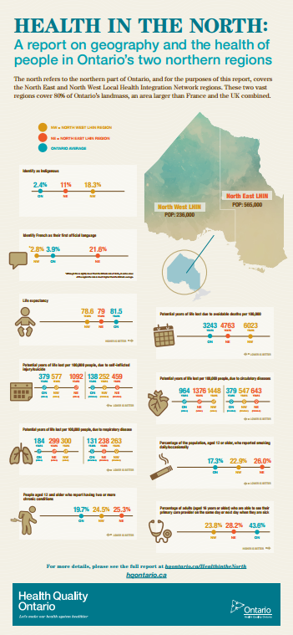
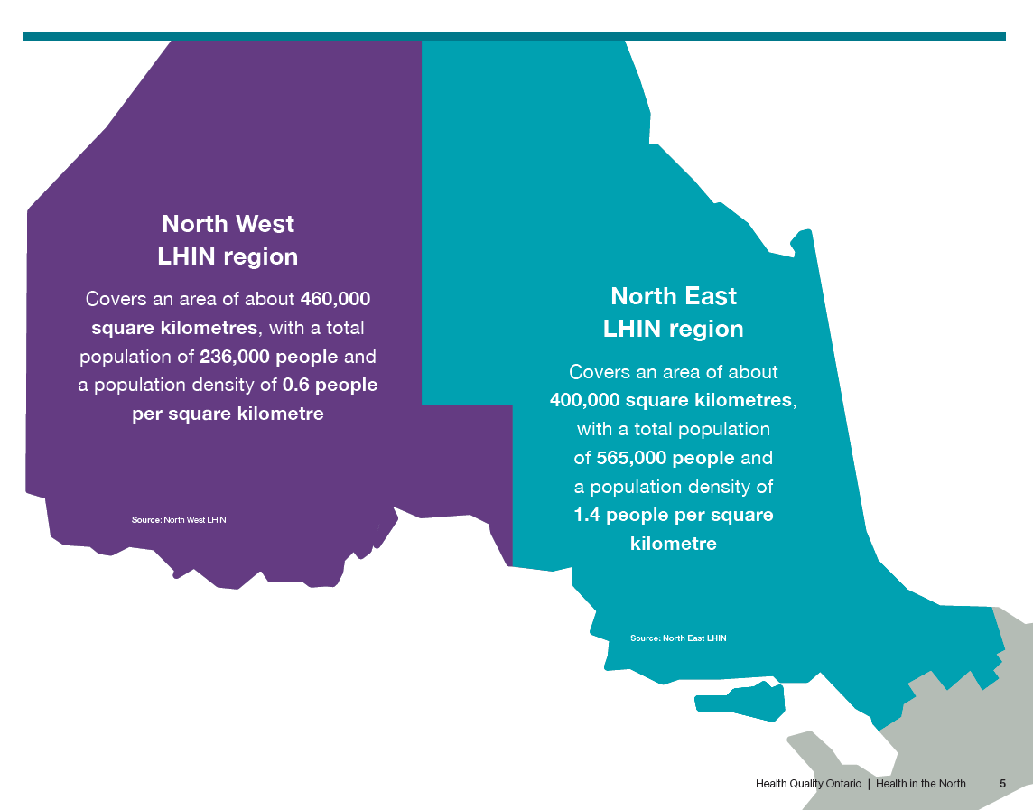

Slide 20
EoLC - Any
No | 96787 | 74.97
Yes | 32320 | 25.03
Palliative
No | 33422 | 25.89
Yes | 95685 | 74.11

Slide 21
Death in Acute Care
No | 68141 | 52.78
Yes | 60966 | 47.22
Palliative
No | 33422 | 25.89
Yes | 95685 | 74.11

Slide 22
EoLC - Chemotherapy
No | 124612 | 96.52
Yes | 4495 | 3.48
EoLC - ED
No | 110244 | 85.39
Yes | 18863 | 14.61
EoLC - ICU
No | 119786 | 92.78
Yes | 9321 | 7.22
EoLC - Hospitalization
No | 118020 | 91.41
Yes | 11087 | 8.59

Slide 23
Summary
Strong relationship between pc and a-eolc, northern/rural Ontario lower pc higher a-eolc
Equity, proxy measures, different “roles” of acute care and ED in northern/rural areas are expected to be occurrring
Acknowledge NCF, Cancer Program ICES
mconlon@hsnsudbury.ca

