Slide 1
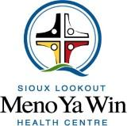
Using the first nation medicine wheel as an aid to ethical decision-making in medical care
Brunton N; Kakekagumick K; Cromarty H, RN; Linkewich B, HBScN; Kelly L, MD, M Clin Sci, FCFP, FRRM; O’Driscoll T, MD, FCFP; Schroeter A, MA.

Slide 2
Conflict of Interest Declaration: Nothing to Disclose
Presenter: Annette Schroeter
Title of Presentation:Using the First Nation Medicine Wheel for Ethical Decision-Making in Medical Care
I have no financial or personal relationships to disclose

Slide 3
SLMHc Ethics Framework

Slide 4
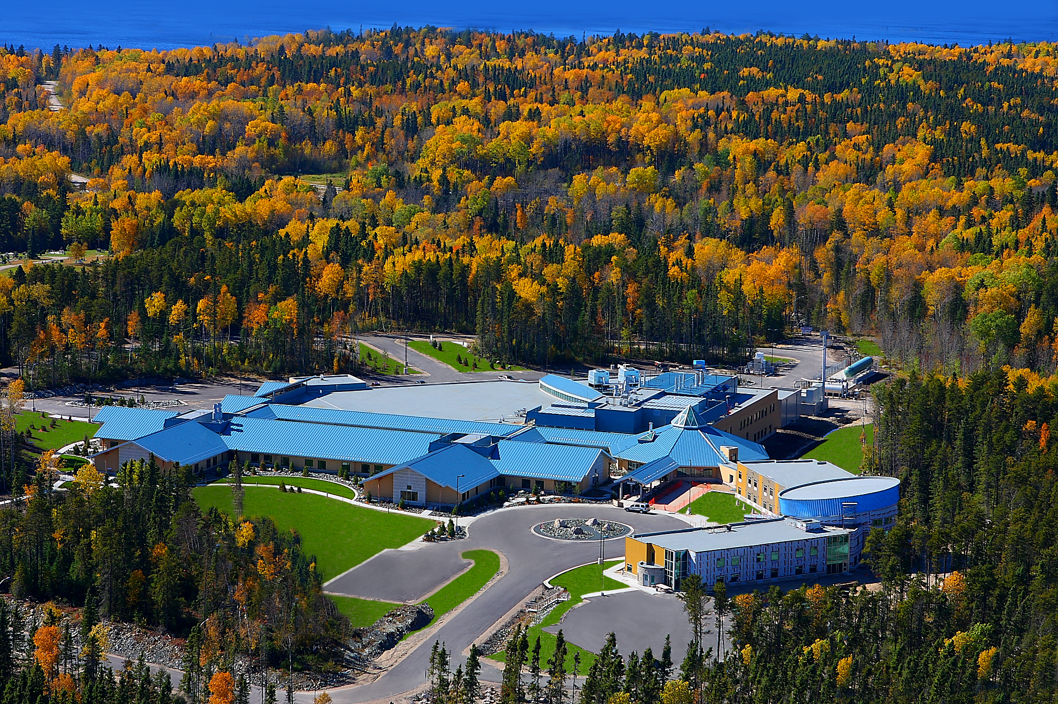

Slide 5
Background
Developed 2011 - 2012 by the SLMHC Ethics Working Group, Chaired by Helen Cromarty, RN, Special Advisor on First Nations Healthcare.
Created to provide healthcare professionals, staff and patients at SLMHC with a tool to assist the conceptualization and management of ethical dilemmas arising from clinical care delivery and from institutional policies and practices.
The Medicine Wheel Ethics Framework attempts to draw Anishinaabe cultural values and voices into the clinical decision-making process.
Traditionally the Medicine Wheel symbolizes the dimensions of health and the cycles of life.

Slide 6
Background
Traditional wisdom of the Medicine Wheel and Western ethical practice and viewpoints are not viewed as mutually exclusive and are integrated together.
It is hoped that this approach will provide users’ with multiple pathways to solve problems.
Research project evaluates the value of the Medicine Wheel Ethics Framework as an analytical tool for resolving complex cross-cultural moral dilemmas.
Feedback will help to guide future iterations and improvements.

Slide 7
Methodology
Sample size of 30 individuals involved in healthcare delivery at SLMHC
10 participants from 3 organization areas including: patients, organization staff and caregivers.
Semi-structured interviews conducted.
Interviews recorded and transcribed. Downloaded into the qualitative data analysis software NVivo10.
Analyzed thematically.

Slide 8
Themes
New Perspectives
Many found the Medicine Wheel Ethics Framework helpful and provided them with new ideas as the re-evaluated the ethical dilemma
A more thorough guide
Think of issues from different perspectives
Specific sections were identified as being particularly helpful
Completing the circle prompted consideration of questions that may not have been otherwise considered.
“It guided me through objective questions and to look at things objectively, holistically and inclusively.”
“makes you think a little deeper.”

Slide 9
Themes
Values
Anishinaabe symbolism and values generally had a positive impact on many participants.
Some were drawn to them as teachings and recognized the value of applying them within the context of health care.
“Every culture has different traditions and different beliefs, it did make me think of that that I hadn’t thought about previously.”
“I feel like I never think about the seven grandfather teachings but the other stuff, even just respecting other people’s values, I found that’s what I thought about more.”

Slide 10
Themes
Confidence
Provides adequate information for participants to analyze the ethical dilemma.
“it helped me to have the confidence in the decision-making or the considerations that we’re doing.”
“you’ve covered your bases by using this framework.”

Slide 11
Some Confusion
A small number of participants found the Medicine Wheel Ethics Framework confusing.
Description and instructions were not provided.
Future development may include incorporating instructions into the Framework.

Slide 12
Discussion
SLMHC constantly striving to improve relationships and address power imbalances between health care workers, patients and families.
Culture of practice to recognize and honor Anishinaabe traditional healing practices and values.
Develop tools and resources which include Anishinaabe cultural teachings and symbolism.
Medicine Wheel is a rich cultural and philosophical source of tradition.
Use of this Ethics tool gives participants the opportunity to explore a given scenario from multiple perspectives.
Can encourage holistic decision-making
Honor traditions of Anishinaabe

Slide 13
limitations
Using the Medicine Wheel Ethics Framework is not a statement of understanding Anishinaabe culture.
Using it as a decision aid in difficult patient care or institutional policy issues may help participants work through the dilemma and honors the traditions of the region.
This study relies on self-reported and subjective findings by the participants and is prone to social desirability bias.

Slide 14
Conclusion
Insight into how patients, health care providers and administrative staff felt about using the Medicine Wheel Ethics Framework.
A tool which can be used in decision-making regarding ethical dilemmas which occur in healthcare facilities, whether or not they deal with First Nations populations.

Slide 15
Annette Schroeter, MA Research Program Lead
aschroeter@slmhc.on.ca
(807)737-6578

