Slide 1
Phase 1: Needs Assessment and Baseline Data Preliminary Results
Jessica Lowey (Presenter), V.L. Kristman, L. Fraser, S. Armstrong, J. Koski
February 3, 2017
Notes:
-Presenting research results for the Superior Mental Wellness @ Work Project, specifically the needs assessment and baseline data results.
- The project, lead by the TBDHU, has brought together key stakeholders in Thunder Bay to improve adult mental health in the community and across the district. The TBDHU has partnered with the Centre of Addictions and Mental Health Services and Lakehead University during this phase of the project

Slide 2
Faculty/Presenter Disclosure Slide
Jessica Lowey
Relationships with commercial interests: NONE
Potential for conflict(s) of interest: NONE

Slide 3
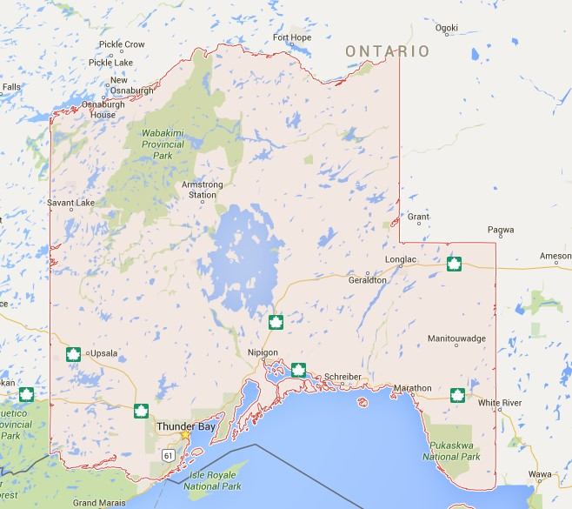
Background Mental Health in Thunder Bay and District
Mental health is influenced by: life experiences, workplace and social environments; personal, social and economic conditions
Geographically isolated and under-served by community services, especially in the District
More residents rate their mental health as fair → poor compared to the Ontario average
Report higher rates of injury, suicide, addiction and chronic disease
Hospitalization rates for mental illness are three times the Ontario average
Notes:
Workplace Mental health varies across the province. In the Thunder Bay district a great number of large employers are resource-based, thus are more vulnerable to unpredictable and volatile markets. In addition many of the District communities are geographically isolated and are underserved by community services.
Statistics have shown residents in Northern Ontario rate their mental health as fair or poor more often than the Ontario average. This geographical area also reports higher rates of injury, suicide, addiction and chronic disease
In a 2013 survey, local human resource professionals and wellness champions indicated a need for support to address workplace mental health.
Many admit that, despite good intentions, they find it overwhelming and don’t know where to start.
Very few, if any, have taken action to implement The Standard

Slide 4
Background Workplace Mental Health in Thunder Bay and District
Large employers are mainly resource-based, vulnerable to unpredicted and volatile markets
In a 2013 survey, local HR professionals and wellness champions indicated need for support to address workplace mental health
Resources and information available→ difficult to interpret and personalize to fit unique needs
Notes:
Workplace Mental health varies across the province. In the Thunder Bay district a great number of large employers are resource-based, thus are more vulnerable to unpredictable and volatile markets. In addition many of the District communities are geographically isolated and are underserved by community services.
Statistics have shown residents in Northern Ontario rate their mental health as fair or poor more often than the Ontario average. This geographical area also reports higher rates of injury, suicide, addiction and chronic disease
In a 2013 survey, local human resource professionals and wellness champions indicated a need for support to address workplace mental health.
Many admit that, despite good intentions, they find it overwhelming and don’t know where to start.
Very few, if any, have taken action to implement The Standard

Slide 5
Background CSA National Standard for Psychological Health and Safety in the Workplace (The Standard)
Launched in January 2013
Voluntary Standard to assist organizations in providing and maintaining a psychologically safe workplace
Developed for employer- to benefit employees
Implementation up to individual organizations- provides guidance for employers, employees and employee representatives
Notes:
CSA=Canadian Standards Association
Employees cannot implement the Standard on their own

Slide 6
Purpose of Research
Overall Project Objectives:
Increase worksite leaders’ understanding of the Standard and how to implement the Standard within their organization
Increase knowledge and skills of leaders to build psychological safety in the workplace and the specific related topics
Reduce mental health stigma
Increase employee awareness of ways to protect mental health
Notes:
1) Increase worksite leaders with an in-depth understanding of the Standard and an action plan for the implementation of the Standard within their organization
2) Increase knowledge and skills of leaders to build psychological safety in the workplace and the specific related topics
3) Reduce mental health stigma
4) Increase employee awareness of ways to protect mental health

Slide 7
Research Objectives of Phase 1
Assess the needs, perceived by worksite leaders
Gain insight on topics to enhance knowledge and build mental wellness
Gather baseline data
Gain insight into workplace culture, including stigma and current awareness on promotion and protection techniques

Slide 8
Methodology
Source populations: Thunder Bay and District contacts provided by the TBDHU, Lakehead University’s Health Sciences Department and Salesgenie
Electronic survey distributed to worksite leaders
Predominantly in management positions
Analysis: Univariate descriptive statistics
Notes:
Salesgenie= online resource that provides contact information for over 5,000 employers in the city of Thunder Bay
Once the data had been collected, it was analyzed using univariate descriptive statistics

Slide 9
Results
316 worksites invited to participate
92 completed the survey
Predominantly worksites in the city of Thunder Bay (62%)
11% rural Thunder Bay
19% Thunder Bay District
8% Other (Dryden, Kenora, and Rainy River Districts)*
*Those who indicated “other” had multiple worksites with employer
Notes:
*Participants able to select multiple answers- Individuals who selected other indicated multiple worksites with employer

Slide 10
Results
Current Knowledge about Mental Health: n=87

Slide 11
Results
Negative Mental Health Stigma in Workplace

Slide 12
Results
71.6% indicated they need some level of support

Slide 13
Results
The National Standard for Psychological Health & Safety

Slide 14
Strengths & Limitations
Strengths | Limitations
Purposeful selection of Thunder Bay and District | Response Rate: 29%
Reassured need is present | Not all Industry sectors represented
 | Participant Recruitment: Predominantly from the city of Thunder Bay
Notes:
NAICS codes- Total: 77,775 (2006)
Agriculture, forestry, fishing, and hunting (11)- 2520
Mining, quarrying, and oil and gas extraction (21)- 1505
Utilities (22) - 850
Construction (23) - 4030
Manufacturing (31-33) - 7200
Wholesale trade (41)- 2040
Retail trade (44-45)- 9220
Transportation and warehousing (48-49)- 4630
Information and cultural industries (51)- 1300
Finance and Insurance (52)- 1810
Real estate and rental and leasing (53) - 1070
Professional, scientific and technical services (54) - 2985
Management of companies and enterprises (55) - 0
Administrative and support, waste management and remediation services (56) -3130
Educational services (61)- 6710
Arts, entertainment and recreation (62) - 1680
Health care and social assistance (71) 10,650
Accommodation and food services (72)- 6115
Other services (except public administration) (81)- 3425
Public administration (91)- 5530

Slide 15
Limitation- Industry Participation
Health, Social Assist.
Representation of industries in survey
Other
Educational
Retail Trade
Professional,
Scientific,
Technical
Manufacturing
Public Admin.
Construction
Transport.
Agi/Forestry/Fishing
Mining
Finance
Arts..
*
Info & Culture
*
Accommodation, food
*
Utilities
*
*
wholesale
Real Estate
Admin, waste, etc
Notes:
Zero participation in 1) Agriculture/Forestry/Fishing industries, 2) Mining, quarrying and extraction, 3) Wholesale trade, 4) real Estate, rental, leasing, 5) administrative, waste management, remediation services
- Data collection occurred in late fall (season-dependent industries harder to contact, also have lower proportions in population)
Low sample population in manufacturing and retail trade industries (industries employee large proportion of Thunder Bay and district, manufacturing and retail in Thunder Bay may be corporations with higher management employed elsewhere- harder to gain permission to participate)
Over-representation of professional/scientific services, educational services, and health care/social assistance
- Services may be more educated in health and mental wellness and may be more willing to participate/realize MH and MW is an issue that needs to be addressed
NAICS codes- Total: 77,775 (2006)
Agriculture, forestry, fishing, and hunting (11)- 2520
Mining, quarrying, and oil and gas extraction (21)- 1505
Utilities (22) - 850
Construction (23) - 4030
Manufacturing (31-33) - 7200
Wholesale trade (41)- 2040
Retail trade (44-45)- 9220
Transportation and warehousing (48-49)- 4630
Information and cultural industries (51)- 1300
Finance and Insurance (52)- 1810
Real estate and rental and leasing (53) - 1070
Professional, scientific and technical services (54) - 2985
Management of companies and enterprises (55) - 0
Administrative and support, waste management and remediation services (56) -3130
Educational services (61)- 6710
Arts, entertainment and recreation (62) - 1680
Health care and social assistance (71) 10,650
Accommodation and food services (72)- 6115
Other services (except public administration) (81)- 3425
Public administration (91)- 5530

Slide 16
Conclusion/Next Steps
Results provide foundation for the subsequent project phases→ 5 focus groups; representing 12 industry types
Training and outreach interventions from the Thunder Bay District Health Unit
Speaker series topics chosen based on survey results
In-depth training for worksite leaders on developing an action plan for implementing the Standard
Additional training opportunities and resources for leaders
Social Marketing Campaign
Final intervention evaluation- determine effectiveness of interventions and programs
Notes:
Evaluation on effectiveness in improving MH awareness, and access to MH-related resources and support within Thunder Bay and District.
October 19, 9:00 am - 12:00 pm - Psychologically Safe Workplace Conversations
November 16, 12:30 pm - 2:00 pm - How Should Managers Respond (to Mental Health)

Slide 17
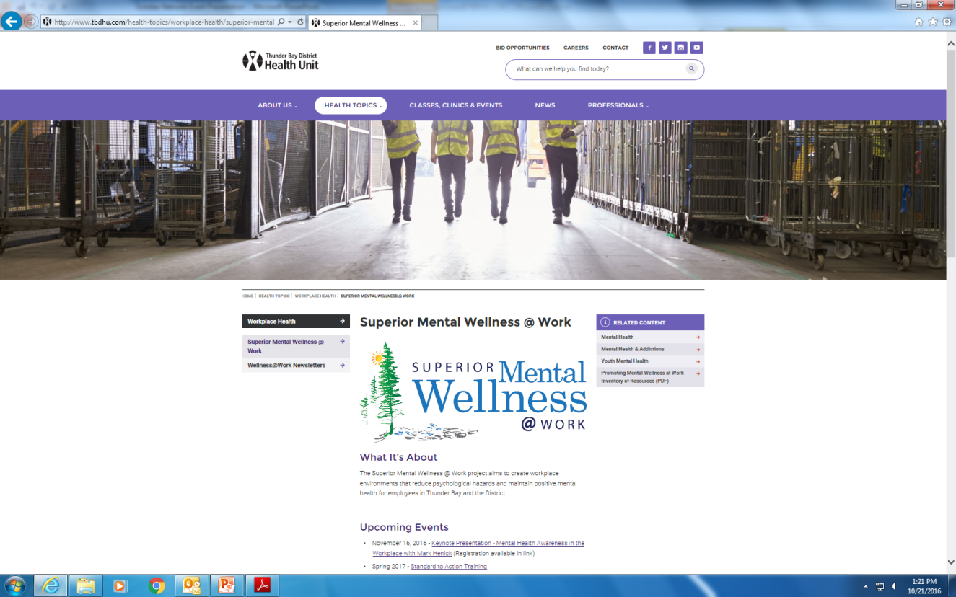
SuperiorMentalWellnessatWork.com

Slide 18
Thank-you Questions?

Slide 19
Partners

Slide 20
References
1) Ward, M. “Short Report#5: Mental Health in Northern Ontario.” Northern Health Information Partnership (2005).
2) Mujtaba, B. G., & Cavico, F. (2013). Corporate wellness programs: implementation challenges in the modern American workplace.
3) National Standard of Canada for Psychological Health and Safety in the Workplace. (2011). Mental Health Commissions of Canada. Retrieved 1 February 2017, from http://www.mentalhealthcommission.ca/sites/default/files/Workforce_National_Standard_of_Canada_for_Psychological_Health_and_Safety_in_the_Workplace_ENG_0_1.pdf
4) National Standard. (2014). Mental Health Commission of Canada. Retrieved 1 February 2017, from http://www.mentalhealthcommission.ca/English/national-standard
5) Statistics Canada, 2006 Census of Population, Statistics Canada Catalogue no. 97-559-XCB2006024.

Slide 21
Supplementary Slides

Slide 22
Results

Slide 23
Additional Results
Demographics of Thunder Bay and District Worksite Participants
Notes:
Based on N.America Industry Classification System
Business, finance and administrative
Education, social science, government service (7,300)
Sales and Service occupations (

