Slide 1
An Exploration of the Relationship Between Marginalization Index and Smoking Cessation in Individuals Diagnosed with Head and Neck Cancer
Grace Scott, MSc¹, Dr. Hosam Amoodi, MD²,
Dr. Damian Micomonaco, MD²
¹Graduate Program in Health and Rehabilitation Sciences, _Western University
²Department of Otolaryngology Head & Neck Surgery,
_Northern Ontario School of Medicine

Slide 2
Conflict of Interest Declaration: Nothing to Disclose
Presenter: Grace Scott
Title of Presentation: An Exploration of the Relationship Between Marginalization Index and Smoking Cessation in Individuals Diagnosed with Head and Neck Cancer
I have no financial or personal relationships to disclose

Slide 3
Background
Tobacco and alcohol use are the most important risk factors for head and neck cancer
Smoking cessation after diagnosis improves prognostic outcomes
Individuals living in deprived neighbourhoods have higher rates of mortality and morbidity independent of individual-level characteristics
“Patients with head and neck cancer who continue to smoke after diagnosis and treatment are more likely than patients who quit to experience tumor recurrence and second primary malignancies.”
“Although the diagnosis of a tobacco related malignancy clearly represents a strong catalyst for smoking cessation, a sizable subgroup of patients continue to smoke.”
(Macintyre et al., 1993; Martikainen et al., 2003;
Ostroff et al.,1995; Smith et al., 2003; Vokes et al., 1993)

Slide 4
Objectives
To assess the prevalence of smoking in those with a previous diagnosis of head and neck cancer,
To analyze the determinants of smoking alongside area-based measures of socioeconomic status

Slide 5
Methods
Prospective cohort study
Inclusion criteria:
Head and neck cancer diagnosis
(excluding melanoma and thyroid)
History of smoking
Exclusion criteria:
Inability to communicate in English over the telephone

Slide 6
Measurement Instruments
Demographic questionnaire
CAMH Readiness Ruler
Fagerström Test for Nicotine Dependence
(CAMH, 2006;Heatherton et al., 1991)

Slide 7
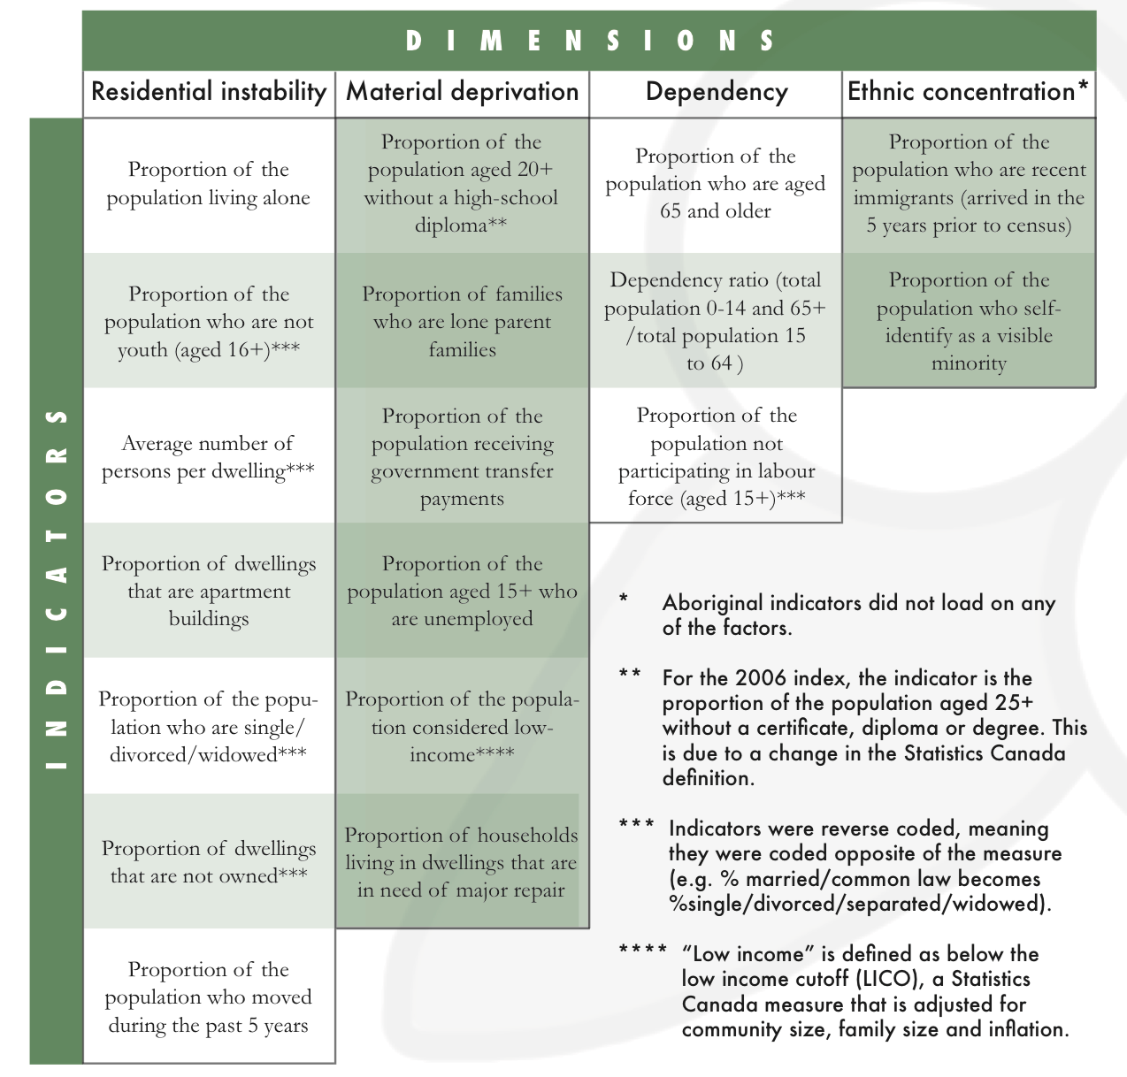
(Matheson et al., 2012)

Slide 8
Statistical Analysis
Kruskal-Wallis Test
Mann-Whitney Test
Cohen’s measure of effect size
Significance defined at p<0.05

Slide 9
Results
137 with head and neck cancer
Deceased
Endocrine or skin disease
Non-smokers
49 potential participants
24 contacted by telephone
24 consented to participate

Slide 10
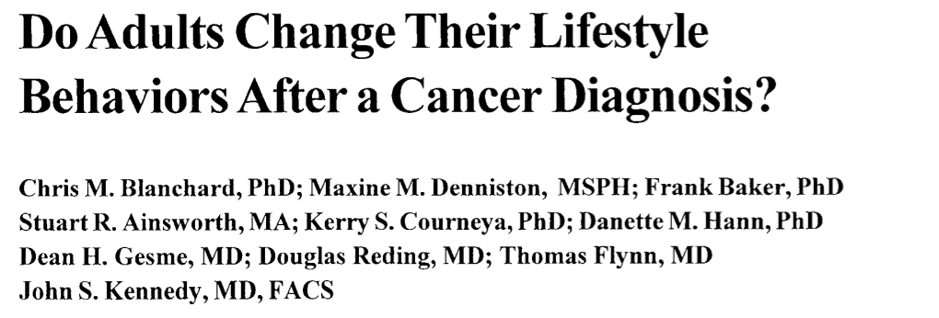
Participants
Variable | Men | Women | Total
Number of Participants | 15 | 9 | 24
Age (mean) | 69.2 | 71.1 | 69.9
Smoking Status
Current | 1 | 2 | 3 (13%)
Former | 14 | 7 | 21 (87%)
Pre-dx | 6 | 4 | 10 (42%)
Post-dx | 8 | 3 | 11 (46%)

Slide 11
Readiness Ruler

Slide 12
Readiness Ruler

Slide 13
Readiness Ruler

Slide 14
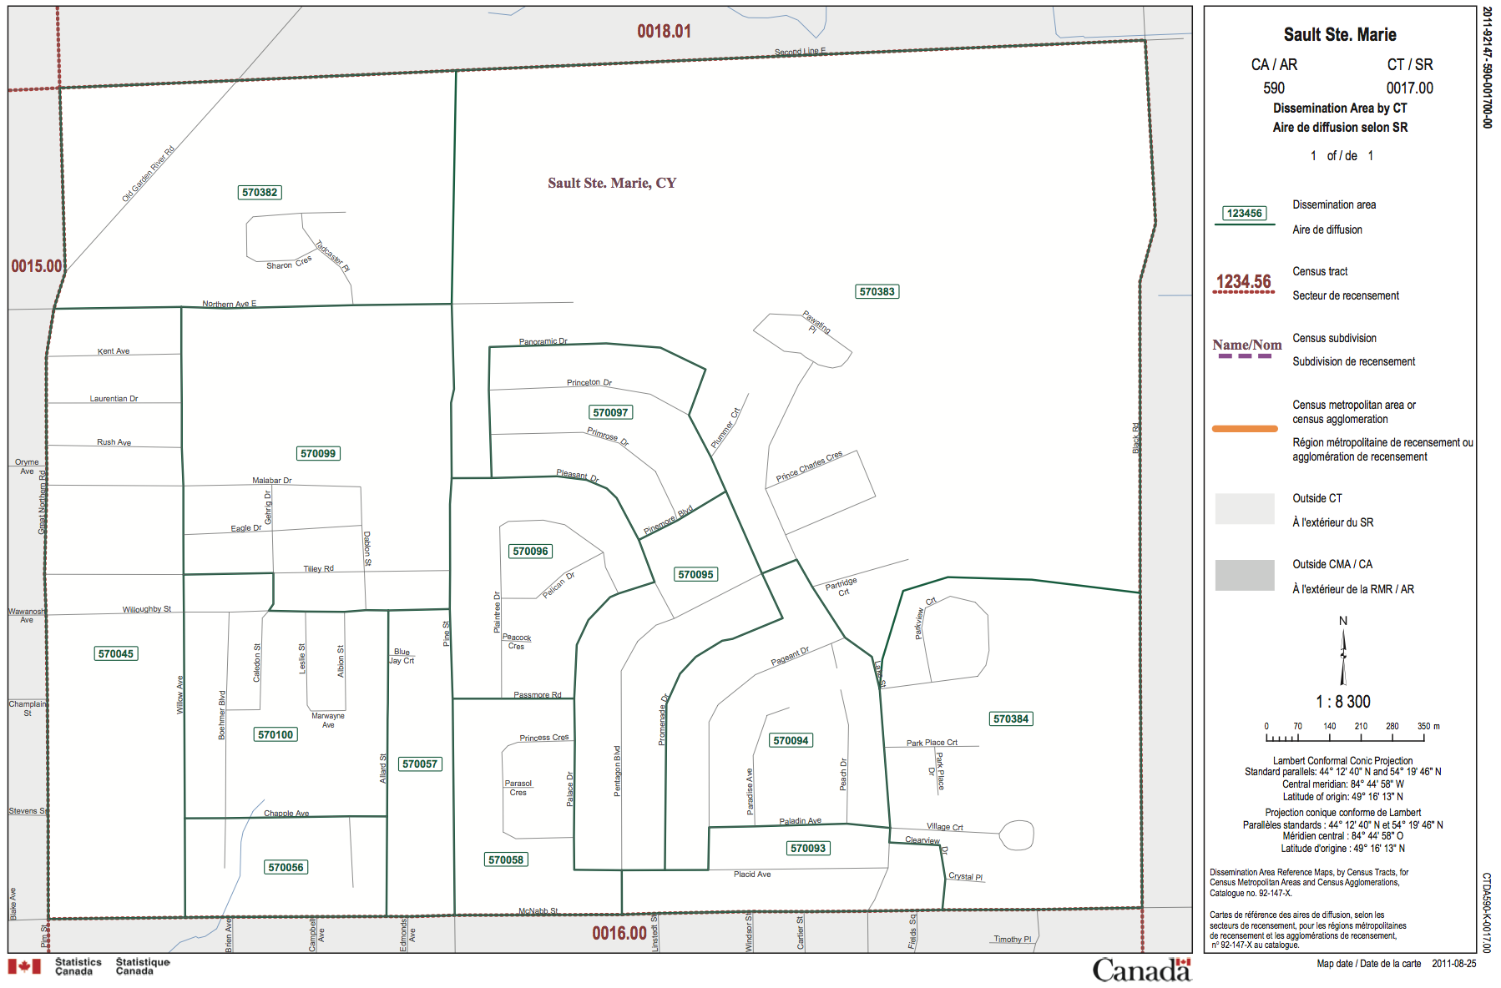

Slide 15
Current vs. Former Smokers
p .034
p .369
p .301
p .033
p .085
Summative Marginalization
Instability
Dependency
Deprivation
Ethnic Concentration

Slide 16
Current Smokers vs. Quit Pre-Diagnosis vs. Quit Post-Diagnosis
p .023
p .225
p .102
p .128
p .188
Summative Marginalization
Instability
Dependency
Deprivation
Ethnic Concentration

Slide 17
Summary
Though SC may be important to individuals who continue to smoke after a cancer diagnosis, they may not feel ready or confident in their ability to quit.
Summative level of marginalization developed from the combined factors of residential instability, material deprivation, ethnic concentration and dependency may be a critical factor in smoking cessation.
This may implicate the need for targeted population-based smoking cessation interventions.

Slide 18
Acknowledgements
Dr. Damian Micomonaco
Dr. Hosam Amoodi

Slide 19
References
Blanchard, C. M., Denniston, M. M., Baker, F., Ainsworth, S. R., Courneya, K. S., Hann, D. M., ... & Kennedy, J. S. (2003). Do adults change their lifestyle behaviors after a cancer diagnosis?. American Journal of Health Behavior, 27(3), 246-256.
Centre for Addiction and Mental Health (2006), retrieved from http://www.healthunit.org/
professionals/ruralnursing/Readiness_Ruler.pdf
Heatherton, T. F., Kozlowski, L. T., Frecker, R. C., & FAGERSTROM, K. O. (1991). The Fagerström test for nicotine dependence: a revision of the Fagerstrom Tolerance Questionnaire. British journal of addiction, 86(9), 1119-1127.
Macintyre, S., MacIver, S., & Sooman, A. (1993). Area, class and health: should we be focusing on places or people?. Journal of social policy, 22(02), 213-234.
Martikainen, P., Kauppinen, T. M., & Valkonen, T. (2003). Effects of the characteristics of neighbourhoods and the characteristics of people on cause specific mortality: a register based follow up study of 252 000 men. Journal of Epidemiology and Community Health, 57(3), 210-217.
Matheson, F. I., Dunn, J. R., Smith, K. L., Moineddin, R., & Glazier, R. H. (2012). Development of the Canadian Marginalization Index: a new tool for the study of inequality. Canadian Journal of Public Health/Revue Canadienne de Sante'e Publique, S12-S16.
Ostroff, J. S., Jacobsen, P. B., Moadel, A. B., Spiro, R. H., Shah, J. P., Strong, E. W., ... & Schantz, S. P. (1995). Prevalence and predictors of continued tobacco use after treatment of patients with head and neck cancer. Cancer, 75(2), 569-576.
Smith, G. D., Hart, C., Watt, G., Hole, D., & Hawthorne, V. (1998). Individual social class, area-based deprivation, cardiovascular disease risk factors, and mortality: the Renfrew and Paisley Study. Journal of epidemiology and community health, 52(6), 399-405.
Vokes, E. E., Weichselbaum, R. R., Lippman, S. M., & Hong, W. K. (1993). Head and neck cancer. New England Journal of Medicine, 328(3), 184-194.

