Slide 1
¹⁹F Chemical Shift Imaging (CSI) as a novel method for detection of 5-Fluorouracil (5-FU) in colorectal tumor
Yurii Shepelytskyi¹, Karen Davenport², Matthew S. Fox³, Tao Li², Mitchell Albert^{1,2,4} and Eric Davenport⁵
¹Lakehead University, Thunder Bay, Ontario, Canada.
²Thunder Bay Regional Health Research Institute, Thunder Bay, Ontario, Canada.
³University of Western Ontario, London, Ontario, Canada.
⁴Northern Ontario School of Medicine, Thunder Bay, Ontario, Canada.
⁵Thunder Bay Regional Health Science Centre, Thunder Bay, Ontario, Canada.

Slide 2
Faculty/Presenter Disclosure Slide
Yurii Shepelytskyi
Relationships with commercial interests: NONE
Potential for conflict(s) of interest: NONE

Slide 3
Significance
Colorectal cancer is the third most common cause of cancer death worldwide¹
5-Fluorouracil (5-FU) is one of the most widely used cytotoxic chemotherapies for treatment of variety of solid cancers, including colorectal and breast cancer²
Low response rates for chemotherapy based on 5-FU is limitation factor for clinical usage³
It has been clinically demonstrated that “trapping phenomenon” (retaining of drug in the tumor) correlates with the clinical effectiveness of 5-FU chemotherapy⁴
Method to detect resistance of tumor to 5-FU is needed in earliest stages of treatment
¹ www.who.int, 2017; ²Longley DB, et al., Nature Reviews Cancer, 2003; ³G. Folprecht, et al., Ann Oncol, 2004;
⁴ Presant C. A., et al., Lancet, 1994

Slide 4
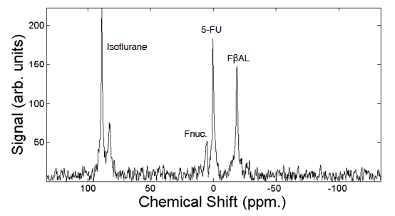
Why ¹⁹F Magnetic Resonance Imaging?
[5]
5-FU metabolizes into fluorinated compounds that each display different chemical shifts, so all of them can be visualized using MRI⁵
Fluorine-19 (¹⁹F) has high natural abundance (≈100%)
Gyromagnetic ratio of ¹⁹F is high (γ = 40.05 MHz/T)
High
MRI
signal
No background signal!
Absence of ¹⁹F compounds in the body
MRI is a non-invasive and non-ionizing imaging technique
⁵Jordan A. Lovis, Matthew S. Fox, Iain K. Ball, Tao Li, Marcus J. Couch, and Mitchell S. Albert.. Proc. ISMRM. 2014.

Slide 5
Materials and Methods
HT – 29 (non respondent to 5-FU treatment ) and H-508 (respondent to 5-FU chemotherapy ) tumors
9 mice with HT – 29 tumor, 9 mice with H – 508 tumor, 5 mice with both tumor types
All animals received a bolus tail vein injection of 5-FU (300uL of 5-FU)
¹H localizer (TSE) parameters: FOV = 75x75 mm², 256x256 resolution, TR/TE = 2000/55.19 ms, slice thickness 2 mm, 16 slices, NSA = 3
¹⁹F CSI parameters: Matrix size = 8x5 or 3x5; FOV = 20x50 or 31x18.6 mm² , TR/TE = 5000/4.27 ms, number of averages 3 or 9, spectral bandwidth = 32 kHz

Slide 6
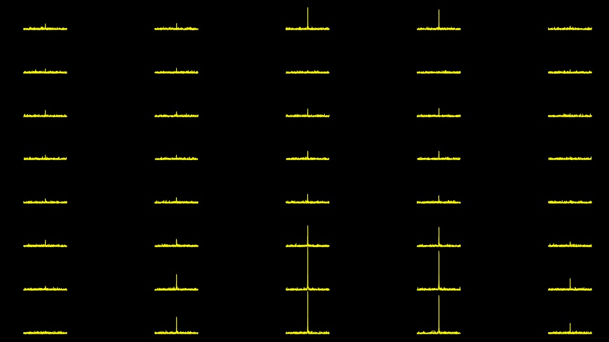
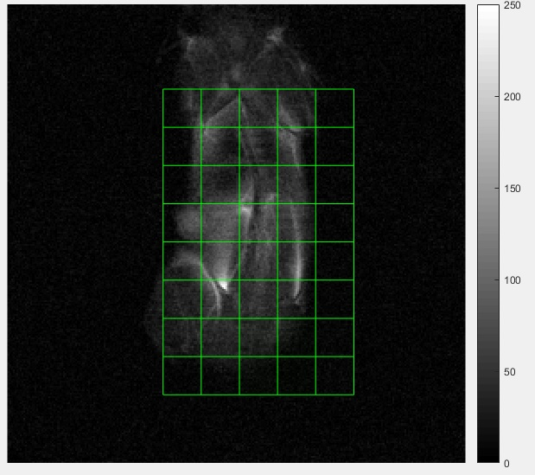
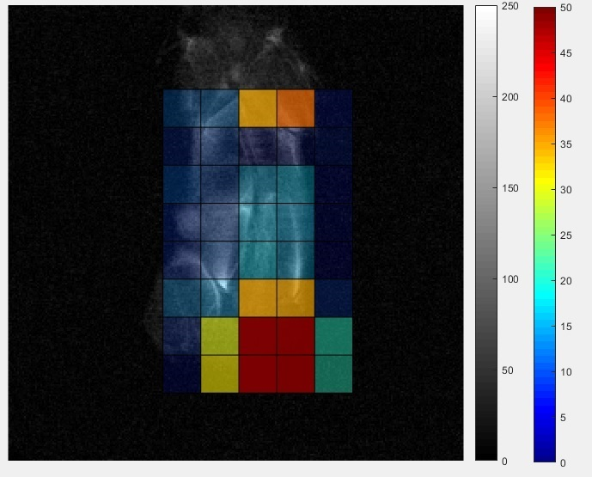
¹⁹F Chemical Shift Imaging
Chemical Shift Image

Slide 7
Results

Slide 8
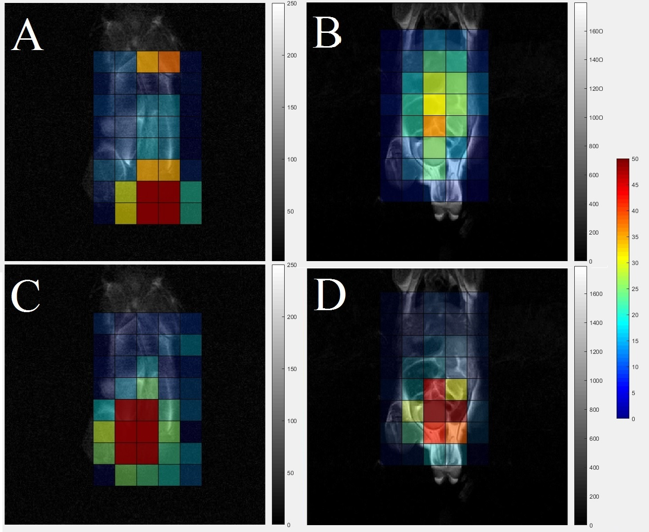
¹⁹F CSI images superimposed on the ¹H localizer of representative mouse with HT-29 (non-responder) tumor (A&C) and mouse with H-508 (5-FU responder) tumor (B&D)
Lung
A & B acquired at 7.5 min. after bolus
C & D acquired at 40 min. after injection
At 40 min., signal was concentrated in the H-508 tumor (D), bladder and kidneys (C,D)
Liver
Liver
H-508
HT-29
Bladder
Bladder
Kidney
HT-29
H-508
Bladder
Kidneys
Bladder

Slide 9
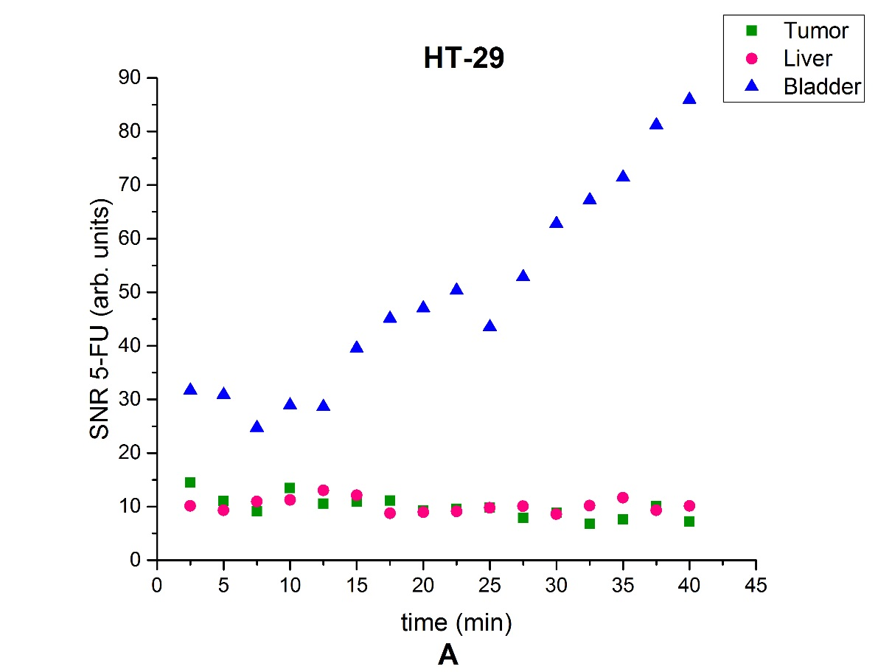
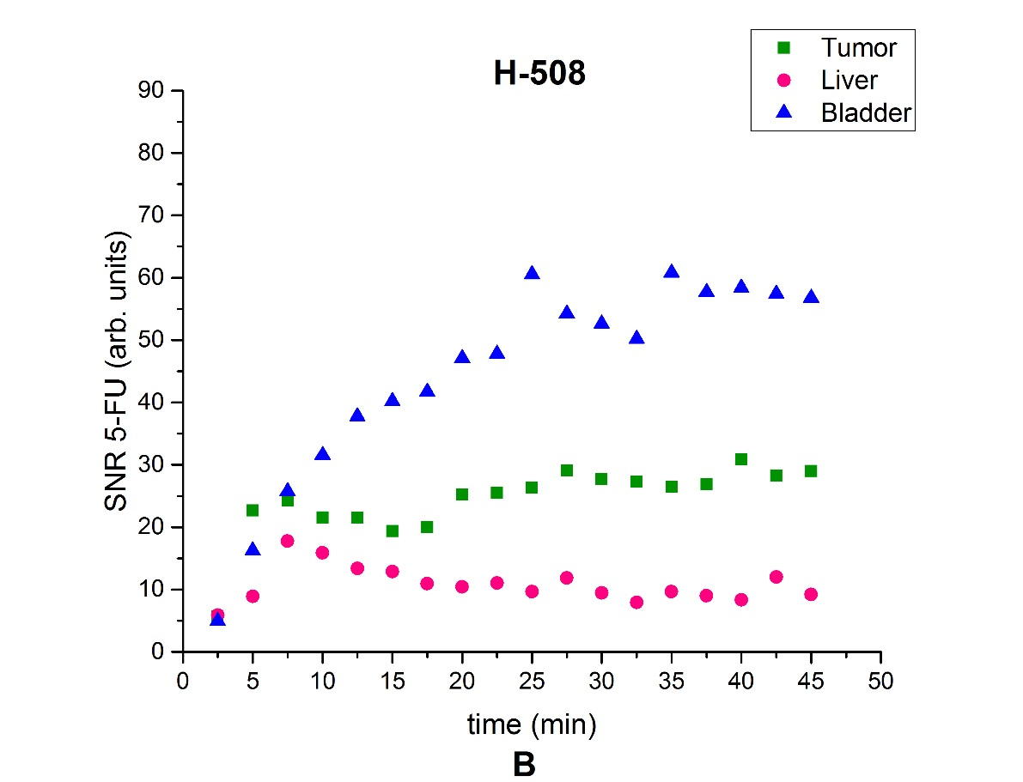
Time course of 5-FU SNR from the tumor, liver, and bladder voxels for representative mouse with a HT-29 tumor (A) and mouse with a H-508 tumor (B)
The H-508 SNR time curve significantly different from the liver SNR time dependence
The HT-29 SNR curve is not different from the liver SNR time curve

Slide 10
¹⁹F CSI images superimposed on the ¹H localizer of representative mouse with both HT-29 (non-responder)(left flank) and H-508 (5-FU responder)(right flank) tumors
A & B acquired at 5 and 70 min. after 5-FU injection
At 70 minutes, signal was concentrated in the H-508 tumor, bladder and kidneys (B)
The H-508 SNR in (B) was two times higher than at (A)
The HT-29 SNR dropped more than 3 times (B)
Kidneys
HT-29
H-508

Slide 11
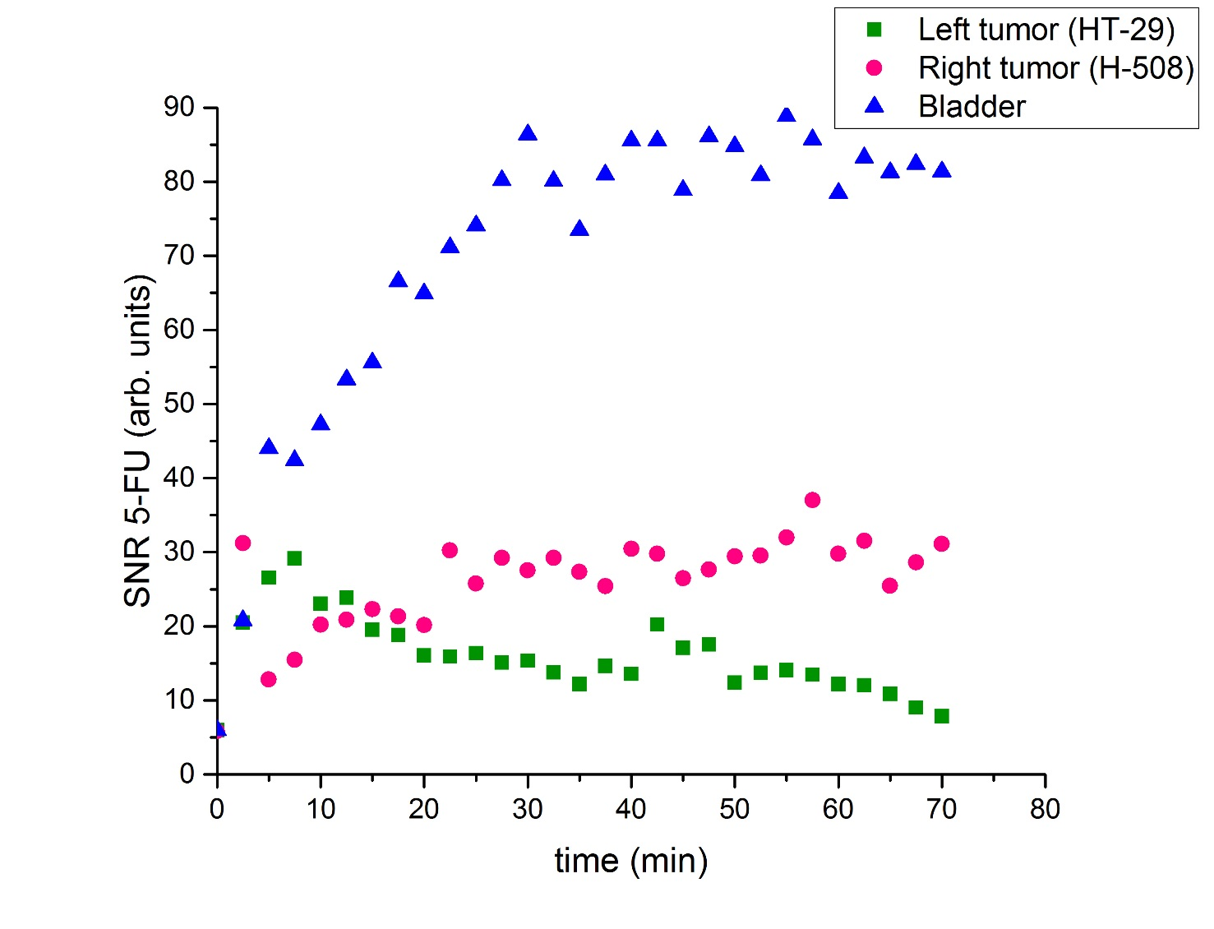
5-FU SNR time curves from the HT-29 (left tumor) ,the H-508 (right tumor), and the bladder of representative mouse which had both tumor types
The HT-29 tumor time curve is significantly different from the H-508 tumor SNR curve (p < 0.01)

Slide 12
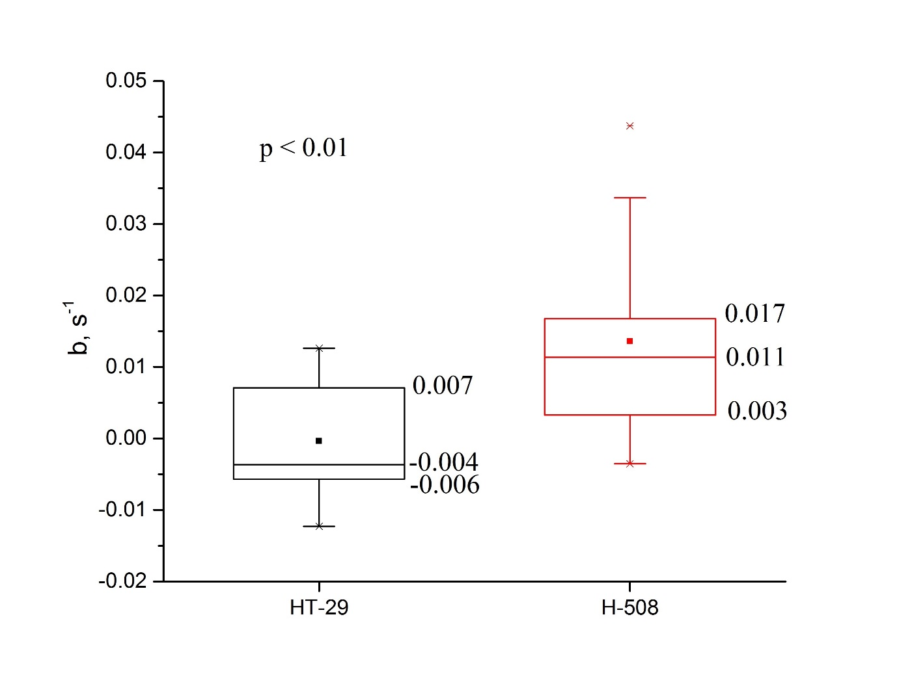
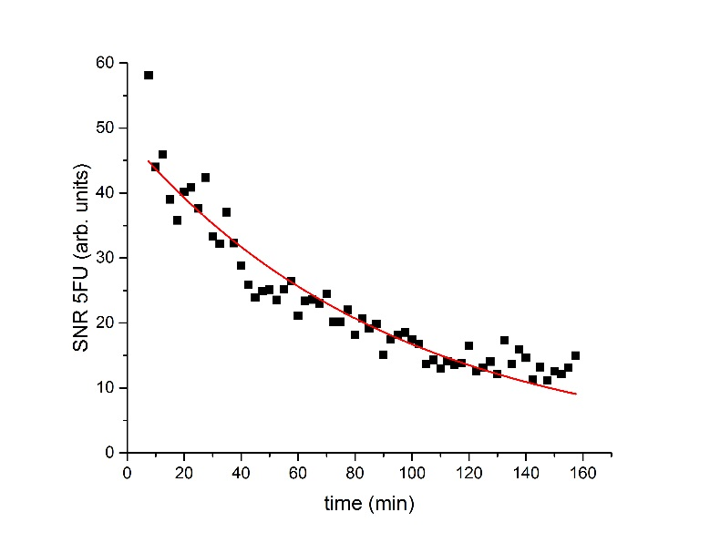
Statistical analysis of time curves for HT-29 and H-508 tumors
Fitting function $S\left(t\right)=ae^{bt}$
b value shows dynamic of signal (b<0 – decreasing, b > 0 - increasing)
Two-sample t – test was applied to the time constant
A Wilcoxon signed rank test has been used to evaluate the difference between SNR time curves obtained from different organs.

Slide 13
Discussion and Conclusion
The results of this study illustrate the feasibility of detecting a 5-FU trapping effect in different types of colorectal cancer using ¹⁹F CSI
The signal from the H-508 tumor tends to increase with time, whereas the signal from the HT-29 tumor shows a tendency to decrease or to remain constant (p < 0.01)
No fluorinated metabolites were observed
This study provided proof of principle that we can use ¹⁹F CSI to detect the resistivity of different types of colorectal cancer to 5-FU chemotherapy in humans

Slide 14
Acknowledgments
Dr. Mitchell Albert
Dr. Karen Davenport
Dr. Eric Davenport
Tao Li
Dr. Matthew S. Fox
Peter Smylie
Jordan Lovis
This work was supported by a grant from the Northern Ontario Academic Medicine Association (NOAMA).
Lakehead University and Thunder Bay Regional Health Research Institute provided partial support and access to their facilities.

