Slide 1
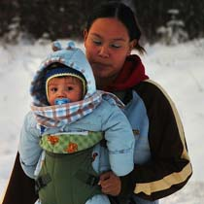
Parental feeding practices, nutrition knowledge and early dental caries risk in young Aboriginal children: A review of the literature
Northern Health Research Conference
June 5, 2015

Slide 2
Conflict Disclosure Information:
Presenters: Christianne Patry, Jaime Ilchyna, Lee Rysdale and Beth Armour
Title of Presentation: Parental feeding practices, nutrition knowledge and early dental caries in young Aboriginal children: A review of the literature
Potential for conflict(s) of interest: Lee Rysdale has received royalties from the University of Guelph Catalyst Centre as one of three Inventors of Toddler NutriSTEP®, a nutrition screening tool discussed in this presentation.

Slide 3
Objectives
Discuss key nutrition risk and protective factors related to EDC in young Aboriginal children
Identify Aboriginal caregiver oral health perceptions/beliefs and EDC risk
Integrate nutrition knowledge and education in the prevention and treatment of EDC

Slide 4
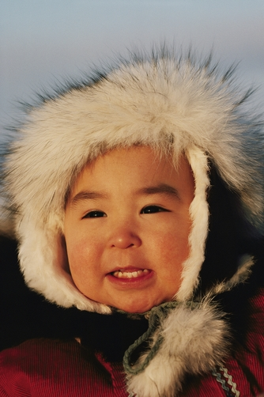
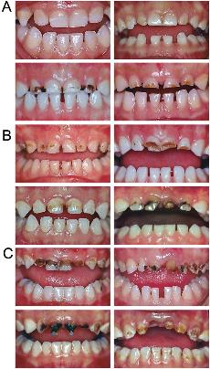
Early Dental Caries (EDC)
No EDC
Over 85% of Canadian Aboriginal & Inuit preschoolers have EDC
Mild to Mod EDC
S-EDC

Slide 5
Research Questions
How do Aboriginal caregiver feeding practices impact early childhood dental caries (EDC) in children 0-6 years?
Does caregiver knowledge, beliefs and attitudes have an effect on the prevalence of early dental caries in Aboriginal children aged 0-6 years?

Slide 6
Methods
n=395
Database search (CINAHL, Cochrane, PMC, Medline, Pubmed)
Relevant article titles
n=25
Relevant abstract content
n=5
Relevant article content
n=8
Hand search of references
n=66

Slide 7
Results
8 Canadian studies (2004-14)
Northern Ontario, Manitoba and Nunavut
Qualitative (focus groups)
Quantitative/Mixed Methods (surveys, dental exams, bloodwork, interviews)
6 themes
Breastfeeding, bottle feeding and beverages
Food intake
Supplementation
Feeding practices
Oral health knowledge and perceptions
Traditional knowledge and practices

Slide 8
Protective Factors
Daily prenatal vitamin D (600IU/day)
Breastfeeding
Increased frequency of cow milk
Limit to 750ml per day
Daily multivitamin or supplement with Vitamin D
Exclusively or partially breastfed, a daily vitamin D supplement of 10 μg (400 IU) from birth to one year of age
(Schroth et al, 2014; Health Canada, 2010; Schroth et al, 2013; Pacey et al, 2010; Leake et al, 2008; Health Canada, 2014)

Slide 9
Risk Factors
Bottle-feeding and daily intake of sugar containing foods
Sugar-sweetened beverages on a regular basis
juice made from powdered juice crystals, fruit juice and soft drinks
Pre-chewing children’s food
(Lawrence et al, 2004; Leake et al, 2008;Pacey et al, 2010; Schroth et al, 2013; Cidro et al, 2014)

Slide 10
Risk Factors
Caregivers don’t believe oral health affects overall health
Aware of healthy feeding practices but do not practice
conflicting knowledge between practitioners and family
generational disconnect
decreased knowledge transfer
(Lawrence et al, 2004; Schroth et al, 2007; Prowse et al, 2014; Cidro et al, 2014)

Slide 11
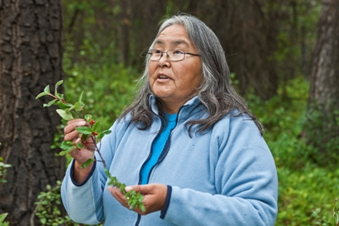
Recommendations
More research is needed
Elders in oral health prevention
Address challenges and barriers to healthy feeding practices
Appropriate training and continuing education in nutrition and oral health
Early risk assessment and nutrition screening
(Prowse et al, 2014; Lawrence et al, 2004; Canadian Paediatric Society and American Academy of Pediatrics, 2011; Canadian Dental Association, 2010; American Academy of Pediatric Dentistry, 2010)

Slide 12
Dental related question stems www.nutristep.ca
Toddler NutriSTEP® (18-35 mo)
My child usually has milk products
My child usually drinks juice or flavoured beverages
I have difficulty buying food I want to feed my child because food is expensive
My child has problems chewing, swallowing, gagging or choking when eating
My child drinks from a baby bottle with a nipple
My child is hungry at mealtimes
Preschool NutriSTEP® (3-5 yrs)
My child usually has milk products
I have difficulty buying food to feed my child because food is expensive
My child has problems chewing, swallowing, gagging or choking when eating
My child is not hungry at mealtimes because he/she drinks all day
My child usually takes supplements

Slide 13
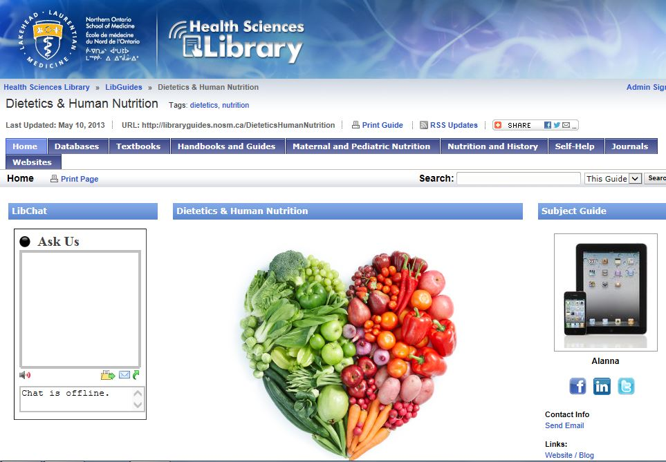
PEN® Key Practice Points
Spring 2015
Key practice points drafted
Summer 2015
Expert review committee
Accessible through NOSM Library
Databases
Libguide/Dietetics & Human Nutrition

Slide 14
References
Schroth R, Harrison R, Moffatt. Oral health of indigenous children and the influence of early childhood caries on childhood health and well-being. Pediatr Clin North Am. 2009; 56, 1481–99.
Lawrence H, Romanetz M, Rutherford, Cappel L, Binguis D, Rogers J. Effects of community-based prenatal nutrition program on the oral health of Aboriginal preschool children in northern Ontario. Probe. 2004; 38(4): 172-190.
Cidro J, Zahayko L, Lawrence H, Mcgregor M, Mckay K. Traditional and cultural approaches to childrearing : preventing early childhood caries in Norway House Cree Nation, Manitoba. Rural and Remote Health. 2014 Oct 29 [cited 2014 Nov 23]; 14(4): 2968. [Epub ahead of print]
Prowse S, Schroth R, Wilson A, Edwards J, Sarson J, Levi J, Moffatt M. Diversity considerations for promoting early childhood oral health: a pilot study. Int J Dent. 2014 Jan 30 [cited 2014 Nov 23]; 2014. [Epub ahead of print]
Schroth RJ, Lavelle C, Tate R, Bruce S, Billings RJ, Moffatt MEK. Prenatal vitamin D and dental caries in infants. Pediatrics. 2014 May;133(5); 1277-84.
Pacey A, Nancarrow T, Egeland GM. Prevalence and risk factors for parental-reported oral health of Inuit preschoolers: Nunavut Inuit Child Health Survey, 2007-2008. Rural Remote Health. 2010 June 18 [ cited 2015 Feb 13]; 10(2) [Epub 2010 June 18]
Schroth RJ, Halchuk S, Star L. Prevalence and risk factors of caregiver reported Severe Early Childhood Caries in Manitoba First Nations children: results from the RHS Phase 2 (2008-2010). Int J Circumpolar Health. 2013 Aug 5; 72.

Slide 15
References
Leake J, Jozzy S, Uswak G. Severe dental caries, impacts and determinants among children 2-6 years of age in Inuvik Region, Northwest Territories, Canada. J Can Dent Assoc 2008; 74(6): 519.
Schroth R, Brothwell D, Moffatt M. Caregiver knowledge and attitudes of preschool oral health and early childhood caries (ECC). Int J Circumpolar Health. 2007 April; 66:2; 153-167.
Health Canada, Canadian Paediatric Society, Dietitians of Canada, & Breastfeeding Committee for Canada. Nutrition for healthy term infants: Recommendations from six to 24 months; 2014 [cited 2015 April 6]. Available from http://www.hc-sc.gc.ca/fn-an/nutrition/infant-nourisson/recom/recom-6-24-months-6-24-mois-eng.php
Health Canada. Vitamin D and Calcium: updated dietary reference intakes; 2012 [cited 2015 April 6]. Available from: http://www.hc-sc.gc.ca/fn-an/nutrition/vitamin/vita-d-eng.php
Health Canada. Dietary Reference Intake. Table 1 – reference values for vitamins; 2010 [cited 2015 April 6]. http://www.hc-sc.gc.ca/fn-an/nutrition/reference/table/ref_vitam_tbl-eng.php
NutriSTEP® Nutrition screening tool for toddlers and preschoolers; 2014 [cited 2014 Nov 23] Available from: www.nutristep.ca
Nutri-e-STEP. Nutrition screening tool for toddlers and preschoolers; 2014 [cited 2014 Nov 23]. Available from: www.nutritionscreen.ca

Slide 16
References
Caulfiel PW, Bromage TG. Hypoplasia-associated severe early childhood caries – A proposed definition. J Dent Res. 2012; 91 (6): 544-550.
Gussy MC, Waters EG, Walsh O, Kilpatrick NM. Early childhood caries: current evidence for aetiology and prevention. J Paediatr and child health. 2006; 42; 37-43.
Irvine JD, Holve S, Krol D, Schroth R, Canadian Pediatric Society, First Nations, Inuit, and Métis Health Committee and American Academy of Pediatrics, Committee on Native American Child Health. Early childhood caries in Indigenous communities. A joint statement with the American Academy of Pediatrics. J Paediatr and child health [cited 2015 April 1]:2011;16(6):351-364.
Canadian Dental Association. CDA position on early childhood caries. 2010. Available from: http://www.cda-adc.ca/_files/position_statements/earlyChildhoodCaries.pdf
American Academy of Pediatric Dentistry. Guideline on caries-risk assessment and management for infants, children, and adolescents. Pediatr Dent. 2010;32:101-8.

