Slide 1
Examining the Impact of Distance Education Opportunities for Health Professionals in Rural, Remote, and Northern Communities and First Nations: An Inclusive 360 Degree Research Study
Research Team Members:
Lorraine Carter, Mary Hanna, Wayne Warry
June 6, 2015
Notes:
Lorraine

Slide 2
Faculty/Presenter Disclosure Slide 1
Faculty: Lorraine Carter and Mary Hanna
Relationships with commercial interests:
N/A

Slide 3
Disclosure of Commercial Support Slide 2
This program has received financial support from N/A
This program has received in-kind support from N/A
Potential for conflict(s) of interest:
There are no conflicts of interest to disclose
Funding: Ministry of Health and Long-Term Care, Heath Systems Research Fund Program Award: Health Equity for Northern Ontarians, Applied Health Research with Vulnerable Populations

Slide 4
Administrative Considerations
Ethical approval obtained from the Research Ethics Boards of Laurentian University and Nipissing University
We would like to acknowledge our various partners including organizations, academic departments, and individuals. Without their generous contributions of time and insight, this study would not be possible.
Notes:
Lorraine

Slide 5
Our Goals
To examine:
key aspects of continuing education, professional development, and training for health professionals in rural, remote, and First Nations communities in northern Ontario
perceptions of impact of the learning experience on practice
Notes:
To examine:
key aspects of continuing education, professional development, and training for health professionals, with a special focus on Northern Ontario; including rural, remote, and First Nations communities.
Perceived impact of the learning experience on practice
To understand the learning experience conceptualized as the interactions of learners and a team of educational, administrative, and technical experts working together

Slide 6
E-learning and Distance Education
In this study, e-learning is conceptualized as the integration of pedagogy, instructional technology, and, frequently, the internet in teaching and learning environments; distance education refers to situations where there is physical distance between the learner and the instructor
Benefits of distance education include “time flexibility, convenience, and lack of transportation worries” (Du et al., 2013, p.168)
No statistically significant difference in learning outcomes achieved through face to face learning methods and e-learning (Cook, 2009)
Notes:
Within the practice of distance education and in keeping with the times, the process we were particularly interested in examining is e-learning. In this study, e-learning is conceptualized as the integration of pedagogy, instructional technology, and frequently, the internet, into teaching and learning environments
There is in the early e-learning literature good documentation of access being a central benefit of e-learning. “time flexibility, convenience and lack of transportation worries” are commonly cited benefits which indeed, speak to a reality for working health professionals in northern, rural, remote, and First Nations ommunities.
No difference in learning outcomes between traditional learning methods and e-learning (Cook, 2009)

Slide 7
Partners and Participants
Using existing networks and through active recruitment efforts, six educational series and courses selected for inclusion:
four nursing courses for persons who are already nurses and who want to increase their professional credentials; one interprofessional series for health leaders in northern Ontario; one series serving health and allied health professionals working in First Nations
Five of six programs delivered out of Northern Ontario; one out of Southern Ontario
Learners: 99 participants in total: 55 pre-survey submissions; 68 post-survey submissions; 10 interviews to date
Education providers/supporting staff:14 participants
Notes:
Partners: 4 nursing courses geared toward nurses who already have a degree or diploma; one interprofessional series; one series geared towards health and allied health professionals in First Nations
Programs housed out of Northern Ontario and one out of Southern Ontario

Slide 8
Data Collection
A mixed methods design
Pre- and post-surveys were developed for learners; one survey was developed for education providers/supporting staff
Survey links, information, and reminders personalized by the research team were disseminated by course administrators
Interview call-outs occurred after completion of course/series and after dissemination of the second survey
Format: semi-structured; open ended questions; invitation to elaborate on points made in surveys
Notes:
Pre and post surveys for learners; one survey for education providers/support
Surveys were developed using Remark Web Survey and distributed and submitted online – Administrators of the different courses and series assisted with disseminating the surveys and survey reminders.

Slide 9
Learner Sample
Gender | Profession | Cultural Identity | Workplace Geography
Predominantly female | Predominantly nurses ~14% other health/allied health professions | <5% identified as Aboriginal ~40% identified as francophone | Communities worked in on a regular basis ~57% northern urban ~37% northern rural ~10% northern remote
~10% male | 1- 30 years in their profession | First language: ~% 50 English ~% 37 French ~13% other languages | 36% work outside province of ON
*Learner Sample is denoted by voluntary survey submissions and interviewees only; not all learners within a program
Notes:
Mary
**QUICK – only mention profession breakdown and that while many were from all across northern ON, we also had about a third who resided and worked either in other parts of ON or outside of the province
Gender composition: predominately female – approx. 10% male. We did not ask for participants’ gender identity. This is a rough observation. [how much should we say about this?]
Our sample consisted primarily of nurses, roughly 14% other types of health and allied health…..
We had a wide range of learners in terms of their experience – anywhere from 1 to 30 years into their career
Cultural Identity
Geography: Overview of geography of participants – Sessions offered from outside of Northern Ontario to rural, remote, First Nations, and urban communities in Northern Ontario and sessions offered by an urban centre in Northern Ontario (e.g., Sudbury or Thunder Bay) to rural and remote communities in Northern Ontario. We also had learners from out of province, several of whom identified the geography of their workplace northern rural and remote and others who work in urban centres
The percentages displayed here are not mutually exclusive - greater than 100% because participants were asked to indicate multiple types of communities that they worked in on a regular basis and many had jobs for which they travelled for
Communities Worked in on a regular basis
~57% northern urban
~37% northern rural
~10% northern remote

Slide 10
Key Highlights and Emerging Themes
The Professional Learner
Notes:
Lorraine
Review quickly – explain more on theme slides

Slide 11
LEARNING STYLES, MIXING OF TECHNOLOGIES
When is technology appropriate? Which technology is appropriate? Relationship between technology and learning styles?
What about experiential learning?
NOT a lesser experience
Community of practice
PART OF WORKING AND STUDYING IN NORTHERN ONTARIO
Not a panacea; institutional and technological issues
Resilience and problem solving skills
TEACHERS
Need for pedagogical knowledge, technical skill, and just in time supports
Know students and where they are from
Engagement and interaction very important
Lens of the educator as student
Notes:
Lorraine

Slide 12
IMPACT
“The content of the series had an immediate impact on my practice. In fact, I had a conversation with the facilitator right after the first session about a challenge I was facing in my practice. And so the first workshop itself sort of inspired a very particular question and then we were able to sort of go into that a little bit deeper and changed my practice immediately, in some respects.”
Notes:
Lorraine

Slide 13
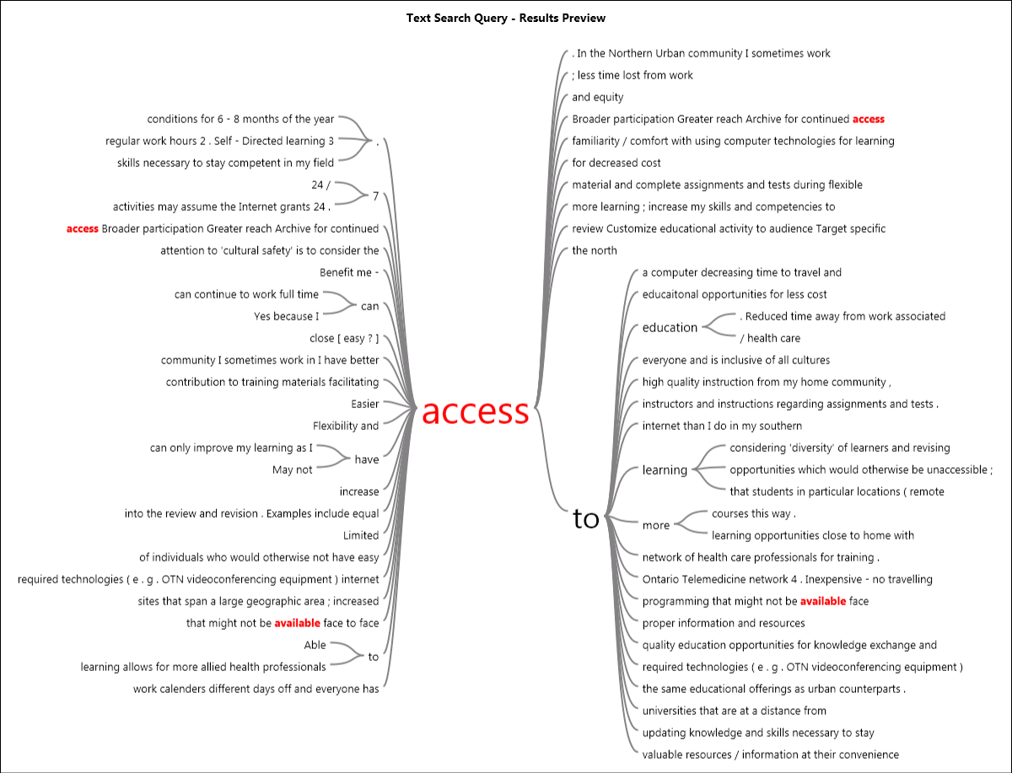
Notes:
Mary
This word tree from Nvivo is a representation of the access theme as it is discussed within a question about the advantages of distance learning [survey 1].
“I do not have to travel to urban areas for education which can be costly over and above the cost of the course itself not to mention dangerous winter driving conditions for 6-8 months of the year. Access to updating knowledge and skills necessary to stay competent in my field. Access to the same educational offerings as urban counterparts.”

Slide 14
PARENT AS LEARNER
“[…] I had two children instead of going to post-secondary and so once I had raised them all up and started another family, I decided it was time to go back to school. So [academic institution] actually offered the RPN program here kind of like a satellite site and it was a fulltime deal, so I did that and immediately after that I applied for a BScN bridging program. So the whole experience has been one of opportunity”
Notes:
Mary

Slide 15
On Cultural and Geographical Context and Program Planning Involving First Nations
“I do not have a sense that there is uniform availability or uptake of different technologies for learning [referring to First Nations/remote communities]. There is often budgetary limitations that make it challenging to translate all learning programs into other languages of interest […] program planners offering online learning activities may assume the Internet grants 24.7 access to everyone and is inclusive of all cultures despite geography. The topic of the program may determine relevance and target audience.”
Notes:
Lorraine
This quote is from one of our education and support participants and also reflects the sentiment of informal conversations that were had with service providers when trying to establish our partnerships

Slide 16
Experiences with Aboriginal Partners
Few offerings targeting health professionals in northern First Nations
Low enrolments in existing programs
Need to return to literature and dig deeper (learning styles, the impact of colonization on uptake, attitudes regarding technology in general)
Notes:
Mary
Not a great deal of distance learning offerings targeting health professionals in northern First Nations; enrolment in other programs unknown

Slide 17
Questions and Comments
Lorraine Carter
lcarter0101@gmail.com
Mary Hanna
mx_hanna@laurentian.ca

Slide 18
References
Cook, D. (2009). The failure of e-learning research to inform educational practice, and what we can do about it. Medical Teacher, 31, 158-162.
Du., S., Liu, Z., Liu, S., Yin, H., Xu, G., Zhang, H., & Wang, A. (2013). Web-based distance learning for nurse education: A systematic review. International Nursing Review, 60, 167-177.
Lingard, L., Albert, M., & Levinson, W. (2008). Grounded theory, mixed methods, and action research. BMJ, 337. DOI: http://dx.doi.org/10.1136/bmj.39602.690162.47
Nursing Council of New Zealand. (2011). Guidelines for Cultural Safety, the Treaty of Waitangi and Maori Health in Nursing Education and Practice.
Ramsden, I. (2000). Defining cultural safety and transcultural nursing [Letter to the editor]. Kai Tiaki Nursing New Zealand.
Ruggeri, K., Farrington, C., & Brayne, C. (2013). A global model for effective use and evaluation of e-learning in health. Telemedicine and e-Health, 19(4), 312-320.
DOI: 10.1089/tmj.2012.0175

