Slide 1

Obesity, Inflammation, and Diabetes: Examining the role of TNFα in GLP-1 Secretion
Jeffrey Gagnon
Laurentian University
Biology

Slide 2

Conflict of Interest Declaration: Nothing to Disclose
Presenter: Jeffrey Gagnon
Title of Presentation: Obesity, Inflammation, and Diabetes: Examining the role of TNFα in GLP-1 Secretion
I have no financial or personal relationships to disclose

Slide 3
Obesity in Canada: at risk populations
Canada: 24.8% Sudbury 34% (StatsCan-2015).
Prevalence of obesity is even higher aboriginals.
Aboriginal children have ~ twice the prevalence of non-aboriginal.
Increased diabetes, cardiovascular disease, and cancers.
2004 Canadian Community Health Survey

Slide 4
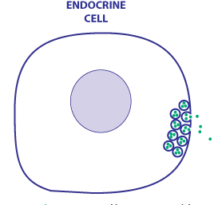
Obesity is an inflammatory state
fat
Inflammation
TNFα, IL6, CRP
AJP Klotting et al 2010

Slide 5

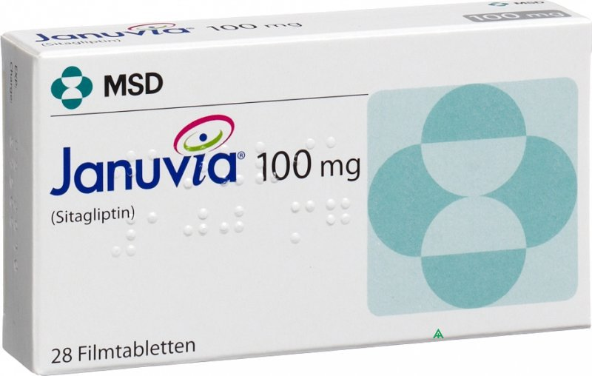
The importance of glucagon like peptide 1 in glucose regulation
GLP-1 is released the small intestine and colon after a meal.
GLP-1 potentiates insulin release.
Incretin effect

Slide 6
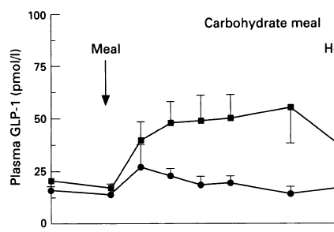
GLP-1 secretion is impaired in obesity
Adapted from Ranganath et al. 1996
Does TNFα inhibit GLP-1 Secretion, and is this partially responsible obesity-driven diabetes?

Slide 7
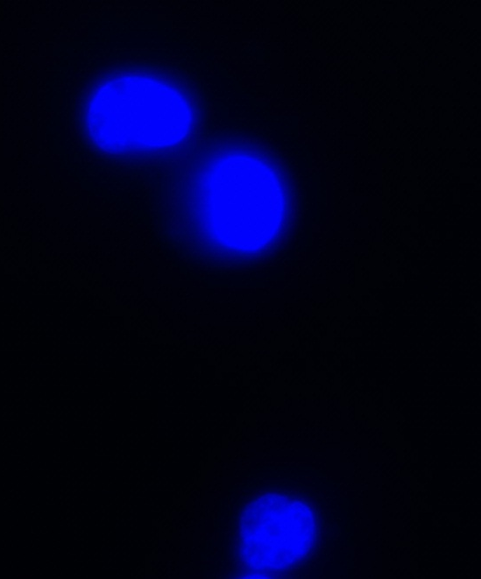
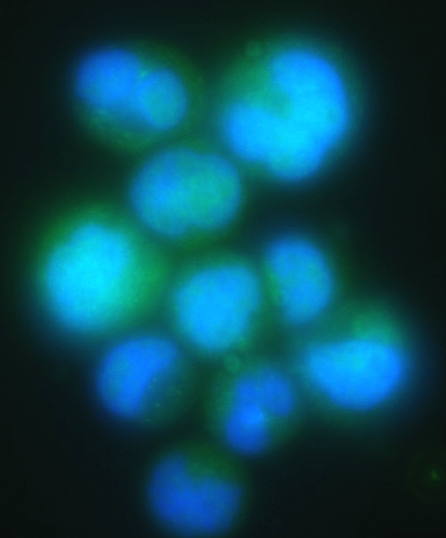
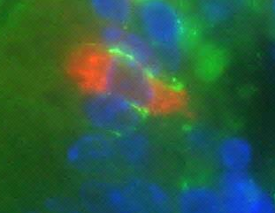
Human and murine L-cells express the TNFα receptor 1
Human NCI-H716 cells
Mouse ileum
Negative
TNFα R1; DAPI
TNFα R1; GLP-1; DAPI

Slide 8
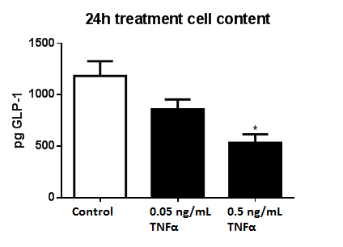
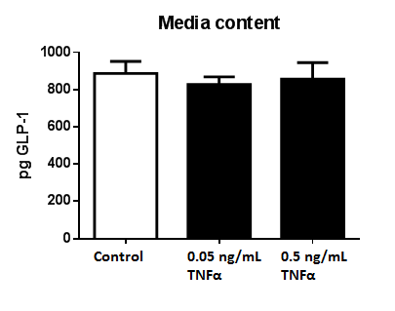
TNFα reduces GLP-1mRNA and Protein
Cell content
Media content

Slide 9
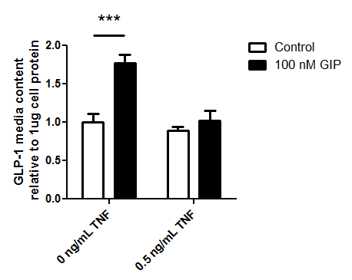
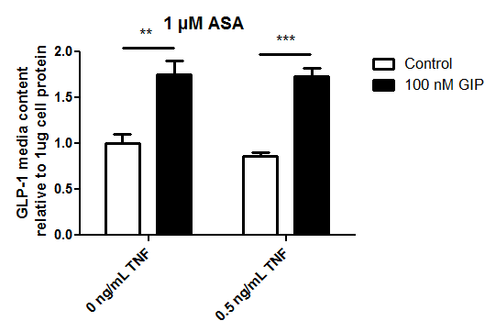
TNFα impairs GLP-1 secretion
GLP-1 secretion is restored by blocking TNFα signaling with the NFκB inhibitor, 5-ASA

Slide 10
Glucose tolerance after 12 weeks of high fat diet

Slide 11
HFD increases adipose and intestinal Inflammation

Slide 12
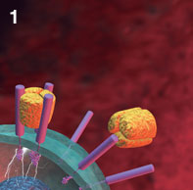

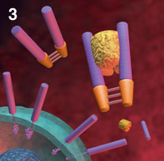
Will neutralizing TNFα restore glucose tolerance?
Enbrel.com

Slide 13
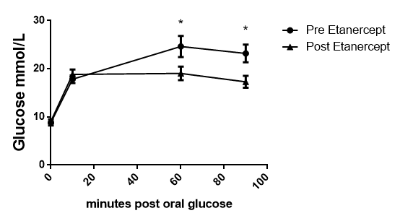
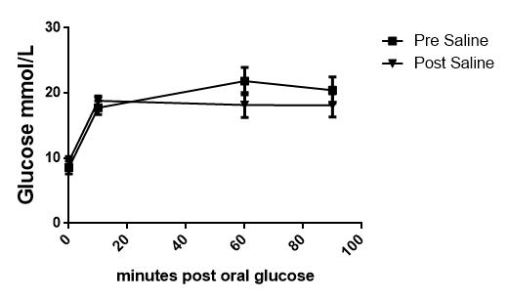
Etanercept treatment for 2 weeks improves glucose tolerance

Slide 14
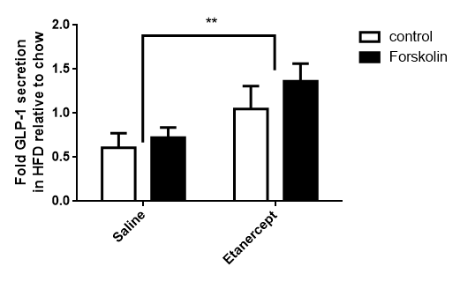
Etanercept treatment for 2 weeks restores GLP-1 secretion by primary L-cells

Slide 15
Conclusion and future work
Obesity driven TNFα impairs GLP-1 secretion and glucose regulation, but this can be reversed by treatment with the TNFα regulating Etanercept.
What other gastrointestinal hormones are dysregulated by obesity-related inflammation?
Do at risk populations produce more inflammatory cytokines during obesity?

Slide 16


Thank you
Dr Patricia Brubaker- U of T
Co-authors: Meghan Sauvé, Wen Zhao, Holly M. Stacey, S.C. Wiber, Steffen-S. Bolz.

Slide 17
TNFα does not reduce cell viability

Slide 18
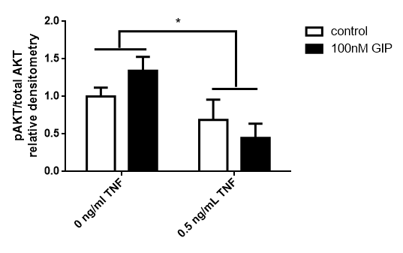
TNFα pre-treatment reduces AKT activation
pAKT
AKT
GIP - - - + + + - - - + + +
0.5 TNFα - - - - - - + + + + + +

