Slide 1
Examining the use of electronic patient portals in an integrated healthcare institution
Presented by:
Suzanne McGuire, MA
Dr. Edward Hirvi, MD, CCFP
Health Informatics Institute – Algoma University
In association with: Dr. Nikki Shaw, PhD

Slide 2
Conflict of Interest Declaration: Nothing to Disclose
Presenters: Suzanne McGuire & Dr. Ed Hirvi
Title of Presentation: Examining the use of electronic patient portals in an integrated healthcare institution
We have no financial or personal relationships to disclose

Slide 3
Introduction
A patient’s ability to access their medical information has been a topic of discussion in healthcare since the 1970s before the concept of the electronic health record (EHR) was even a reality(Aday & Andersen, 1974)
One way this is now being promoted is through the use of electronic patients portals (EPPs)

Slide 4
What are Electronic Patient Portals (EPPs)?
Web-based programs giving patients access to information from their electronic health record (EHR) and doctor’s office
Patients can:
Communicate with their doctor
View their cumulative patient profile and update with any changes
Order prescription refills
Setup appointments
View test results with comments/further instruction from their physician
Receive updates regarding health maintenance
Complete pre-visit questionnaires
Facilitate “e-visits”
Pagliari, Detmer & Singleton (2007)

Slide 5
What are the benefits of an EPP?
Gives patients a chance to become more informed about their health and care
Provide another means of communication with doctor’s office & allied health professionals
Access lab test results
Make it easier to schedule an appointment

Slide 6
Who uses EPPs?
Common portal users:
Caucasian, female
Mid-high SES
Computer & health literate
Patients with chronic health conditions

Slide 7
Purpose
Measure use of the myCARE portal at the Group Health Centre (GHC) in Sault Ste. Marie, Ontario
Understand the motivation behind why or why not patients choose to engage in it’s use

Slide 8
Group Health Centre myCare
Group Health Centre* is a multi-specialty, multi-disciplinary ambulatory care facility and diagnostic centre with a history of providing comprehensive and seamless outcome-based primary and specialty care. It has been a model for an innovative concept in the provision of health care in Ontario since its early beginning and is often referred to as Canada's pioneer membership-based health care organization.
It serves as the primary ambulatory care facility for the community, serving approximately 65,000 patients including those of the Sault Area Hospital and some of the surrounding Algoma District residents, located in Northern Ontario, Canada.
GHC promotes community wellness and provides numerous programs focused on preventative medicine that reduces the number of hospital visits and allows for care to be provided at home and in the community.
* GHC is a partnership between the Group Health Centre (GHC) and the Algoma District Medical Group (ADMG). The Association is governed by a community Board of Directors that is a not-for-profit corporation and owns the physical facility, equipment, furnishings, and hires all the non-physician staff. Physicians are shareholders and associates of the ADMG, an independent corporation that provides and arranges medical services in agreement with the Association.
http://www.ghc.on.ca/about.php

Slide 9
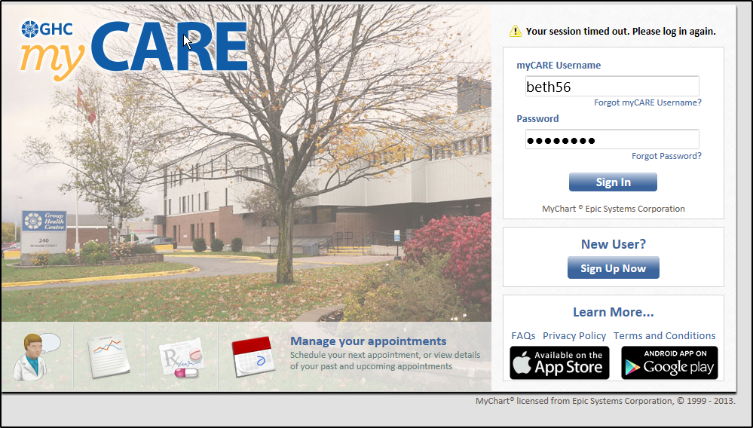

Slide 10
myCARE Home Page

Slide 11
Inbox –Message List

Slide 12
Ask Your Healthcare Team

Slide 13
Test Results -Details

Slide 14
Health Summary

Slide 15
Medication List

Slide 16
Schedule an Appointment

Slide 17
Methods
Mixed-method, cross-sectional examination of electronic, demographic & interview data examining:
Patients who accept or decline use of myCare
Motivation to use or decline myCare
Usage patterns of specific services

Slide 18
Methods:
Patients of Dr. Ed Hirvi & Dr. Russell Tull received letters inviting them to register for myCare online.
Patients are provided the opportunity to sign-up for myCare at the conclusion of their office visit if they have not already signed up.
Patients retain access to myCARE regardless of their willingness to participate

Slide 19
Method #1 – Quantitative Data
Statistical analysis of:
Demographic information
Usage rates for patients that registered
Use of specific myCARE services

Slide 20
Method #2 – Qualitative Data
Interviews with 30 patients chosen at random
Equal mix of people who did/did not register
Want to understand:
Patients’ decision to accept or decline to use of myCARE
Motivation to use myCare services

Slide 21
Other Measures of Interest
Perceived value and/or risks
Age distribution
Barriers to use (i.e. computer/internet access)
Patient concerns (i.e. privacy)

Slide 22
Conclusions
Study will help understand who is more likely use patient portals in a Canadian setting
Identify potential barriers to accessing or use of patient portals
Provide initial perceived benefits of a patient portal from the patient perspective

Slide 23
Funding Acknowledgements

Slide 24
Ongoing research:
Do patient portals engage patients in healthcare?
Do patient portals improve access to healthcare services?
Can patient portals improve health screening?
Can patient portals improve care for patients with chronic disease(s)
Can patient portals reduce medication errors in providing a more accurate record?

Slide 25
References
Aday, L.A. & Andersen, R. (1974). A framework for the study of access to medical care. Health Services Research, 9(3), 208-220.
Emont, S. (2011). Measuring the impact of patient portals: What the literature tells us. Prepared for the California Healthcare Foundation.
Goel, M.S., Brow, T.L., Williams, A., Cooper, A.J., Hasnain-Wynia, R. & Baker, D.W. (2011). Patient reported barriers to enrolling in a patient portal. Journal of the American Medical Informatics Association, 18, i8-i12.
Goel, M.S., Brown, T.L., Williams, A., Hasnain-Wynia, R., Thompson, J.A. & Baker, D.W. (2001). Disparities in enrollment and use of an electronic patient portal. Journal of General Internal Medicine, 26(10), 1112-1116.
Goldzweig, C.L., Orshansky, G., Paige, N.M., Towfigh, A.A., Haggstrom, D.A., Miake-Lye, I., . . . Shekelle, P.G. (2013). Electronic patient portals: Evidence on health outcomes, satisfaction, efficiency, and attitudes. Annals of Internal Medicine, 159(10), 677-687.
Group Health Centre. (2015, February 23). About the Group Health Centre. Retrieved from
http://www.ghc.on.ca/about.php.
Longworth, D.L. (2012). Pushing the envelope of electronic patient portals to engage patients in
their care. Annals of Internal Medicine, 157, 525-526.
Pagliari, C., Detmer, D. & Singleton, p. (2007). Potential of electronic personal health records. British Medical Journal, 335, 330-333.
van der Meijden, M.J., Tange, H.J., Troost, J. & Hasman, A. (2003). Determinants of success of inpatient clinical information systems: A literature review. Journal of the American Medical Informatics Association, 10(3), 235-243.

Slide 26
Questions?

