Slide 1



Using Hyperpolarized ¹²⁹Xe MRI to Detect Impaired Cerebral Perfusion in Human Brain with Alzheimer’s Disease
Tao Li¹ , Francis T. Hane^{1,2} , Jane M. Lawrence-Dewar² , Ayman Hassan³ , Karl Granberg³ , Raiili M. Pellizzari¹ , Jennifer A. Plata¹ , and Mitchell S. Albert^{1,2,4}
1. Department of Chemistry, Lakehead University, Thunder Bay, ON, Canada,
2. Thunder Bay Regional Health Research Institute, Thunder Bay, ON, Canada,
3. Thunder Bay Regional Health Sciences Centre, Thunder Bay, ON, Canada,
4. Northern Ontario School of Medicine, Thunder Bay, ON, Canada.

Slide 2
Faculty/Presenter Disclosure
Slide
Tao Li
Relationships with commercial interests: NONE
Potential for conflict(s) of interest: NONE

Slide 3
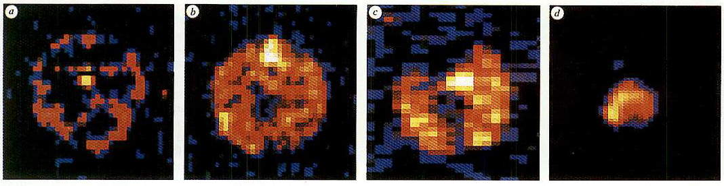
Introduction
Hyperpolarized (HP) xenon-129 (¹²⁹Xe) MRI has long been used to study structural and functional information of the lungs.
Inhaled Xenon gas can dissolve in the blood and be carried to brain tissues by cerebral blood flow (CBF), this makes it potentially a powerful tool to probe the physiological and functional information of the brain.
Albert et al. Nature, 1994

Slide 4
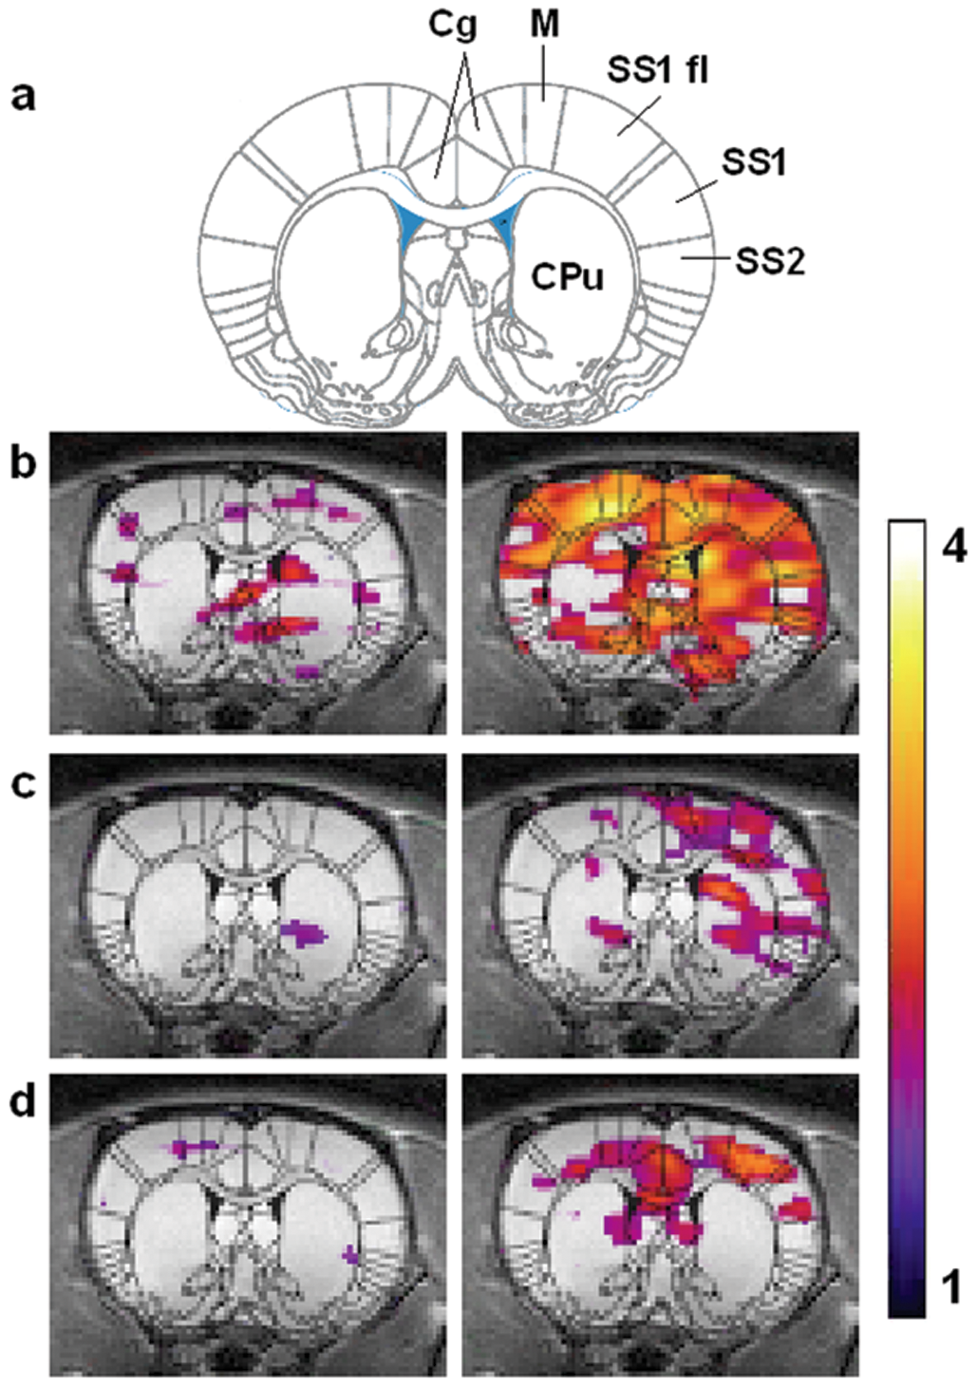
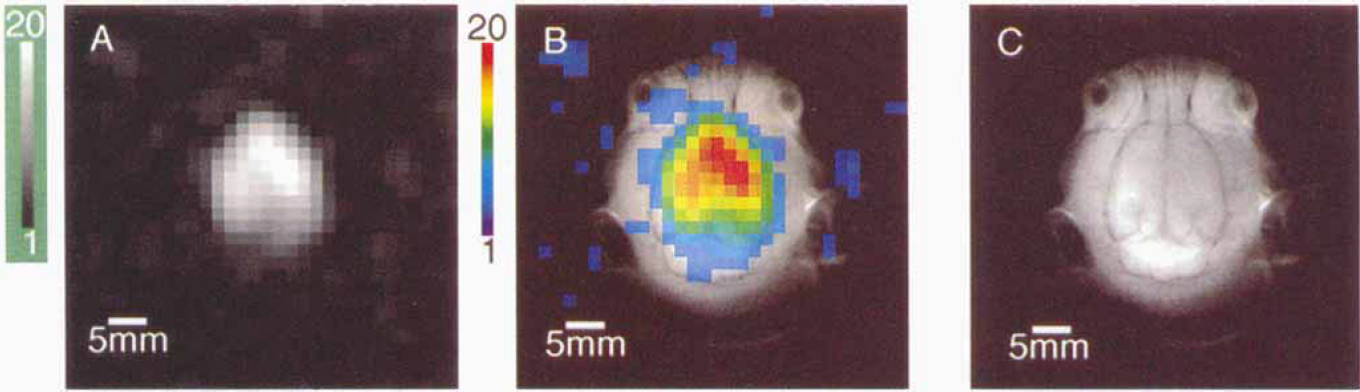
¹²⁹Xe Brain Study – Preclinical
HP ¹²⁹Xe brain MRI studies have been conducted in animal models by numerus groups through the years.
Advanced brain studies such as stroke and fMRI using this technique have also been investigated.
Swanson et al. (1997)
Zhou et al. (2010)
Mazzanti et al. (2011)
Notes:
Full References.

Slide 5
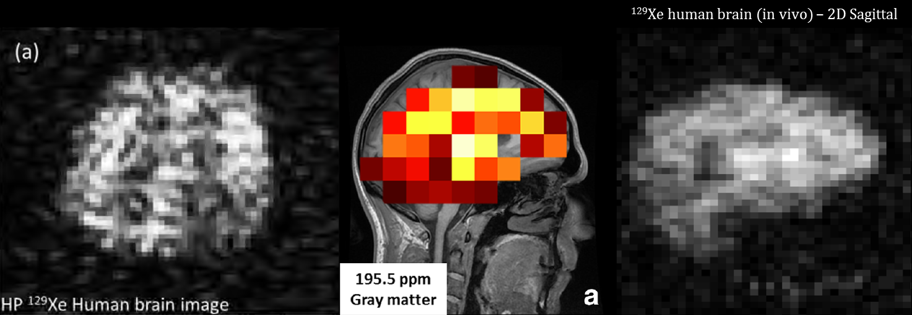
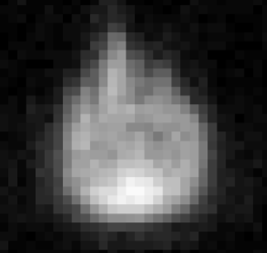
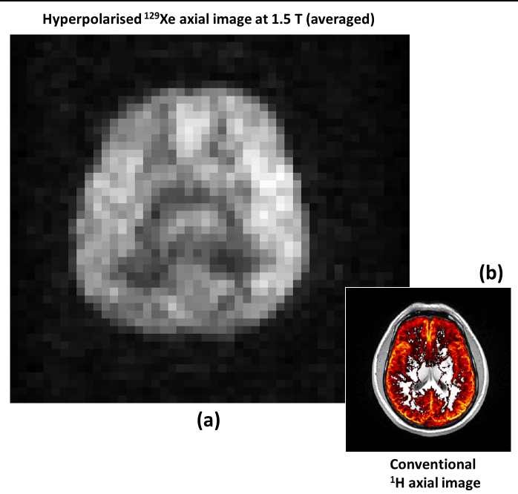
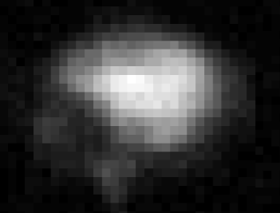
¹²⁹Xe Brain Study - Human
¹²⁹Xe human brain images have been acquired in recent years.
We have started to explore using HP ¹²⁹Xe MRI as a tool to probe and assess physiological and functional changes in the brain.
Rao et al. (2015-2016)
Rao et al. (2017)
Li et al. (2017)

Slide 6
Alzheimer’s Disease
Alzheimer’s Disease (AD) is a neurodegenerative disease and the leading type of dementia.
Diagnosis of AD largely relies on cognitive assessment combined with traditional MRI and CT to rule out other pathological changes in brain structure.
Quantitative assessment of AD can also be done with PET or SPECT, using a radiotracer that binds to the beta-amyloid plagues.
All at a stage when symptoms start to show.

Slide 7
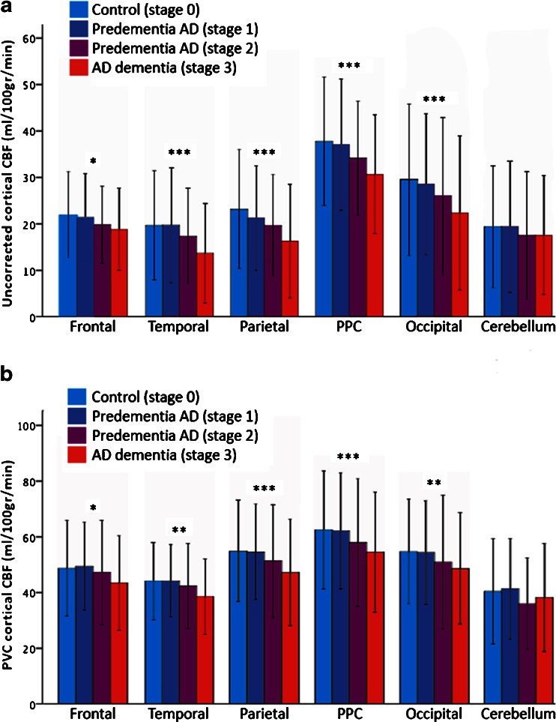
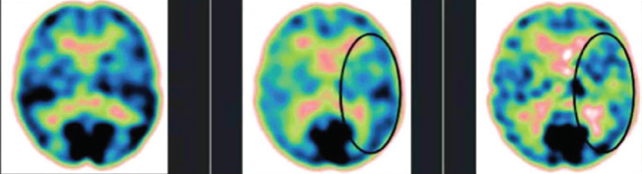

Study Rationale
Increasing evidence has shown that reduced CBF starts at an early, asymptomatic stage of AD.
Glucose uptake reduced due to degraded CBF in different stages of AD.
Jack C. de la Torre (2017)
J Alzheimers Dis DOI 10.3233/JAD-161266
Binnewijzend et al. (2017) Eur Radiol. Feb;26(2):506-14.
Can HP ¹²⁹Xe MR detect the physiological changes at an early stage of AD?

Slide 8
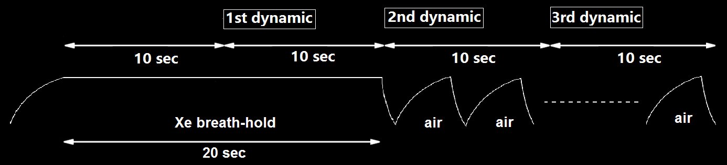
Methods – Dynamic Imaging
Images were dynamically acquired at 10s, 20s, and 30s from the start of a 20s-breathhold after the inhalation of 1L xenon gas.
Pulse Sequence | Views | FOV (mm) | Matrix | TR / TE (ms) | Flip angle (degree) | Bandwidth (Hz/pixel) | NSA
2D GRE | Sag./Ax. | 250 x 250 | 32 x 32 | 250 / 0.84 | 12 | 150 | 1

Slide 9
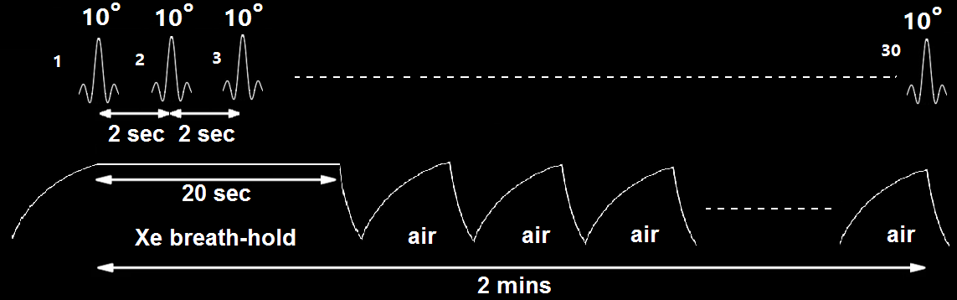
Methods – Xenon Washout Spectroscopy
Our study was to measure xenon washout times in brain tissues and compare it between the healthy and AD group.
MR spectra were acquired at 2 seconds intervals, starting immediately after 500ml xenon gas inhalation.

Slide 10
Methods – Clinical Study Design
Study participants:
    AD participants : n = 4, age 72 ± 7, MoCA score 21 ± 3,
    Healthy participants: n = 6, age 70 ± 5, MoCA score 28 ± 1.
Montreal Cognitive Assessment (MoCA) was used to assess the cognitive level of all participants.
This study protocol had been approved by Health Canada and local Research Ethics Boards.

Slide 11
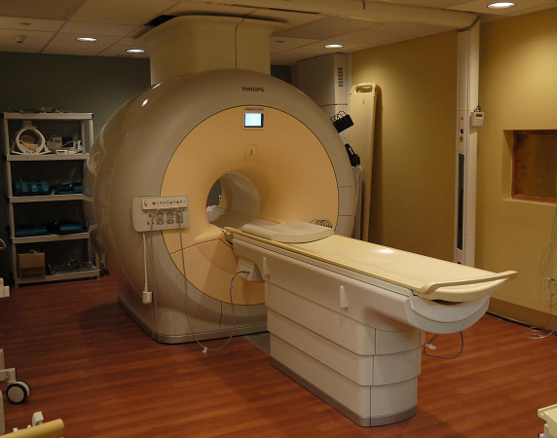
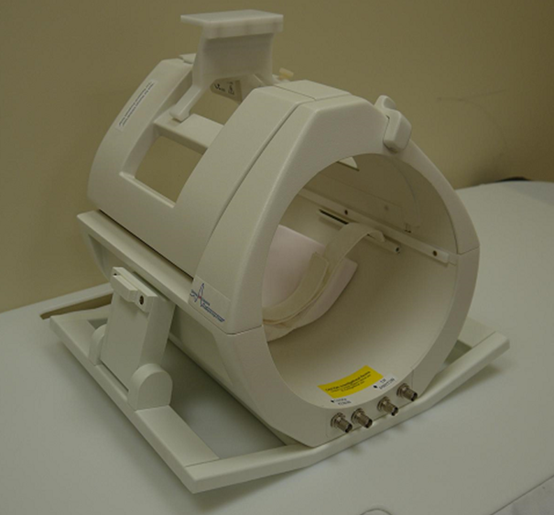
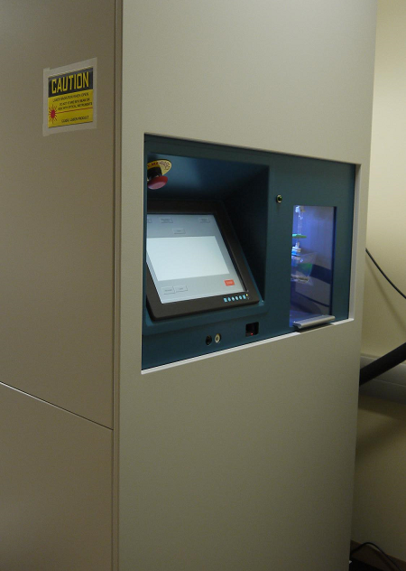
Methods - Hardware
Philips Achieva 3T clinical scanner.
CMRS Dual-Brain ¹²⁹Xe - ¹H dual-tuned quadrature coil.
Xemed SEOP xenon polarizer (enriched xenon-129 to 30% polarization).

Slide 12
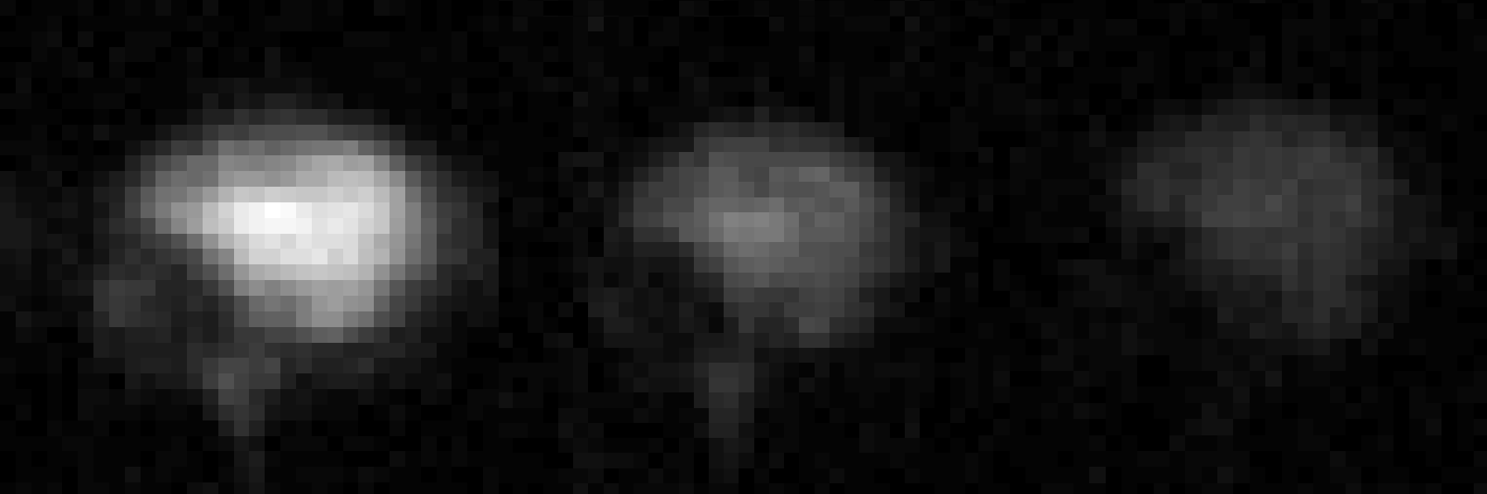
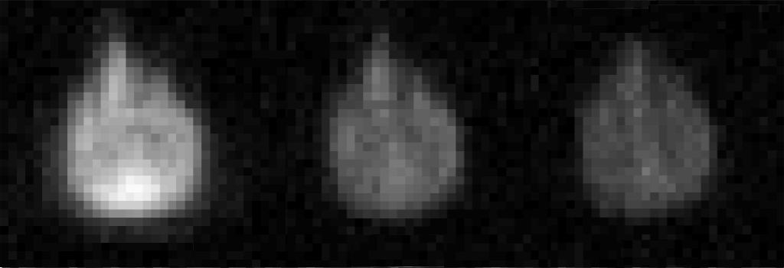
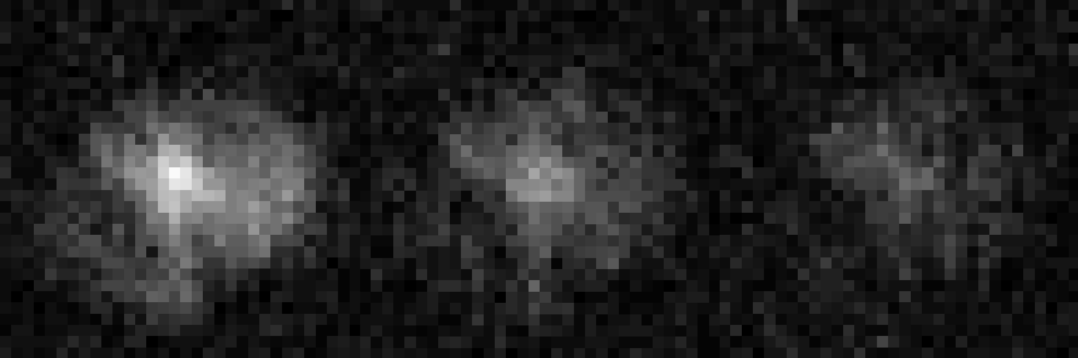
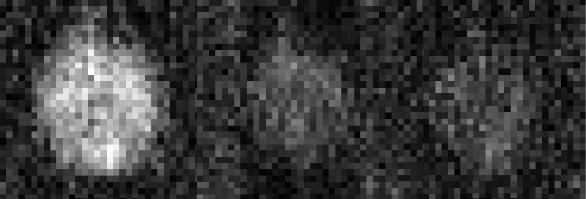
Results - ¹²⁹Xe Dynamic Images
Sagittal
Axial
Healthy
AD
Three dynamics images were acquired in each view.

Slide 13
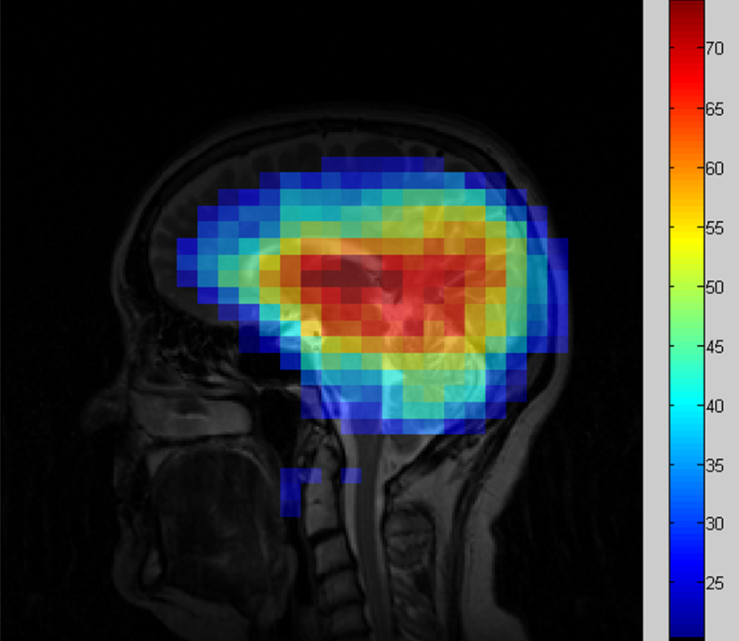
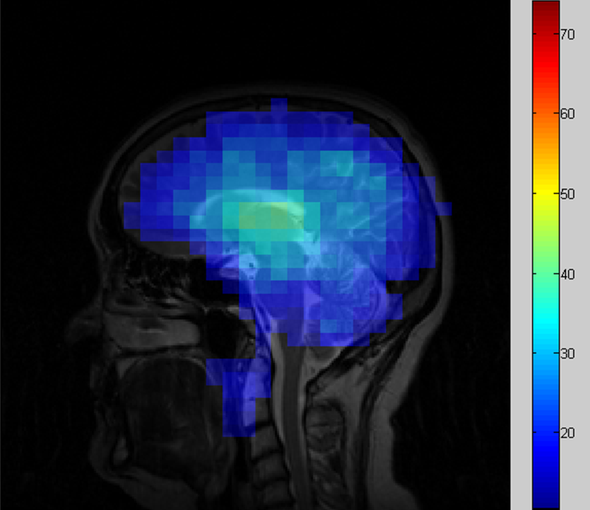
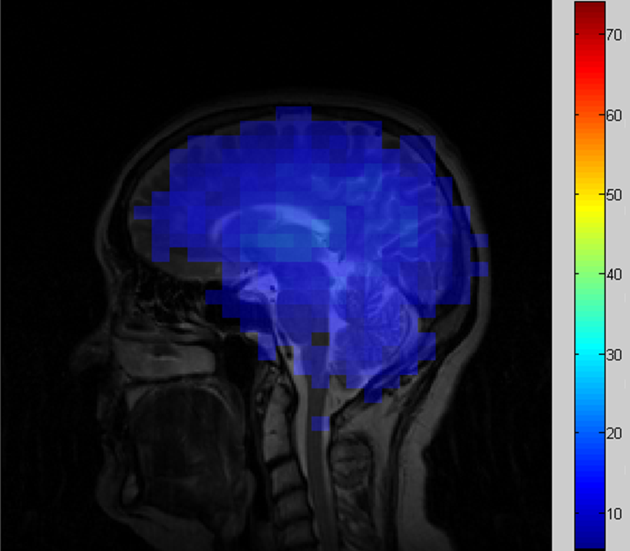
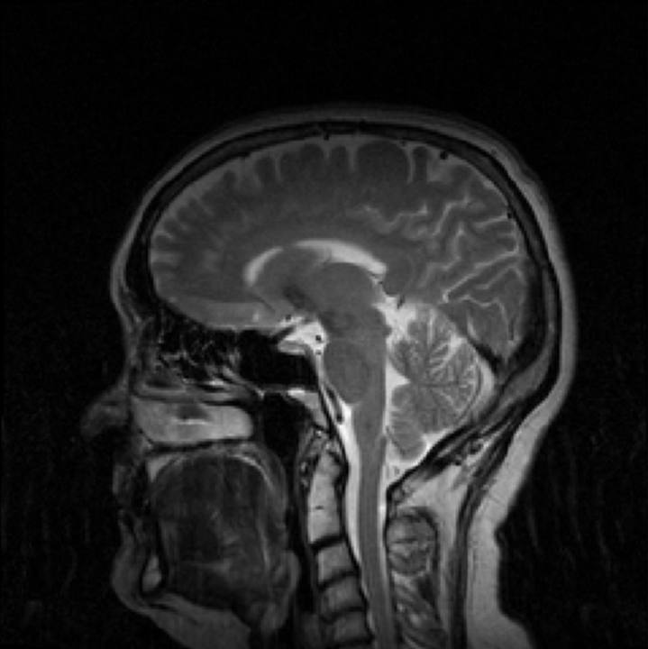
Results - ¹²⁹Xe Dynamic Images
SNR of each dynamic image was normalized with respect to that of the first one.
1st dynamic
2nd dynamic
3rd dynamics
¹H Localization

Slide 14
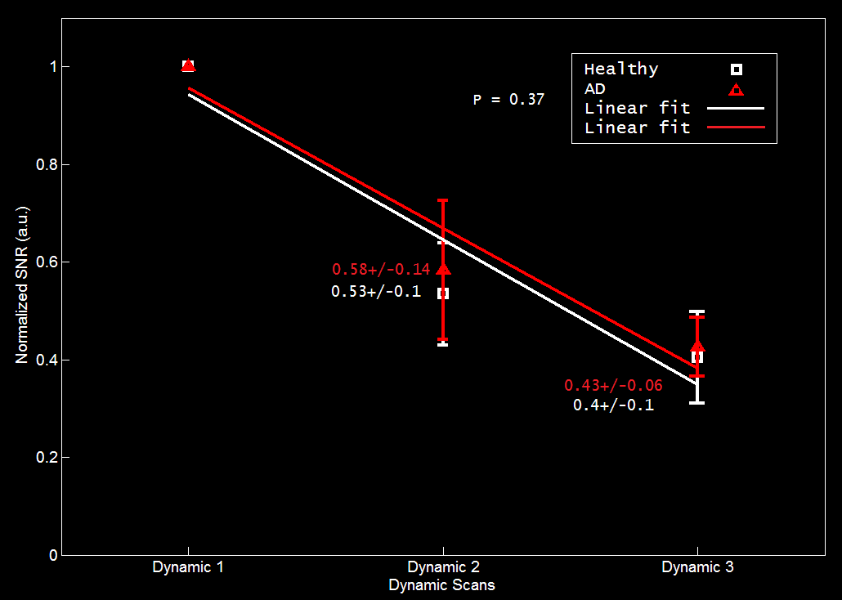
Results - ¹²⁹Xe Dynamic Images
A slower decay of the signal were observed in AD participants, but it’s not statistically significant (p = 0.37).

Slide 15
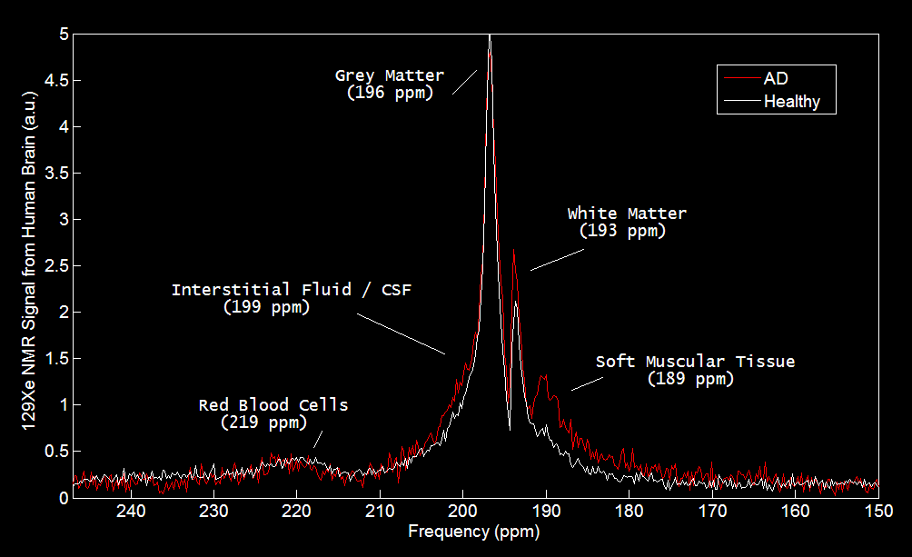
Results – High Resolution Spectroscopy
Four of five previously identified xenon peaks are well resolved.
The peak from interstitial fluid/CSF (199ppm) is barely observable.
No significant differences were found between the two groups.

Slide 16
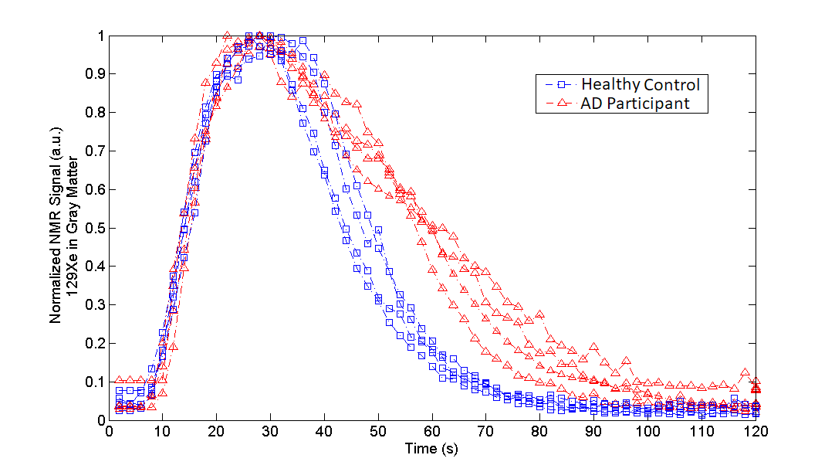
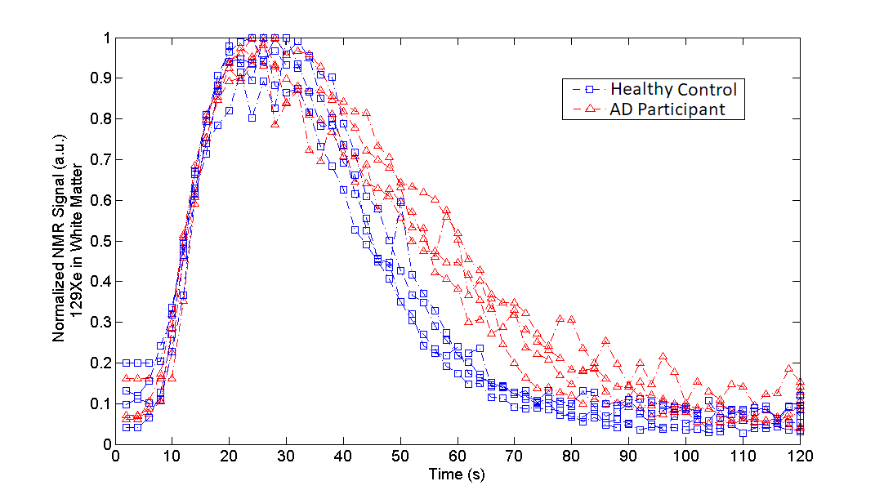
Results - ¹²⁹Xe Wash-out
In both gray matter and white matter, xenon wash-out time is significantly longer in AD group than in the age-matched healthy group.
Gray Matter White Matter

Slide 17
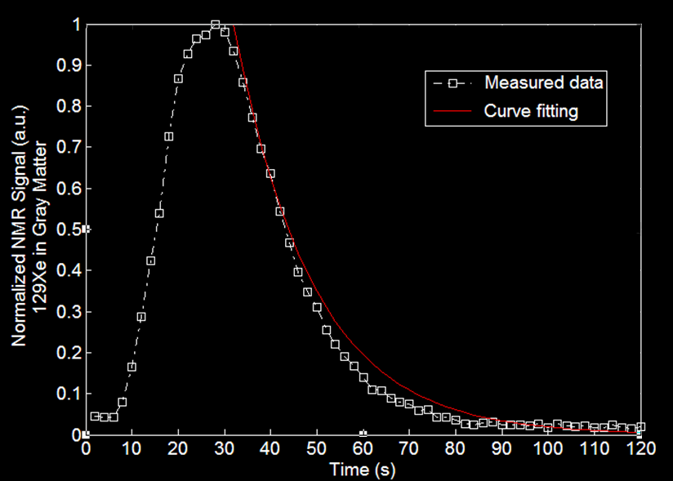



Xenon Washout Spectroscopy
The measured xenon washout signals were fitted to the following model:
where , and
$f$ is cerebral perfusion,
$p= \frac{λ_{tissue}}{λ_{Blood}}$ is Xenon partition coefficient,
T₁ is xenon relaxation time in tissue.
$$S\left(t\right)=S\left(T\right)×e^{−β × \left(t − T\right)}×\cos^{(\frac{t}{2}−1)}⁡(α)$$
$$β= \frac{f}{p}+\frac{1}{T_{1}}$$
Martin et al. J Magn Reson Imaging. 1997 Sep-Oct;7(5):848-54.

Slide 18
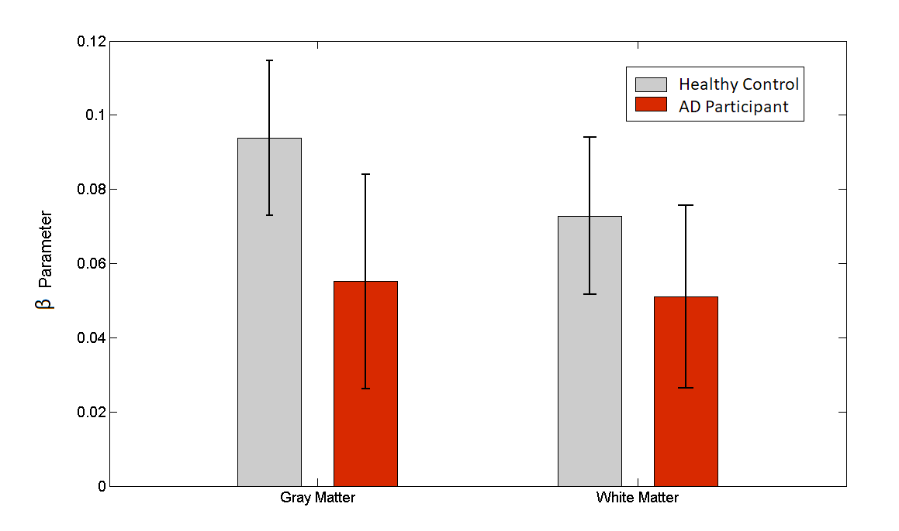

Results - ¹²⁹Xe Wash-out
The $β$values derived from xenon wash-out time from the two groups were significantly different in both gray matter and white matter (p < 0.01), largely attributed to a degraded cerebral perfusion in AD group.
Notes:
Use all data

Slide 19
Discussion
Significantly different xenon wash-out times from the brain tissues of healthy and AD participants.
Resulted from degraded cerebral perfusion caused by AD.
T₁ relaxation time of Xenon in brain tissues healthy group and the AD group could contribute to the difference.
A third compartment containing dissolved xenon can also lead to a different wash-out time.

Slide 20
Conclusions
The study demonstrated that HP ¹²⁹Xe MRI is potentially a sensitive bio-marker to probe physiological changes caused by AD, and possibly for other neurodegenerative diseases as well, at an early predementia stage.
Notes:
New bio marker

Slide 21



Acknowledgement
Dr. Seda Rafilovich
Dr. Alla Reznik
Dr. Ayman Hassan
R.Ts and MRI technicians at Thunder Bay Regional Health Science Center
Clinical MR Solutions, LLC
Xemed, LLC

Slide 22

Thank you!

