Slide 1
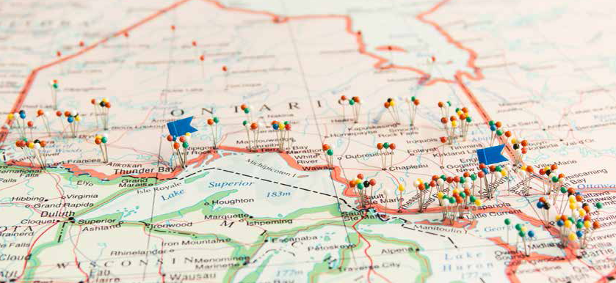
The Opioid Addiction Treatment Database:
Using administrative health data to conduct socially accountable research in the North
.
Joseph K. Eibl, PhD
and David C. Marsh, MD
June 5, 2015

Slide 2

Faculty/Presenter
Disclosure
Speaker Name: J. Eibl
Relationships with commercial interests:
  None

Slide 3

Aims
Overview of ICES and health systems research
Illustrate power of health systems research to evaluate opioid-dependence treatment
Mechanisms to access data for all research purposes

Slide 4
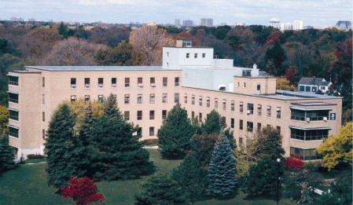
Health System Data and ICES
Institute for Clinical Evaluative Sciences
Located at Sunnybrook Hospital
Ontario Health Insurance Plan - largest single payer health system in the world
Identified as a global leader in health systems research
Data repository for Ontario Health System and Patient Registry data
Platform to facilitate access to data and expertise for NOSM’s clinical faculty who have a question or wish to do research

Slide 5
Major Linked Data Holdings
>13,000,000 anonymous linked health system records
Discharge Abstract Database
National Ambulatory Care Reporting System
Ontario Drug Benefit Plan
Statistics Canada
Canadian Institute for Health Information
EMRs linked to ICES data (>330,000)
80 other linked databases
(e.g., Cancer Care Ontario, MomBaby)

Slide 6
Opioid-Dependence:
How can we evaluate the size of the problem and the effectiveness of therapy?

Slide 7

Opioid-dependence is a major concern for the people of Northern Ontario
Opioid-overdose is the number one cause of mortality in 24-35 year-olds in Ontario
Opiate addiction is recognized as a serious problem in the North
Opioid Agonist Therapy (substitution/maintenance) is the standard of care for patient
Number of Ontario patients in methadone/Suboxone therapy increased from 6000 (2004) to over 38,000 in 2014

Slide 8
Dhalla, 2009, CMAJ – Ontario Drug Policy Research Network

Slide 9
Gomes et. al., (2014) Opioid Related Mortality in Ontario

Slide 10

Opioid Agonist Therapy
OAT is an observed treatment
Patient must present at the addiction clinic for daily dose
Resource heavy treatment
Geography is likely to play a role in addiction therapy;
Shortage of health
human resources in
the North
Ensuring access to therapy
is primary focus of system

Slide 11
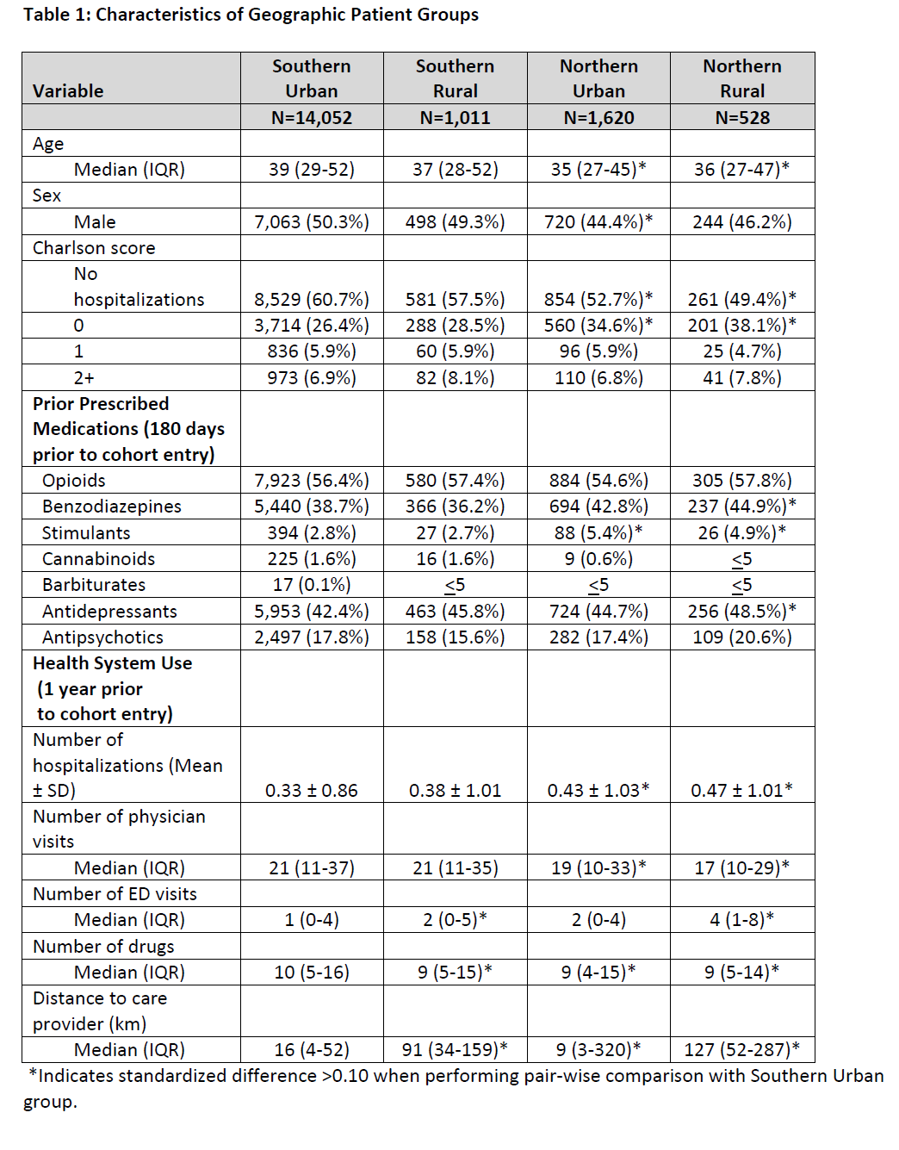
Northern Patients:
-younger
-more hospitalizations
-more concurrent prescriptions
-fewer physician visits
-Northern Rural patients had
almost 10x further distance
from care provider
Southern Urban 16km
vs Northern Rural: 127 km
Eibl et al., (2015) Journal of Addiction Medicine

Slide 12
Ontario Addiction Treatment Centers
(OATC) Clinic Network Sites
-12,000 active patients

Slide 13
Adoption of telehealth-delivered OAT

Slide 14
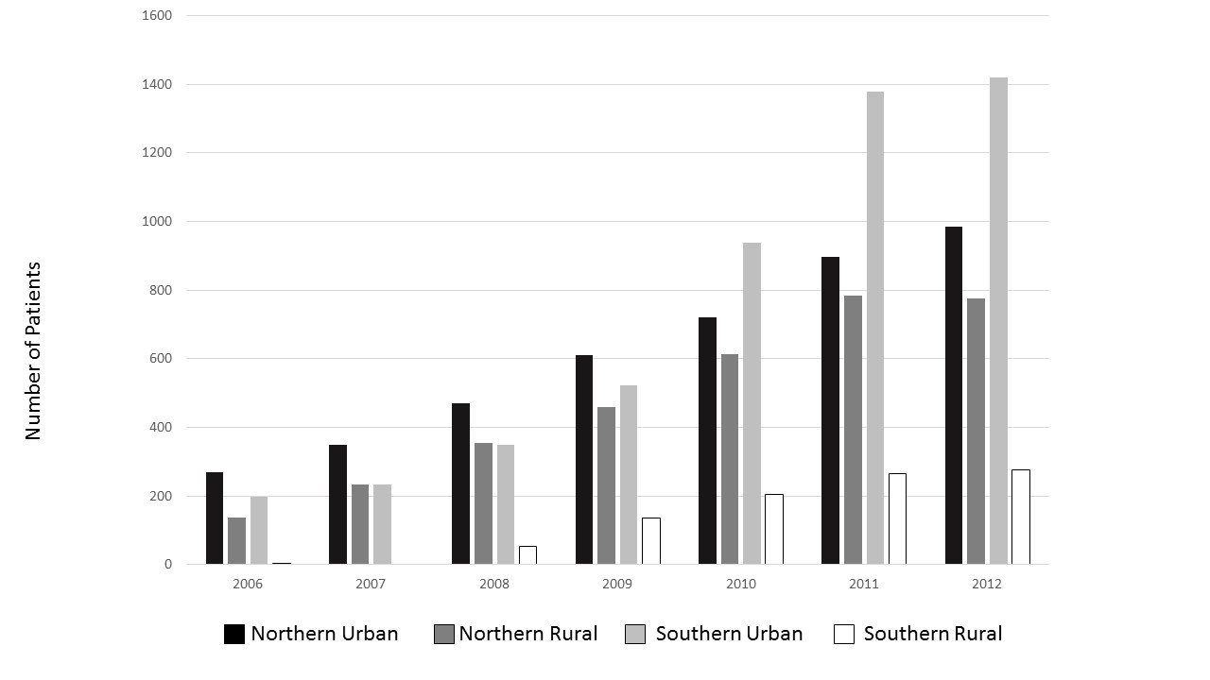
Adoption of telehealth-delivered OAT

Slide 15
Is telehealth an effective treatment modality for OAT?

Slide 16
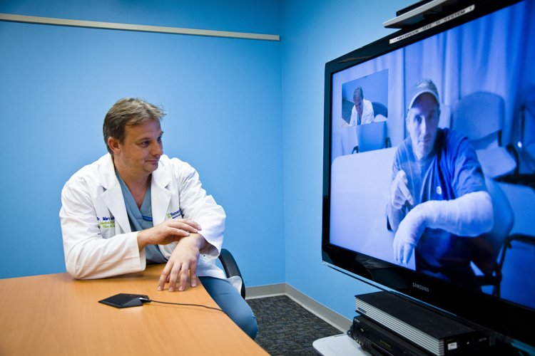
Study Design
Identified first-time methadone patients from 2009 – 2012
in the province of Ontario
5,854 eligible first-time methadone patients
Categorized into:
  -Telehealth (n=3689),
  -In-person (n=2165),
  One year of continuous treatment defined as a positive outcome

Slide 17
Impact of Telehealth on Opioid Agonist Therapy
Telehealth
In Person

Slide 18

Conclusions
Telemedicine is a very effective way to deliver opioid agonist therapy, especially where physician supply is limited

Slide 19
Thank You

Slide 20
Pathways to access ICES data
Clinical / Research Question
AHRQ
Work with ICES Scientist
Data Access Services
Applied Health
Research Question
(simple question with
a fast turnaround)
-Mechanism for researchers outside ICES to access data an ask research questions
-Cost recovery model (charged by analyst hour)
-ICES will provide estimate prior to undertaking project
-ICES Scientists have ability to access data based on their research interests
-ICES Scientist actively collaborate
-Peer mentorship streams
-Expertise in complex datasets

Slide 22
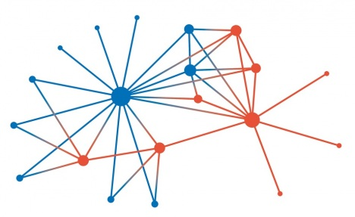
Opioid Addiction
Treatment Database
Electronic Medical Record for approximately 1/3 of the patients in Ontario (n>38,000)
2004-present
Clinical data: dose; urine toxicology; HIV/HepC status; telehealth / in person
Linked to broader ICES-data via OHIP number

Slide 23
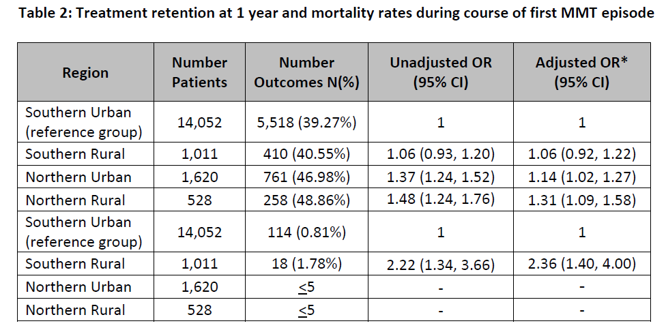
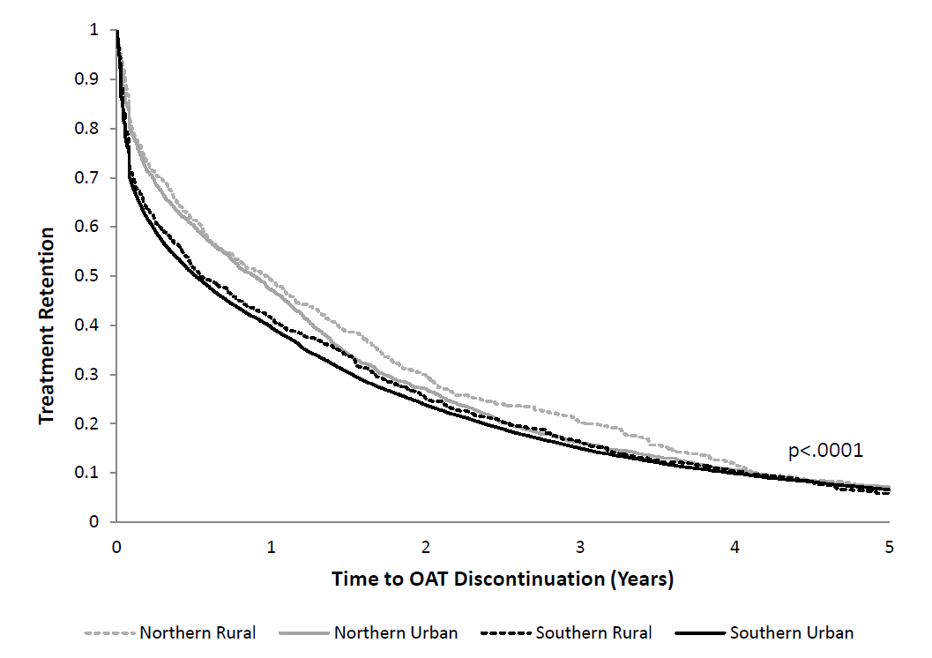
Results

Slide 24
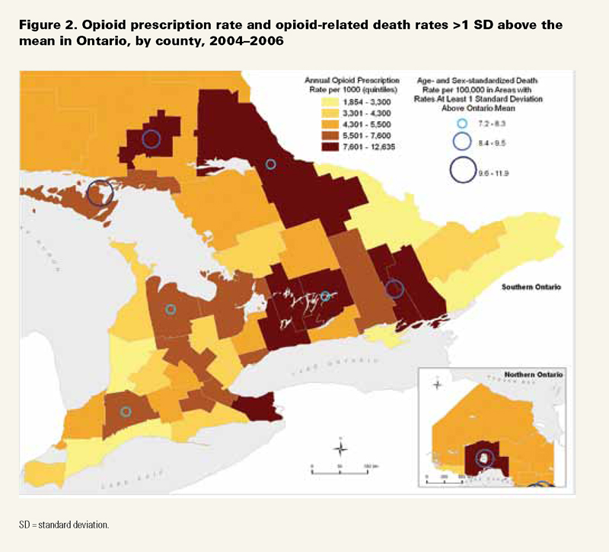
Gomes et al., 2011

Slide 26
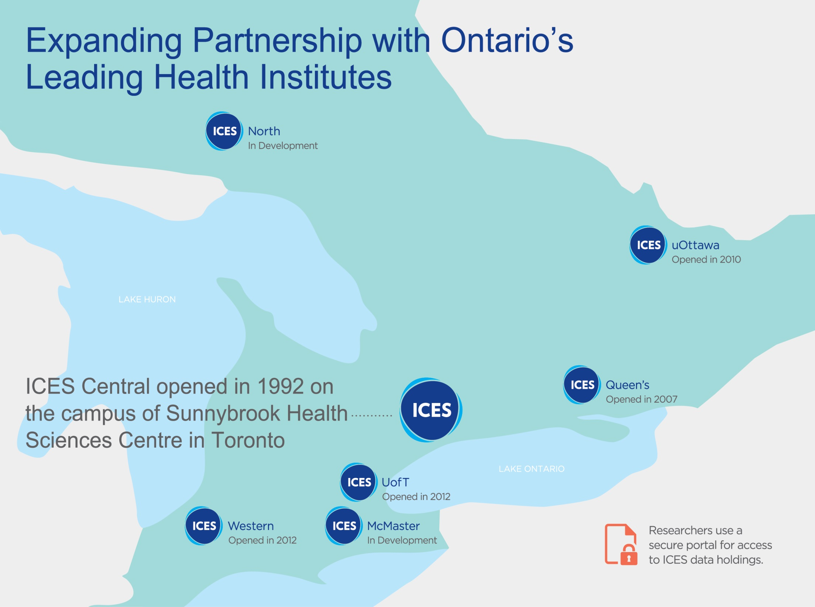
Institute for Clinical Evaluative Sciences
For more than 20 years, ICES has been a leading not-for-profit research institute that acts as a independent steward for Ontario’s holdings of individual-level, de-identified and linkable health and health-related data
ICES’ 192 scientists at four locations across Ontario (with 2 additional sites under development) have expertise in using these linked data sets to generate new knowledge that has directly informed health policy and improved the safety and quality of practice in Ontario.
As part of the Ontario SPOR SUPPORT Unit (OSSU) infrastructure and processes will be established to make ICES data and analysis services available to a broad array of Ontario and Canadian researchers and health system stakeholders
Recognizing that the health system includes major contributions from private sector organizations, ICES is also having exploratory conversations to identify possible future ICES products and services that might address the information needs of private sector clients

