Slide 1
L’utilisation des “smartphone camera” par les malades dans un pratique urologique Patient-Driven Use of Smartphone Camera in Office Urology Practice
Emmanuel Abara. MD.1,2;Nioushah Noushi.BMSc.1; Erinma Abara.BA(Hons),JD.1
Richmond Hill Urology Practice and Prostate Institute, Richmond Hill, ON, CA
Division of Clinical Sciences, Northern Ontario School of Medicine, Sudbury, ON/ Thunder Bay, ON

Slide 2
Conflict of Interest/ Conflit d’Interet
Nothing to declare
Rien a declarer

Slide 3
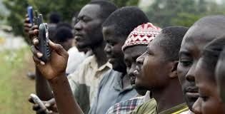
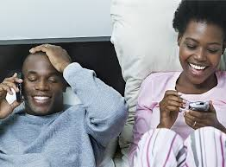
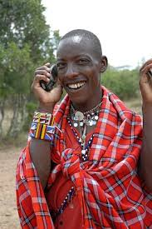
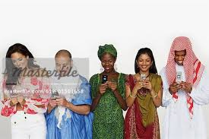
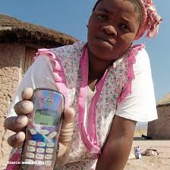
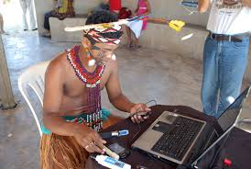
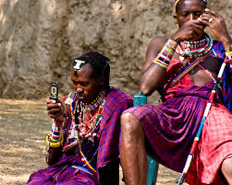
The Smartphone Camera is ubiquitous/ Le telephone intelligent est partout!

Slide 4
Historical Perspective of Smartphone L’histoire de la “smartphone”/ le telephone intelligent
1971 Concept of Smartphone- Telephone and computer – Theodore G. Paraskevakos - le concept du telephone intelligent concu par – Theodore G.
1993 Smartphones sold for the first time- les telephones intelligents sont vendus pour la premiere fois
2000 In Japan, smartphone equipped with camera- moniker “Cameraphone”- en Japon, le telephone intelligent est equipe avec un camera
2003- Smartphones flooded the markets; captured our live.- les telephones intelligents devient populaire
2015 advances in digital technology continue – les avancements dans la technologie continue
Notes:
Lessons to learn; see the patients to examine them and discuss management, until regulatory bodies get it, history taking is fundamental

Slide 5
Historical Perspective – Trends/ les tendances historique
By 2014, the camera phone has become “a communication tool readily available to most of the world’s inhabitants.”- en 2014, le telephone intelligent etait accessible a plusieur de monde
“It is estimated that although there are slightly over 7 billion people on Earth, there are 7.38 billion mobile connections and 3.7 billions subscribers”- on estime qu’il y a 3.7 milliards de souscriptions, il y a 7.38 milliards de connection mobile
The number is increasing yearly by 6.10% and 5.3% annually in the past 3 years- les nombres augmentent par 6.10% et 5.3%

Slide 6
Definitive Data and Analysis for the Mobile Phone Industry/ les faits et l’analyse de l’industrie de le telephone mobilier
7,350,330,259 mobile connections
3,646,464,593 mobile subscribers
$1.13 trillion revenue per year
$12.15 subscription cost per month
(GSMA Intelligence 2014- current year end data)/ l’intelligence 2014 de GSMA- l’information de l’annee courante 2014
International Society for Telemedicine and e-Health Newsletter January 2015/ le lettre des nouvelle pour la societe international des Telemedicine et le sante electronique

Slide 7
Historical Perspectives/ l’Histoire
Several applications of the smartphone and its various devices continue to grow in our lives impacting the way we live, play and in our healthcare
Les applications des telephone intelligent et les telephones mobilier qui impactent notre style de vie et notre sante

Slide 8
Materials and Methods/ les methods et les materiaux
Observational Study/ une etude observationelle
Period: January 5 to December 23 2014/ la periode de l’etude: le 5 janvier a le 23 December 2014
Frequency of Patient-driven use of smartphone camera to capture images/ le frequence del’utilisation du telephone intelligent pour capturer les images
Literature review- on use of smartphone camera by patients in Urology/ le revue des literatures de telephone intelligent par les maladies d’Urologie

Slide 9
Results/ Resultats
We see an average of 80 patients/week/ le moyen des malades qui sont traits – 80 maladies/semaine
90% of our patient have one type of cellphone or the other/ 90% des malades ont un telephone intelligent
Most were smartphones- of varying makes and sophistication/ il y a plusieurs type des telephones intelligent

Slide 10
Case 1/ cas no. 1
54 year old man with history of penile lesion of 5 year duration./ homme age 54 ans avec un histoire de la lesion penile
Post excision wife documented healing phases of wound and sent photos to urologist/ après l’excision, l’epouse a documente et a envoys les photos a l’urologue
Wound healing was reassuring./ le blessure guerit
They did not have to travel to see the Doctor./ il n’ont pas voyage au medecin

Slide 11
Case 2/ cas no.2
56 year old man with post-papaverine priapism and penile bruising ./ un homme age 56 ans avec le priaprisme et les bles penile
Used his smartphone camera to monitor his clinical condition and communicate with his urologist./ le malade utilise le telephone intelligent pour surveyer leur condition et communique avec l’urologue
The outcome was very favourable/ les resultats etaient positive
All is well/ Tout va bien

Slide 12
Case 3/cas no.3
45 year old man with a history of penile chordee in the absence of a palpable Peyronie’s plaque./ homme age 45 ans avec l’histoire de le penile chorde dans l’absence du plaque Peyronie palpable
Provided the urologist with photos by his smartphone to visually supplement his medical history ./ le malade a fournit les photos par les telephone intelligent pour son histoire medicale
This aided in the diagnosis and discussion of management options/ cette methode aide avec le diagnostic et les options d’entretiens

Slide 13
Case 4/ cas no.4
60 year old man with left flank pain. CT scan showed a small stone non-obstructing stone. On his way to see his Family MD, he uploaded the CT scan report instead of taking a paper copy / homme age 60 ans plaint de douleur du flanc
We still sent an electronic copy to the family MD as best practices require./ un copie electronique etait envoye au medicin primaire

Slide 14
Literature Review/ Revue de Literature
PubMed search revealed/ le recherche de PubMed identifie:
Few articles in Urology and other specialties on Patient-Driven use of smart cell phone cameras/ il y avait des articles un urologie et dans les autres specialities sur l’utilisation des telephones de malade
However, there are several articles in the literature about cell phone use but not cellphone cameras/ par contre, les articles dans l’academie discutent les telephones intelligents mais pas les telephones equipe avec les cameras.

Slide 15
Potential Benefits/ les benefies potentiels
“Patient-Driven”./ les maladies utilisent
Useful in supplementing history/ utile dans l’histoire medicale du malade
Convenient, no waiting for hard core images or paper reports/ il n’y a pas d’attend pour les images ou les rapports, c’est pratique
Consent may be implied./ le consentement est suggere
Images can be shared with preferred health care providers by the patients/ les images peuvent etre partager avec les medecins

Slide 16
Ethics, Privacy and Confidentiality Issues/ l’ethique, la privee et la confidentialite
Ethical ,Privacy and Confidentiality issues are equally applicable in situations where patients send smartphone photos as part of their medical records./ l’ethique, la privee, et la confidentialite sont applies au situations ou les maladies renvoient les images du telephone a leur medecin
Best practices by health care professionals are paramount./les regles professionnelles sont supreme
Colleges and regulatory bodies will continue to guide the profession as the uptake information technology and social media rise/ les colleges et les licenseurs continuera a guider la profession medicale comme la technologie informatique deviant plus populaire

Slide 17
Suggestions/les suggestions
Regulatory Bodies and Medical Protective Associations’ advice need to be followed/l’avis des licenseurs et des associations protective medicale devrait etre suiver.
Treat as part of patient’s medical records – obtain patient’s approval , if it is to be used as part of record/ l’informations des telephones intelligent sera partie du rapport de la malade si le malade oblige
Develop special consent form for electronic communication with patients, photos, records for second opinion and/or medical education/ le development d’un consentement pour la communiquation electronique avec les malades concernant les photos et les rapport pour une deuxieme avis

Slide 18
Conclusions/ conclusions
Use of smartphone camera occur in different situations in several specialties / l’utilisation du telephone intelligent se recontre dans les specialites divers
Patient-driven photo with smartphone camera can be complimentary to clinical assessment/ l’utilisation du telephone intelligent avec le camera pourrait etre utile dans l’evaluation clinique
Use of this device by Urology patients are occurring but are probably not frequently reported/ l’utilisation de cette appareil est utilise mais n’est pas rendus compte
Its usefulness in diagnosis, treatment, counseling and surveillance needs further study/ l’utilite de l’appreil dans le diagnostic, le traitement, le conseiller et la surveillance a besoin plus de recherche
Quality of the photos is improving but not to replace proper clinical examinations/ le qualite des photos ameliore mais n’est pas encore raisonnable pour les examens medicale
These photos should be handled ethically and appropriately as other patients’ medical records

Slide 19
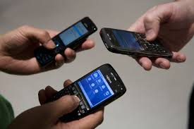
Mobile smartphone use: changing the way we live
We are at a stage where mobile technology in health holds great potential both for the industrialized and developing worlds.

Slide 20
References/les references
1. GSMA Intelligence 2014. Current year end data. International Society for Telemedicine and e-Health Newsletter. Janury 2015.
2. Sanjay Radzan, James Johannes, Ramsey Kuo, Demetrius Bagley: The Camera Phone: A novel aid in urologic practice: Urology April 2006. Vol 67. pp665-669.
3. Sidana A, Norri S, Patil N. Utility of smartphone camera in patient management in Urology. Can J Urol 2014. Oct:21(5).pp7449-53
4. Leo Celi, Luis Sarmentia, Jhonathan Rotberg, Alvin Marcelo, Gari Clifford. Mobile Care(MOCA) for Remote Diagnosis and Screening. J Heath Inform Dev Ctres 2009. January 9: 3(1): 17-21
Notes:
The real reference 1 is the history of the cell phone – missing for now.

Slide 21
Merci ! Thank you ! De Toronto a Abidjan

