Slide 1
No Surprise, Gas does Spoil your Appetite
Erik Slade, MSc. Biology
Supervisor: Dr. Jeffrey Gagnon

Slide 2
Faculty/Presenter Disclosure Slide
Erik Slade
Relationships with commercial interests: NONE
Potential for conflict(s) of interest: NONE

Slide 3
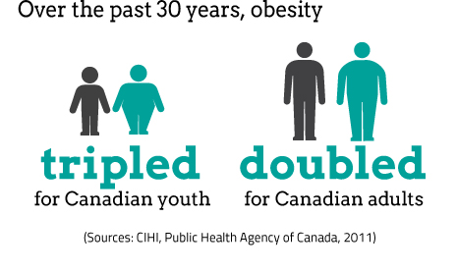
1 in 10 children
1 in 4 adults

Slide 4
Obesity's Impact on Health
Heart Disease
Type 2 Diabetes
Cancer
Depression

Slide 5
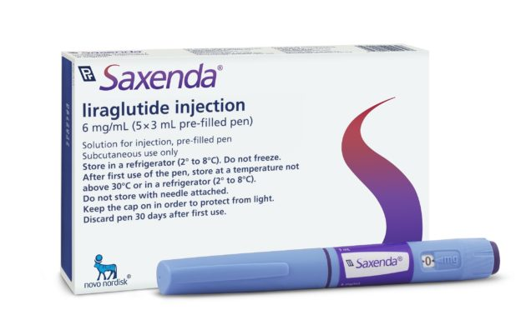
Treatments for Obesity include:
Dietary changes
Exercise and activity
Weight-loss surgery
Prescription weight-loss medications
Notes:
Estimated 60 billion in US

Slide 6
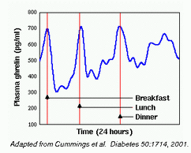
Ghrelin
Hormone produced primarily in the stomach
Functions:
Appetite stimulant
Regulates energy metabolism

Slide 7
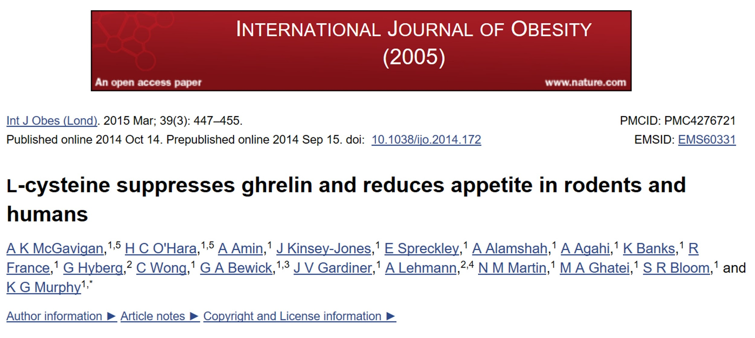
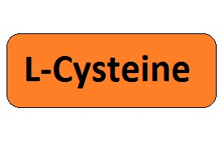
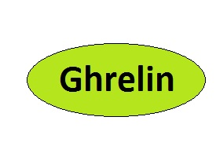
Notes:
Suppressed L- cysteine in rats 30 minutes after oral administration
crop title

Slide 8
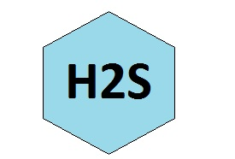
L-Cysteine
Amino acid
Protein rich meals produce greater satiation
↓ ghrelin release and ↓ appetite in humans and mice fed L-cysteine
Cystathionine gamma-lyase (CSE)

Slide 9
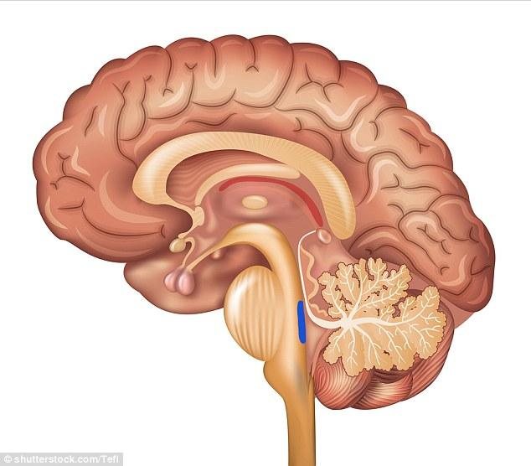
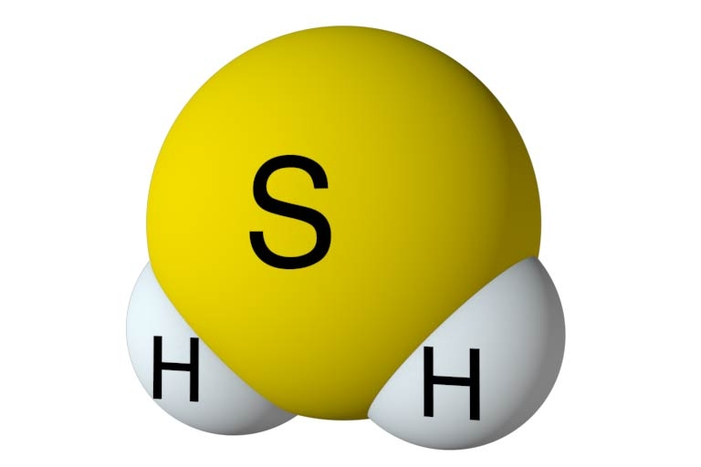
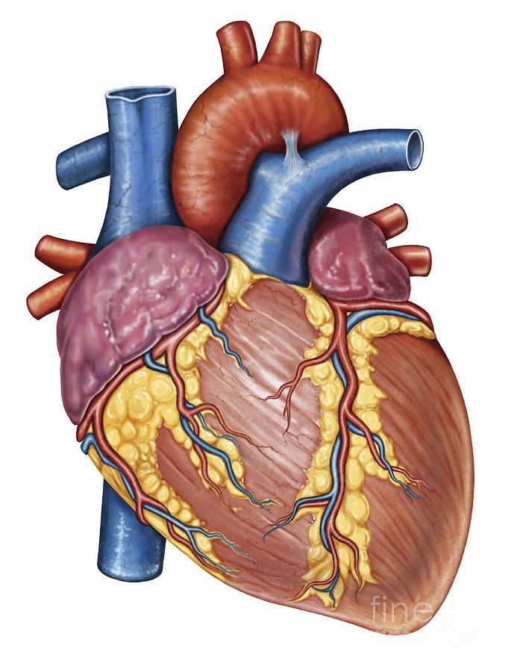
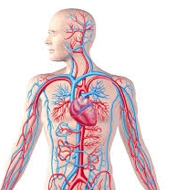
Hydrogen Sulfide H₂S
Endogenous Gasotransmitter
Cardiovascular system
Nervous system
Inflammation
Insulin regulation

Slide 10
Research Question
Does H₂S decrease ghrelin secretion and in turn decrease appetite?

Slide 11
Objectives
Direct effect of H₂S in vitro
Cell culture experiments
Direct effect of H₂S in vivo
Introduction into animal model

Slide 12
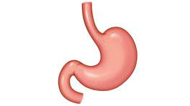
Primary Stomach Culture
Tissue collection
Physical tissue breakdown
Enzymatic tissue digestion
Plate cells for secretion experiments
Notes:
Stain image 2 slides 1 primary 1 treatments

Slide 13
H₂S Suppresses Ghrelin Secretion
Treatments
H₂S Donors
GYY4137
NaHS
Notes:
Stain image 2 slides 1 primary 1 treatments

Slide 14
Blocking H₂S Production Stimulates Ghrelin Secretion
Treatments
CSE inhibitor
PAG
Notes:
Stain image 2 slides 1 primary 1 treatments

Slide 15
Summary
Two different H₂S donors directly inhibit ghrelin secretion in stomach primary culture
PAG, an inhibitor of H₂S production, increases ghrelin secretion

Slide 16
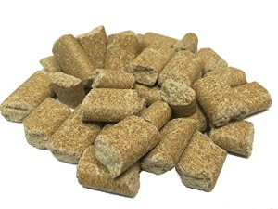
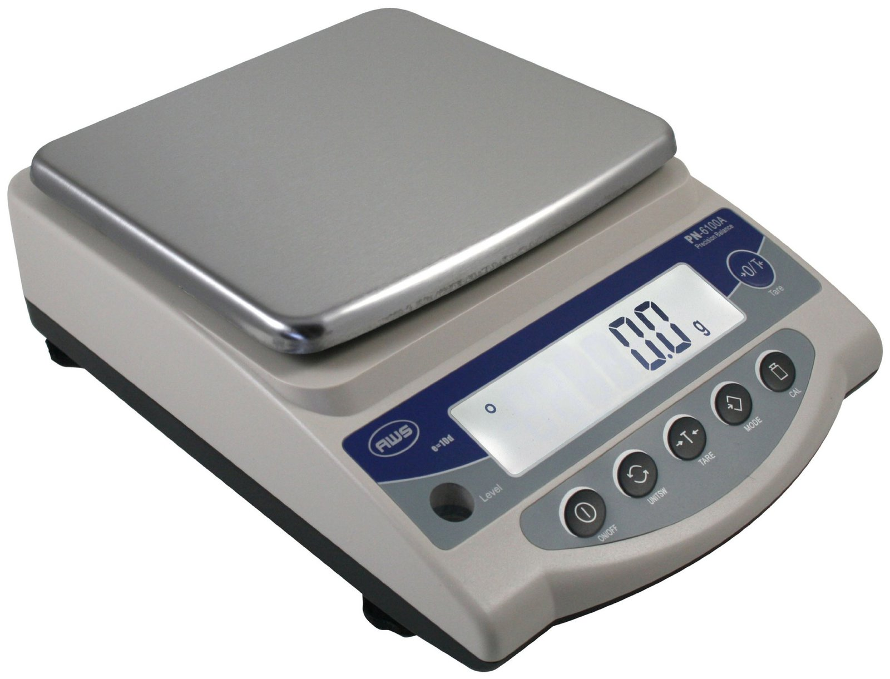
Appetite Study
Normal Ghrelin
Response
Oral Gavage -1 hour
Vehicle
H₂S Donor
L-Cysteine
Plasma collections
0, 10 and 60 minutes
Food weighed
1, 2, 6 and 12 hours post gavage
With H₂S
Donor/L-Cysteine
Ghrelin
0
10
60
-1
0
1
2
6
12
Notes:
Food Consumption?

Slide 17
Inhibitor Experiment
Oral Gavage -1 hour
L-Cysteine
L-Cysteine + PAG
Plasma collections
0, 10 and 60 minutes
Normal Ghrelin
Response
With L-Cysteine
Ghrelin
With L-Cysteine + PAG
0
10
60
Notes:
Edit cut words make sense

Slide 18
Summary
The use of in vitro and in vivo experiments to:
Discover the direct effect of H₂S on appetite and ghrelin secretion

Slide 19
Impact
This study will contribute:
Potential dietary therapy for weight loss
Potential target for weight loss therapies using H₂S
CSE
Notes:
L cysteine food

Slide 20
Acknowledgements
Supervisor - Dr. Jeffrey Gagnon
Lab Members - Laura Williams, Erin Frey
Thesis Committee
Dr. Guangdong Yang, Dr. Eric Gauthier

Slide 21
Notes:
Stain image 2 slides 1 primary 1 treatments

Slide 22
Immunocytochemistry of Stomach Primary Culture
Notes:
Rabbit anti cse, mouse anti ghrelin, DAPI nuclear

Slide 24
L-Cysteine’s potential mechanism of suppression
2.
1.
5.
4.
3.
CSE
Notes:
H₂S production plays a role in ghrelin induced appetite suppression * cut out ghrelin

Slide 25
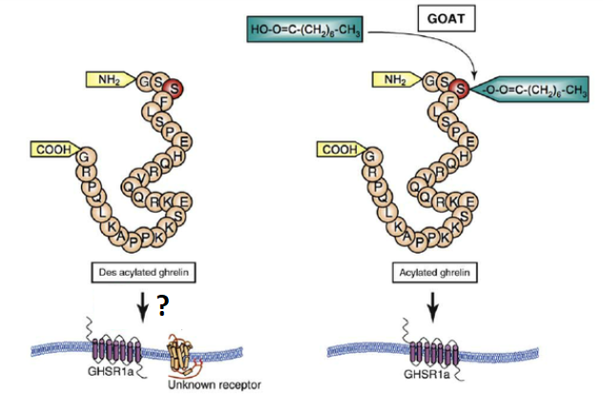
20% approximately is acyl-ghrelin and has a half-life of 10-30 minutes

Slide 26
Neutral Red Assay

Slide 27
Ly inhibits Akt Pathway

