Slide 1
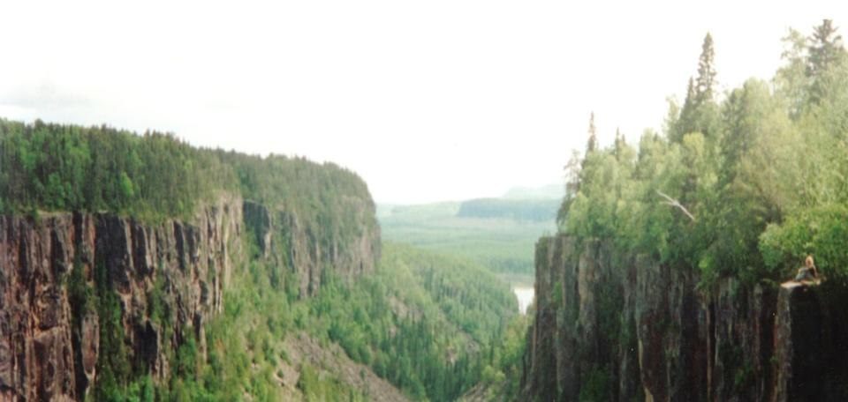
Expanding Aboriginal Cultural Competency and Curriculum:
The NODIP Experience
Northern Health Research Conference
June 5, 2015

Slide 2
Faculty/Presenter Disclosure
Presenters:
Lee Rysdale
Denise Raftis
Relationships with commercial interests: None
Potential for conflict(s) of interest: None

Slide 3
Objectives
Best practices to integrate Aboriginal cultural competency into health professional education and training
Enablers and challenges in implementation and evaluation of Aboriginal cultural competency in health education curriculum
Strategies to assess the impact of health education and training on cultural self-efficacy

Slide 4
NODIP-46 weeks

Slide 5
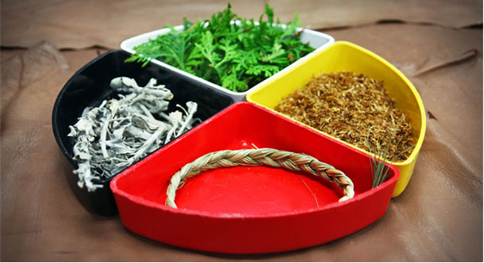
Almost half (40-46%) of Ontario’s Aboriginal population
20% of total population in Northwestern Ontario
About 25% of Franco-Ontarians
Majority in Northeastern Ontario

Slide 6
Best Practices
A common model, measure or definition across health disciplines?
‘Teachability’ with health practitioners and learners?
Curriculum and cultural self-efficiency?
Cultural
Desire
Cultural
Awareness
Cultural Knowledge
Cultural
Skill
Cultural
Encounter
Cultural
Competency

Slide 7
Activities and Timelines
Literature Review
Competency Assessment Framework & Indicators
Internal and External Key Informants
Minimum and Advanced Competencies
Environmental Scans
Draft Implementation Toolkits for Preceptors
Draft Competency Checklists for Learners
Ongoing Consultations and Feedback
Ongoing Scans, Checklist and Toolkit Revisions
Preceptor Readiness & PD Needs (2 REBs)
Targeted Implementation & Process Evaluation
5 intern/RD pairs
Summer/Fall 2012
Winter/Spring 2013

Slide 8
Activities and Timelines
Preceptor Training
Aboriginal Workshop-Sudbury/Thunder Bay
Francophone Webinar Series
Ongoing Scans, Checklist and Toolkit Revisions
Formatted and Launched Online (Feb 2014)
http://www.nosm.ca/education/general.aspx?id=17879
http://www.nosm.ca/education/general.aspx?id=17825
Track web traffic-uptake and distribution
National and International Conferences
Health Sciences FACE Committee
Targeted Implementation
10 interns/RD pairs
Intern training by NOSM Aboriginal Affairs
September 2014 orientation and May 2015
Summer/Fall 2013
Winter/Spring 2014
Summer 2014
Fall/Winter 2015
Spring 2015

Slide 9
Challenges
I loved the videos!
NOSM vs Health Sciences
Indicators and Evaluation
Education commitment and content
Clinician and learner performance
Environmental Scans
Ongoing, current
Draft Implementation Toolkits
Updates July 2013 and Feb 2014
Online version
Draft Competency Checklists
Pilots (9/12 completed)
Five updates/revisions
Online version
Way too much to expect in 6 weeks
Some links are broken
It’s all right there for you
Optional readings & videos should be required
Didn’t have enough actual experience
Provides direction for the learner and develops minimum competency without having to go further and do one’s own research.

Slide 10
Challenges
Preceptor readiness and PD needs
Needs assessment (n=61 of 550) (2 REBs)
Preceptor training
Distance, diverse disciplines, appropriate format

Slide 11
So…Now What?
Commitment
& Collaboration
Early Implementation
Preceptor & Learner Competence
Organizational & Preceptor Buy-In

Slide 12
Model of Cultural Competence for Education and Training of RDs
Multicultural nutrition counselling skills
Multicultural food and nutrition knowledge
Medico, TJ. (2011). http://trace.tennessee.edu/utk_gradthes/899

Slide 13
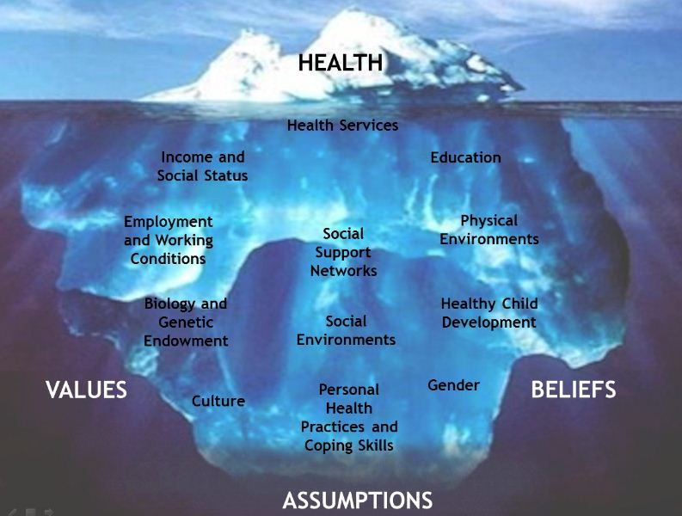
Goal: Cultural Self-efficacy
Increase awareness, knowledge and skills
Function in culturally diverse situations
More likely to work with priority populations
Train
Recruit
and
Retain
in the
North

Slide 14
Our Questions
How do we assess cultural self-efficacy?
What shapes cultural self-efficacy and practice setting decisions?
individual and/or organizational factors?
What types of educational experiences increase cultural self-efficacy (e.g. workshops, placements)?
Are there specific aspects of the learning experience that are more effective?
How do we assess the impact of specific experiences on cultural self-efficacy?

Slide 15
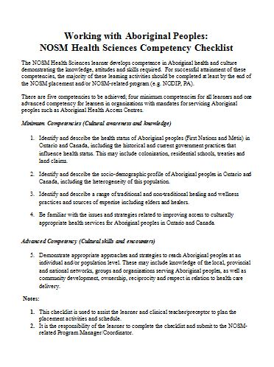
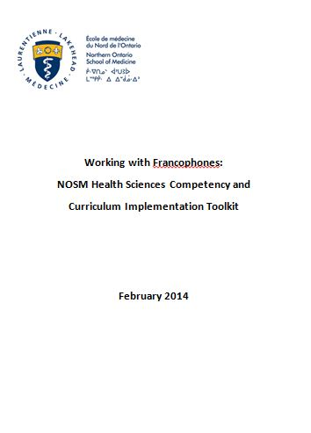
Learn More
http://www.nosm.ca/education/general.aspx?id=17879
http://www.nosm.ca/education/general.aspx?id=17825

Slide 16
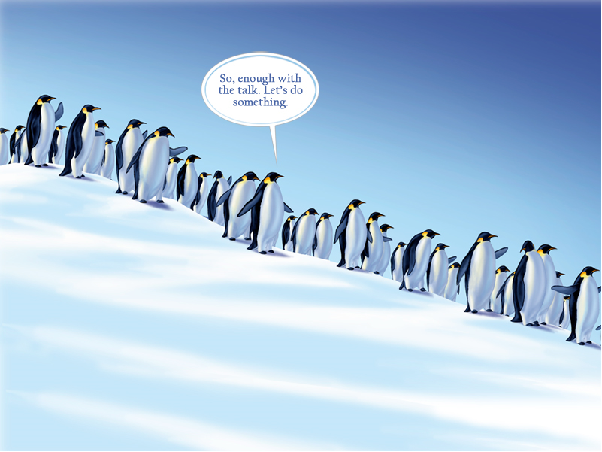
Your Questions

