Slide 1
Charting Knowledge into Practice: Assessing Opioid &Chronic Pain Management Performance in ECHO Ontario, a Retrospective Chart Review
Bayley V. Ostenfeldt
Authors: Jane Zhao, Bayley V. Ostenfeldt, Bryan MacLeod, Yalnee Shantharam, Santana Diaz, Maria Laura Santos, Leslie Carlin, & Andrea Furlan
October 14, 2017
Northern Health Research Conference, Thunder Bay, ON

Slide 2
Faculty/Presenter Disclosure Slide
Bayley V. Ostenfeldt
Relationships with commercial interests: NONE
Potential for conflict(s) of interest: NONE

Slide 3
Learning objectives
Understand the basic principles of the ECHO model and the goals of the ECHO Ontario Chronic Pain and Opioid Stewardship program
Cite data supporting the impact of the ECHO Ontario Pain program on clinician behaviour
Overview of clinical benefits to be expected from ECHO attendance

Slide 4
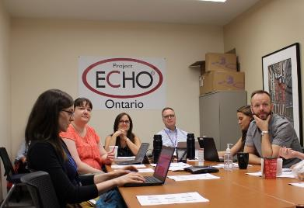
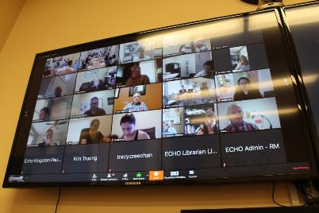
Background
ECHO Ontario Pain and Opioid Stewardship
Launched in June 2014
Content of chronic pain: common, complex disease managed mostly in primary care
Notes:
Chronic pain (CP) and opioid management is a challenging and complex problem in the province of Ontario. Primary healthcare providers (HCPs) manage the majority of CP patients, yet receive minimal training.¹ Project ECHO™ (Extension for Community Healthcare Outcomes) is a model that uses telehealth technology to bridge specialists in academic centres to HCPs in remote areas.² Using a combination of didactic and case-based learning, ECHO Ontario Chronic Pain and Opioid Stewardship (“Project ECHO”) aims to disseminate knowledge and enhance capacity in PCPs across Ontario.

Slide 5
ECHO Pain Achievements
147 ECHO sessions to date
12-member interprofessional hub
369 individuals signed-up for ECHO
7,000 + hours of medical education provided
3,500 + of CME hours granted
4 Hands-on training workshops conducted with 109 learners
Notes:
195 new patient cases presented, 35 follow-up
147 didactic lectures given

Slide 6
Family MD on Chronic Pain Patients
“I would say that my chronic pain patients, I don’t have a huge number, they are my most challenging patients and I’ve got their faces in my brain. And [sic] my top three probably take more brain and mental energy than the next 500 most challenging people. I often feel helpless…They have seen all the specialists and the specialists had sent them all back to me with not a lot [sic] of help…”
- MD, rural Ontario
Notes:
Very little training in pain management
Remote, rural areas across the province
Long wait lists for specialists

Slide 7
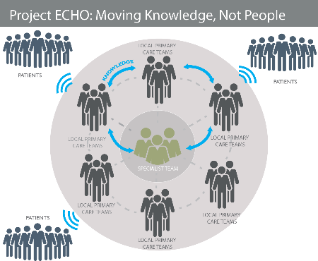
Chart review - Introduction
Previous studies suggest ECHO can be effective for knowledge translation
This study investigates KT from the ECHO program into implementation into practice
Notes:
Though previous studies have shown improvement in self-report items and suggest that ECHO can be an effective strategy for knowledge translation, few studies have explored provider performance in clinical practice.⁴ This study investigates the translation of knowledge from the ECHO program to its implementation in practice.

Slide 8
Chart review - Methods
HCP Inclusion criteria: attended at least 4 ECHO sessions, able to obtain consent from 5 to 10 patients for whom they prescribed opioids for chronic pain
Patients were being treated by a HCP who had attended ECHO
Analysis: pre- and post-ECHO comparison of data related to: number of visits to healthcare provider, pain, function, sleep, mood, prescription of opioids and non-opioids, recommendations for non-pharmacological management and urine drug testing.
Goal of 100 charts
Notes:
Recruited healthcare providers (HCPs) who attended ECHO Ontario Chronic Pain and Opioid Stewardship from June 2014 to XXX (study ongoing).
Inclusion criteria for HCPs: attended at least 4 sessions of ECHO, able to obtain consent from 5 to 10 patients for whom they prescribed opioids for chronic pain in the past 3 years (before and/or after their attendance in ECHO).
Patients were not presented at ECHO, but were being treated by a HCP who had attended ECHO.
Chart review of each patient according to a pre-established form by a researcher in our team.
Analysis: pre- and post-ECHO comparison of data related to: number of visits to healthcare provider, pain, function, sleep, mood, prescription of opioids and non-opioids, recommendations for non-pharmacological management and urine drug testing.
Sample size: goal of 100 charts

Slide 9
Chart review – Preliminary Results (n = 14)
PATIENT DEMOGRAPHICS
Sex
Patient Age
57% Female
43% Male
40-49
7%
50-59
43%
Rurality
60-69
21%
71% Urban
29% Rural
70-79
29%

Slide 10
Chart review – Preliminary Results
PAIN DIAGNOSES
Migraines
13%
Neck Pain
13%
Abdominal Pain
20%
Shoulder Pain
27%
Back Pain
67%
Knee Pain
27%
CRPS
7%
Fibromyalgia
7%
COMORBIDITIES
40% with comorbid
Sleep Disorders
53% with comorbid Mental Health conditions

Slide 11
Chart review – Preliminary Results
PRACTICE CHANGES
25% reduction in number of visits to HCP
21% increase in discussion around pain interference with the patient’s functional status (mood, sleep, etc.)
36% tapered opioids Post-ECHO (decrease dose or eliminated altogether)
21% reduction in dangerous polypharmacy (benzodiazepine + opioids, CNS depressants + opioids)
29% increase in Urine Drug Screening in opioid-related management
36% increase in recommendation to stay active (walking, gym membership, etc.)

Slide 12
Chart review - Conclusions
Documented implementation of knowledge into clinical practice at one-year following ECHO attendance
Further work aims to review our full sample of charts, refine the chart review tool’s sensitivity to change, and to investigate patient-level outcomes
Notes:
Our preliminary results demonstrate the documented implementation of knowledge into clinical practice at one-year following ECHO attendance. This finding complements previous findings of increased self-reported knowledge and self-efficacy in chronic pain management.
Further work aims to review our full sample of charts, refine the chart review tool’s sensitivity to change, and to investigate patient-level outcomes.

Slide 13
Discussion
Challenges
Physician recruitment
Patient retention
All data was collected in North Western Ontario
Your experience, thoughts?
Notes:
Difficulties with engaging physicians willing to turn over their files to review opioid prescribing practices
It was easy enough to get verbal consent over the phone. However, when we were trying to get them to return the signed consent form we ran into trouble, even though we sent out the consent form to send back, a copy to keep, all in a self addressed stamped envelope they were not being returned.

Slide 14
Acknowledgements: Research funding is made possible by the Ontario MOHLTC, CIHR, & NOAMA.
For more information: www.echoontario.ca
Aa @EchoOntario & @PainResearchNWO

