Slide 1


Results of the First In Vivo HyperCEST MRI Detection of a Hyperpolarized Xenon Biosensor, Cucurbit[6]uril
Francis Hane^{1,2}, Tao Li², Peter Smylie¹, Mitchell Albert^{1,2,3}
¹ Lakehead University, Department of Chemistry, Thunder Bay ON
² Thunder Bay Regional Health Research Institute, Thunder Bay ON
³ Northern Ontario School of Medicine, Thunder Bay ON

Slide 2
Faculty/Presenter Disclosure
Presenter: Francis Hane
Relationships with commercial interests:
  Patent with the US Patent Office and the EU Patent Office
  Patent Issued to Drs Mitchell Albert and Francis Hane

Slide 3
Mitigating Potential Bias
Dissemination & peer review occurred prior to patent application.

Slide 4
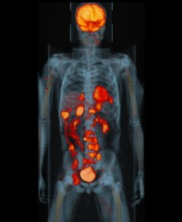
Molecular Imaging
Provides functional information inside the body.
Can determine the presence or severity of disease without surgery or biopsies.
May provide personalized care.

Slide 5
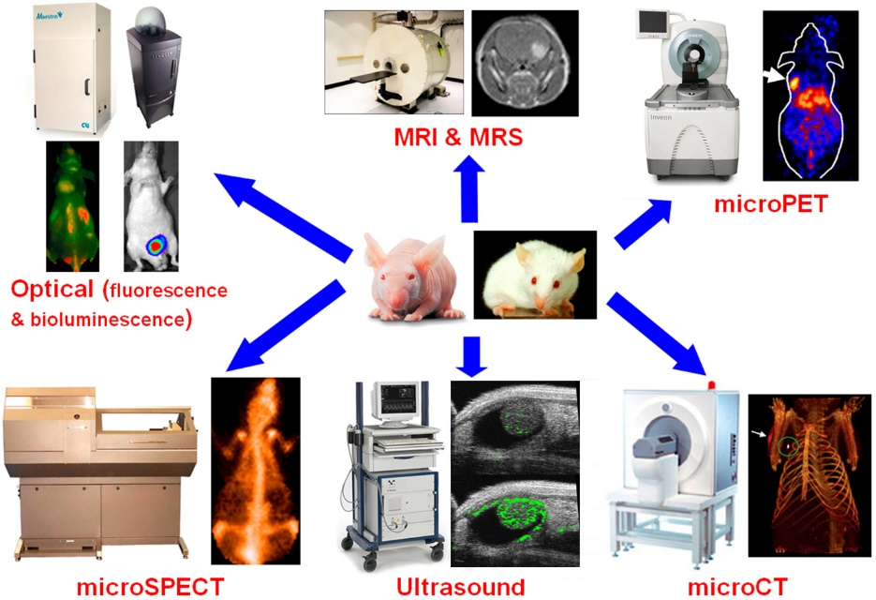
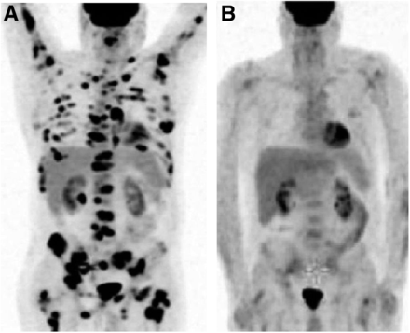
Molecular Imaging
https://mi.wisc.edu/
Berthet, L (2013) J Nucl Med 54:1244-1250
Very small concentrations of radiotracers are injected
  Bind to certain molecules in the body
Detected using positron emission tomography (PET) or other imaging modalities.
Different radiotracers may differentiate diseases.

Slide 6
Molecular Imaging
Unfortunately, many of these techniques use ionizing radiation, have poor resolution, and rely on other imaging modalities (i.e. CT) to localize pathogenic tissues.

Slide 7
Molecular Imaging using MRI
Magnetic Resonance Imaging (MRI)
  high resolution, low sensitivity
  no ionizing radiation
Need to increase sensitivity to make MRI a usable molecular imaging modality

Slide 8
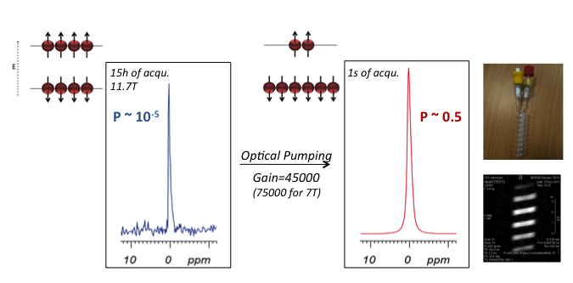
Hyperpolarized gas MRI
A noble gas, such as xenon-129, is polarized by exchanging the quantum spin between an excited alkali vapour (Rb) and the noble gas
  10⁵ increase in sensitivity

Slide 9
Hyperpolarized gas MRI
First demonstrated by my mentor, Prof. Mitchell Albert & colleagues
Awarded Presidential Early Career Scientist Award by President Bill Clinton.
Albert, 1994

Slide 10
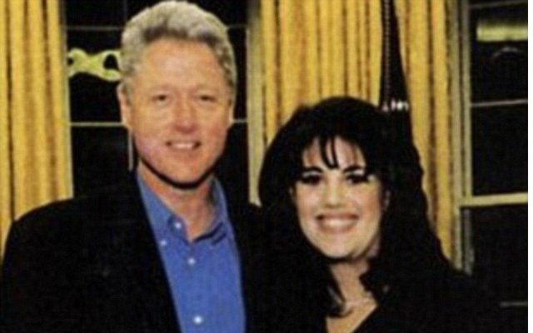
Hyperpolarized gas MRI
First demonstrated by my mentor, Prof. Mitchell Albert & colleagues
Awarded Presidential Early Career Scientist Award by President Bill Clinton.
Albert, 1994

Slide 11
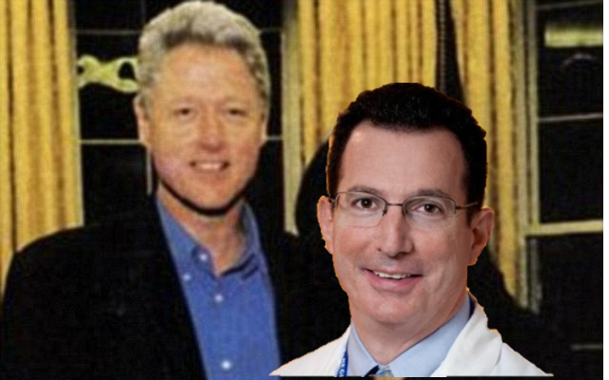
Hyperpolarized gas MRI
First demonstrated by my mentor, Prof. Mitchell Albert & colleagues
Awarded Presidential Early Career Scientist Award by President Bill Clinton.
Albert, 1994

Slide 12
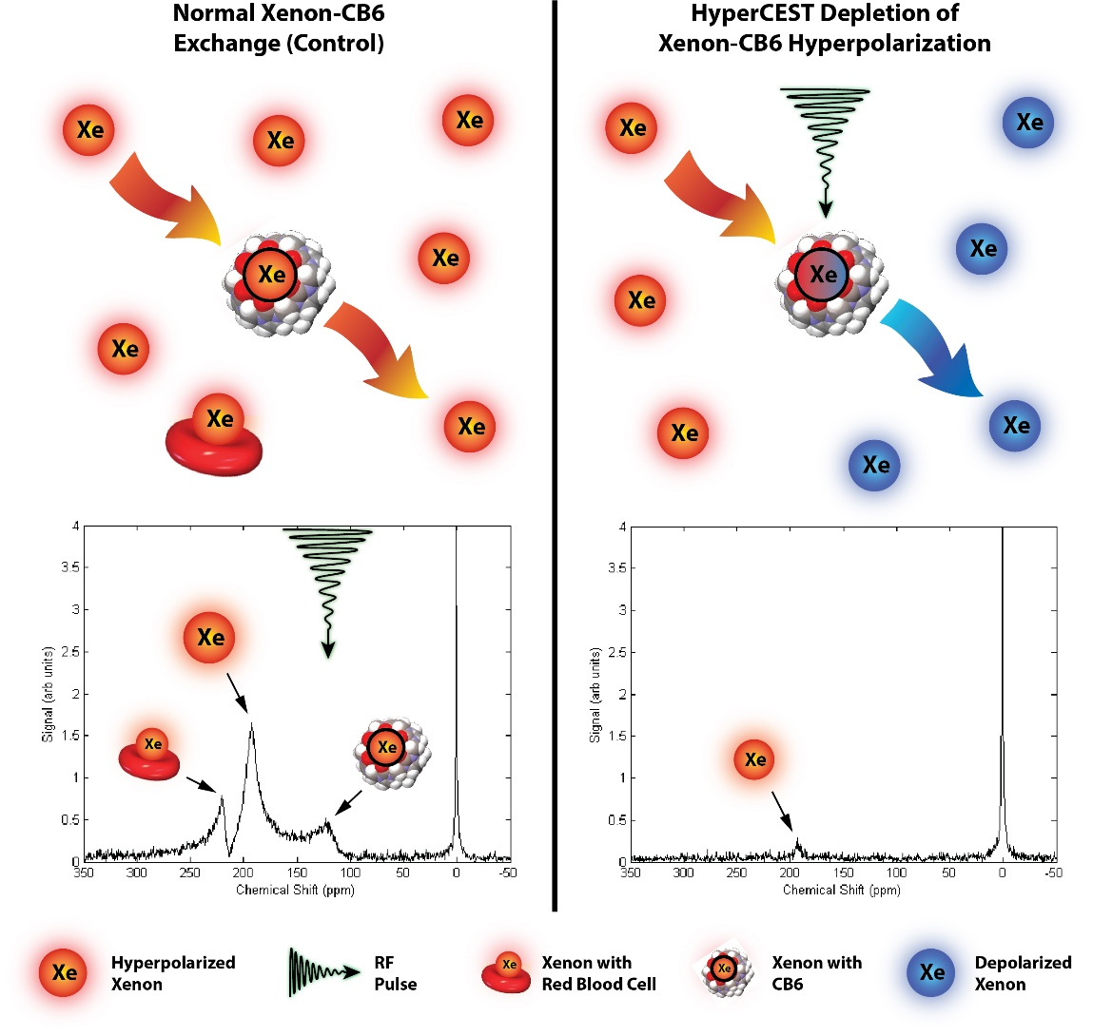
Hyperpolarized Chemical Exchange Saturation Transfer
Hane F, et al. (2016). CMMI. 11: 285-290.

Slide 13
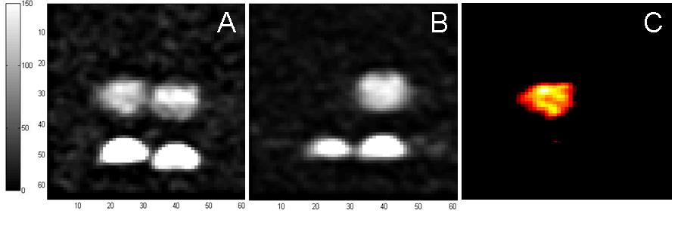
Detection of CB6 in Blood
Control
HyperCEST Pulse
Saturation Map
CB6 Present
CB6 Absent
Hane F, et al. (2016). CMMI. 11: 285-290.

Slide 14
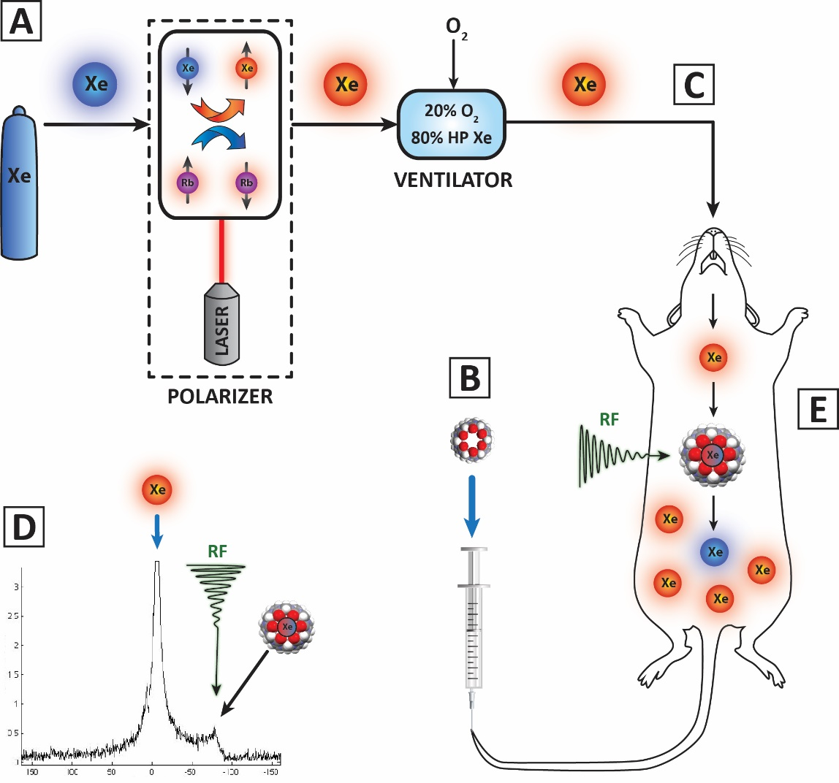
CB6 Detection In Vivo
Hane F, et al (2017). Scientific Reports. 7: 41027.

Slide 15
CB6 Detection In Vivo
Control
HyperCEST
Abdomen
Brain
Hane F, et al (2017). Scientific Reports. 7: 41027.

Slide 16
CB6 Detection In Vivo
Control
HyperCEST
Saturation Map
Hane F, et al (2017). Scientific Reports. 7: 41027.

Slide 17
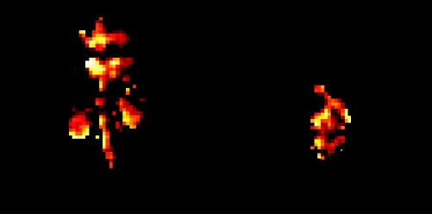
CB6 Detection In Vivo
Hane F, et al (2017). Scientific Reports. 7: 41027.

Slide 18
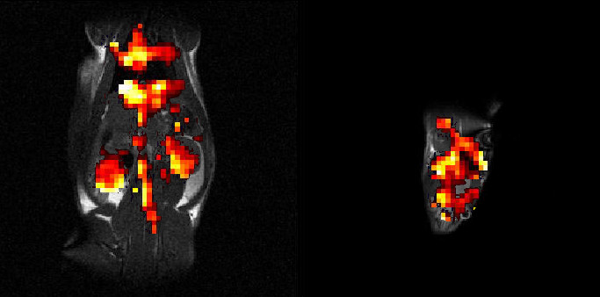
CB6 Detection In Vivo
Hane F, et al (2017). Scientific Reports. 7: 41027.

Slide 19
Future Work
Further optimize techniques to continue to increase detection sensitivity
Conjugate with affinity tags to detect different diseases in the body

Slide 20



Acknowledgements
Albert Group
Trista King, RVT
Prof. Brenton De Boef
Dr. Patricia Alderson, DVT

Slide 21

Questions?

