Slide 1


Translating Science for a Healthier North
Serum anti-VacA IgG and IgA antibodies as markers of H. pylori infection and disease progression
Northern Health Research Conference 2015
Dr. Elizabeth Acosta-Ramirez

Slide 2

Conflict of Interest Declaration: Nothing to Disclose
Presenter: Elizabeth Acosta-Ramirez, PhD
Title of Presentation: Serum anti-VacA IgG and IgA antibodies as markers of H. pylori infection and disease progression
I have no financial or personal relationships to disclose

Slide 3
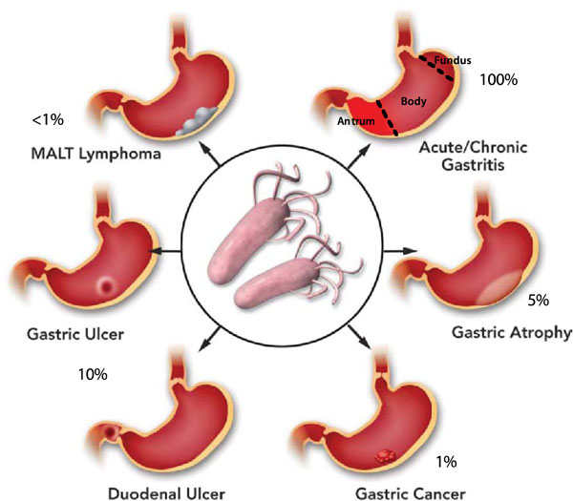

H. pylori infection
http://f1000.com/prime/reports/m/4/7/fig-001
The affiliated research institute of:
Translating Science for a Healthier North

Slide 4
Prevalence of H. pylori infection in different countries within WHO Regions
Region of the Americas
European Region
Western Pacific Region
From: Dig Dis Sci. 2014 Aug;59(8):1698-709

Slide 5
Top 20 causes of death worldwide
2000 & 2012
RANK | 2000 | 2012
1 | Ischaemic heart disease | Ischaemic heart disease
2 | Stroke | Stroke
3 | Lower respiratory infections | Chronic obstructive pulmonary disease
4 | Chronic obstructive pulmonary disease | Lower respiratory infections
5 | Diarrhoeal diseases | Trachea, bronchus, lung cancers
6 | HIV/AIDS | HIV/AIDS
7 | Tuberculosis | Diarrhoeal diseases
8 | Preterm birth complications | Diabetes mellitus
9 | Trachea, bronchus, lung cancers | Road injury
10 | Diabetes mellitus | Hypertensive heart disease
11 | Birth asphyxia and birth trauma | Preterm birth complications
12 | Road injury | Cirrhosis of the liver
13 | Cirrhosis of the liver | Tuberculosis
14 | Self-harm | Kidney diseases
15 | Malaria | Self-harm
16 | Hypertensive heart disease | Birth asphyxia and birth trauma
17 | Kidney diseases | Liver cancer
18 | Stomach cancer | Stomach cancer
19 | Measles | Colon and rectum cancers
20 | Congenital anomalies | Alzheimer’s disease and other dementias
WHO Report 2000-2012
The affiliated research institute of:
Translating Science for a Healthier North

Slide 6
Gastric cancer mortality demographics
WHO Report 2000-2012
The affiliated research institute of:
Translating Science for a Healthier North

Slide 7
Global H. pylori antibiotic resistance
Gastroenterol Res Pract. 2012;2012:723183
The affiliated research institute of:
Translating Science for a Healthier North

Slide 8
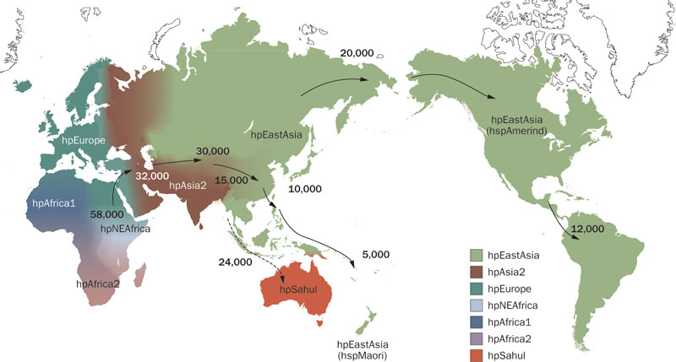
Distribution of H. pylori genotypes before Columbus found the New world and human migration to America and Oceania began
Nat. Rev. Gastroenterol. Hepatol. 2010.154
The affiliated research institute of:
Translating Science for a Healthier North

Slide 9
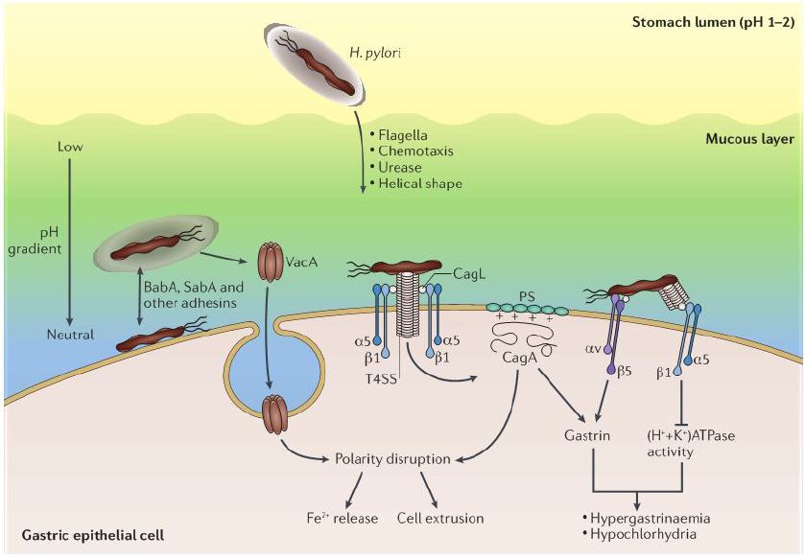
H. pylori
The affiliated research institute of:
Translating Science for a Healthier North

Slide 10
Is there a marker that can be used to identify patients infected with H. pylori that have increased susceptibility to develop gastric cancer?
The affiliated research institute of:
Translating Science for a Healthier North

Slide 11
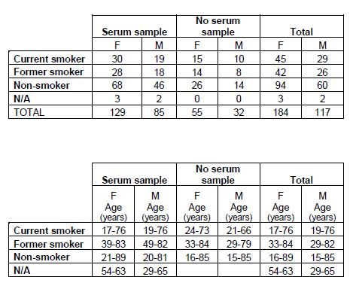
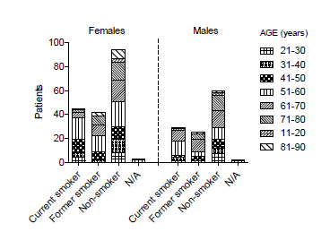
Study volunteers
The affiliated research institute of:
Translating Science for a Healthier North

Slide 12
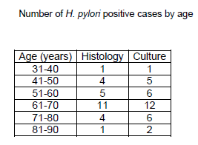
Distribution of H. pylori in patients from HSN
FEMALES
PATIENT ID# | HISTOLOGY | CULTURE
HP 011 | √ | √
HP 060 | √ | √
HP 066 | √ | √
HP 068 | √ | √
HP 079 | √ | √
HP 103 | √ | √
HP 120* | √
HP 163 | √ | √
HP 172** |  | √
HP 173** |  | √
HP 181 | √ | √
HP 193* | √
HP 209** |  | √
HP 217* | √
HP 225** |  | √
HP 233 | √ | √
HP 240 | √ | √
HP 290 | √ | √
MALES
PATIENT ID# | HISTOLOGY | CULTURE
HP 017** |  | √
HP 045** |  | √
HP 063 | √ | √
HP 076* | √
HP 104 | √ | √
HP 110 | √ | √
HP 170 | √ | √
HP 195 | √ | √
HP 207 | √ | √
HP 227** |  | √
HP 236** |  | √
HP 239 | √ | √
HP 243 | √ | √
HP 263 | √ | √
HP 283 | √ | √
HP 288 | √ | √
HP 299** |  | √
 | F | M | Total
Histology | 14 | 12 | 26/301
Culture | 15 | 16 | 31/301
The affiliated research institute of:
Translating Science for a Healthier North

Slide 13
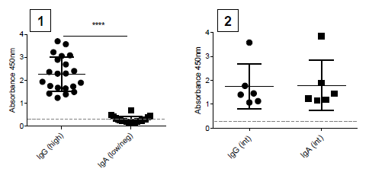
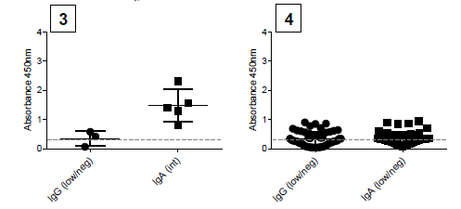
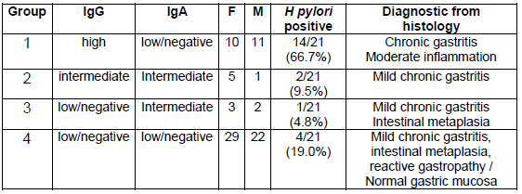
Serum IgG and IgA anti-H. pylori antibody response correlates with severity of gastric mucosa pathology
The affiliated research institute of:
Translating Science for a Healthier North

Slide 14
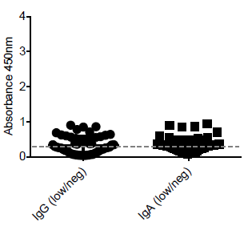
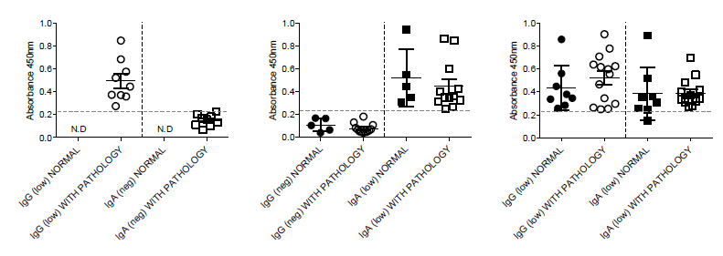
Serum IgG and IgA anti-H. pylori antibody response correlates with severity of gastric mucosa pathology
Chronic gastritis
Intestinal metaplasia
Reactive gastropathy
Adenocarcinoma
Mild chronic gastritis
Focal intestinal metaplasia
No active inflammation
The affiliated research institute of:
Translating Science for a Healthier North

Slide 15
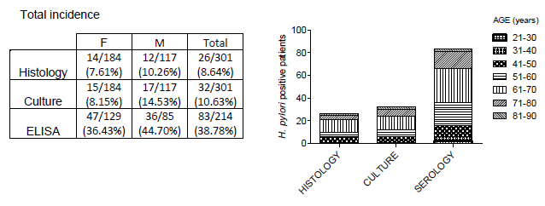
H. pylori incidence
The affiliated research institute of:
Translating Science for a Healthier North

Slide 16
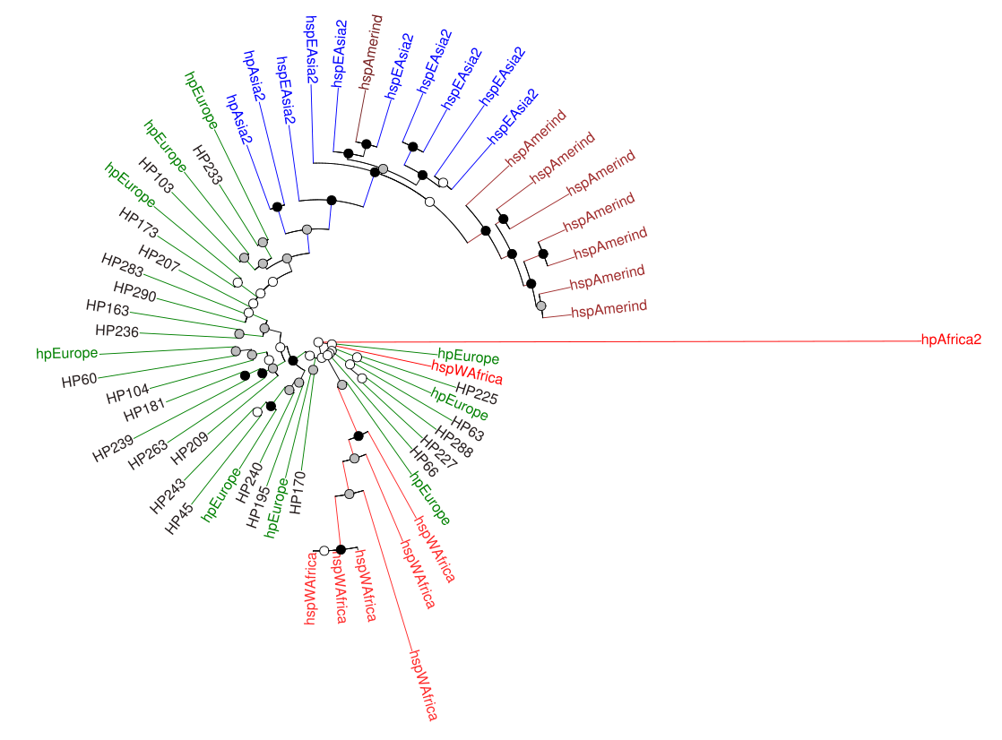
Genome sequencing
 | with serum sample |  |  | all clinical isolates
GENOTYPE | FEMALES | MALES | TOTAL | FEMALES | MALES | TOTAL
cagA+vacA+ | 2 | 2 | 4 (23.53%) | 5 | 3 | 8 (25.81%)
cagA-vacA+ | 7 | 6 | 13 (76.47%) | 10 | 13 | 23 (74.19%)
TOTAL | 9 | 8 | 17 (100%) | 15 | 16 | 31 (100%)
The affiliated research institute of:
Translating Science for a Healthier North

Slide 17
Conclusion
We found that histological analysis, culturing and VacA serology studies combined to not only better diagnose H. pylori infection, but also to predict which patients have increased risk to develop gastric cancer.
The affiliated research institute of:
Translating Science for a Healthier North

Slide 18
Acknowledgements
Dr. Francisco Diaz-Mitoma
Katrina Chapman, B. Sc.
Dr. Gustavo Ybazeta
Dr. Nelson Eng
HSN
Department Pathology
Department Gastroenterology
Funding:
NOAMA
The affiliated research institute of:
Translating Science for a Healthier North

