Slide 1
Telemedicine, Regulatory bodies, and the Practitioner
Erinma Abara, BA(Hons), JD, Emmanuel Abara, MB, FRCS(C), FACS, FICS
1. Abara Law Professional Corporation 2. Richmond Hill Urology Practice and Prostate Institute 3. Northern Ontario School Of Medicine (NOSM)
Notes:
Expectations: American Telemedicine Association – call and ask if there are any legal cases; call NWT and get an update on their Telemedicine policies (speak to somebody); call the other territories, PEI, Quebec –where is the patient seen? Doctor’s office/hospital – who is the host? Take home messages (Summary)

Slide 2
Conflict of Interest Declaration: Nothing to Disclose
Presenter: Erinma Abara
Title of Presentation: Telemedicine, Regulatory bodies, and the Practitioner
I have no financial or personal relationships to disclose

Slide 3
Objectives
At the end of the presentation, the practitioner will:
Understand the concept of Telemedicine and its use in medical practice;
Understand existing Telemedicine policies and related Telemedicine policies;
Understand CPSO’s 2014 policy on Telemedicine, its impact on current and prospective practitioners and the practitioner-patient relationship

Slide 4
Introduction and Aim of the Study
Telemedicine is the use of modern information technology such as videoconferencing in patient care.
This care can include patient consultation, follow-up assessments, management of various care plans, academic, health education and administration

Slide 5
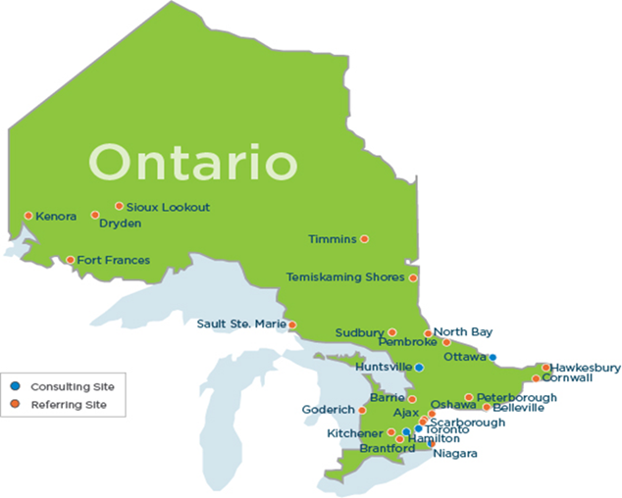
Where is Telemedicine in Ontario?
https://otn.ca/fr/blog/telestroke%3A-virtual-care-that-recognizes-time-is-muscle

Slide 6
Who is the Telemedicine Practitioner?
A health professional who uses the various telemedicine modalities to administer health care services.
In this study, we focused on the physician as the Telemedicine practitioner. We also acknowledge other health care professionals as potential users of Telemedicine.

Slide 7
Purpose
By reviewing the existing guidelines and policies of various regulatory bodies and the Canadian Medical Physicians Association (CMPA), we hoped to understand these policies and highlight them to current and prospective telemedicine practitioners.

Slide 8
Methods
Literature search was conducted using the search engines: Pubmed, GoogleScholar, and the Cochrane Medical Library
Review of Canadian Case law through the Canadian Legal Information Institute (CANLII)
Telephone interviews with some of the licensing bodies were undertaken

Slide 9
Methods (cont’d)
Legal Search – CANLII
CANLII is the legal case and review database which contains case law, commentary and legislation concerning various aspects of the legal industry.
CANLII was employed to identify related telemedicine case law.

Slide 10
Methods(cont’d)
Key Search terms:
Telemedicine in Ontario;
Telemedicine law;
Medical aspects of Telemedicine;
Telemedicine in Canadian legal system;
Telemedicine and privacy;
Telemedicine and confidentiality;
Telemedicine privacy in Ontario;
Telemedicine and Canada and guidelines

Slide 11
Results
Currently, there appears to be no national framework on Telemedicine.
Out of 10 provinces and three territories, 9 provinces had published telemedicine guidelines
At the time of this review, 1 of the colleges had their Telemedicine policy under review; three territories did not have a Telemedicine policy published.
Different positions on the location of care

Slide 12
Results (cont’d)
Key concepts identified:
Professionalism;
Patient confidentiality;
Protection of privacy; and
Good record-keeping

Slide 13
Results (cont’d)
CMPA Guidelines and advice on Telemedicine drafted in 2013, revised March 2015:
Issues for the Telemedicine practitioner’s review identified by CMPA:
  Benefits and limitations
  Jurisdictional and licensing standards,
  privacy and information security,
  patient consent in telemedicine
  Location of Telemedicine encounter and CMPA assistance

Slide 14
Results (cont’d)
CPSO 2014- Issues for the Telemedicine Practitioner identified by the CPSO:
General expectations for Telemedicine;
Patient’s existing health status, specific health care needs and specific circumstances
What resources are required – information and communication technologies, support staff
Reliability, quality and timeliness of patient information sufficient; accurate identification of the patient;
Protection of patient’s personal health information privacy and confidentiality
Security protocols in place
Risk management protocols in place

Slide 15
Results (cont’d)
Specific Expectations for Practising Telemedicine Across Borders
CPSO Members
  Jurisdictional matters: location of the Telemedicine encounter
  Non-CPSO Members
  CPSO expects that non-CPSO members maintain compliance with their respective jurisdiction concerning medical practice and professional ethics

Slide 16
Commentary
Case law - illustration

Slide 17
Conclusion
Telemedicine is here, the adoption rate is increasing.
Guidelines and policies from various Canadian licensing bodies exist but vary in some measures depending on the province or territory.
Minimal expectations from the colleges include: professionalism, good record keeping, strict management of patient’s privacy and confidentiality

Slide 18
Questions?

Slide 19
Thank you.

